Slide 1
Notes:
[Click on each slide to automatically bring in the next colour ball and the Bible verse that goes with it. Use these colours as you share God’s Good News Colours with your students.]

Slide 5
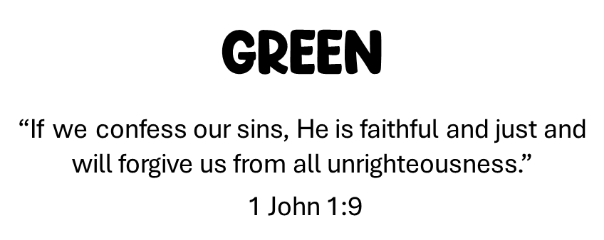

Slide 8
W

