Slide 1
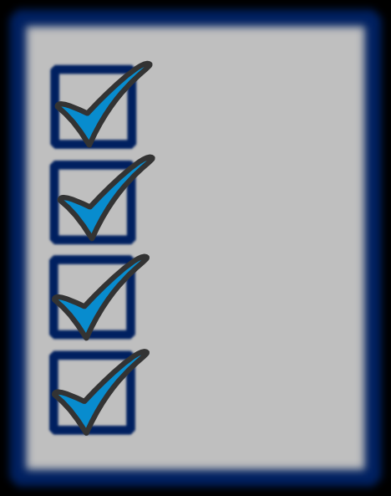
Running Effective Meetings
Key Messages – Planning Checklist:
When conducting meetings, make them ‘POP’ by always including the meeting purpose and outcomes in an agenda.
Purpose and Outcomes:
Drive the “thinking” and development of the process you will follow, which…
Informs the kind of engagement activities and questions you will use to achieve the outcomes.
Have assigned and understood roles (i.e. chair, facilitator, note taker, timekeeper)
Set meeting norms
Have clarity on decision-making options to be used
Manage participation
Do periodic process checks
Deploy conflict-management strategies when needed
Have a process that creates true closure
Set next steps and follow-up as needed
Allow for post-meeting evaluation or exit survey
This structure alone will make your meetings more productive!

Slide 2
What Do Facilitators Do?
Core Practices of Facilitators
Understand needs of the group
Define the session’s goal and objective
Prepare – both content and process (agenda and flow)
Set and model meeting norms
Remain neutral on content
Listen actively to the dialogue
Question, probe, paraphrase, summarize and record
Encourage participation by all
Provide leadership without taking control of outcome
Keep discussions on track
Help manage differences and redirect or ‘park’ items when needed
Achieve closure and identify next steps
Provide and allow for feedback

Slide 3
Meeting and Facilitation Framework
Starting includes…
During involves the facilitator…
Allowing and encouraging discussion
Questioning, paraphrasing, summarizing
Watching timing and staying on track
Managing Conflict where needed
Intervening or ‘parking’ off-topic items if needed
Making process checks - taking the ‘pulse’ of the group and adjusting where needed
Ending a facilitation includes…
Summarizing decisions made
Identifying what can be dealt with now, and what requires additional follow-up (including ‘parked’ items)
Using exit surveys (e.g., ‘2 Stars and a Wish’) and/or written evaluations to seek feedback and inform next steps
Thanking all for their participation
‘Facilitators are always keenly aware of the group dynamic and work hard to make sure that all voices are heard.’
Introductions and roles
Specifying purpose, process and timing
Setting behavioural/engagement norms
Ice-breaker to gain initial engagement

Slide 4
Running Facilitations and Effective Meetings
‘90% of the difference between a good meeting and a bad meeting has to do with process, not content.’
Key messages:
Have a plan
Make your meetings POP!
Identify POP (Purpose, Outcomes, Process)
Set norms for engagement, including how decisions will be made
Follow the plan, adjust as needed
Deal effectively with conflict or resistance
Summarize and determine next steps

Slide 5
Running Facilitations and Effective Meetings

Slide 6
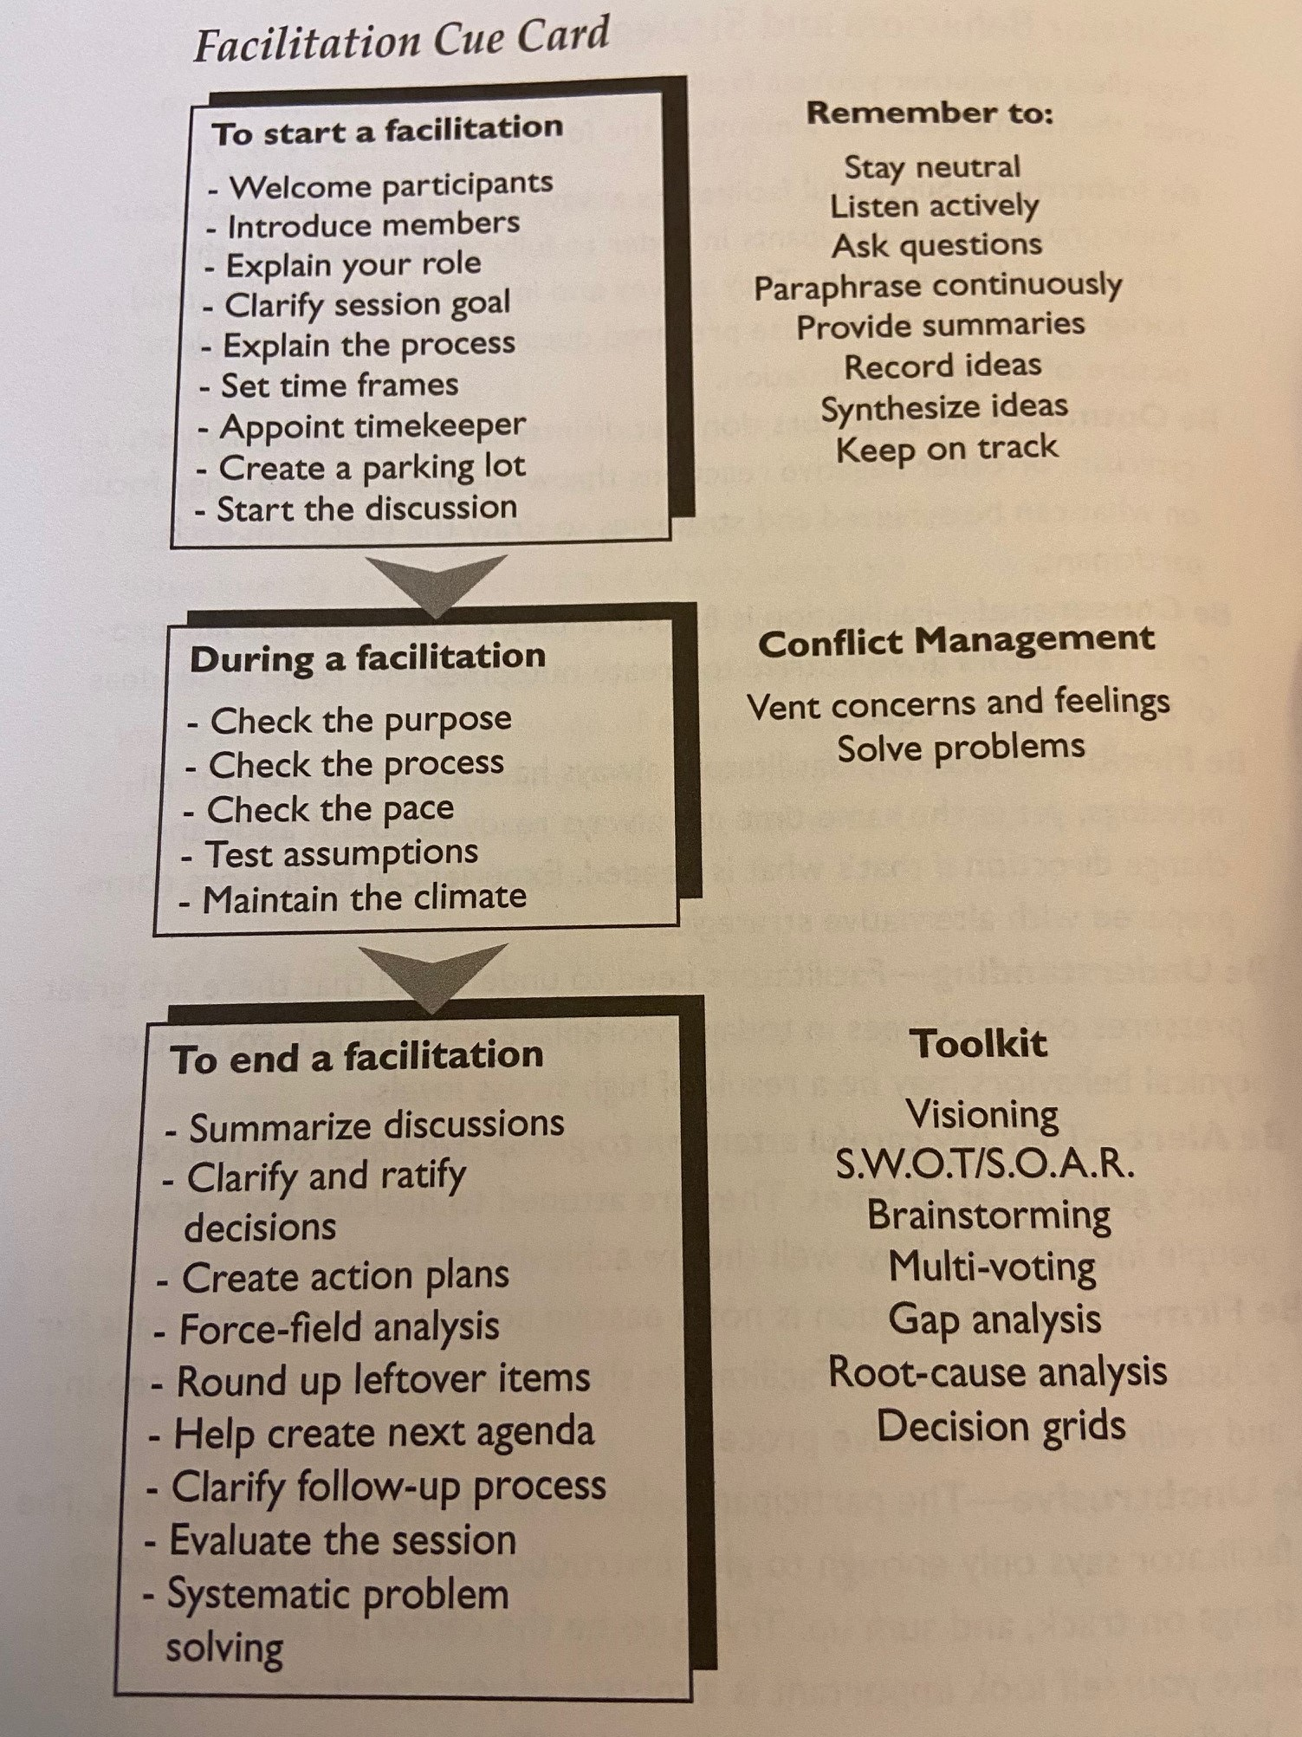
Planning Meetings – Key Take-Aways

Slide 7
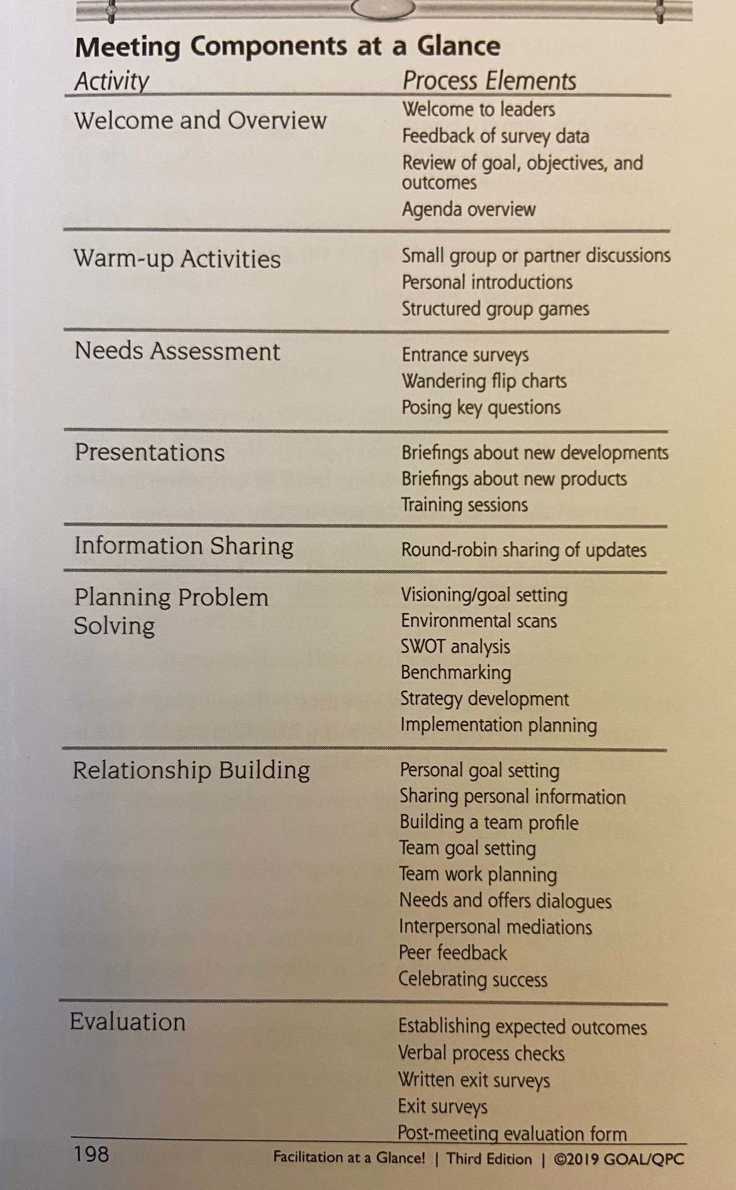
Planning Meetings – Key Take-Aways

