Slide 1


COMFORT YE MY PEOPLE A Grief Care Workshop
Northridge Community Church SA
March 31 and April 1, 2023
Day 1
Notes:
Slide 1 – “Comfort Ye My People” on screen prior to start
Welcome participants
To insert into PP:
There are three needs of the griever:
To find the words for the loss,
to say the words aloud, and
to know that the words have been heard.
(Victoria Alexander.)
Fred
Slides 1-4
10 minutes
6:15-6:25p

Slide 2

Housekeeping
Notes:
Slide 2 – Housekeeping
In sharing, we are on sacred ground; mutual respect of all persons and experiences; no right or wrong answers; guarding confidentiality; sharing is optional––share only what you want, if you want; resist the urge to compare experiences.
Ensure everyone has their binders with schedule, outline, etc.
FRED
Slides 1-4
10 minutes
6:15-6:25p

Slide 3
Workshop objectives . . .
To expand our understanding of grief and to familiarize ourselves with our church’s Grief Care ministry,
To provide practical tools for helping and praying with/for grieving people, and
To familiarize ourselves with particular situations and losses and to recognize our limitations.
Notes:
Slide 3 – Workshop objectives
Make note of objectives as listed on slide
FRED
Slides 1-4
10 minutes
6:15-6:25p

Slide 4
Presenters . . .
Carolyn Reid
Fred Reid
Terry Wiseman
Pat Breedon
Ruth Whitt
Notes:
Slide 4 – Presenters
Make note of presenters as listed on slide.
FRED
Slides 1-4
10 minutes
6:15-6:25p

Slide 5
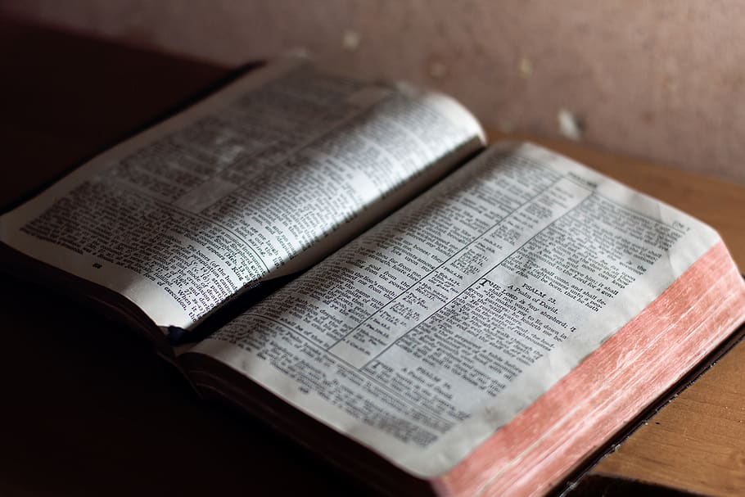
A biblical reflection on grief
Notes:
Slide 5 – A biblical reflection on grief
Devotional, suggest referencing Hasting’s quote on next two slides
FRED
Slides 5-7
10 minutes
6:25-6:35p

Slide 6

“At the heart of the Christian gospel
is a loving triune God to whom we can go . . .
a Father
of compassion [who grieves] and embraces us,
a Son
who entered into the heart of our pain and brokenness, who gathers up our sorrows and presents them to the Father, and . . . comes to us by his presence within and among us in
the Holy Spirit,
the Comforter.”¹
Notes:
Slide 6 - Hastings’ quote
Based on Hastings’ writings on the triune God in Where Do Broken Hearts Go? “At the heart of the Christian gospel is a loving triune God to whom we can go; specifically, a Father of compassion [who grieved] and embraces us, a Son who entered into the heart of our pain and brokenness, who gathers up our sorrows and presents them to the Father, and at the same time, comes to us by his presence within and among us in the Holy Spirit, the Comforter.
FRED
Slides 5-7
10 minutes
6:25-6:35p

Slide 7

“The church is to be a community that goes out to the grieving and broken, and that draws others into the heart of the God who is on the lookout for his broken . . . children.
Churches that reflect the Father heart of God are havens of refuge and communities of comfort, with specific ministries for the healing of the broken.”²
Notes:
Slide 7 – Hastings’ quote continued
“[God the Father] has provided access to himself in his Son Jesus, through the incarnation; but that Son also indwells his church by the presence of the Holy Spirit. . . The church is to be a community that goes out to the grieving and broken, and that draws others into the heart of the God who is on the lookout for his broken . . . children. Churches that reflect the Father heart of God are havens of refuge and communities of comfort, with specific ministries for the healing of the broken.”
Prayer, then hand off to Ruth.
Hastings, W. Ross. Where Do Broken Hearts Go? An Integrative Participational Theology of Grief. Eugene: Cascade Books, 2016, 2,3.
FRED
Slides 5-7
10 minutes
6:25-6:35p

Slide 8

Where we are headed tonight . . .
Grief, a universal experience.
Can grief be good, Charlie Brown?
Grief care at Northridge.
Notes:
Thank Pastor Fred.
Thank leadership team for recognizing the needs that attend those that mourn and for offering space, time and finances for related initiatives.
My background as a critical care nurse, a minister’s wife, nor my academic studies nor the deep losses I’ve experienced make me an expert on how to companion with those in grief.
In addition to Terry Wiseman, there are among us this evening those of you who have learned through the deepest sorrows and griefs what helps and what doesn’t. You are the experts.
The presentations this weekend are by no means exhaustive. In fact, they barely scratch the surface of how to companion with grievers. But my hope is that today and tomorrow we will open our hearts and minds and learn together how to comfort those in grief.
Slide 8 – Where we are headed tonight
Grief, a universal experience
Can grief be good, Charlie Brown?
Grief care at Northridge
DIRECT PARTICIPANTS TO SECTION IN BINDERS FOR NOTE TAKING
RUTH
Slides 8-9
5 minutes
6:35-6:40p

Slide 9
“Everyone can master a grief
but he that has it.”³
We cannot understand another’s pain
if we ourselves have never felt pain.
Notes:
Slide 9 – Shakespeare quote
Shakespeare once said: “Everyone can master a grief but he that has it.” We cannot understand another’s pain if we ourselves have never felt pain.
For that reason, we will take time for reflection.
For some of you, this may be hard; for others it will be uncharted territory—you’ve never gone there in your own soul.
Tonight, we invite you to begin that journey, and we will be available in the days ahead if you want to explore this further.
Quoted by Ken Gire in Winter’s Promise: Hope-Filled Reflections for the Difficult Seasons, 2013 Harvest House Publishers, 137.
RUTH
Slides 8-9
5 minutes
6:35-6:40p

Slide 10

If comfortable, briefly share a significant death loss, noting:
Your relationship to deceased (i.e., parent, sibling, spouse, child, friend).
Your attachment with deceased (i.e., close, distant, casual, estranged).
The cause of death (i.e., miscarriage, stillbirth, natural, disease, accident, suicide).
If the death was sudden, expected, slow.
Your age at the time of death.
The deceased’s age at the time of death.
Your response to the death (i.e., shocked, bewildered, accepted, angered).
Notes:
Slide 10 – Interactive activity
If comfortable, briefly share with tablemates a significant death loss that you have experienced, noting:
Your relationship to the deceased (grandparent, parent, sibling, child, friend, work colleague, etc.),
Your attachment to the deceased (close, distant, casual, etc.),
The cause of death (miscarriage, stillbirth, natural, disease, accident, suicide, etc.),
If the death was sudden, expected, slow,
Your age at the time of death,
The deceased’s age at the time of death, and
Your response to the death (shocked, bewildered, accepted, angered, etc.).
RUTH
Slides 10-11
15 minutes
6:40-6:55p

Slide 11

“Each person’s grief
is like all other people’s grief . . .
is like some other person’s grief
and . . .
is like no other person’s grief.”⁴
Notes:
Slide 11 – Worden quote
“Each person’s grief is like all other people’s grief; each person’s grief is like some other person’s grief; and each person’s grief is like no other person’s grief.”
Worden, J. William. Grief Counselling and Grief Therapy: A Handbook for the Mental Health Practitioner. New York: Springer Publishing, 2009, 8.
RUTH
Slides 10-11
15 minutes
6:55-7:00p

Slide 12
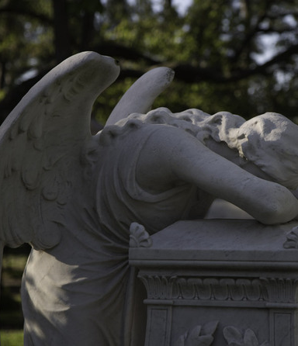
Grief . . .
What it is.
What it looks and feels like.
Non-death griefs.
COVID-19 impact on grief.
Examples from the Bible.
Responses to grief.
Styles of grieving.
Notes:
Slide 12 – Grief
What it is
What it looks and feels like
Kinds of death grief
Examples of non-death grief
Impact of COVID-19 on grief
Death, grief, and comfort in the Bible (include references from “Biblical Basis,” at beginning of proposal)
Responses to grief––physical, mental, emotional, social, spiritual, relational, vocational, and
Styles of grieving––intuitive, instrumental, and blended.
RUTH
Slides 12-13
20 minutes
7:00-7:20p

Slide 13
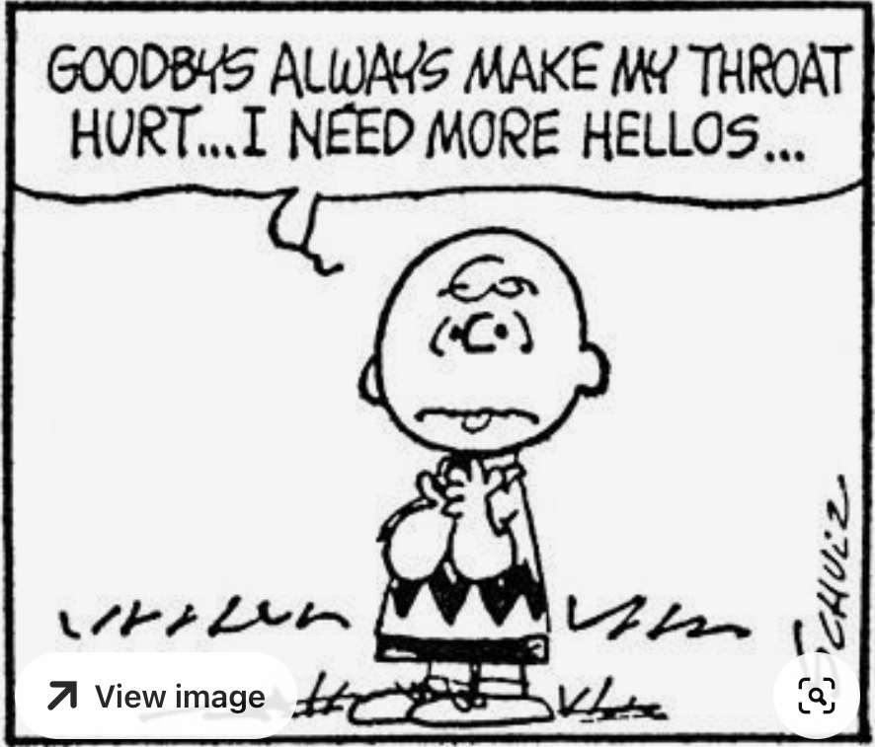
Notes:
Slide 13 – Charlie Brown cartoon
“Goodbyes always make my throat hurt . . . I need more hellos” (Schulz 2015).
Schulz, Charles. https://www.pinterest.ca/pin/349240146083978777/.
RUTH
Slides 12-13
20 minutes
6:55-7:20p

Slide 14
One person at each table is invited to share:
One thing you learned from your own grief experience,
How your perspective on death or your response to the grief of others changed as a result of your grief experience, and
What you learned from the experiences of others at your table.
Notes:
Slide 14 - Feedback from each table
One thing you learned from your own grief experience,
How your perspective on death or your response to the grief of others changed as a result of your own grief experience, and
What you learned from the experiences of others at your table.
RUTH
Slide 14
15 minutes
7:20-7:35p

Slide 15
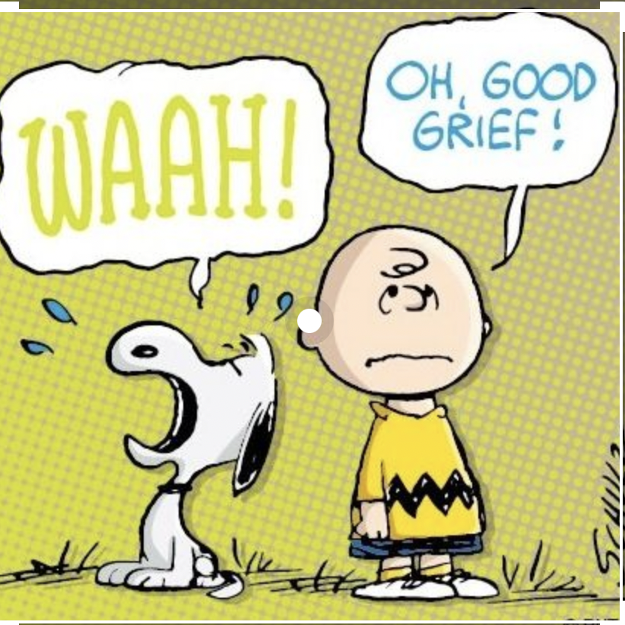
Notes:
Slide 15 – Good grief, Charlie Brown cartoon
RUTH
Slides 15-16
15 minutes
7:35-7:50p

Slide 16
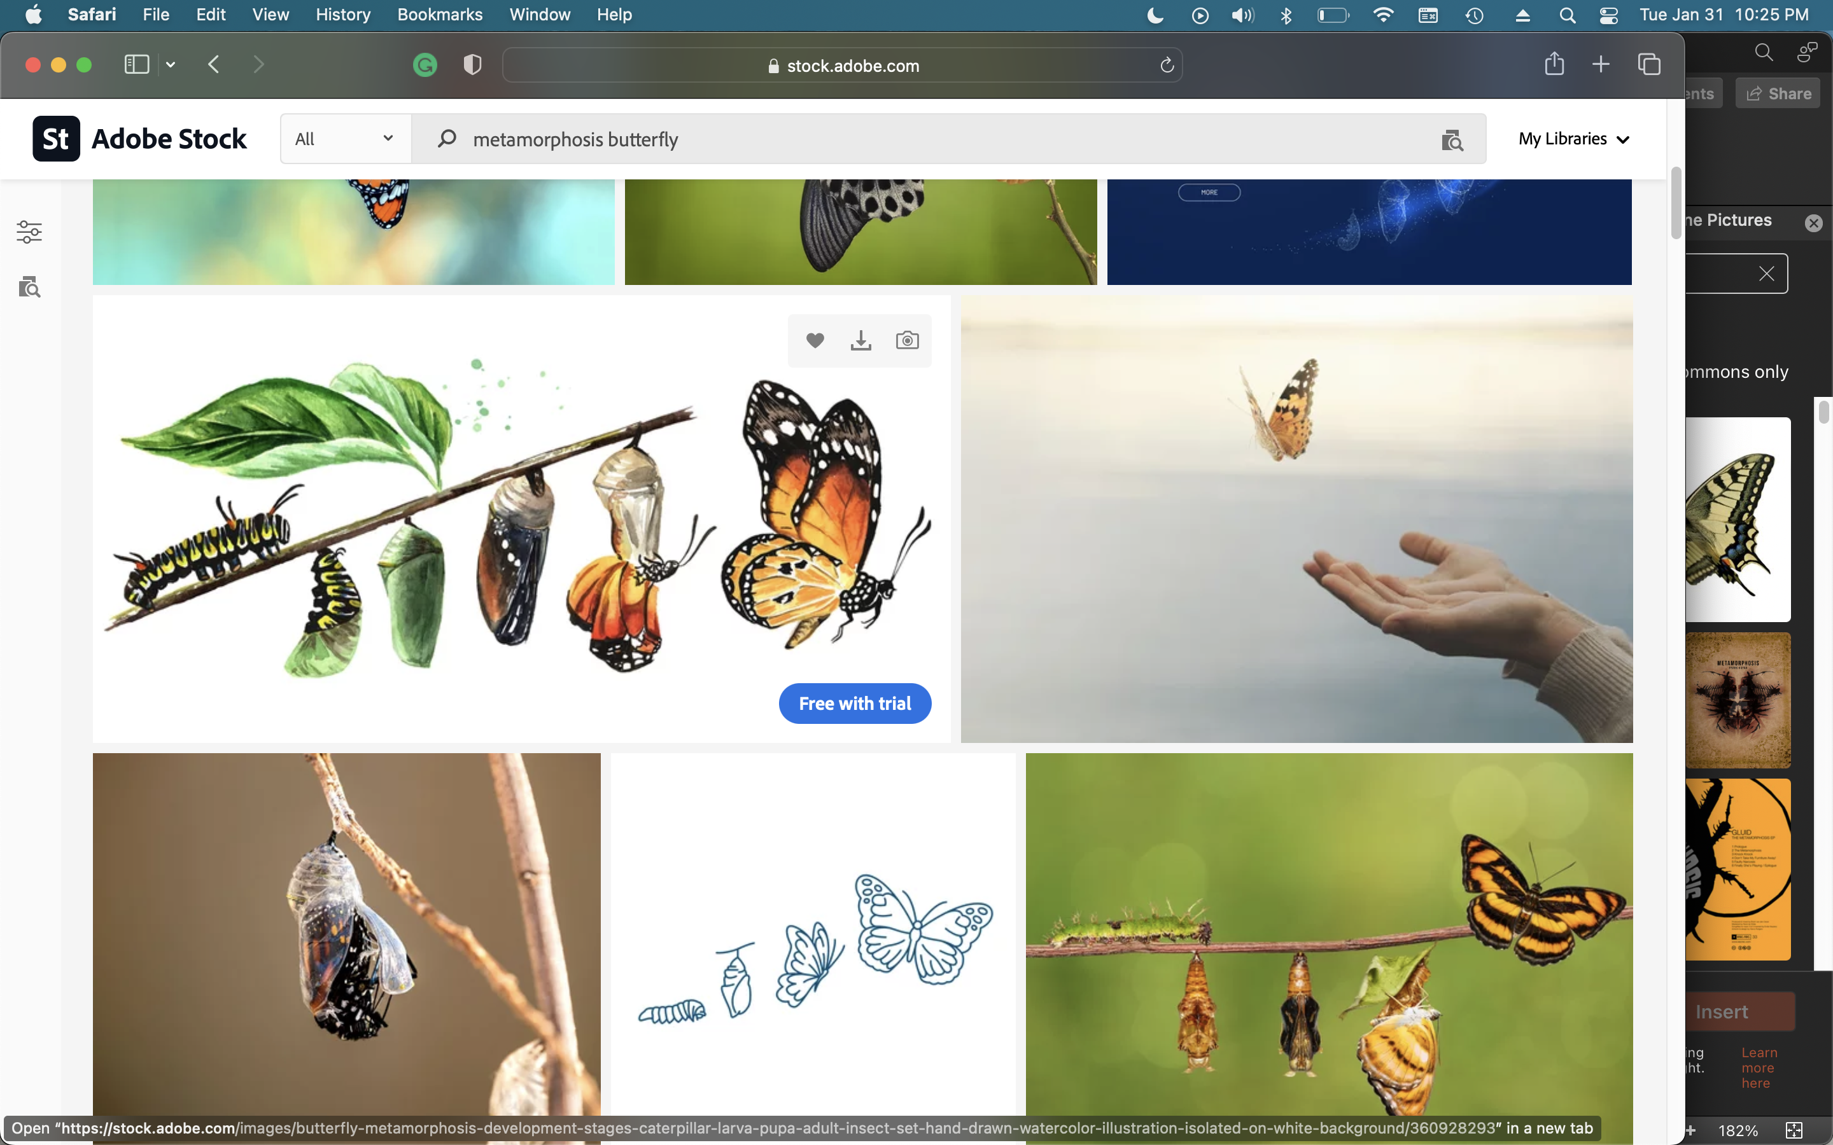
“The worst thing is not the sorrow
or the loss or the heartbreak.
Worse is to be encountered by death and
not to be changed by the encounter.”⁵
Notes:
Slide 16 – Neuhaus quote in Hastings
Many grievers just want to get to the point where their loss doesn’t hurt so much.
Eventually, some may even be able to comfort others in their grief.
But “the worst thing is not the sorrow or the loss or the heartbreak. Worse is to be encountered by death and not to be changed by the encounter.”
Death causes those that remain to examine their mortality, their spirituality.
It causes some to re-examine their attitudes, habits, perspectives, values, and beliefs.
American politician Hubert Humphrey said, “It’s not what they take away from you that counts, it’s what you do with what you have left.”
It’s an opportunity to engage in special interests, causes either of personal interest or interest of the one who died.
It’s an opportunity to evaluate the legacy you will leave behind.
[Living Well, Dying Well.]
To answer the question, I believe grief can be good if we learn from it, if we allow God to speak to us through it, and if we use what we learn to journey alongside others—if we thrive, not just survive.
Neuhaus, Richard. The Eternal Pity: Reflections on Dying. Notre Dame: University of Notre Dame Press, 2000, quoted in Hastings, 83.
https://www.brainyquote.com/quotes/hubert_h_humphrey_103505
RUTH
Slides 15-16
15 minutes
7:35-7:50p

Slide 17

Notes:
Slide 17 – Coffee break x 10 minutes.
Note that Pat will be presenting next segment.
RUTH
Slide 17
10 minutes
7:50-8:00p

Slide 18
Notes:
Slide 18 – Promo card for Grief Care at Northridge
Brief history of GriefShare at Northridge
2009-2018, Jan & Gord Evans; Fall 2018, Ruth
Rationale for switching to Grief Care Spring 2022
GS – southern Bible belt, expected participants to have good grasp of the Christian worldview and Scriptures, primary focus to help with grief; secondary focus, conversion.
GC – still biblically based, Christo-centric with clear message of the Gospel, but more suited to the pluralistic Canadian context; it subtlety shows the relevance of Scripture to their lives and invites them on a journey of the soul.
Meetings – Tuesdays, 7:00-9:00p, Fireside Room
Fall and spring, 10-12 weeks
Ability to easily pivot to online delivery, as we did during COVID
Topics covered include:
Am I going crazy? What’s normal? What’s not?
What can I expect on the journey of grief?
Why did this happen? Why now? Why me? Why? Why? Why?
What are the challenges of grief? (two nights)
What are the tasks of grieving? (two nights)
How do I face special dates and occasions?
Is there life after death?
Where to from here?
Feedback from GC participants
Concurrent activities
Meet one-on-one with participants prior to start
One-on-one meetings as warranted with participants, calls, weekly emails, etc.
Post-series get-togethers
Cards to bereaved persons connected to church
Weekly reports to leadership and prayer teams
Delivery of materials to participants on Zoom
Memorial gathering for attendee that died
Turn back to Ruth.
PAT
Slide 18
15 minutes
8:00-8:15p

Slide 19
Stats for NCC Grief Support Programs Fall 2018 – Winter 2023
Heard about the program through
NCC, work colleague,
websites, Facebook,
friend, counsellors,
neighbours
Losses
Parent, child, sibling, other family member, spouse/partner, friend, colleague,
natural causes, MAID, suicide, drug overdose, vehicular accidents, etc.
Notes:
Slide 19 – GS/GC data
Note how participants hear about the program
Types of losses experienced by participants
RUTH
Slides 19-21
4 minutes
8:15-8:19p

Slide 20
Stats for NCC Grief Support Programs Fall 2018 – Winter 2023
Number of people
completing series
50
(+ 9 in present group)
Group sizes
(excluding facilitators)
2-9
Age range
30s-90s
Gender
50F, 9M
Notes:
Slide 20 – GS/GC data
RUTH
Slides 19-21
4 minutes
8:15-8:19p

Slide 21
Stats for NCC Grief Support Programs Fall 2018 – Winter 2023
Faith
Protestant (34),
Catholic (7), Jewish (3), Ba’hai (1), no faith (6)
Nationalities/Ethnicities
Canadian, Eastern European, Hispanic (Cuban, South American), American, British, German, Iranian, Italian, Kyrgyzstan
27 NCC adherents at
23 Non-NCC adherents
4 Began attending NCC
Does not include current group
Notes:
Slide 21 – GS/GC data
Whereas GS followed a rigid set of topics, our GC curriculum allows for flexibility of topics, depending on kinds of losses, needs of group, and where they are in their faith journey (i.e., may replace Is There Life after Death with Why Do Christians Suffer?)
RUTH
Slides 19-21
4 minutes
8:15-8:19p
RUTH
Grief Care, week #3 slides
16 minutes
8:19-8:35p

Slide 22
Where we are headed tomorrow . . .
8:45-9:15 Hospitality
9:15 Principles & practices of helping
11:40-12:15 Lunch
12:15-1:55 Particular considerations, recognizing our limitations, & praying for/with grieving people
1:55-2:15 Closing
Notes:
Slide 22 – Where we are headed tomorrow
Review schedule per slide
Reference a cloud of witnesses: “Men and women out of the pages of Scripture, heroes from history, poets, storytellers, composers, and people from around the world, all of whom show us that we have not suffered alone nor in vain. They remind us that life is bigger than loss because God is bigger than loss. They bear witness to the truth that pain and death do not have the final words; God does” (Sittser 2004, 192-93).
A few classic examples: Dietrich Bonhoeffer, Steven Curtis Chapman, Isaiah Majok Dau, Brian Doerksen, Susan Duke, Elisabeth Elliot, Mike Janzen, C.S. Lewis, Rick Warren, Alan Wolfelt, Helen Steiner Rice, Horatio Spafford, Corrie ten Boom, John Tucker.
Prayer.
CAROLYN
Slide 22
10 minutes
8:35-8:45p

