Slide 1


COMFORT YE MY PEOPLE A Grief Care Workshop
Northridge Community Church SA
March 31 and April 1, 2023
Day 2
Notes:
Slide 23 – “Comfort Ye My People” on screen prior to start
Welcome participants back to day two
CAROLYN
Slides 23-24
10 minutes
9:15-9:25a

Slide 2

Where we are headed today . . .
Principles and practices of helping
Particular situations
Recognizing our limitations
Praying for/with grieving people
Q & A and closing
Notes:
Slide 24 – Where we are headed today
Helping those who grieve
Particular situations
Recognizing our limitations
Praying for and with grieving people
Q&A and closing
CAROLYN
Slides 23-24
10 minutes
9:15-9:25a

Slide 3
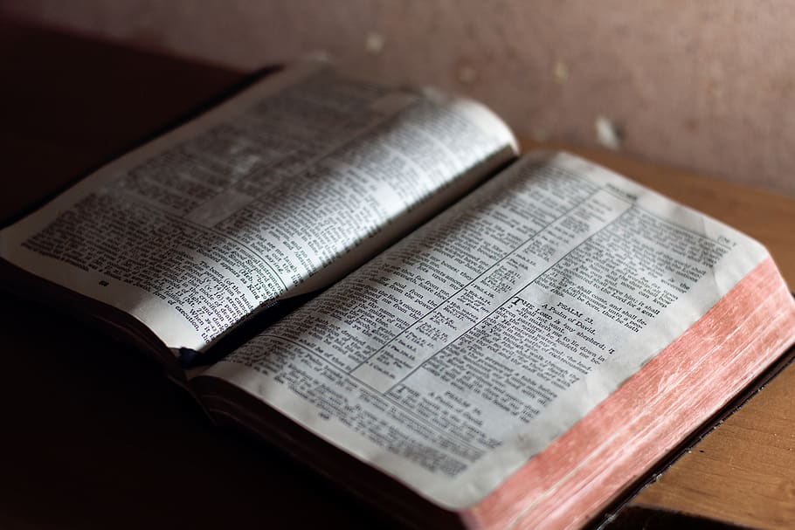
A biblical reflection on grief
Notes:
Slide 25 – A biblical reflection on grief— [suggested: 2 Corinthians 1:3-11]
CAROLYN
Slides 25-26
10 minutes
9:25-9:35a

Slide 4
2 Corinthians 1:3-5
^{3 ”}Praise be to the God and Father of our Lord Jesus Christ, the Father of compassion and the God of all comfort,
⁴ who comforts us in all our troubles, so that we can comfort those in any trouble with the comfort we ourselves receive from God.
⁵ For just as we share abundantly in the sufferings of Christ, so also our comfort abounds through Christ.”
Notes:
Slide 26 – 2 Corinthians 1:3-5
Prayer
CAROLYN
Slides 25-26
10 minutes
9:25-9:35a

Slide 5

If comfortable, briefly share with your tablemates . . .
What someone said to you that either helped or irritated or even hurt you.
What someone did for you that helped or didn’t help you in your grief.
What you have said or done that you know has been appreciated by someone who is grieving.
What did you learn from your tablemates?
Notes:
Slide 27 – Think back to a grief that you experienced. Then, if comfortable, briefly share with tablemates:
What someone said to you that either helped or irritated or even hurt you.
What someone did for you that helped or didn’t help you in your grief.
What you have said or done that you know has been appreciated by someone who is grieving.
Then:
What did you learn from your tablemates?
RUTH
Slide 27
20 minutes
9:35-9:55a
Feedback
20 minutes
9:55-10:15a

Slide 6
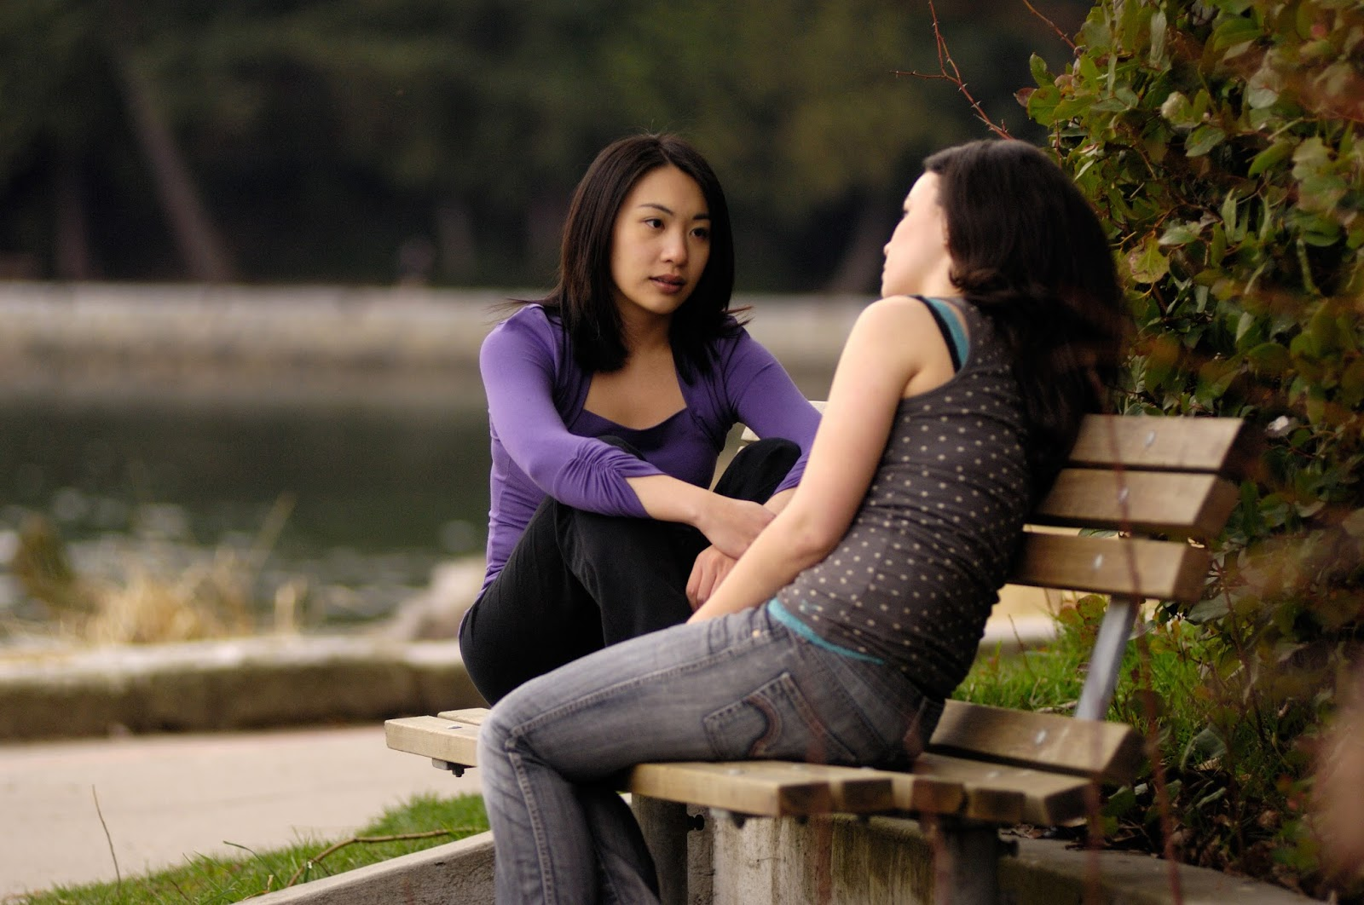
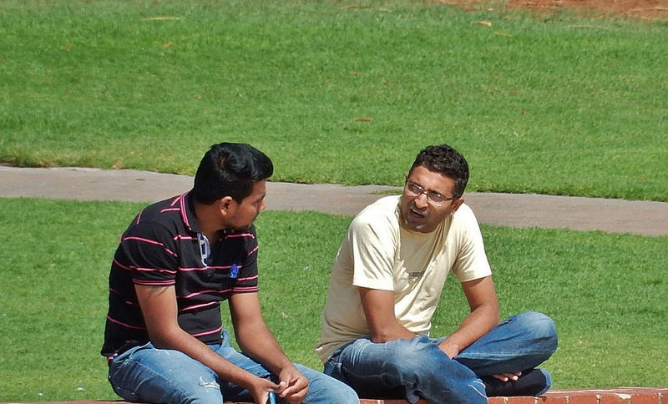
“To comfort me,
you have to come close.
Come sit beside me
on my mourning bench.”⁶
This Photo by Unknown Author is licensed under CC BY-NC-ND
This Photo by Unknown Author is licensed under CC BY-SA-NC
Notes:
Slide 28 – Wolterstorff quote
“To comfort me, you have to come close. Come sit beside me on my mourning bench.”
Wolterstorff, Nicholas. Lament for a Son. Grand Rapids: Eerdmans Publishing, 1987, 34.
RUTH
Slides 28-29
20 minutes
10:15-10:35a

Slide 7

Notes:
Brene Brown, Empathy vs sympathy

Slide 8

Principles of helping . . .
Be available
Be authentic
Be patient
Be empathetic
Be Christ-like
Notes:
Slide 29 - Principles of helping
1) Be available
“Our availability speaks . . . of our love, sympathy and care” (Dau 2002, 228).
Be a non-anxious presence; present and attentive, in the moment.
2) Be authentic
“It is important for simply being ‘fully human’ to discover our hearts, to know our affections, to discern our emotions, so that we can truly love God with heart, mind and strength, and our neighbor as ourselves” (Hastings 2016, 35).
Don’t spiritualize grief. “Since my diagnosis with cancer, I’ve found that my fellow Christians know how to rejoice about answered prayer and also how to petition God for help, but many don’t know what to do when I express sorrow and loss or talk about death” (Billings 2015, 41).
3) Be patient
“Mourning is a process, not an event” (Wolfelt 1996, quoted in Arnold 2018, 22).
Recognize that the griever will never return to the state prior to loss. They will now need to search out a new normal, which takes time.
4) Be Christ-like
“The comfort we give . . . isn’t the ‘you can do it’ and ‘everything will be okay’ comfort of the world. . . It doesn’t sugar-coat or wish things away. Instead, it seeks hope and help outside of our own strength and in the only One who can save. It’s grounded in the glad news of who Christ is and what he descended to do” (Fox 2018).
Sometimes we need to hold the griever in our embrace (figuratively or literally), allowing them to “borrow” strength and courage for the journey (Cash 2015, 3).
RUTH
Slides 28-29
20 minutes
10:15-10:35a

Slide 9

Notes:
Slide 30 – Coffee break x 20 minutes.
RUTH
Slide 30
20 minutes
10:35-10:55a

Slide 10
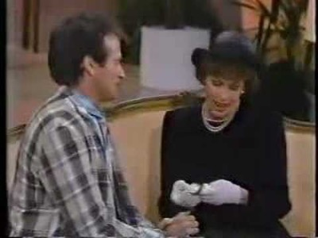
Notes:
Before showing next slide & playing video:
Before Terry leads us into discussing the practices of helping, we have a brief video to play of a funeral scene enacted by Carol Burnett and Robin Williams.
Filmed in the US some 17 years ago, it uses culturally insensitive language and demonstrates numerous faux paus.
For some of you, it may initiate triggers, and for that I apologize in advance.
In showing it, we are not making light of death but rather want to open the conversation around what helps and what doesn’t help people who are grieving.
Slide 31 – Carol Burnett and Robin Williams
https://www.youtube.com/watch?v=jfDyTUiL8xs
Stop at minute 4:00
RUTH
Slides 31-32
10 minutes
10:55-11:05a

Slide 11
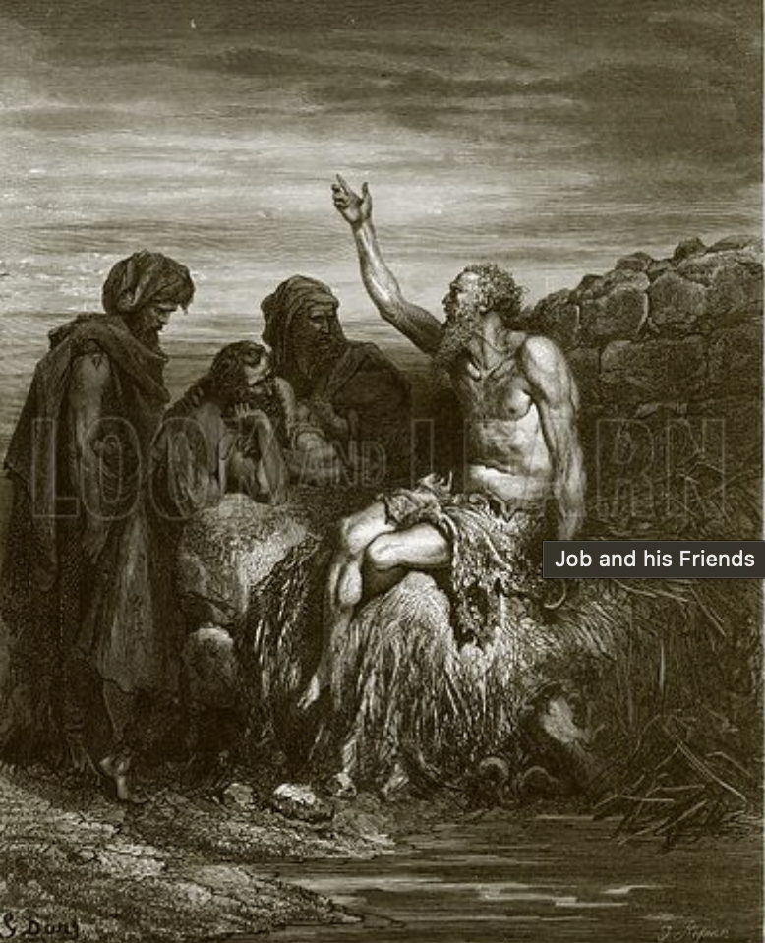
William Blake, Job’s Comforters
Notes:
Slide 32 – Picture of Job’s friends
Job’s friends do well to show up and sit with him for a week without saying anything (Job 2:11-13), but
They mess up when they open their mouths to state the possible causes of his calamity and try to fix the situation.
Job calls them “miserable comforters” (16:2).
RUTH
Slides 31-32
10 minutes
10:55-11:05a

Slide 12

Practices of helping . . .
What not to say/what to not to say
Notes:
Slide 33 - Suggestions for what not to say/what to say
You can’t say anything to take away the pain, but you can say things to increase the pain.
Terry’s presentation:
A few definite things to say/do, but no one size fits all.
What works for one person, one situation, may backfire with another.
Watch body language for clues from mourner.
TERRY
Slide 33
10 minutes
11:05-11:15a

Slide 13
Practices of helping . . .
What not to say/what to not to say
Notes:
Slide 33 - Suggestions for what not to say/what to say
You can’t say anything to take away the pain, but you can say things to increase the pain.
Don’t
Offer clichés––“Trite answers [are] a poor replacement for compassion” (Sittser 2004, 174).
Try to fill silence with meaningless words––“They assumed that words, however lame, would do the trick. They made noise, but silence would have been more helpful and wise” (Sittser 2004, 174).
Try to minimize, to teach, to find solutions (Bowler 2018, 116-118).
Offer unsolicited advice: You’ll need to get rid of their clothes soon, or you should think about moving soon.
Say, “It’s not really so bad, because it is” (Wolterstorff 1987, 34).
Say, I know how you feel––you don’t, you can’t; every relationship is unique, everyone feels grief differently; how we process grief is different––siblings will not grieve the loss of a parent or other sibling in the same way; widows may share similar losses, but their griefs are different.
Say, Be glad it’s over. They’re at rest. Time heals all wounds. The Lord knows best. It must be God’s will.
Say, Our days are numbered by the Lord; their days were up. God doesn’t make mistakes. God doesn’t give us more than we can bear (in that moment the griever feels they’ve already got more than they can). God needed another angel in heaven or flower in his garden.
Use euphemisms (in a better place, gone on to their reward; use the word death, died).
Say, You can have another child. You can marry again. (Another child, another spouse won’t take the place of this baby or spouse); similarly
Say, At least you have other children.
Tell the griever to be brave or not to cry––that forces them to suppress their feelings, to feel guilty about their feelings, invalidates their feelings [grief will come out now or later; when suppressed, it may surface later in anger, illness, mental health––example, Prince Harry].
Ask, How are you doing? Unless you really mean it and have time to listen.
Make statements or ask questions that induce guilt or affix blame––If only you had . . . If only the doctors had . . .
Try to change the subject when they want to talk about their loss or the person.
Say, You’ll get over it soon––time heals all wounds (the wound will always be there; it just won’t be as intense).
Compare their loss to yours or others’: Rabbi Grollman, “So often I am asked, ‘What is the greatest loss—the death of a child, a parent, a spouse, a sibling, or what?’ . . . The answer [is] when it happens to you, whatever the circumstances or relationship” (Doka 2002, xi).
Do
Say, I’m so sorry or Words fail me, or I cannot imagine what you are feeling.
Use the deceased’s name.
Pray for wisdom, discernment.
Share a good or funny memory or photo that you have of their loved one.
Apologize if you say something stupid.
TERRY
Slide 33
10 minutes
11:05-11:15a

Slide 14
Practices of helping . . .
What not to say/what to say
What not to do/what to do
Notes:
Slide 34 - Suggestions for what not to do/what to do
“Wise words may encourage and comfort, but they will do more when practical action accompanies them” (Dau 2002, 228).
Don’t
Avoid the grieving person because you don’t know what to say.
Try to find the cause––such as is often done in prosperity gospel circles.
Try to fix it––nothing you do or say will reverse the loss.
Assume that a stoic disposition means grief is handled; lack of emotion may signal overcompensation or denial of grief––they still need you.
Spiritualize––“They died so that so and so would be saved . . .”
Wait for the griever to call you for help––at first they don’t know what they need, or it takes too much effort to call, or they’re too independent.
Do
Acknowledge the loss with a call, card, letter, etc.
Think twice about the wording on a sympathy card; does it fit this situation?
Extend condolences to forgotten mourners––i.e., other family members, colleagues, close friends.
Be alert to body language (theirs––don’t overstay; yours––fidgety, etc.).
Allow them to lament, to express grief, anger, fear, bewilderment without judgment or trying to fix it; to talk about the deceased; to share what happened.
Offer to pick up groceries, or provide a meal (check about allergies, sensitivities, etc.), babysit the kids, mow the lawn, help write thank you cards, or just make a cup of tea. Say, I’m available Saturday to mow the lawn, or I’m heading over to the grocery store this afternoon, can I pick up some bread or milk or . . .
Be alert to financial concerns and find sensitive ways to act (gift cards; assistance through church, local, or government resources;) (Job 42:11).
Offer to sit with them in church (save a seat in the back perhaps so they can come in late and leave early; offer to run interference).
Touch if appropriate.
Tell them you’ll be praying—and be sure you do.
Remember them on holidays and anniversaries, especially “firsts.”
Be a good listener.
TERRY
Slide 34
10 minutes
11:15-11:25a

Slide 15
Practices of helping . . .
What not to say/what to say
What not to do/what to do
What not to think/what to think
Notes:
Slide 35 - Suggestions for what not to think/what to think
“The dynamics of each person’s sorrow must be allowed to work themselves out without judgment” (Wolterstorff 1987, 56).
Don’t
Don’t judge.
Don’t compare.
Do
Pray before you speak, and
Think before you speak.
James 1:19, “My dear brothers and sisters, take note of this: Everyone should be quick to listen, slow to speak and slow to become angry.”
TERRY
Slide 35
5 minutes
11:25-11:30a

Slide 16

Notes:
Slide 36 – Questions/feedback on morning session.
RUTH
Slide 36
10 minutes
11:30-11:40a

Slide 17

Lunch
Notes:
Slide 37 – Lunch
Invite participants to lunch in the atrium.
Be back promptly at 12:15p for final session.
Offer grace.
CAROLYN
Slide 37
25 minutes
11:40-12:15p

Slide 18

Particular considerations . . .
Various ages and stages of life
Gender and sexual orientation
Cultural differences
Mentally challenged persons
Disenfranchised grief
Faith /religious beliefs or not
Notes:
Slide 38 – Particular considerations
Speak to how items on the list affect grief.
Summarize with slides 39, 40
TERRY
Slides 38-40
30 minutes
12:15-12:45p

Slide 19

“The comfort of God in the midst of loss
is extended to ALL people. . .
His face shines on even
the most image-marred human being. . .
“It is true that being in relationship with God
gives access to the comfort of the ‘God of all comfort,
but God’s intention is to woo and redeem and
reconcile every human life.
Notes:
Slide 39
Expound briefly on Hasting’s quote as noted on this slide and the next.
TERRY
Slides 38-40
30 minutes
12:15-12:45p

Slide 20
“In caring for . . . bereaved people . . .
God is at work in their hearts, and . . .
“As we walk in the Spirit, we are participating in what God may be up to in them, even as they grapple with what is happening.”⁷
Notes:
Slide 40 – see note on previous slide.
TERRY
Slides 38-40
30 minutes
12:15-12:45p

Slide 21
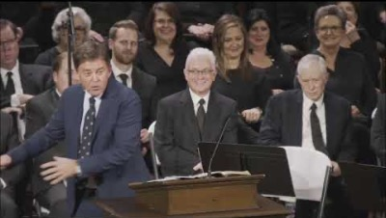
Notes:
The Man on the middle cross said I could come, Alistair Beggs
https://www.youtube.com/watch?v=GDl8euKhd3U

Slide 22

Recognizing our limitations . . .
Complicated, traumatic, and catastrophic losses
Prolonged or delayed grief
Disenfranchised grief
Mental health challenges, substance abuse, suicidal thoughts
Short-term vs long-term support
Notes:
Slide 41 - Recognizing our limitations
Complicated, traumatic, and catastrophic losses,
Prolonged or delayed grief,
Disenfranchised losses––infertility, miscarriage, stillbirth; suicide; extra-marital relationships, etc.,
Severe depression, violent outbursts, signs of possible suicide, and how to respond [also—need to differentiate between wishing they had died with the person who died and actual suicidal talk]
Short-term vs long-term support
TERRY
Slides 41-43
20 minutes
12:45-1:05p

Slide 23

Emergency numbers for suicidal persons
Call 911
Call 1-855-310-cope (2673)
Available 24 hours a day, 7 days a week.
Notes:
Slide 42 – Emergency numbers for suicidal persons
TERRY
Slides 41-43
20 minutes
12:45-1:05p

Slide 24
Non-emergency contacts . . .
Pastor Fred Reid fred.reid@northridgesa.com
Pastor Carolyn Reid carolyn.reid@northridgesa.com
Gabriella Meleca gabriella.meleca@northridgesa.com
Vicki Nishihama vicki.nishihama@northridgesa.com
Terry Wiseman terry@ancoracounselling.ca
Grief Care knitwhitt47@rogers.com
Notes:
Slide 43 – Referral numbers for counsellors and Grief Care
TERRY
Slides 41-43
20 minutes
12:45-1:05p

Slide 25
Notes:
Slide 44 – Coffee break x 15 minutes.
If running short on time, shorten or skip.
RUTH
Slide 44
15 minutes
1:05-1:20p

Slide 26
Praying for and with grieving people . . .
Some suggestions:
Pre-prayer prep
Prayer
Post-prayer
An example
Notes:
Slide 45
FRED or
CAROLYN
Slide 45
20 minutes
1:20-1:40p

Slide 27

Notes:
Slide 46
Invite questions for all presenters.
RUTH
Slide 46
15 minutes
1:40-1:55p

Slide 28

Feedback Form
Please complete and leave on the table afterwards.
Thank you!
Notes:
Slide 47 – Feedback form
RUTH
Slide 47
15 minutes
1:55-2:05p

Slide 29
Rejoice with those who rejoice; mourn with those who mourn.
Romans 12:15 NIV
Notes:
Slide 48
Thank participants for attending and engaging.
Thank hospitality team and presenters.
Send off with a prayer for empowerment/enablement to minister to those that mourn.
FRED
Slide 48
10 minutes
2:05-2:15p

Slide 30
Citations
¹Hastings, W. Ross. Where Do Broken Hearts Go? An Integrative, Participational Theology of Grief. Eugene: Cascade Books, 2016, 2.
²Hastings, 3.
³Shakespeare, quoted by Ken Gire in Winter’s Promise: Hope-Filled Reflections for the Difficult Seasons, 2013 Harvest House Publishers, 137.
⁴Worden, J. William. Grief Counselling and Grief Therapy: A Handbook for the Mental Health Practitioner. New York: Springer Publishing, 2009, 8.
⁵Neuhaus, Richard. The Eternal Pity: Reflections on Dying. Notre Dame: University of Notre Dame Press, 2000, quoted in Hastings, 83.
⁶Wolterstorff, Nicholas. Lament for a Son. Grand Rapids: Eerdmans Publishing, 1987, 34.
⁷Hastings, 66.

