Slide 1
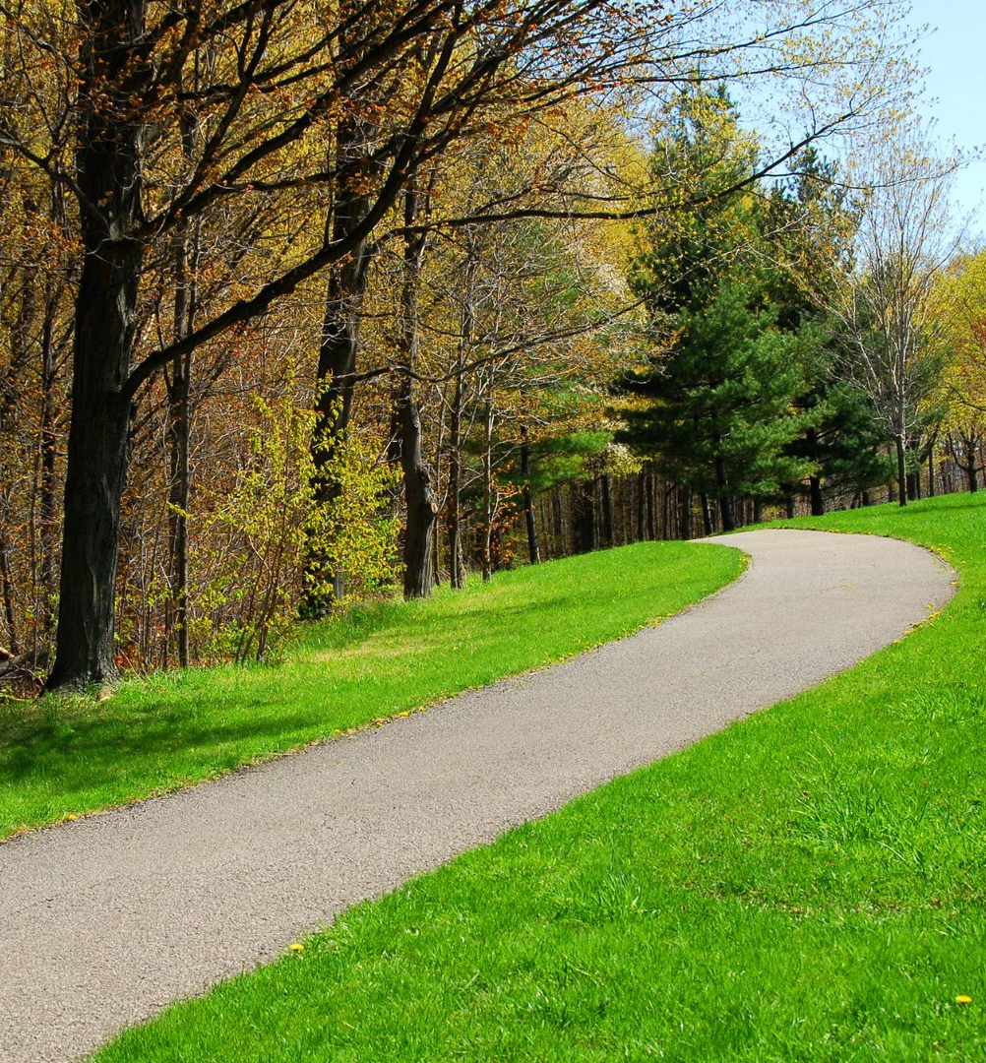
Welcome to
Grief Care
Week #8
What are the tasks of grief?
(part two)
Continuing bonds
Notes:
Pre-meeting
Have this slide on screen before participants arrive.
Play background music until meeting starts.

Slide 2

Notes:
~ 15 minutes
Begin meeting
Welcome participants and invite them to “ketchup” on their week.
Invite one person to share a picture and memento or special memory.
Afterwards, remind participants that each week one (or two, depending on group size) of them will be invited to share about their loved one, as they are comfortable.
Pray
God, You made us for relationship with ou and with others. But someone with whom we shared a special relationship has died. Guide our discussion today as we consider how to continue the bond we had with them in healthy ways. Amen.

Slide 3

Reflecting on last week’s session
What task did you decide to work on?
What steps did you take this week?
How did you feel while working on the task and then afterwards?
What is your plan moving forward?
Notes:
~ 10 minutes
Invite participants to respond to these questions.

Slide 4

The primary tasks of grieving:
accepting the reality of the death,
processing the pain of our loss,
adjusting to a world without them,
continuing our bonds with them, and
finding new/renewed meaning in life.
Notes:
~ 2 minutes
Last week we talked about the first three of these tasks:
accepting the reality of the death,
processing the pain of our loss,
adjusting to a world without them,
In this session we will explore
4. continuing our bonds with the person who died.
In week ten, we will look at
finding new or renewed meaning in life.

Slide 5
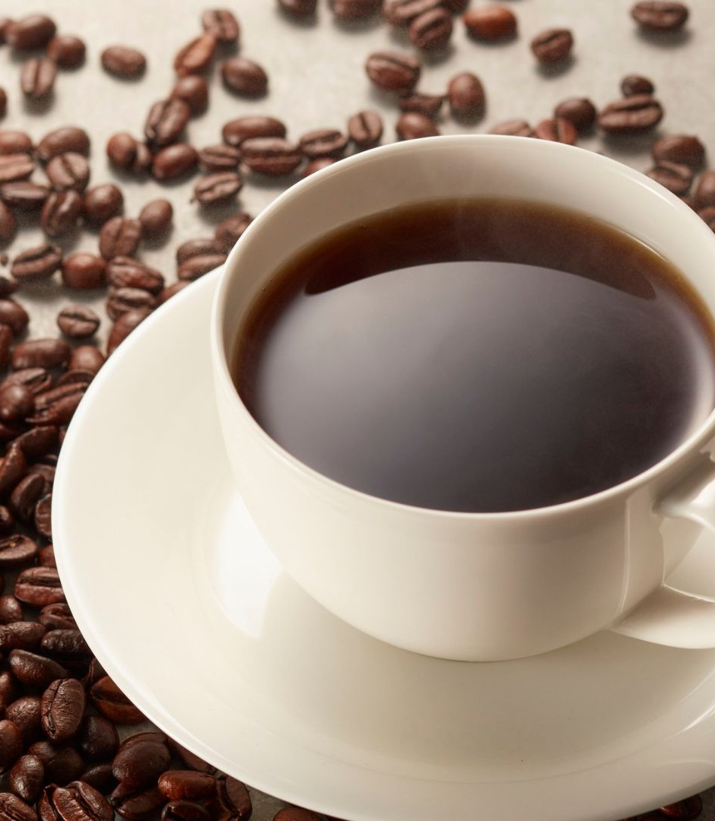
Take 5
Notes:
~ 5 minutes
But before we look at these tasks, let’s take a 5-minute break for tea/coffee.

Slide 6
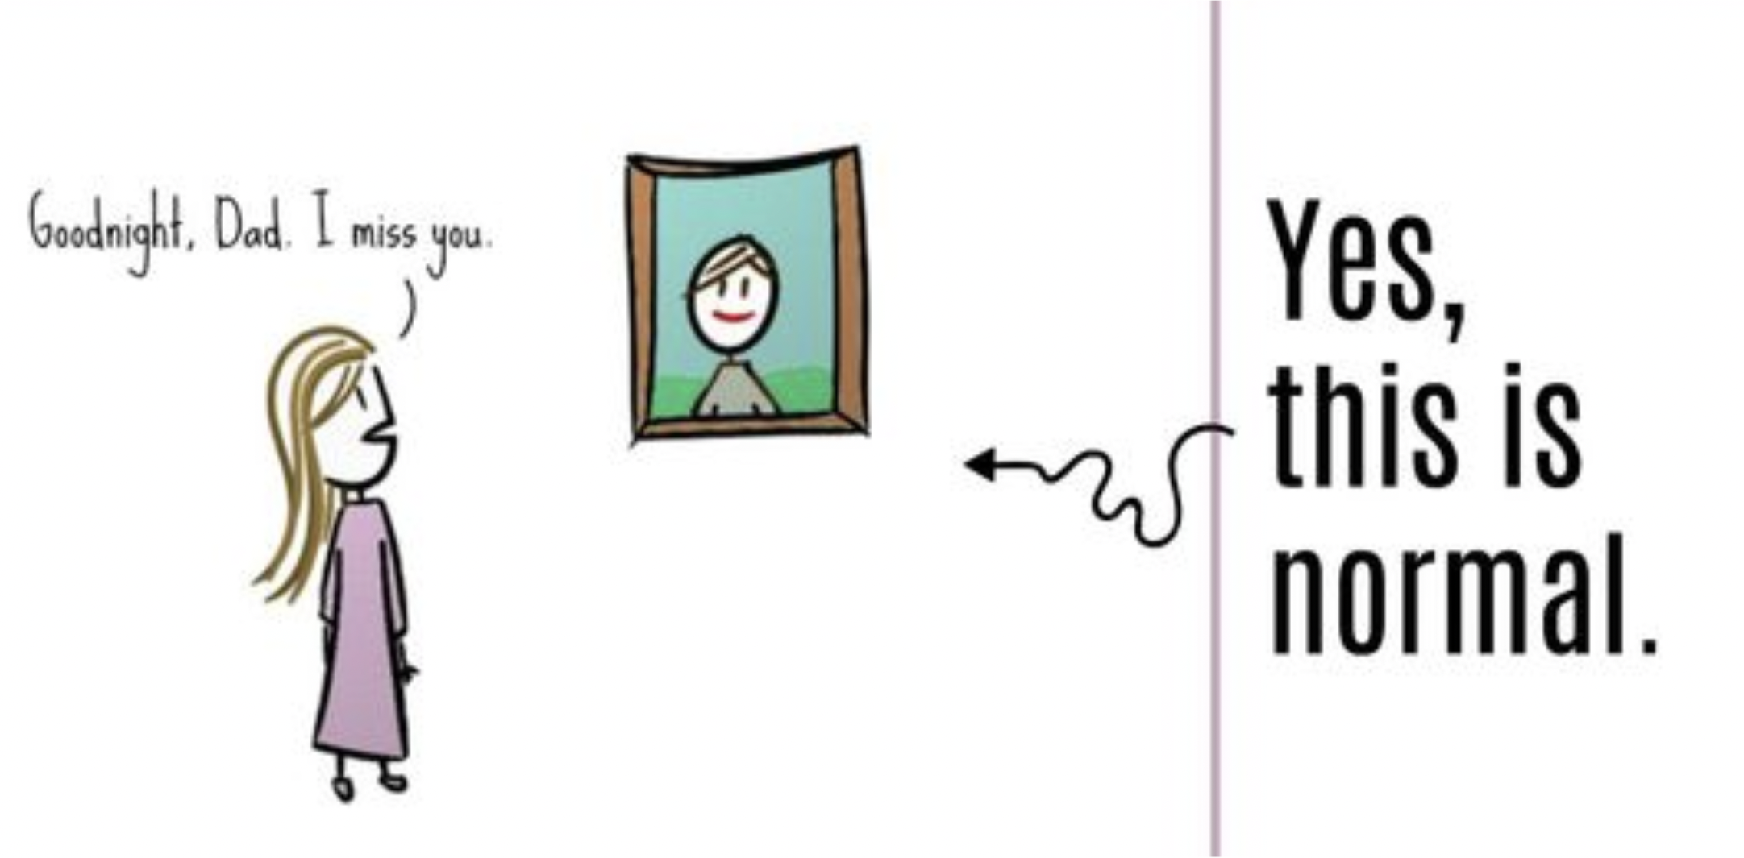
Continuing bonds
Task #4
Notes:
~ 5 minutes
Continuing bonds
In the book Tuesdays with Morrie, author Mitch Albom writes about his weekly visits with his favorite university professor Morrie Schwartz who is slowly dying with ALS. It is a classic, full of wit and wisdom. In talking about the perfect day, Professor Schwartz ends the conversation with these words, “Death ends a life, not a relationship.”⁶⁹
Invite participants to share if they
have kept anything of their loved one’s belongings, wear a piece of their clothing or jewelry,
engage in daily habits or rituals that they and their loved one shared,
visit places where they went together or where they are buried or their ashes scattered,
sometimes think they just saw or heard them,
talk to them, or reminisce about special moments, events, or the life yjey shared.
These are all examples of continuing bonds.
⁶⁹ Mitch Albom, Tuesdays with Morrie. (New York: Doubleday, 1968), 174.

Slide 7
Continuing bonds
Task #4
Notes:
~ 5 minutes
If you had lived during Sigmund Freud’s lifetime (1856-1939), you would have been subjected to his teaching that all remembrance of a person should cease completely upon that person’s death. And if you mourned, the founder of psychoanalysis would have diagnosed you as being mentally ill.
Fortunately for us, over the past 50 years psychologists and psychotherapists have debunked this theory. They recognize that it is not only impossible to erase our loved one’s memory, but that memories and mourning are essential to moving forward and finding new purpose and meaning in life.⁷⁰
In the movie Titanic, Rose’s continuing bond with Jack is expressed in the iconic song entitled “My Heart Will Go On:”⁷¹
Every night in my dreams
I see you, I feel you
That is how I know you go on
Far across the distance
And spaces between us
You have come to show you go on
Near, far, wherever you are
I believe that the heart does go on
⁷⁰ Ruth Whitt, “The Integration of the Gospel, Church, and Culture with a Church-based Grief Support Ministry,” Tyndale University, April 15, 2024.
⁷¹ James Horner and Will Jennings, “My Heart Will Go On.” © Sony/ATV Music Publishing LLC, Universal Music Publishing Group, https://www.google.com/search?client=safari&rls=
en&q=my+heart+will+go+on+lyrics&ie=UTF-8&oe=UTF-8.

Slide 8
Continuing bonds
Task #4
Notes:
~ 2 minutes
Because we have the gift of memory, “our loved ones remain part of our lives, though the connection is [emotional] rather than physical. . . . The attachment to our loved one . . . is part of our [life’s] story^{”72––}who we were, who we are now, and who we will become.
Four cautionary notes re: continuing bonds
If the relationship was abusive, continually dwelling on the abuse is harmful and hinders moving forward. Professional counselling can help you change the focus to lessons learned and help you to move forward in healthy ways.
If the grief and attachment to the deceased person takes precedence over living relationships, that too is unhealthy and may require professional help.
Attempting to connect with the deceased loved one through seances, mediums or psychics does not help with grief, nor will it help in moving forward.
Mental health practitioners warn against these activities. The concern is that though mediums purport to be helpful, there is great potential and risk for exploitation or psychological harm for vulnerable and grieving persons. These activities can also be a substitute for facing the reality of a loved one’s death.
Interestingly, the Bible has warned against this practice since ancient times (Leviticus 19:31; Isaiah 8:19-20; 1 Samuel 28).
Since 2023, artificial intelligence (AI) has gained popularity and is widely used in education, medicine, finance, social interaction, etc. A CTV news article published in April 2023 was entitled “Can AI ‘bring back’ the dead?” It explores how AI technology can replicate images and voices of the dead, but notes that “AI can not ‘think’ on its own, it only makes decisions based on input and training from another human. . . [Thus,] AI could only generate a superficial copy of a dead person.” The persona it creates is not and can never be the real or living person. This use of AI leads to “unhealthy coping mechanisms or avoid[ing] the reality of loss altogether.”⁷³ In other words, it harms, hurts, and hinders healing.
⁷² Kenneth J. Doka, Grief Is A Journey. (New York: Simon & Schuster, 2016), 52.
⁷³ Natasha O'Neill, “Can AI ‘bring back’ the dead? Debating the use of tech in the grieving process,” CTV News, April 30, 2023. https://www.ctvnews.ca/sci-tech/article/can-ai-bring-back-the-dead-debating-the-use-of-tech-in-the-grieving-process/.

Slide 9
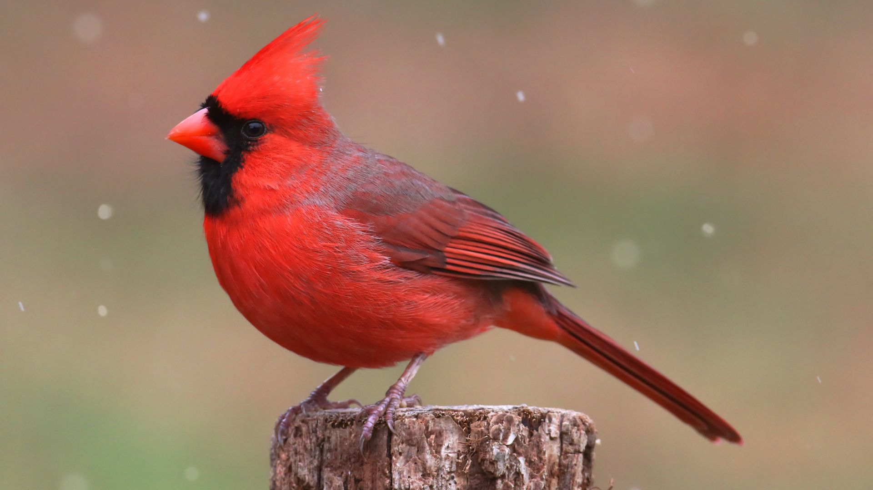
Notes:
~ 5 minutes
Special signs
You may have heard that the appearance of cardinals are often believed to mean that a deceased person is sending a message of comfort to the living. Some people claim the same with pennies or dimes, or random messages on signs. You too may have experienced various phenomenon—signs that seemed more than mere coincidence.
What do you think about these “signs”? Give participants time to respond.
Susan Duke, who we have mentioned previously, cites numerous ways that God has unexpectedly reached out to her. She doesn’t suggest that we look “for signs to help soothe our broken hearts, but that we leave room in our grief to see with new perspective the simple, often-overlooked gifts God provides when we least expect them and need them most.”⁷⁴
In pondering these “signs,” the author of Grief Care has concluded that these are not messages from our loved ones but rather are God’s way of reminding us of His love and comfort in grief.
⁷⁴ Susan Duke, Grieving Forward—Embracing Life Beyond Loss. (New York: Warner Faith, 2006), 60.

Slide 10
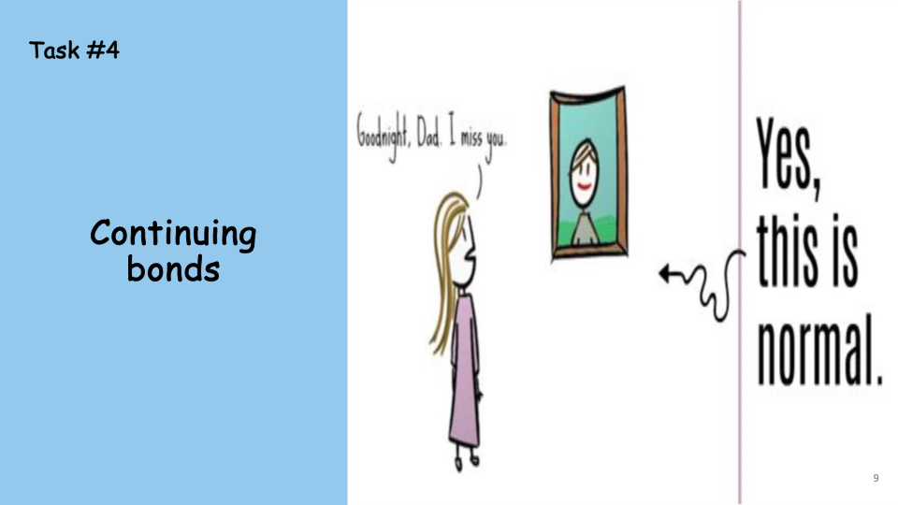
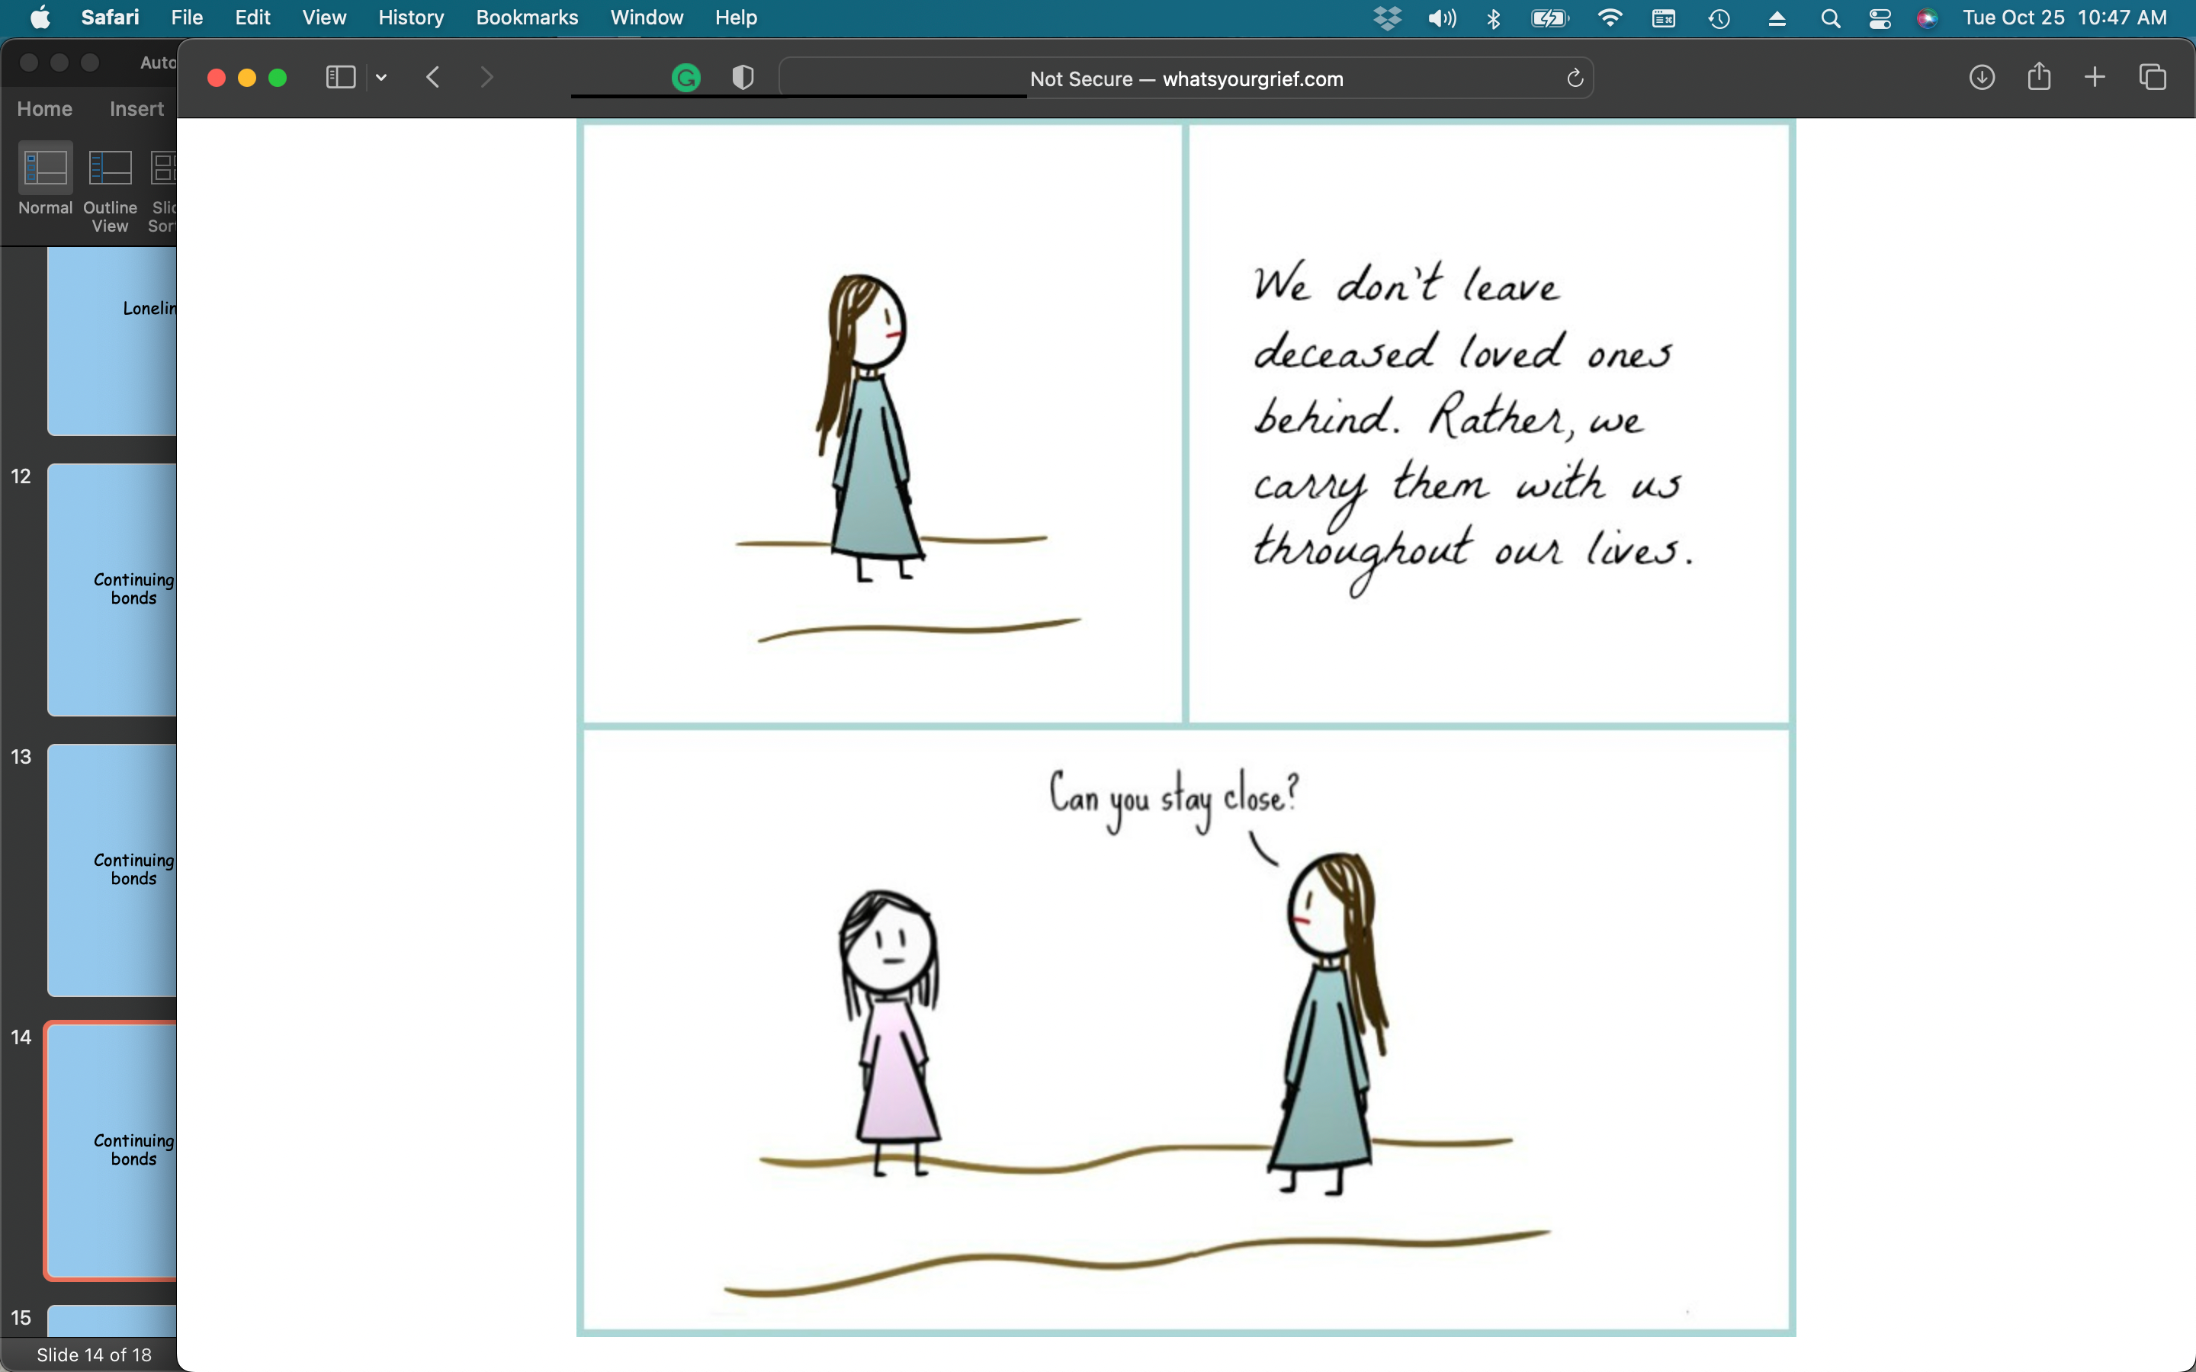
Notes:
~ 5 minutes
How continuing bonds are maintained
Some ways in which connections are maintained:
Through dreams or reminiscing.
In a shared faith and hope of being reunited again.
In a shared hobby or interest.
Through memories of events, sights, pictures, videos, recordings of their voice (actual videos and recordings—not those generated by AI).
Through a hymn or particular song.
A special gift or piece of jewelry, such as a wedding ring or birthstone.
Physical features or personality traits––we will see our loved one in their children or their siblings.
Life lessons––we may sometimes wonder what they might do in a particular situation, or we act a certain way because of the way they did something (perhaps as mundane as how to make a pot of tea).
Through rituals/symbolism––remembering them on their birthday, an empty chair at a wedding, a candle at Christmas, or buying yourself flowers on an anniversary.
Cemetery visits.
By continuing to use our loved one’s name.

Slide 11
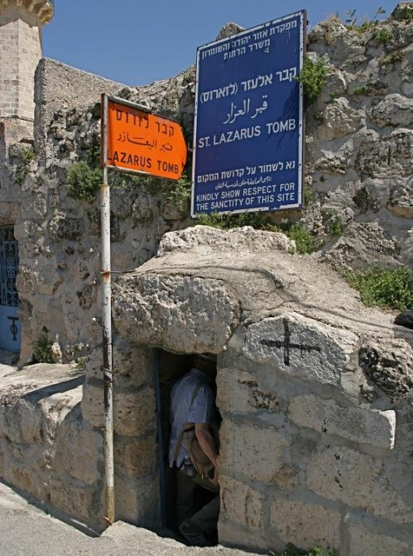
The Story
of Lazarus
Notes:
~ 4 minutes
A man named Lazarus
The biblical account of Jesus raising Lazarus from the dead is a beautiful description of how Jesus enters into grief, even our grief. He comes to us, he comforts us, he listens to us, he weeps with us. But there is an oft over-looked aspect of this narrative.
When we read John’s account in his gospel, chapter 7, we learn that Jesus had a close bond with Lazarus and his sisters Mary and Martha. Jesus was in another city when he received news that Lazarus was sick and then shortly thereafter that he was dead.
While Lazarus was alive, his sisters referred to him by name, but after he died, they no longer used his name—as if their bond or relationship had been irreparably broken:
Martha said (vs 21), Lord, if You had been here, my brother would not have died.
Mary repeated this lament (vs 32).
Even at the graveside when Jesus asked for the stone covering the entrance to the tomb to be removed, Martha protested saying, He has been dead four days (vs 39).
The other mourners referred to him as this man (vs 37). And neither did the disciples use his name after he died.
It is interesting, however, that Jesus continued to refer to Lazarus by name after his death:
Upon receiving news that Lazarus had died, Jesus told his disciples that Lazarus is dead (vs 14), and then later at the gravesite with a loud voice called him by name, Lazarus, come forth! (vs 43).
This seems to speak of the bond Jesus had with Lazarus before and after his death, even before he miraculously raised him from the dead.

Slide 12
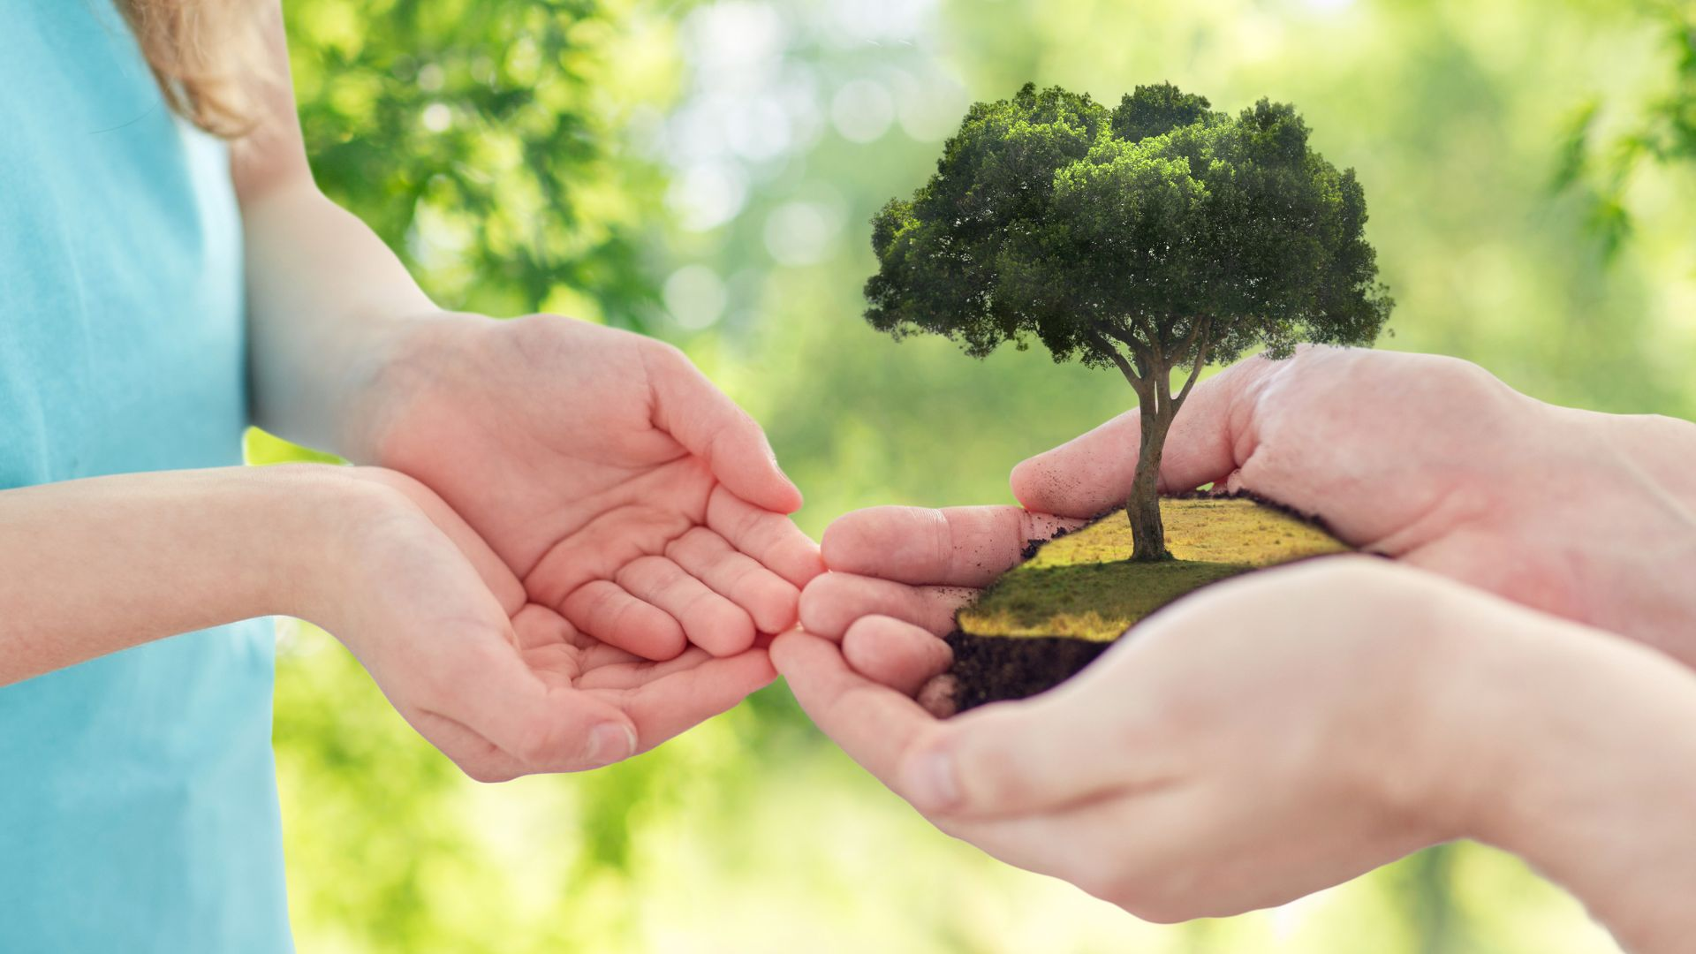
Notes:
~ 3 minutes
What helps
A practical way to continue the bond with our loved one is by honoring their legacy.
Ken Doka says that “one of the tasks of grief is . . . deciding how you will live and honor your memories of and associations with” your loved one. “The critical question is not if but how you will remember” them.”⁷⁵
Suggestions for creating a legacy
Create memory boxes, photo albums, collages, scrapbooks, DVDs, etc.
Journaling, writing your or their story.
Establishing a scholarship, foundation, etc. in their memory.
Volunteering with an organization that honors an interest or passion of theirs or a challenge they faced, such as substance abuse, mental health, illness or disease, MADD, etc.
Two Canadian legacies that started small and have grown are:
⁷⁵ Kenneth J. Doka, Grief Is A Journey. (New York: Simon & Schuster, 2016), 72-73.

Slide 13

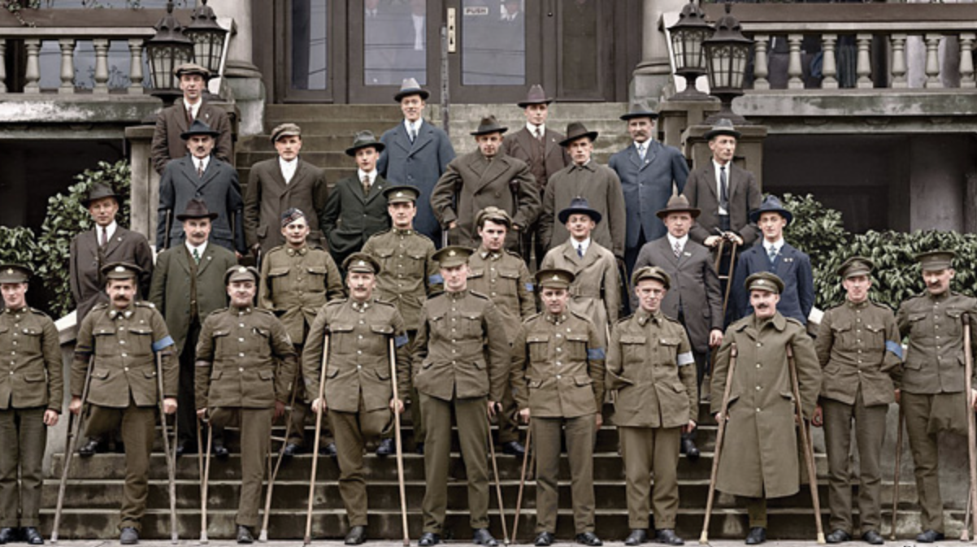
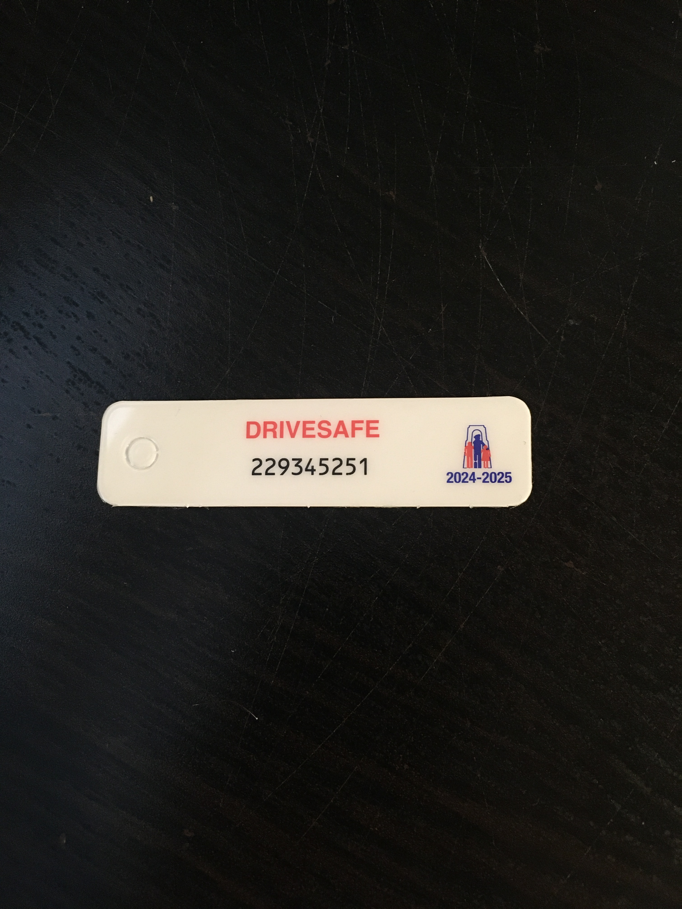
Continuing bonds
through legacy
Notes:
~ 3 minutes
The War Amps program traces back to September 1918, when the Amputation Club of British Columbia held its first meeting. It was the first of many Canadian groups of amputees from WWI to organize and eventually amalgamate into a national organization.
Today, War Amps services are available for children and adults, born without limbs or who have lost limbs through injury or disease whether they are in the military or not. Nearly $20 million was raised in 2022.
One beneficiary of the War Amps program was . . .

Slide 14
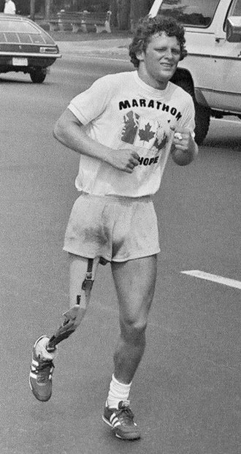
Continuing bonds
through legacy
This Photo by Unknown Author is licensed under CC BY-SA
Notes:
~ 3 minutes
Terry Fox
In 1980, with one leg having been amputated due to cancer, Terry embarked on an east-to-west cross-Canada run to raise money and awareness for cancer research. Although the spread of his cancer eventually forced him to end his quest after 143 days and 5,373 kilometres (3,339 mi), and ultimately cost him his life at age 22, his efforts resulted in a lasting, worldwide legacy.
The annual Terry Fox Run began in 1981 and raised $24.17 million. It has grown to involve millions of participants in over 60 countries and is now the world’s largest one-day fundraiser for cancer research; over $850 million Cdn had been raised in his name as of September 2022.⁷⁶
⁷⁶ “Terry Fox.” https://en.wikipedia.org/wiki/Terry_Fox.

Slide 15


Notes:
~ 5 minutes
What stands out for you from today’s presentation?
What questions does it raise?

Slide 16
Journal assignment
1. What memories do I need to shed in order to move toward healing?
2. How can I continue the bonds with my loved one in a healthy manner?
3. How can I honor them through a lasting legacy?
Notes:
~ 1 minute

Slide 17
Next week
Is there life after death?
Notes:
~ 2 minutes
Pray
Dear Jesus, thank you for these times of sharing. Thank you for the life and love of those we now grieve. Help us to exercise wisdom as we find ways to continue our bonds with them in healthy and healing ways. Amen.

Slide 18
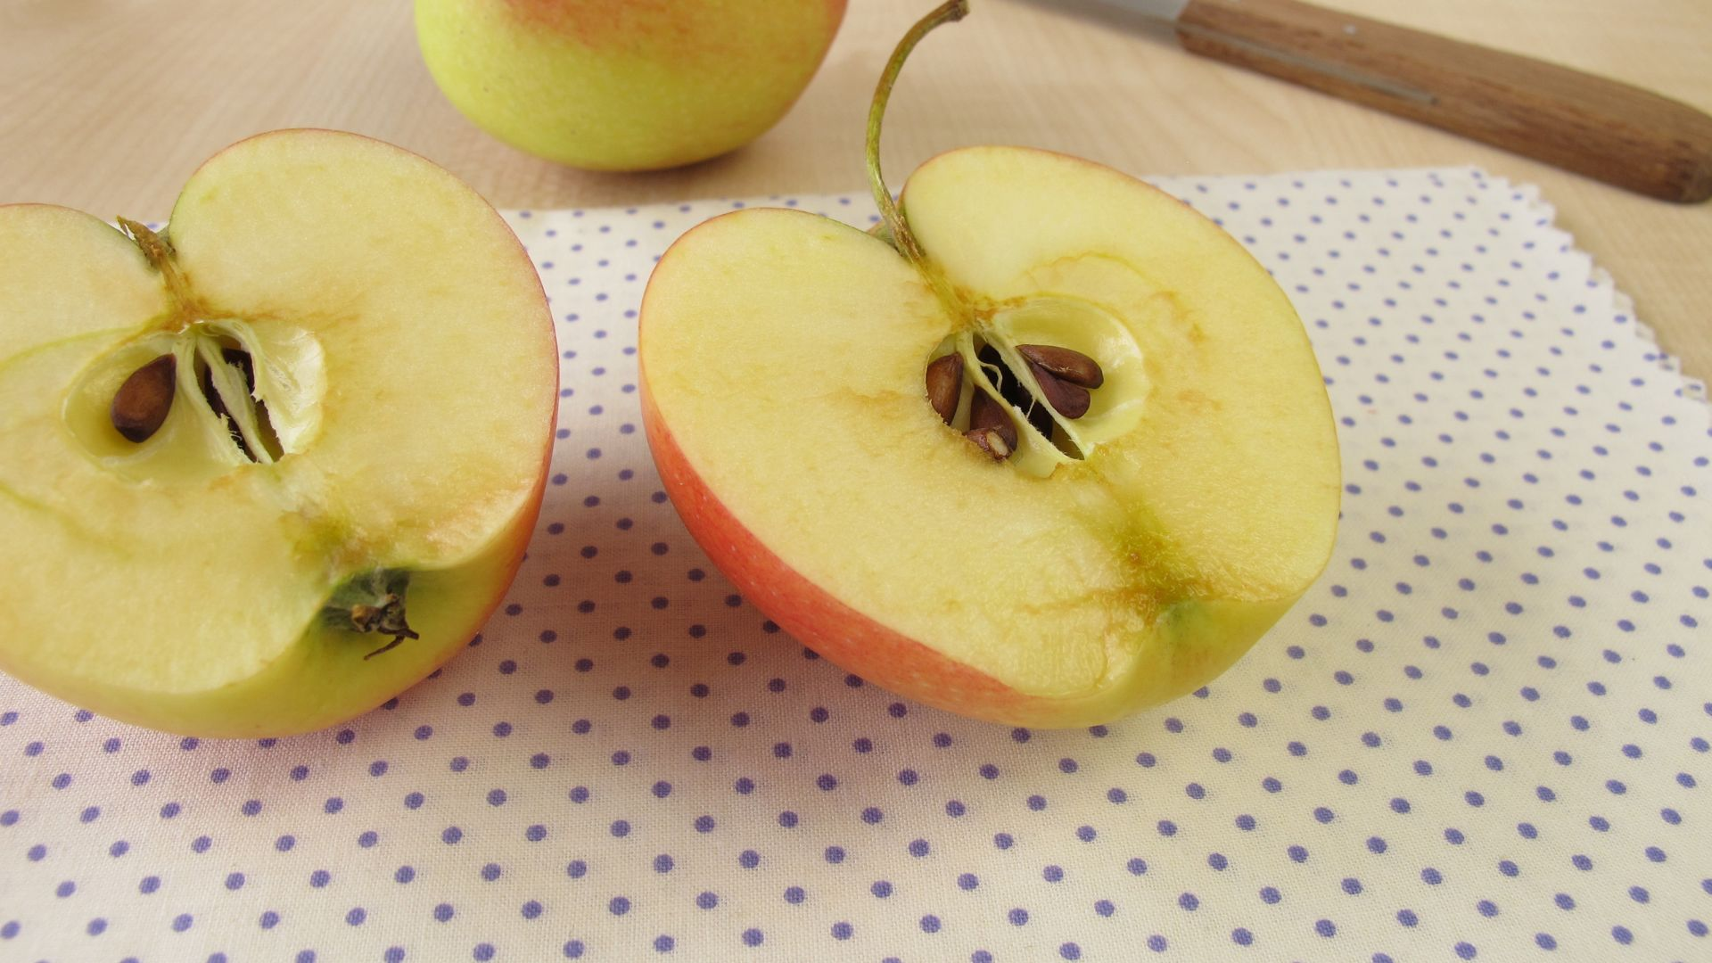
“You can count
the number of seeds in an apple,
but only God knows
the number of apples in one seed.”
Anonymous
Notes:
~ 2 minutes
“You can count the number of seeds in an apple, but only God knows the number of apples in one seed.”⁷⁷ Though the legacy you create in honor of your loved one may seem small, it has enormous potential and unless it is planted, it will never bare fruit.
⁷⁷ Anonymous.

