Slide 1

Welcome to
Grief Care
Week #1
What’s normal? What’s not?
Am I going crazy?
Notes:
~ 5 minutes
Pre-meeting
Have this slide on screen before participants arrive.
Play background music until meeting starts.
Ensure everyone has a participant manual, journal, pen, and name tag.
Collect any outstanding registration, agreement forms, and registration fees.
Begin meeting
Welcome everyone and acknowledge the courage it took to come.
The death of a loved one or friend, whether sudden or anticipated, whether young or old, is always a surprise, and “grief surprises us with emotions we’ve never experienced.”¹
We are bewildered and unsettled by the onslaught of emotions. We wonder what is going on and if we are going crazy.
In her book Grieving Room, Leanne Friessen writes that “a lot of us don’t know what to do with grief. We often think that the best thing to do with grief is to avoid it . . . [but] there is no skipping, avoiding, or going around grief.”²
If our grief wounds are going to heal, we must face our grief head-on.
The goal of Grief Care is to give you practical tools to face your grief so that you can learn to live with your loss in a healthy way.
¹ Susan Duke, Grieving Forward—Embracing Life Beyond Loss. (New York: Warner Faith, 2006), 27.
² Leanne Friesen, Grieving Room—Making Space for all the Hard Things after Death and Loss. (Minneapolis: Broadleaf Books, 2024), 1-2.

Slide 2
About
Grief Care
Focus
Guidelines
Disclaimers
Attendance
Format of meetings
Notes:
~ 5 minutes
Focus
Our sessions will focus on the common experiences of grief and refer to the losses that bring each of you to Grief Care. The series is based on an evangelical, biblical worldview but with respect for all perspectives.
Guidelines
With respect to the Participant Agreement that you have been asked to sign, we just remind you that for this group to function well, it is essential that we
Maintain confidentiality. What happens in Vegas, stays in Vegas. Sessions are not to be recorded.
Be respectful of others’ opinions, feelings, experiences, lifestyle, and doctrinal stances—no debating.
Silence electronic devices during sessions.
Ask if there are any questions about the Participant Agreement form.
Disclaimers/Facilitators
This Grief Care series will be facilitated by _______________ and _______________.
Attendance
Each week will build on the previous week’s discussion, so to get the most from this series, it is important to attend all sessions and complete the weekly assignments to the best of your ability. If you know you will be absent or something arises last minute, please inform a facilitator as soon as possible.
Regarding the weekly journal assignments—these are for your eyes only. We do not collect them or check to see if you have completed them.
Format of meetings
Time: We begin promptly at _______ and end by _______.
Format: Welcome, sharing about our week, reviewing the previous week’s journal assignment, a brief prayer, the evening topic followed by questions and/or feedback, a journal assignment for the week ahead, and a closing prayer. The format is interactive, so we invite you to engage with the evening’s topic as you are comfortable.
Handouts: Each week, you will receive a summary of that week’s topic.

Slide 3

Introductions . . .
If comfortable, please briefly share:
your name,
your loss and when it occurred,
what you hope to learn during Grief Care.
Notes:
~ 15 minutes
Start introductions with co-facilitator, then participants, and end with lead facilitator.
Optional reading
When we say we know something about grief,
we’re not saying we understand your pain—
we’re just whispering that we have also grieved.
When we speak of surviving grief,
we’re not saying we are strong—
we’re professing that we are weak and continue to pray daily for strength.
When we share our stories,
we’re not saying we have all the answers to grief’s questions—
we’re saying we’re willing to let you see inside our pain.
When we offer you our hand,
it’s not because we are more courageous than you—
we offer because we understand weakness … and vulnerability.
When we speak of God’s healing,
it doesn’t mean we don’t still feel the sting of grief—
it means we’ve found hope.
And when we mention faith,
it’s not because we have found a formula for surviving loss—
it means we are here because God helped us find our way through the darkness.³
Acknowledge again the courage that it took to come today.
³ Adapted from Susan Duke, “What I Know about Grief,” Grieving Forward—Embracing Life Beyond Loss. (New York: Warner Faith, 2006), 188.

Slide 4

Today . . .
Am I going crazy?
What’s normal?
What’s not?
How does it affect us?
Why do we grieve?
What is grief?
How should we grieve?
Notes:
~ 3 minutes
In your grief, have you felt like you were going crazy or losing your mind?
In today’s session, we will talk about the craziness of grief, what’s normal and what’s not.
We’ll also talk about how grief affects us, why we grieve, what grief is, and how we should grieve.
In subsequent weeks, we will consider what to expect in our grief journey, the why questions, the challenges and tasks of grieving, if there is life after death, how to move forward, and other topics woven through each week.
Throughout this series, we will share wisdom from ancient and modern writers, including those who wrote the Bible. It is interesting that death and dying are mentioned more than one thousand times in the Bible, from the first book, Genesis, to the last book, Revelation). God takes death, suffering, and grief seriously. He grieves with us and invites us to cry out to Him in our grief and comes alongside to offer comfort through His person, His presence, His promises, and His people.
As we begin, let us offer a brief prayer.
Jesus, we have come here to find our way through the clouds of confusion, doubt, and fear brought on by the death of significant persons in our lives. Meet us in our grief, O God, and journey with us we pray. Amen.⁴
⁴ Adapted from Douglas Kaine McKelvey, Every Moment Holy, Vol. 2. (Nashville: Rabbit Room Press, 2021), 155.

Slide 5

Take 5
Notes:
~ 5 minutes
Let’s take a 5-minute break for coffee and to stretch before beginning today’s discussion.
During this time, feel free to top up your coffee or tea as needed.

Slide 6
In your journal . . .
Write as many adjectives as you can that describe your present grief.
Notes:
~ 5 minutes
Read slide and allow time for participants to write in their journals.
Ask if anyone would like to share what they wrote.
Jerry Sittser, whose mother, wife and daughter were killed by a drunk driver, writes: “Grief, like floodwaters refusing to subside, finds every crack and crevice of the human spirit to enter and erode.”⁵
For the next few minutes, let’s look at the cracks and crevices that grief erodes.
⁵ Jerry Sittser, How the Soul Grows through Loss, expanded edition. (Grand Rapids: Zondervan, 2004), 27.

Slide 7
Some common responses to grief . . .
Anger
Appetite changes
Brain fog
Fear
Full of questions
Gratitude
Guilt, regret
Hopelessness
Increased energy
Insomnia
Irritability
Joy
Lack of concentration
Lack of emotion
Lack of energy
Loss of identity
Physical symptoms
Profound sorrow
Relief
Self-doubt
Shock, disbelief
Unrelenting tears
Withdrawal from normal activities
Notes:
~ 10 minutes
Show this slide (no need to read it out loud) and ask participants if they have experienced any of these responses.
Then invite participants to turn to pages 5 and 6, in the Participant Manual. Allow participants a few minutes to circle all the responses that describe their grief and add any others to the list.
Invite participants to name three of their responses.

Slide 8
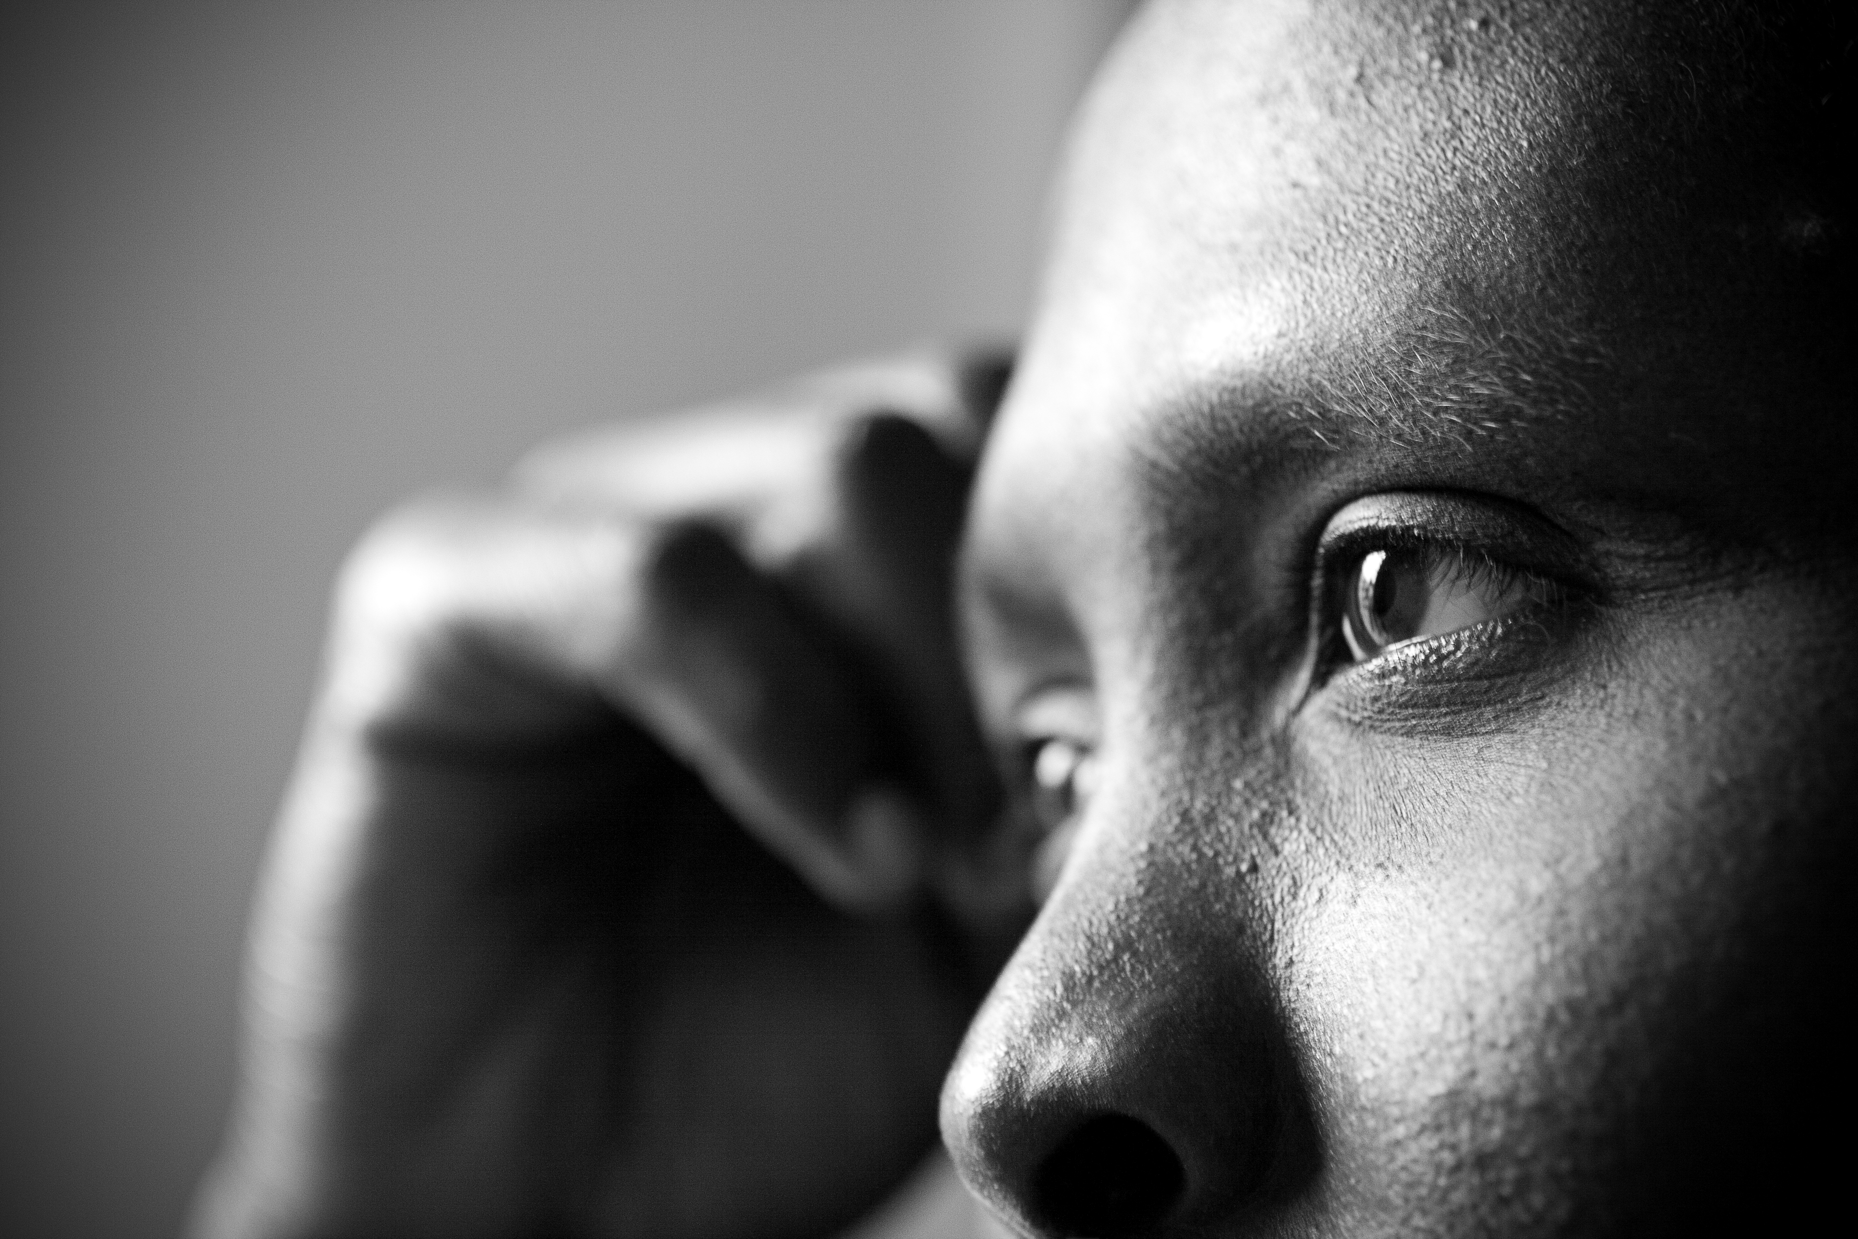
How some people describe grief . . .
Notes:
Allow time for participants to respond to the descriptions in the following slides.

Slide 9

Grief is like the ocean.
It is unpredictable.
It comes in waves,
ebbing and flowing.
Sometimes the water is calm,
and sometimes it is overwhelming.
Vicki Harrison.
Notes:
~ 2 minutes
Play sound track while revealing description.
Vicki Harrison, https://www.crazygrief.com/myownjourney/anoceanofgrief.

Slide 10
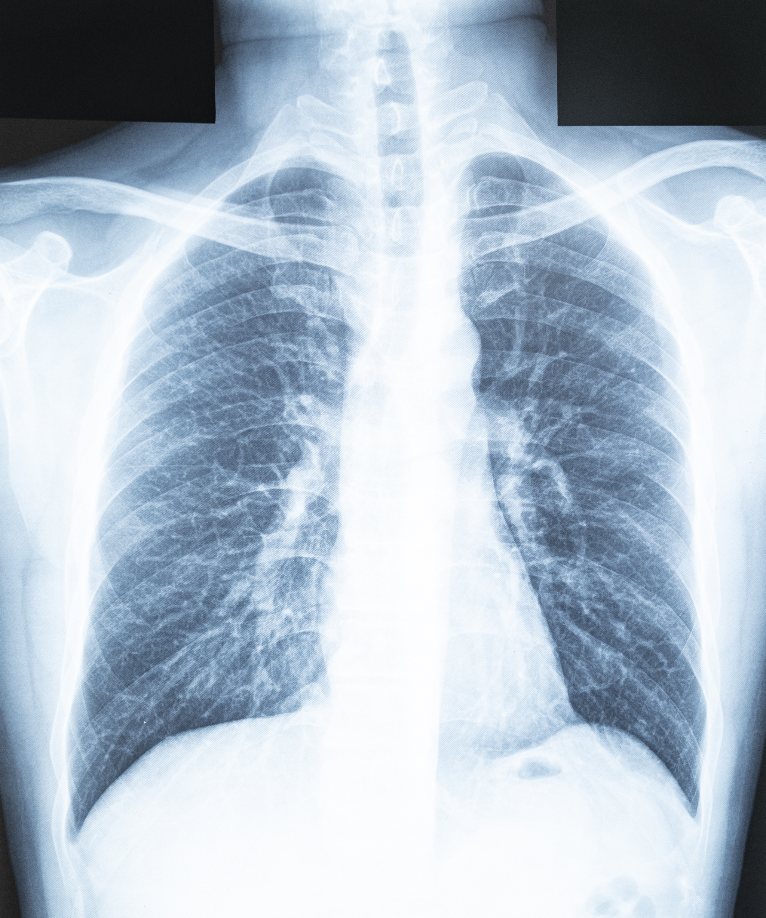
Grieving is like
having broken ribs.
On the outside,
you might look fine,
but with every breath,
it hurts.
Author unknown.
Notes:
~ 2 minutes

Slide 11
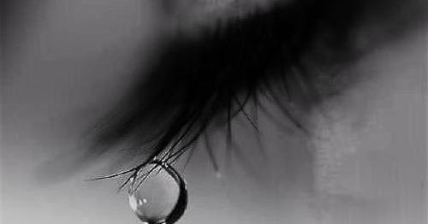
I am weary with my groaning;
Every night
I soak my bed with tears,
I drench my couch
with my weeping.
David, Psalm 6:6, Amplified Bible
Notes:
~ 3 minutes
Don’t show author.
Have any of you experienced this? If so, you are in good company.
An ancient king described his grief as groaning and profuse crying.
Show author.
The king’s name was David, and his description is found in Psalm 6, verse 6, in the Bible.
Next week we will talk about the value of tears.

Slide 12
How grief affects us . . .
Uniquely
Emotionally
Physically
Mentally
Socially/relationally
Behaviourally
Vocationally
Spiritually
Notes:
~ 2 minutes
Grieving affects every part of our being– emotionally, physically, mentally, socially, relationally, behaviourally, vocationally, and spiritually—every “crack and crevice.” And it affects each of us differently. We will consider each of these areas in the coming weeks, beginning with the uniqueness of grief next week.

Slide 13
Whatever we love––whether a person, a pet, an object, a home, a job––we may one day lose.
And when we lose what we love, we grieve that loss.
Why we grieve . . .
Notes:
~ 3 minutes
We experience grief before we even have words—think about an infant losing their soother, or a toddler their blanket or teddy bear—they express their loss through inconsolable crying and wailing.
Grief also occurs in the death of a person with whom there was not a good relationship—grief over what could have been and never was, or what once was and was lost, grief over not having reconciled.
Note for facilitators
Throughout this series, the person who died is referred to as a “loved” one. If someone in the group is grieving the death of someone who they would not describe as a “loved” one, then it would be more appropriate to refer to deceased persons as “the person who died.” You will need to change those references throughout the Facilitator and Participant Manuals.

Slide 14
What we grieve . . .
We grieve
the person who died,
our future without that person, and
the unexpected experience of grief itself.
Notes:
~ 1 minute
What we grieve
the death of the person who died,
our future without that person, and
the unexpected experience of grief itself.⁶
⁶ Kenneth R. Mitchell and Herbert Anderson, All Our Losses, All Our Griefs—Resources for Pastoral Care. (Philadelphia: Westminster Press, 1983), 61.

Slide 15
Grieving is not . . .
a sign of weakness,
a lack of faith, or
forgetting the person we loved.
Notes:
~ 2 minutes
Read slide about what grieving is not.

Slide 16
What grieving is . . .
Grieving is our reaction to loss.
It is the price we pay for loving something or someone.
The more we loved, the more we were attached to something or someone, the greater will be our grief.
Notes:
~ 2 minutes
Note for facilitators
Grief is what we feel internally.
Grieving/mourning is how our grief/internal feelings are manifested outwardly.
Many people use these terms interchangeably, as we will throughout this series.

Slide 17
In the grief of losing someone,
why do I feel like the lost one?
Notes:
~ 3 minutes
Have any of you felt this way?
In our lostness, every part of us grieves—body, mind, spirit, but be assured that . . . Grief is a normal response to loss, and in our grief, we may wish we had died with or instead of our loved one. This too is normal.

Slide 18

What’s not normal . . .
Notes:
~ 3 minutes
What’s not normal is self-harm or contemplating ending one’s life.
Have participants turn to pages v and vi in the Participant Manual with emergency numbers and contact information for professionals that can help.
We invite you to speak to us further about this at any time.
Someone has described grief this way (move to next slide):

Slide 19
Grieving is as natural as
crying when you are hurt,
sleeping when you are tired,
eating when you are hungry,
or sneezing when your nose itches.
It’s nature’s way of healing a broken heart.
Doug Manning, Don’t Take My Grief Away From Me.
Notes:
~ 1 minute
Now that we’ve established that grieving is normal, let’s look for a few minutes at some other aspects of our grief.

Slide 20
So, are you going crazy,
or is what you are experiencing
normal in grief?
Notes:
~ 5 minutes
Give participants opportunity to respond to the question.
One writer says this: “It is reassuring to discover that there is a kind of normal craziness to grief.”⁷
⁷ Kenneth R. Mitchell and Herbert Anderson, All Our Losses, All Our Griefs—Resources for Pastoral Care. (Philadelphia: Westminster Press, 1983), 72.

Slide 21
The question is not whether we will grieve, but how . . .
If we suppress our grief, it will in time re-surface and be far worse.
If we lean into it, if we do the work of grieving, we will heal.
Notes:
~ 3 minutes
Your presence today indicates your desire to heal, so let’s work together, encouraging each other on our journeys.

Slide 22
How should we grieve?
What you are feeling isn’t just normal. It is necessary for healing.
There is no right or wrong way to grieve.
Time alone won’t heal us. We must do the work of grieving.
Notes:
~ 3 minutes
Re: point #1
We must feel the pain and acknowledge our emotions to begin the work of healing.
Re: point #2
We will talk more about this in our next session.
Re: point #3
The adage that time heals is bogus. Time itself does not heal grief; while our grief may become less intense with the passage of time, we heal by leaning into our grief and doing those things that will help us heal. And that is what we hope to help you do in this series.
Optional reading
“Time only anesthetizes a wound long enough for it to become internally locked away.”⁸ We need to do the work of grieving to heal.
⁸ Susan Duke, Grieving Forward—Embracing Life Beyond Loss. (New York: Warner Faith, 2006), 114.

Slide 23


Notes:
~ 5 minutes
What stands out for you from tonight’s presentation?
What questions does tonight’s session raise for you?

Slide 24
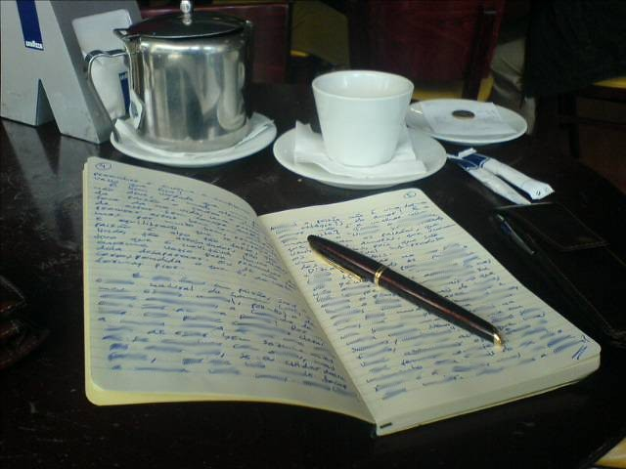
Journal assignment
In your own words, write what you learned this week about your grief.
Review Some typical responses to grief. Add other responses that come to mind.
Write what you hope to learn in this series.
Notes:
~ 5 minutes
Review assignment.
Begin working on the assignment tomorrow—don’t wait until the day before or the morning of our next meeting. As in school, cramming generally produces short-term results.
The more time and effort you put into the assignments, the more progress you will make toward healing. So, we encourage you to do your best this week.
We will take a few minutes at the beginning of next week and each week thereafter to reflect on your journal assignments and share as you are comfortable, so remember to do your work and to bring your journal each week.
For some of you, however, your grief may be so fresh that you find it difficult to do the assignments. Don’t be discouraged by this. Try your best and know that just being in a safe place to share what you are experiencing with others in grief will be beneficial, too.

Slide 25
Next week
What can I expect
on the journey of grief?
Notes:
~ 2 minutes
Announce next week’s topic.
Closing
The ancient king David, whom we quoted earlier, learned this in his grief: “The Lord is close to the brokenhearted and saves those who are crushed in spirit” (Psalm 34:18, NIV).
Eugene Peterson paraphrases it this way: “If your heart is broken, you’ll find God right there; if you’re kicked in the gut, he’ll help you catch your breath” (Psalm 34:18, The Message).
Prayer
Lord, our hearts are broken and our spirits crushed. We ask that You would be close to each of us and mend our minds, bodies, and spirits. Amen.

Slide 26
He who has no time to mourn
has no time to mend.
Anonymous.
Notes:
~ 1 minute

