Slide 1

Welcome to Grief Care
Week #2
What can I expect
on the journey of grief?
27
Notes:
~ 5 minutes
Pre-meeeting
Take ketchup bottle and tear bottle
Have this slide on screen before participants arrive.
Play background music until meeting starts.
Begin meeting
Welcome everyone and acknowledge the courage it took to come.
Collect registration and agreement forms from those that didn’t bring them last week.
Collect registration/agreement forms from new participants.
If there are newcomers, briefly summarize:
Focus
Goals
Attendance
Importance of completing weekly journal assignments
As we begin this evening, we offer a brief prayer:
Jesus, we gather tonight again because each of us has experienced the death of someone we cared deeply about or otherwise. As we travel this unfamiliar pathway through our grief, we have questions about the past and fears about our present and our future. But you have promised to guide the steps of all those that trust in you. Help us to trust you on this journey. Amen.

Slide 2

28
Notes:
~ 15 minutes
If there are new participants
Invite them and everyone else to briefly share their name, their loss and when it occurred, and what they hope to learn during these sessions.
If no new participants
Start the session with with some “catch up.” Invite one person to take the bottle and briefly share a high or a low of their week and then pass the bottle to someone else to share. (If participants are uncomfortable doing this, they can simply pass the bottle to someone else.)

Slide 3
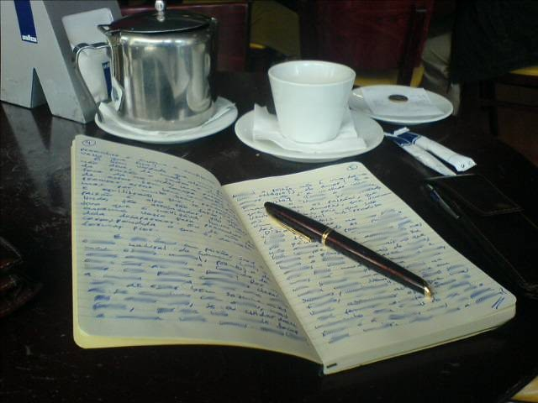
Review of last week’s journal assignment . . .
What did you learn about your grief?
What do you hope to learn during the upcoming sessions?
29
Notes:
~ 10 minutes
Ask participants if they found it hard to set aside time to do their assignments. If so, what can they do this coming week to make time?
When and where did they work on the assignments?
Ask if any would like to share what they wrote.
Offer encouragement.

Slide 4

Grieving is
a journey.
30
Notes:
~ 2 minutes
We’ve each been handed a ticket for a trip we didn’t want to take.
When our family member or friend died, our journey began.
For some, we had time to prepare but realize now nothing could fully prepare us for what we are experiencing.
For others, we suddenly find ourselves on the journey and wonder how we got here. What just happened? This was not on our bucket list.
You’ve likely heard Psalm 23 read at funerals. We often think of it as a psalm for the dying, but it is also a psalm for the living.

Slide 5
“Yea, though I walk through the valley
of the shadow of death,
I will fear no evil
for you are with me.”
31
Notes:
~ 3 minutes
Verse 4 is particularly comforting. It reads: Yea, though I walk through the valley of the shadow of death, I will fear no evil for you are with me.
Susan Zonnebelt-Smeenge, a respected licensed clinical psychologist and RN who was widowed at age 46, writes this about the valley of the shadow of death:
We can’t walk around it, dig under it, or fly over it.
And I have found that neither can we sprint through it.
We must walk through it, one step at a time.
This verse also encourages us that we don’t need to stay in our grief permanently; we can go through it. And go through it we must, to heal.
Because our goal is to move through this valley, we refer to it as a journey.
Optional
Alan Wolfelt writes that “grief creates a natural disorientation—a . . . wilderness. In loss comes a period of emptiness, aloneness—new life has not yet emerged. As I commit myself to find healing, I am led to a deeper understanding of myself and a longing to return to the world around me.”⁹
In upcoming sessions, we will look at the challenges we will encounter and the tasks to be completed on our journey, but . . .
⁹ Alan Wolfelt, The Journey through Grief—Reflections on Healing. (Fort Collins, Companion Press, 1997), 36.

Slide 6

What to expect
32
Notes:
~ 1 minute
Today we want to focus on what to expect on this journey.

Slide 7

Take 5
33
Notes:
~ 5 minutes
Let’s first take a 5-minute break for refreshments.

Slide 8

Influencers
34
This Photo by Unknown Author is licensed under CC BY-SA-NC
Notes:
~ 10 minutes
You are most likely familiar with the impact of social media influencers. These are people who build a reputation for their [supposed] knowledge and expertise on a specific topic. Their frequent posts about particular topics or products generate large followings of people who pay close attention to their views.
Similarly, many factors influence how we grieve.
External factors:
Family patterns
Cultural influences
Faith traditions
Societal influences
Gender stereotyping
Internal factors:
Personality
Age/stage of life
Attachment to the deceased
Other factors:
The nature of the loss - sudden, unexpected, traumatic, anticipated
Other losses or multiple losses within a short time
Invite participants to share in pairs some of the factors that influence how they are grieving. Take about 3 minutes each.
Then invite them to share with the whole group what they heard/learned from each other.

Slide 9
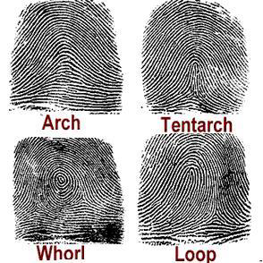
Every grief is unique
35
35
Notes:
~ 6 minutes
With all these variants, it is easy to see how each of our grief journeys will vary.
In fact, our grief is as unique as our fingerprints.
No two people’s fingerprints are the same, not even those of identical twins.
As unique as our fingerprints are, so too each of our griefs is unique.
No one else shared all the same activities, conversations, emotions that you and the person that died shared together––so no one can know exactly how your grief feels, nor you theirs.
As an example,
Each child will grieve differently the loss of the same parent––as does each parent the loss of the same child.
In this GC group, no two of you will grieve the same even though you may share the same kind of loss or may be grieving the same person’s death.
Pause for questions.
It is important to note:
We grieve each of our losses differently. We may not grieve the same for each of our parent’s or sibling’s deaths.
We may grieve the death of a friend more than a family member. The degree to which we grieve is impacted by the degree of attachment not kinship.
How we grieved or did not grieve previous deaths may impact or complicate our current grief journey—unresolved griefs of the past may resurface.

Slide 10
J. William Worden writes:
Each person’s grief is
like all other people’s grief;
like some other person’s grief; and
like no other person’s grief.
Grief Counselling and Grief Therapy. (London: Routledge, 2009), 8.
36
Notes:
~ 5 minutes
Read quote:
Each person’s grief is
like all other people’s grief;
like some other person’s grief; and
like no other person’s grief.¹⁰
Invite participants to comment on quote.
Does it make sense?
Have you found this to be true?
Have you wondered why your family members or circle of friends grieve differently this present loss?
¹⁰ J. William Worden, Grief Counselling and Grief Therapy. (London: Routledge, 2009), 8.

Slide 11
So, what does this mean for you?
It means that your grief journey won’t be like anyone else’s.
How you feel, how you process your grief, and how long it takes you to heal will be different from everyone else.
37
Notes:
~ 2 minutes
It means that there is no one size fits all grieving instruction manual.
In addition to the uniqueness of each of our griefs, what else can we expect on this journey?

Slide 12

Grieving
takes time.
There’s no
quick fix.
38
Notes:
~ 2 minutes
Show left side of slide only
Just as it took time for your relationship with your loved one to grow, so too grieving will take time. It takes time to learn to live without that person, to establish new routines, and perhaps even a new identity.
Just like kids on a road trip, we ask how much longer? When will we/I get there? We might have been able to answer kids’ questions, but in grief there is no answer-–we don’t know how long healing will take.
Reveal right side of slide
There are no drive-through windows where we can pay for a McHappy Meal and be done with grieving.

Slide 13
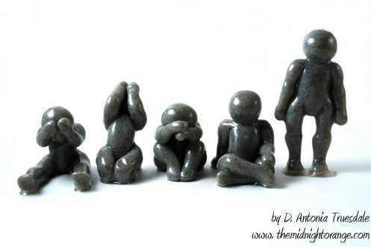
Grieving is not a five-step plan.
39
Notes:
~ 2 minutes
It was long thought that grieving consisted of five stages––denial, anger, bargaining, depression, and finally acceptance. And furthermore, it was thought that people had to progress from one stage to the next to reach a new normal.¹¹
But researchers now realize that grieving is not linear; we do not complete one stage and then move to the next. Often, we will return to previous stages or jump ahead to another.
Sometimes we will work on several stages simultaneously, and some of us may not experience all of the stages.
We will explore this further in another session when we look at the tasks of grieving.
Another thing about grief is . . .
¹¹ Elizabeth Kübler-Ross, On Death and Dying. (New York: Scribner, 1969).

Slide 14
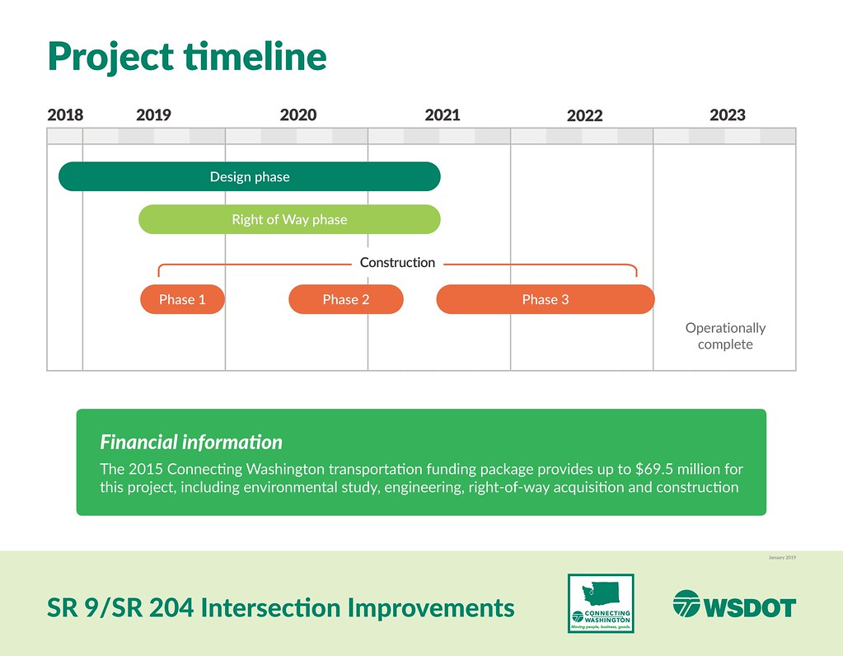
Grieving is not a work project with a timeline and a due date.
40
Notes:
~ 2 minutes
Show slide before commenting.
It is important to grieve at our own pace.
Don’t let others impose how or for how long you grieve or push you to “get over it.”
And just as major work or home or school projects aren’t completed quickly, neither is grieving. It is done one step at a time—and sometimes it may feel like you are taking two steps backward and only one step forward. That, too, is normal. There will be days—trust us, there will be days—when you take take three or more steps forward.

Slide 15

Grieving is work—hard work.
41
Notes:
~ 2 minutes
“Death wounds us, but wounds are meant to heal. And—given time [and work]—they will. But we must want to be healed. We cannot be like the child who keeps picking the scab from a cut.”¹²
So, how do we get through this valley? How do we move forward on our grief journey?
During these Grief Care sessions, you will hear a lot of useful information.
But to avoid getting stuck in your grief, you will have to do some hard work—including the practical steps that we will suggest along the way and the weekly journal assignments.
And there’s something else to expect on this grief journey . . .
¹² Joseph Bayly, The Last Thing We Talk About—Help and Hope for Those Who Grieve. (Elgin: David C. Cook Publishing Co., 1969), 47-48.

Slide 16
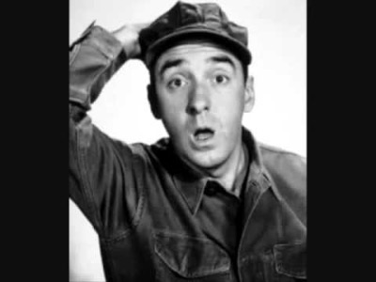
42
Notes:
~ 2 minutes
Show slide and play video before commenting on the iconic Gomer Pyle.
Grief is unpredictable.
There will be surprises along the way.
There will be times when something suddenly, unexpectedly impacts your emotions—this is called a grief ambush and is caused by triggers.

Slide 17
A grief ambush happens when . . .
an event,
a person,
a place,
a smell,
a sound,
almost anything
triggers a memory of your loved one, which then leads to an emotional reaction.
43
Notes:
~ 5 minutes
In short,
It’s when grief sneaks up behind you and bam, ambushes you out of nowhere;
It takes you down to your knees . . . you can’t function worth a squat, and
You are confused and weepy, bewildered, and perhaps embarrassed if it occurred publicly.
Invite participants to share a “trigger” experience.

Slide 18
Some helpful suggestions
Recognize that triggers cannot always be avoided.
Withdrawing or avoiding all reminders is not helpful.
44
Notes:
~ 1 minute

Slide 19
Some helpful suggestions
We can be selective in where we go, with whom, and when.
We need to lean into our pain in order to heal.
45
Notes:
~ 1 minute
We will talk more in a later session about how to respond to triggers that arise from special dates and occasions.

Slide 20
Some helpful suggestions
Don’t berate yourself when triggers occur; remember they are to be expected and are a normal part of grieving.
In time, triggers will lose their intensity.
46
Notes:
~ 1 minute

Slide 21
Some helpful thoughts
Some triggers may stay with us forever.
Triggers are not always negative.
47
Notes:
~ 2 minutes
Triggers can serve as reminders of funny and beautiful memories––memories that we don’t want to fade. That special song perhaps brings an outburst of tears now, but in time may bring a single tear with a smile, a moment for pleasant reminiscing.
Ask if there are any questions/comments before moving on to the final part of this presentation.

Slide 22

“Don’t cry because it’s over, but smile because it happened.”
48
Notes:
~ 1 minute
Despite Dr. Seuss’ sage advice, there will be times that we can’t smile.
Triggers will happen, and they may bring tears.
So, let’s talk about tears . . .

Slide 23
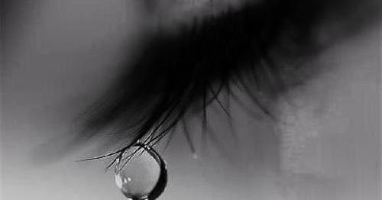
Tears
49
Notes:
~ 3 minutes
Invite participants to share how they feel about tears.
Are they comfortable, uncomfortable, embarrassed?
Do they cry? Do they wish they could cry?

Slide 24

Tears are words the heart can’t express. Author unknown, quoted by Terri Guillemets, www.quotegarden.com/crying .
50
Notes:
~ 1 minute
Show slide before reading comment below.
Susan Duke says it this way, “Tears release what our hearts cannot hold.”¹³
¹³ Susan Duke, Grieving Forward. (New York: Warner Faith, 2006), 120.

Slide 25

Tears are anti-freeze for the soul. Author unknown.
51
Notes:
~ 4 minutes
The Healing Power of Tears
William Shakespeare knew it. “To weep is to make less the depth of grief.”¹⁴
And some of our mothers knew it, too, when they would tell us, Go ahead and cry. You’ll feel better afterwards.
William Frey and researchers at the St. Paul Ramsey Medical Center in Minnesota have studied tears . . . And their conclusions are fascinating:
The tears you cry when you are grieving are made up of different chemicals than the tears you cry when you are injured or have an irritant in your eye.
They also found that emotional tears contain the adrenocorticotrophic hormone (ACTH), one of the highest indicators of stress.
They discovered that the tears of grief are full of stress toxins. Grief tears actually cleanse the body of these harmful chemicals.
Crying doesn’t solve a problem, but it offers relief and makes us feel better. After a good cry, there is a decrease in breathing and heart rates as we enter a calmer emotional and biological state.
So yes, the tears of grief really are healing tears. They are your body’s release valve for stress, sadness, grief, anxiety and frustration.¹⁵
In our society we often see tears as a sign of weakness, but tears are healthy.
Our body’s have a built-in mechanism for relief, release, and healing. The Bible tells us that we are fearfully and wonderfully made. If you ever wondered why God made tear ducts, you now know—one reason is for the release of healing tears.
¹⁴ Richard, Act 2 Scene 1.
¹⁵ William Frey, https://www.pancreaticcancerjourney.com/healing-tears.html
Copyright © PancreaticCancerJourney.com .

Slide 26
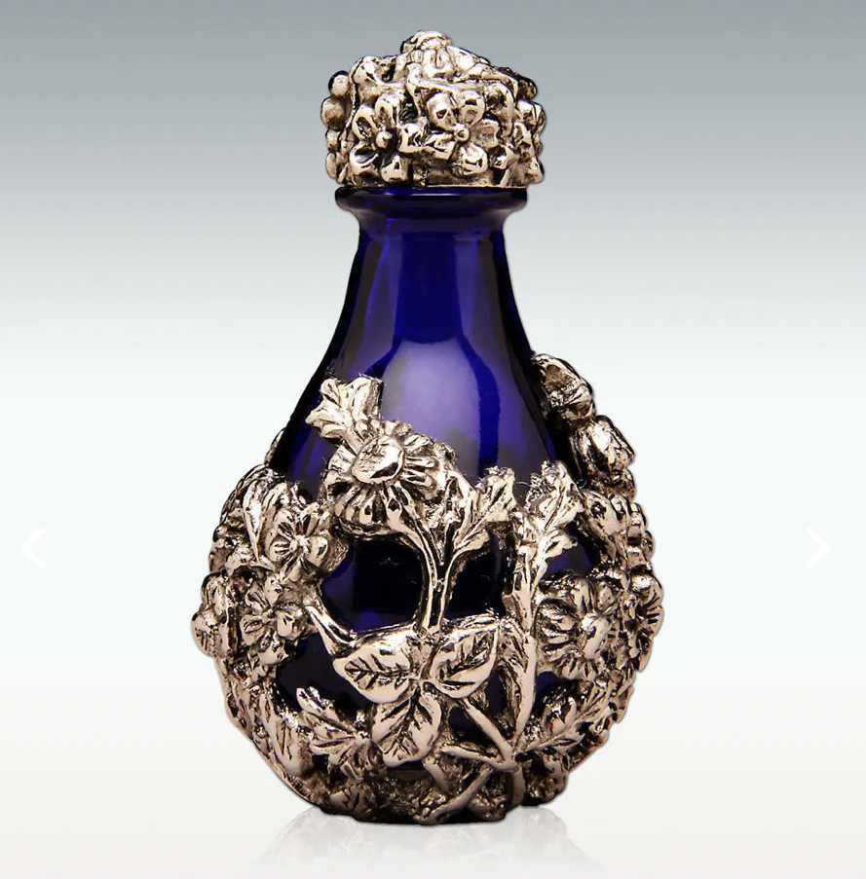
52
Notes:
~ 3 minutes
Ask if participants know what this is.
It is a lachrymatory [pronounced, la crim a tory], more commonly known as a tear bottle.
Tear bottles are small decorative glass bottles for holding tears of love, joy, sympathy and remembrance. The tear bottle tradition dates back at least 3,000 years, when mourners collected their tears in a bottle and buried them with loved ones to express honor and devotion.
History
Tear bottles were common in ancient middle Eastern societies.
Ancient Romans had a similar tradition. Mourners filled small glass vials or cups with tears and placed them in burial tombs as symbols of love and respect. Sometimes women were paid to cry into “cups,” as they walked along the mourning procession. Those crying the loudest and producing the most tears received the most compensation, or so the legend goes. The more anguish and tears produced, the more important and valued the deceased person was perceived to be.
Tear bottles reappeared during the Victorian period of the 19th century, when those mourning the loss of loved ones would collect their tears in bottles ornately decorated with silver or pewter. Special stoppers allowed the tears to evaporate. When the tears were gone, the mourning period would end.
In some American Civil War stories, women were said to have cried into tear bottles and saved them until their lovers or family member returned. Their collected tears would show the men how much they were loved and missed.
Tear bottles continue to be used in middle Eastern countries today.¹⁶
In our grief, we may wonder if God cares or even sees our tears.
¹⁶ https://tearcatcher.com/tear-bottles/tear-bottle-history

Slide 27
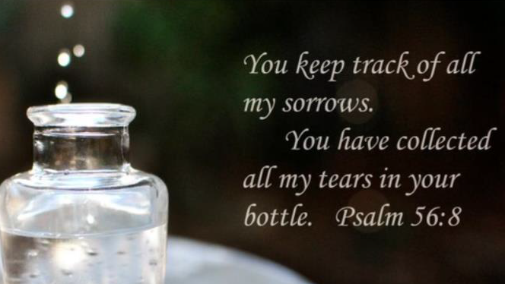
53
Notes:
~ 1 minute
Psalm 56 assures us that He sees, and He cares! He too has a tear bottle!

Slide 28

There is no right or wrong way to grieve.
54
This Photo by Unknown Author is licensed under CC BY
Notes:
~ 2 minutes
To heal, we must grieve.
Author Anne Brener says this: “Giving ourselves time to heal and creating space for the process allows the painful memories to be replaced gradually by more pleasant ones. The pain subsides, and one remembers the whole relationship, not just the most recent memories of illness and death.”¹⁷
Remember the quote from last week?
He who has no time to mourn has no time to mend.
¹⁷ Mourning and Mitzvah. (New York, Jewish Lights Publishing, 1993), 148. Quoted in Harold Ivan Smith, A Decembered Grief, Living with Loss While Others Are Celebrating. (Kansas City, Beacon Hill Press, 2011), 122.

Slide 29


55
Notes:
~ 4 minutes
What stands out for you from tonight’s presentation?
What questions does tonight’s session raise for you?

Slide 30
Journal assignment
Write about what has surprised you in your grief journey so far.
Write about what you learned tonight that can help you.
Bring a picture or memento of your family member or friend to share with the group in an upcoming week.
56
Notes:
~ 3 minutes
Review assignment.
At the beginning of each week, we will invite one or two, depending on how many are in the group, to share a picture of your loved one and to tell us what you miss most about them and a humorous or happy memory of them. Again, this is voluntary, and only as you are comfortable doing so.

Slide 31
Next week
What do I do
with why questions?
57
Notes:
~ 2 minutes
“Our whys can also become like boulders thrown across our paths if we allow them too much space in our grief. Unlike the beginning of ordinary journeys, when we try to determine how we will get to where we’re going, grief’s journey begins not with how, but why.”¹⁸ We look forward to seeing each of you next week as we look at our why questions.
Pray.
Jesus, thank you that you have promised never to leave us or forsake us—even in our grief. How amazing that you, the God of the universe, care enough for each of us that you enter into our grief, walking with us, comforting us, and even holding our tears. Help us to remember this in the coming days. Amen.
¹⁸ Susan Duke, Grieving Forward—Embracing Life Beyond Loss. (New York: Warner Faith, 2006), 49.

Slide 32
Notes:
This page is intentionally blank.

