Slide 1

Welcome to Grief Care
Week #3
What do I do with
why questions?
Notes:
Pre-meeting
Take tapestry.
Have this slide on screen before participants arrive.
Play background music until meeting starts.

Slide 2

Notes:
~ 15 minutes
Begin meeting
Welcome participants and invite them to “ketchup” on their week.
PRAY
Dear Jesus, Thank you for bringing us together again—for this safe and sacred space where we can share our sorrows, our pains, our fears, and our questions. We ask that you meet us here in our journey through grief. Amen.

Slide 3
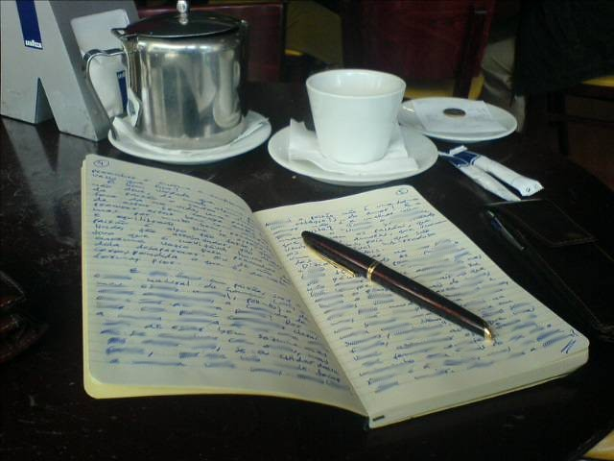
Review of last week’s journal assignment
What has surprised you in your grief journey so far?
What did you learn last week that can help you?
Would anyone like to share a picture or memento and special memory of your loved one?
Notes:
~ 15 minutes
Review journal assignment and offer encouragement.
Invite one person to share a picture, memento, or special memory.
Afterwards, remind participants that each week one or two, depending on group size, will be invited to share about their loved one, as they are comfortable.

Slide 4

Take 5
Notes:
~ 5 minutes
Let’s take a 5-minute break for coffee and to stretch, etc.

Slide 5

Notes:
~ 3 minutes
Ask if any participants have seen an elephant up close outside a zoo.
If you have, you might have thought they could benefit from a mega-dose of Oil of Olay.
The African savannah elephant is a massive creature and much larger than its African forest or Asian counterparts, weighing in around 8,000 kg and measuring about 3-4 meters; or if you prefer imperial measures, that’s about 17,600 pounds and 10-13 feet tall at the shoulders.
Personal reflection by author of Grief Care – This can be skipped.
When we lived in Kenya, East Africa, savannah elephants were a common sight on the road from the capital city of Nairobi to where we lived 9 hours away in a small coastal town north of Mombasa. I don’t ever recall not seeing a herd, either on the side of the road or on the road. When they were on the road, our travel time could be delayed by an hour or more as there was no way to go around them, over them, or under them—and no alternative routes. For however long we waited, they dominated our thoughts, conversation, and vision.
Today, we will address the elephant in the room—the subject that, like the elephant, often dominates our thoughts, our conversations, our vision in our grief but is uncomfortable for others to engage in with us.
Our elephant in the room is the question that even the best and brightest thinkers have a hard time answering . . .

Slide 6

The question is . . .
Notes:
1 minute
and that question is why.

Slide 7

What are your why questions?
Notes:
~ 4 minutes
Invite participants to write in their journals their why questions.
Then invite them to share as they are comfortable.
Some questions that may be asked are . . .
Why did this happen?
Why did it happen to me or us?
Why did it happen now?
Why did it happen this way?
Why did it happen so soon?
Why all these losses at once, or so close together?
Why do bad things happen to good people?
If God exists, why didn’t He stop this from happening?
If God is good, why did He allow this to happen?

Slide 8

Why do we
ask why?
Notes:
~ 7 minutes, including next page
Allow participants time to respond to the question on the slide.
The why question . . . goes back thousands of years.
You may have heard the phrase Job’s comforters. It comes from the story of Job in a book of the Old Testament that bears his name. A wealthy man, in one day, Job was financially ruined, most of his servants were killed, and his ten children died in a tragic accident. Job asked God a lot of questions, including Why was I born? (Job 3:11-26).
David wrote many psalms that are contained in the Book of Psalms. In these, he cried out to God with laments and questions. In Psalm 22, he asks God, My God, My God, why have You forsaken Me? Why are You so far from helping me? And from the words of my groaning?
Those familiar with the Easter account of Jesus’ death on the cross may remember that He too asked My God, My God, why have you forsaken me? (Matthew 27:46).
In the 20th century, those who witnessed two World Wars, the Holocaust, genocides in the Soviet Union, China, and Rwanda, the ethnic cleansing of Kosovo, the killing fields of Cambodia, the emergence of AIDS, and devastating famines in Africa asked why.
And the 21st century isn’t any better. There was 9/11 [September 11, 2001], the Tsunami of December 26, 2004, civil war in Syria, wars in Ukraine and Gaza, devastating earthquakes in Nepal [2015] and Turkey [2023], and repeated mass shootings and tragedies. And we ask why?

Slide 9
Why do we
ask why?
Notes:
~ 7 minutes, including previous page
Why do we ask why?
When I was in school, we were taught to ask the six questions: who, what, when, where, how, and . . . why.
Wilson Benton Jr. says this: “It does seem that man is born to question, because he begins that exercise so early in his earthly pilgrimage.
There is the innocent, incessant, inquisitive, why? why? why? of a three-year-old.
There is the nagging, whining, complaining, why? why? why? of a nine-year-old.
Then there’s the haughty, challenging, rebellious, why? why? why? of a fifteen-year-old.
“And, because God is our Father and we are his children, we find ourselves asking him those same kinds of questions.”¹⁹
¹⁹ Wilson Benton, Jr., “A Profound Answer to the Pressing Question, ‘Why?’” in Be Still, My Soul––25 Classic and Contemporary Readings on the Problem of Pain, Nancy Guthrie, ed. (Wheaton: Crossway, 2010), 55.

Slide 10
We ask because . . .
Death challenges our assumptions
about ourselves
about life in general
about God
Notes:
1 minute
Authors Mitchell and Anderson write that the mystery of loss is part of the pain of grief.²⁰
²⁰ Kenneth R. Mitchell and Herbert Anderson, All Our Losses; All Our Griefs. (Philadelphia: The Westminster Press, 1983), 79.

Slide 11

Assumptions about ourselves . . .
Notes:
~ 2 minutes
Assumptions about ourselves
We live with the illusion that we are “the master of our fate, the captain of our soul” as Henley wrote in his poem Invictus. I believe that there is much that we can and do control by our life choices, but sometimes, regardless of good and wise choices, life seems unfair.
David Jeremiah writes that “most of us live under the illusion of invulnerability . . . controlling our own destiny. We determine our own fate (or perceive we’re doing so) by acting and taking things into our own hands. We feel we’ve got it all figured out, and everything under control . . .”²¹
²¹ David Jeremiah, Shelter in God. (Nashville: Thomas Nelson, 2020), 34.

Slide 12

Assumptions about life in general . . .
Notes:
~ 3 minutes
Assumptions about life in general
We live as if we believe death won’t happen to us––at least not until we’re much, much older––but even then, we think we’re not there yet. It’s not yet time. And this is normal because we were born with eternity in our hearts,²² but with our finite minds we think of death as an end, not a beginning. In our Western, death-defying culture––death may be delayed through the advances of modern medicine. We don’t talk about it much; death is usually the last thing on our minds––until we are touched by it.
To quote David Jeremiah again, “The first thing a serious crisis does is burst [our] pleasant bubble [that we can control our lives]. Suddenly everything we’ve believed about life seems to be shattered. Our lives are in chaos just when everything seemed to be in such fine order.”²³
We live with a sense of entitlement. If I’m a good person, I shouldn’t suffer. People living in developed countries “feel violated when life does not turn out [good] . . . when we get what we do not deserve and do not get what we feel we do deserve.”²⁴ But who are the privileged to say they deserve this or that? What have we done to merit the health and wealth that the developing world lacks? Are we better? Are we more deserving?
One writer has said that we do not know what will happen tomorrow, our life is like a vapor that appears for a little time and then vanishes away (James 4:14).
An ancient writer examined life and concluded that life isn’t always fair (Ecclesiastes 3-6).
²² “He has made everything beautiful in its time. He has also set eternity in the human heart; yet no one can fathom what God has done from beginning to end” (Ecclesiastes 3:11, NIV).
²³ David Jeremiah, Shelter in God. (Nashville: Thomas Nelson, 2020), 34.
²⁴ Jeremiah, 124.

Slide 13

Assumptions about God . . .
Notes:
~ 5 minutes
Assumptions about God
If God is good, how can evil exist?
The biblical account reveals that God is not the creator of evil and suffering. He created “a world where tragedy and suffering didn’t exist [Gen. 1:31]. God created mankind with a free will [not robots], and mankind chose to disobey, which resulted in suffering and evil entering the world.”²⁵
Rabbi Harold Kushner addressed this assumption in his perennial classic, When Bad Things Happen to Good People. He wrote this: “Why . . . do bad things happen to good people? One reason is that our being human leaves us free to hurt each other, and God can’t stop us without taking away the freedom that makes us human. Human beings can cheat each other, rob each other, hurt each other, and God can only look down in pity and compassion at how little we have learned over the ages about how human beings should behave.”²⁶
Kushner goes on to say, “This line of reasoning helps me understand that monstrous eruption of evil we speak of as the Holocaust, the death of millions of innocent people at the hands of Adolf Hitler. When people ask, Where was God in Auschwitz? How could He have permitted the Nazis to kill so many innocent men, women, and children? [Kushner continues], my response is that it was not God who caused it. It was caused by human beings choosing to be cruel to their fellow men.
“Evil . . . extends not only to the moral world, but also to the natural world. When human beings do bad things to one another, this is moral evil. But so-called natural disasters are often considered evil as well because of all the suffering they cause. Earthquakes, tidal waves, floods, and so forth, are all examples of what might be termed natural evil.”²⁷
²⁵Lee Strobel, “Why Does God Allow Tragedy and Suffering?” in Leadership Journal, July 24, 2012, https://www.christianitytoday.com/2012/07/doesgodallowtragedy/).
²⁶Harold Kushner, When Bad Things Happen to Good People. (New York: Avon Books, 1981), 81.
²⁷ Robert Velarde. “How Can God Allow So Much Suffering?” Focus on the Family, February 2, 2024. https://www.focusonthefamily.com/faith/how-can-god-allow-so-much-evil-and-suffering/).

Slide 14
Assumptions about God . . .
Notes:
~ 5 minutes
Our assumptions about God, cont’d
If God is powerful, why does He let bad stuff happen?
God exercises restraint of His power by not interfering with our free will and not showing partiality—doing for one person what he doesn’t do for another.
Note for facilitators
If participant(s) don’t believe in God, or that He is not good—you may want to briefly share the biblical narrative of creation, fall, redemption, return to perfection in eternity through Jesus Christ.

Slide 15
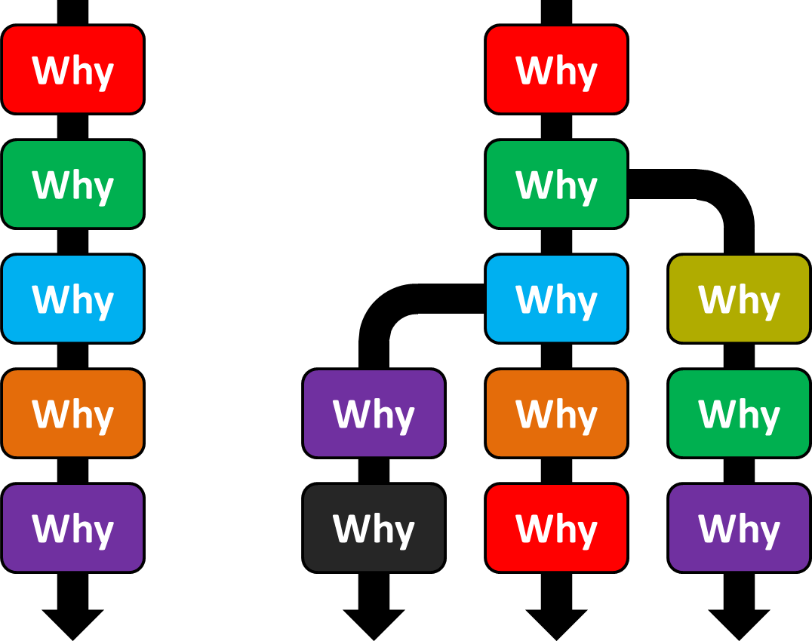
What do we do with the why questions?
This Photo by Unknown Author is licensed under CC BY-SA
Notes:
~ 4 minutes
Invite participants to share how they have dealt with their why questions.
Ask if any of the participants had a hamster when they were younger, or if they had one for their kids. If so, they are familiar with the hamster wheel.

Slide 16

Notes:
~ 5 minutes
Play video²⁸—let music repeat three times, then ask:
What did you see?
What did you hear?
Do you ever feel like you are on a hamster wheel with your why questions? Asking, asking, asking—but getting nowhere, much like this hamster—and your questions, much like the music, keep repeating?
If we get hung up on our why questions––demanding of ourselves, others or God an answer or explanation before allowing ourselves to move on––we can become stuck in our grief.
Let’s look at what to do with our questions.
^{28 “}Richard the Hamster in His Hamster Wheel.” https://www.youtube.com/watch?v= 4K5h1MbBcgI .

Slide 17

We can get stuck, or . . .
We can go to someone who can help us sort through our questions, such as a
Friend, family, colleague
Counsellor
Grief support group
Books, the Bible,
Minister, rabbi, priest
God
Notes:
~ 5 minutes
Invite participants to identify resources they have found helpful with their why questions.
What helps
Friend, family, colleague –– someone who has dealt with tragedy and why questions.
Counsellor –– someone who is trained in how to deal with grief and why questions.
Grief support group –– such as Grief Care; there’s wisdom in numbers, and we can learn from each other.
Books –– i.e., Jerry Sittser, A Grace Disguised—How the Soul Grows through Loss, expanded edition.
The Bible –– offers comfort and peace as we struggle with the whys.
Minister, rabbi, priest –– someone trained in answering tough questions.
We invite you to consider another source—God.
Whitney Houston made popular the song entitled Where Do Broken Hearts Go?²⁹ which includes these lyrics:
So here I am
And can you please tell me, oh
Where do broken hearts go?
It’s a ballad about the pain of loss and the desperate search for love, for attachment. Interestingly Houston, who released the original track, reportedly disliked the lyrics for the stated reason that she had no idea where broken hearts go.
If we want a response to a complaint about a poor product or service, we direct our complaint to customer service or a manager. For that reason, I direct my laments (as David did in the Psalms) to God because I know He cares and will help me deal with the whys.
Rabbi Kushner writes: “Because tragedy is not God’s will, we need not feel hurt or betrayed by God when tragedy strikes. We can turn to Him for help . . . because . . . God is as outraged by it as we are.”³⁰
²⁹ Written by Frank Wildhorn and Chuck Jackson.
³⁰ Harold Kushner, When Bad Things Happen to Good People. (New York: Avon Books, 1981), 134.

Slide 18
In time, we can learn
to accept the limitations
of an answer.
Notes:
~ 5 minutes, including next slide
Ask participants if they had the answer to their why questions, would they be satisfied? (give time for a response).
Or would we be like the toddler who is never satisfied with the answer, continuing an endless litany of But why, Mommy to every offered answer?
Sometimes the answer or an insight or acceptance is a long time coming.
Three months after my grandson’s death, his mother/my daughter sent these words to me in a text:
Your story and life give me hope that God will provide
a hope and vision for our future. I am already seeing fragments of it.
When I read those words, tears came to my eyes. In my grief over my husband’s death, the subsequent healing that occurred over time, the new life that I have forged without forgetting the life I had, is encouraging my daughter and her family in their journey of grief. And in that moment, I was able to thank God—not for my husband’s death—but for the timing of his death eight years earlier and for time to heal and move through my valley of the shadow of death into new life and renewed hope before my grandson died.
We need to recognize also that we may never have an answer that will fully satisfy, and if we did, it wouldn’t change the fact that our loved one has died––we still have an empty chair at the table. . . . An autopsy report might give us answers as to how our loved one died, but it doesn’t solve the why.
Authors Mitchell and Anderson write that “living through grief requires an ability to tolerate unanswered questions.”³¹
³¹ Kenneth R. Mitchell and Herbert Anderson, All Our Losses; All Our Griefs. Philadelphia: The Westminster Press, 1983), 138.

Slide 19
In time, we can learn
to accept the limitations
of an answer.
Notes:
~ 5 minutes, including previous slide
Ask participants what the point is of asking why if we may never get an answer?
Allow time for their responses.
The point is that questions can be a great help in mourning our loss, communicating our frustration, and expressing our feelings.³²
So, what can we do with our why questions?
³² Laura Story, “When We Ask Why God? Why?” http://faithgateway.com/blogs/Christian-books/when-we-as-why-god-why).

Slide 20
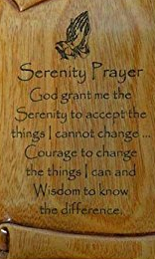
Notes:
~ 3 minutes
Many people find the Serenity Prayer³³ to be helpful when there are no answers to their why questions.
Read it.
³³ The prayer is attributed to Karl Paul Reinhold Niebuhr, an American theologian and has been used by Alcoholics Anonymous.

Slide 21
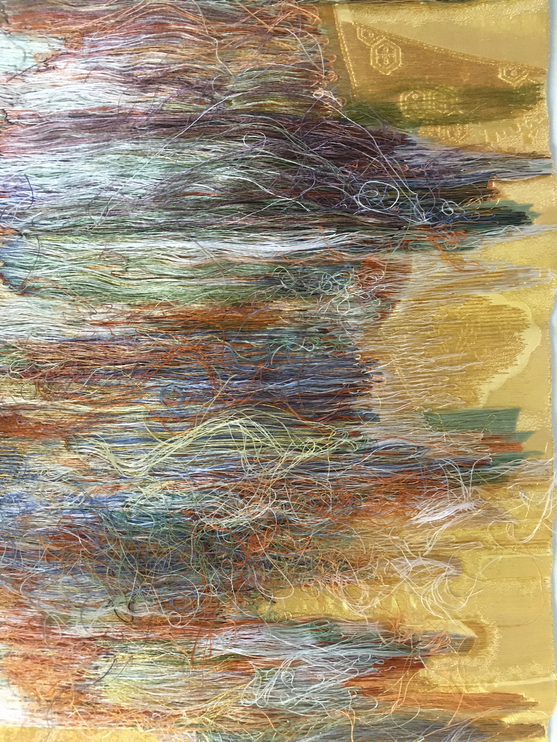

Notes:
~ 5 minutes
Show underneath side of tapestry only
Ask participants to describe what they see.
Life can be puzzelling with its unanswered questions.
Some of you may be familiar with the poem entitled The Weaver³⁴ that reads:
My life is but a weaving
Between my Lord and me;
I cannot choose the colors
He worketh steadily.
Oft times He weaveth sorrow
And I, in foolish pride,
Forget He sees the upper,
And I the under side.
Not til the loom is silent
And the shuttles cease to fly,
Show upper side of tapestry
Shall God unroll the canvas
And explain the reason why.
The dark threads are as needful
In the Weaver’s skillful hand,
As the threads of gold and silver
In the pattern He has planned.
Two thousand years ago, another writer expressed it this way . . .
³⁴ Anonymous.

Slide 22
For now we see through a glass darkly;
but then face to face:
now I know in part;
but then shall I know
even as also I am known.
1 Corinthians 13:12
Notes:
~ 2 minutes
In our grief, we seem to be looking through an opaque lens, seeing only the underside of our life’s tapestry.

Slide 23


Notes:
~ 4 minutes
What stands out for you from this presentation?
What questions does tonight’s session raise for you?

Slide 24
Journal assignment if you have why questions
Add to your list of why questions.
Take time to ponder them.
Write what insights you might have as you ponder your questions.
Write what you will do with these questions.
Notes:
~ 4 minutes
Don’t rush this exercise. We would suggest taking a full week for this assignment.
If you have why questions
Wednesday: Add to your list of why questions.
Thursday, Friday: Take time to ponder your questions. Consider why you are asking them. What assumptions have been rattled? Don’t write anything these days—just spend time thinking about your questions.
Saturday, Sunday: Write what insights you may have gained from Thursday and Friday.
Monday: Write what you will do with these questions, where you will go with them. Can you accept not having answers? Why or why not?
Tuesday: Bring your journal to Grief Care.
For facilitators
Change days according to your group’s schedule, starting with the first day after this session.

Slide 25
Journal assignment if you don’t have questions
Write why it is you don’t have why questions or, if you had questions in the past, how you came to terms with them.
Write what questions others may have asked and how you responded.
If why questions arise in the future, how can you address them?
Notes:
~ 4 minutes
If you don’t have why questions
Wednesday, Thursday: Write why it is you don’t have these questions or, if you had questions in the past, how you came to terms with them.
Friday, Saturday: Write what questions others may have had and how you responded.
Sunday, Monday: If why questions arise in the future, how can you address them?
Tuesday: Bring your journal to Grief Care.
For facilitators
Change days according to your group’s schedule, starting with the first day after this session.

Slide 26
Next week
What are the challenges of grief? (part one)
Special days, holidays, ordinary days,
and sleepless nights
Notes:
~ 1 minute

Slide 27
Serenity Prayer
God grant me the
Serenity to accept
the things I cannot change . . .
Courage to change
the things I can and
Wisdom to know the difference.
Amen.
Notes:
~ 4 minutes
“For many there is no clear answer [to the why question]. A mother whose young son died in the 1988 crash of PanAm Flight 103 said, ‘It is not how to find an answer, but how to live without one.’”³⁵
With respect to the why question, Rabbi Kushner counsels us to “rise beyond the question ‘why did it happen?’ and begin to ask the question ‘what do I do now that it has happened?’”³⁶
If comfortable, please join with us in praying the Serenity prayer.
³⁵ J. William Worden, Grief Counselling and Grief Therapy—A Handbook for the Mental Health Practitioner, fourth edition. (East Essex: Springer Publishing, 2009), 49.
³⁶ Harold S. Kushner, When Bad Things Happen to Good People. (New York, Avon Books, 1981), 71.

Slide 28
Notes:
This page is intentionally blank.

