Slide 1

Welcome to
Grief Care
Week #4
What are the challenges of grief?
Special days, holidays,
ordinary days, and sleepless nights
Notes:
Pre-meeting
Have this slide on screen before participants arrive.
Play background music until meeting starts.

Slide 2

Notes:
~ 20 minutes
Begin meeting
Welcome everyone.
Invite participants to get a tea/coffee now as the break will be later than usual.
Invite one person to share a picture, memento, or special memory.
Afterwards, remind participants that each week one person (or two, depending on group size) will be invited to share about their loved one, as they are comfortable.
Pray
Jesus, thank you for bringing us together again this evening as we consider how to face the special days and holidays that once brought joy and laughter, the routines of life that once seemed ordinary. Be present to heal and comfort us this evening as we journey together. Amen.

Slide 3
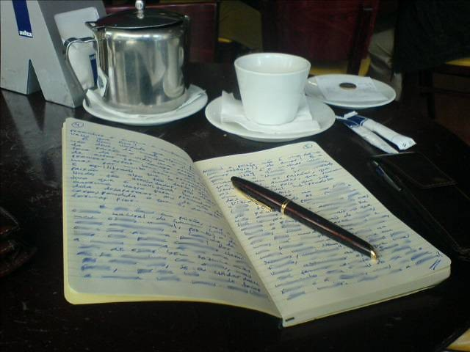
Review of last week’s journal assignment
If you have why questions:
If you don’t have why questions:
Saturday/Sunday:
What insights have you gained from pondering your why questions?
Monday:
What will you do with your unanswered questions, where will you go with them?
Can you accept not having answers? Why or why not?
Wednesday:
If you had why questions in the past, how did you resolve them?
Friday/Saturday:
How have you responded to other peoples’ why questions.
Sunday/Monday:
If why questions arise in the future, how can you address them?
Notes:
~ 10 minutes
After reviewing questions, ask if participants are reading the weekly handouts and if they are helpful.

Slide 4
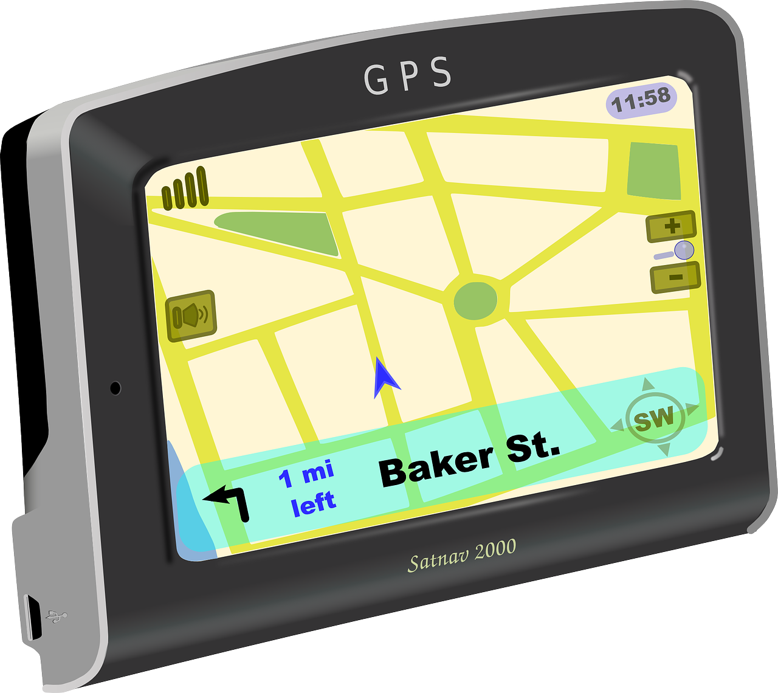
Where we’re headed —
how to deal with:
special days,
holidays,
ordinary days, and
sleepless nights.
Notes:
~ 1 minute
In our grief journey, we will encounter special days and holidays, interspersed with ordinary days and sleepless nights.

Slide 5
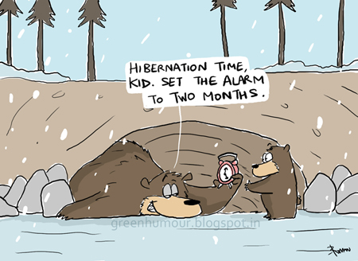
It’s natural, but not helpful, to want to hibernate during grief.
Notes:
~ 2 minutes
Billie Joe Armstrong’s father died in September of the year Billie Joe was 10 years old. Reportedly, he locked himself in his room after the funeral. Later that day, when his mother knocked on his door, his response was “Wake me up when September ends.”
Years later, as frontman for the American rock band “Green Day,” he wrote and performed a song entitled Wake Me Up When September Ends in which he talks about the loss of his father 20 years earlier.
When holidays and special days approach, it’s natural to want to yank the covers over your head and snarl, “Wake me up when it’s over.”³⁶
It’s not just natural, it’s a normal desire when we are grieving—but it’s not a healthy way to handle our loss.
³⁷ Paraphrased from Harold Ivan Smith, A Decembered Grief. (Kansas City: Beacon Hill Press, 2011), 14.

Slide 6

Some guiding principles

Slide 7

Don’t ignore the day.
Notes:
~ 2 minutes
Do accept that special events/holidays will occur, whether we like it or not.
Nothing good comes from hiding your head in the sand like the proverbial ostrich.³⁷
Grief must be acknowledged to be dealt with—it doesn’t go away by ignoring or suppressing it.
As we’ve learned already, acknowledging our emotions, our pain, our grief takes courage to be authentic, to be honest with ourselves, with others, and with God. It is the first step—and perhaps the hardest step—in the process of moving forward and healing.
³⁸ Ostriches can’t fly so can not build their nests in trees. Thus. they bury their eggs in the sand. When they appear to be hiding their heads in the sand, they aren’t—they are simply repositioning their eggs.

Slide 8
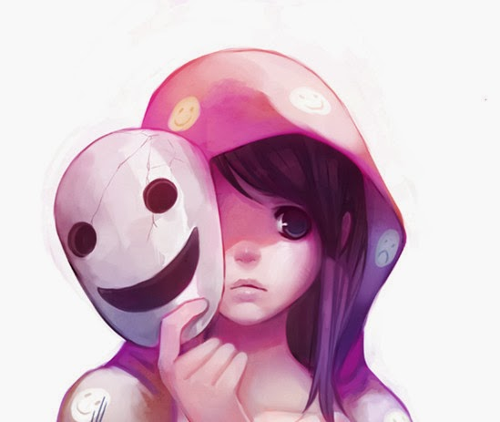
Don’t fake how you are feeling.
Notes:
~ 3 minutes
We are not talking here of being selective with whom we share our grief and those that we give a polite reply of “I’m doing okay; thank you for asking.”
Nor are we talking about faking sorrow that we do not feel.
We are talking here about consistently masking or suppressing the emotions that we feel—allowing no one in.
Fake it till you make it doesn’t work when we are grieving.
When we fake how we are feeling
We waste emotional energy that would be better spent on the work of grieving.
When we appear to have it all together, people think we are okay and won’t offer to help.
Grief that is suppressed in this way may seem safer, BUT eventually it will come to the surface as anger, rage, illness, or depression, and be much harder and take much longer to heal.

Slide 9
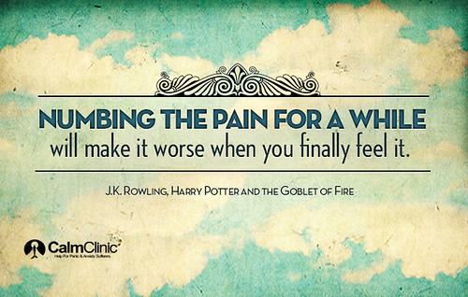
Don’t numb your pain.
Notes:
~ 5 minutes
Some people will try to numb their grief through drugs or alcohol, but grief will feel much worse when the effects of numbing wear off, when you have to face your grief AND deal with the after-effects of drugs or alcohol.
Others will shop till they drop—then literally drop when the credit card bill comes due.
Invite participants to share what lessons they have learned when they tried to ignore a special day, fake or hide their emotions; or attempted to numb their pain.
An alternative to ignoring, faking or numbing our grief is to . . .

Slide 10
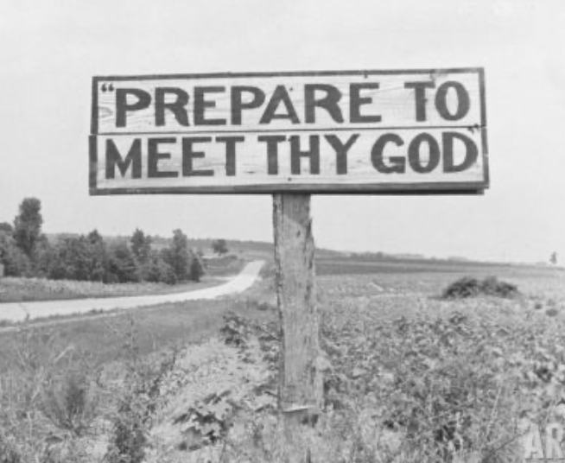
Be prepared . . .
Notes:
~ 3 minutes
If you have driven through the United States, you may have seen roadside signs that say Prepare to meet thy God. This one is on the roadside between Charlotte, North Carolina, and Atlanta, Georgia.
The message is clear––be prepared.
We’ve all heard media outlets and weather stations broadcast warnings in advance of impending bad weather or impending disasters.
Preparedness checklists are issued for what to do if there is a hurricane, forest fire, snow or ice storms, or a reason to leave our homes immediately.
Pre-holiday advertisements remind us how many shopping days are left before Christmas and to shop early to avoid the rush of last-minute shoppers.
Likewise, we are wise if we prepare in advance for holidays, special days, and the not so ordinary days.

Slide 11

The key to being prepared is to
plan ahead starting with the next “first.”
Notes:
~ 3 minutes
Some benefits of advanced planning
It helps relieve the stress of the event.
It gives you a reason to say no to events/activities in which you don’t want to participate.
It diminishes emotional ambushes.
It allows you to be pro-active rather than re-active in how you observe or celebrate the event.
It gives you time to think about new and meaningful traditions, volunteer opportunities.
It is wise to plan ahead but you need to also
keep your plans flexible, even having a back-up plan and
allow yourself freedom to change your mind about attending an event, how long you will stay, etc.

Slide 12

Take 5
Notes:
~ 5 minutes

Slide 13

Your Special Days
Birthdays
Weddings
Anniversaries
Graduations
Mother’s Day/Father’s Day
Grandparent’s Day
Valentine’s Day
Notes:
~ 7 minutes
“Anniversaries—of the death, life events, birthdays—can be especially hard when you are in grief^{.”39}
Invite participants to share:
How have you celebrated these events since your loved one died?
What new tradition(s) do you want to start now?
What helps
If it is your birthday or anniversary or Valentine’s Day, think about buying something special for yourself that your loved one or friend might have given you (or you wish they had given you). Or, doing an activity that you might have done on these days.
If it is your loved one’s birthday, is there something you could do (volunteer for a special cause) or give (to a charity) in their honor?
If you gave them a gift, give a gift to their child or a charity in their honor.
Perhaps visit with others who may also be missing them.
Share memories, funny stories, pictures, etc. with others.
Schedule quiet time for yourself on these days—time to reflect and for self-care.
Engage in an activity that they would like to do or that you did together (i.e., hiking, biking, kayaking).
³⁹ Alan D. Wolfelt, Healing a Spouse’s Grieving Heart. (Fort Collins: Companion Press, 2003), 53.

Slide 14
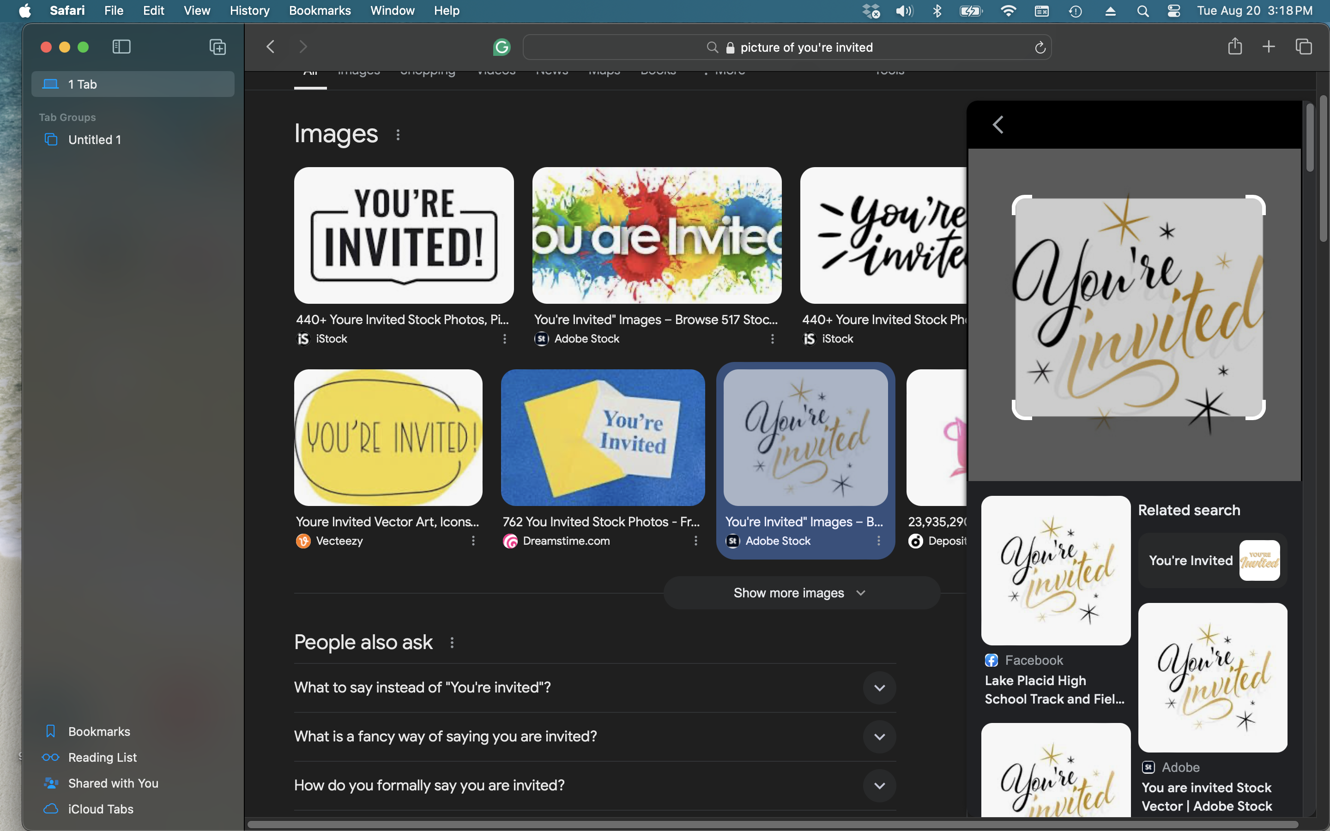
Invitations to other people’s Special Days
Weddings
Retirement parties
Christenings/baptisms
Confirmations/communions
Funerals
Notes:
~ 7 minutes
Invite participants to share how they have handled these events.
What helps
Recognize that these may be especially difficult events to maneuver.
Be selective in what you attend—there’s no harm in saying, I can’t do it yet, or politely declining.
If appropriate, ask the host to allow you to change your mind at the last minute.
If you want to attend, decide what you need to do to make the event the least stressful as possible.
You may want to ask someone to go with you who would be comfortable exiting early if needed or who can run interference for you.
Rehearse in your mind ahead what it will be like and how you might respond to questions or the lack thereof.
Wear waterproof mascara and carry tissues. 🤣
Have an exit plan.
If it turns out horrible, learn from it what to do better the next time—but don’t decide to never again attend such events.

Slide 15
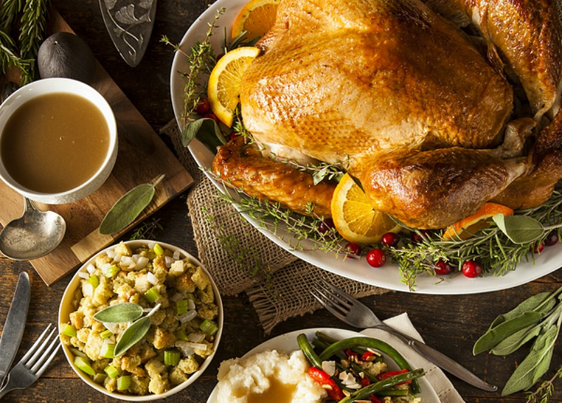
Holidays
Easter
Thanksgiving
Christmas & surrounding events
New Year’s Day, Chinese New Year
Family Day, Victoria Day, Canada Day,
Civic Holiday, Labour Day, etc.
Notes:
~ 1 minute

Slide 16

Why are holidays so difficult?
Notes:
~ 5 minutes
Ask participants why the holidays are so tough.
Why holidays are so difficult
In Dr. Seuss’s book entitled How the Grinch Stole Christmas, the Grinch learned that the holidays don’t really come from a store—they come from the heart and soul. And that is why when a loved one dies the holidays are so tough—the heart and soul are gone.
Nicholas Wolterstorff expresses it this way: “When we’re all together, we’re not all together.”⁴⁰
Each holiday tradition has special music or special wishes for happiness, but these greetings––such as Merry Christmas or Happy New Year––make us wince. In other years, we would have responded And a merry Christmas and happy new year to you, too! But not this year. This year we may want to scream, to shut down the frivolity, the songs, the laughter, to yell at the world—Don’t you know my loved one died? The world has no right to be happy!
A popular Christmas carol tells us
It’s the most wonderful time of the year,
with everyone telling us to be of good cheer, and
it’s the hap-happiest time of the year, and
hearts will be glowing when loved ones are near;
it’s the most wonderful time of the year.⁴¹
⁴⁰ Nicholas Wolterstorff, Lament for a Son. (Grand Rapids: Wm B. Eerdmans, 1987, 14).
⁴¹ Eddie Pola and George Wyle, “It’s the Most Wonderful Time of the Year,”1963.

Slide 17
Why are holidays so difficult?
Notes:
~ 5 minutes
Ask participants why the holidays are so tough.
The rigorous emotional and social agendas of the end of the year challenge [us], and the “holiday demands shove the griever into emotional overload.”⁴²
We can’t escape the sights and sounds, which seem to start earlier and earlier every year. We wonder how we are ever going to get through this. Well, the way through is to make a plan and a back-up plan, and to be flexible with your plans. Decide in advance on the who, what, where, when, and how much you will engage in an activity.
What do you find most difficult about the holidays?
⁴² Harold Ivan Smith, A Decembered Grief. (Kansas City: Beacon Hill Press, 2011), 21.

Slide 18

Seasonal Affective Disorder
Notes:
~ 3 minutes
It also is important to note that winter festivals and holidays come during the season of the year when for those of us living in the Northern Hemisphere days are shorter and nights are longer.
“Seasonal Affective Disorder (SAD) is a depressive mood disorder brought on by lack of natural light during the winter months. Based on population forecasts, an estimated one million Canadians will suffer from SAD in 2025.
“If you are experiencing symptoms of SAD, you may have a particularly difficult time coping with holiday grief because the holidays ... coincide with the weeks of the least daylight [in North America]. Light therapy has been found to be an effective treatment for SAD sufferers.”⁴³
What helps
Twenty-minutes outside in the sunshine or the use of a light therapy lamp are often very helpful. Intentionally bring light into your home, open the curtains and blinds, leave lights on when you will be coming home in the dark, use lots of LED candles, turn on the Christmas lights while at home. A trained psychotherapist can be of invaluable help as well helping you create a light therapy routine.
⁴³ Canadian Psychological Association, “‘Psychology Works’ Fact Sheet: Seasonal Affective Disorder,” posted December 31, 2020. https://cpa.ca/psychology-works-fact-sheet-seasonal-affective-disorder-depression-with-seasonal-pattern/, accessed August 19, 2025.

Slide 19

Additional suggestions for facing holidays and special days
Notes:
~ 5 minutes
What helps
Interaction with others: Don’t ignore using your loved one’s name in conversations. Be cognizant of children and youth and their feelings and capacity for grief; tell funny stories, share pictures, special interests. Be gracious to people who wish you Happy Easter or Merry Christmas—they may not know that you are grieving, or are at a loss for words and blurt out the greeting without thinking.
Gatherings on special days or holidays: Think about how you want to observe these occasions and consider if you need to include others in planning. For Christmas, it is often helpful to make a list of all the things you normally would do—such as decorating indoors and outdoors, baking, entertaining, sending cards, buying gifts, etc. Then decide what you may want to eliminate, scale back, can do on your own, or need help with. Consider what old traditions to continue and what new ones to introduce.
Gift giving: Consider giving meaningful gifts—such as a framed picture of the recipient and your loved one, a letter about a special memory of the recipient with your loved one, a memory pillow, etc.
Self-care: Taking care of yourself is always important to your healing but especially so during holidays and around special days. Staying hydrated, eating healthy meals, exercising, resting, and connecting with others, nature, and your faith are vital.

Slide 20
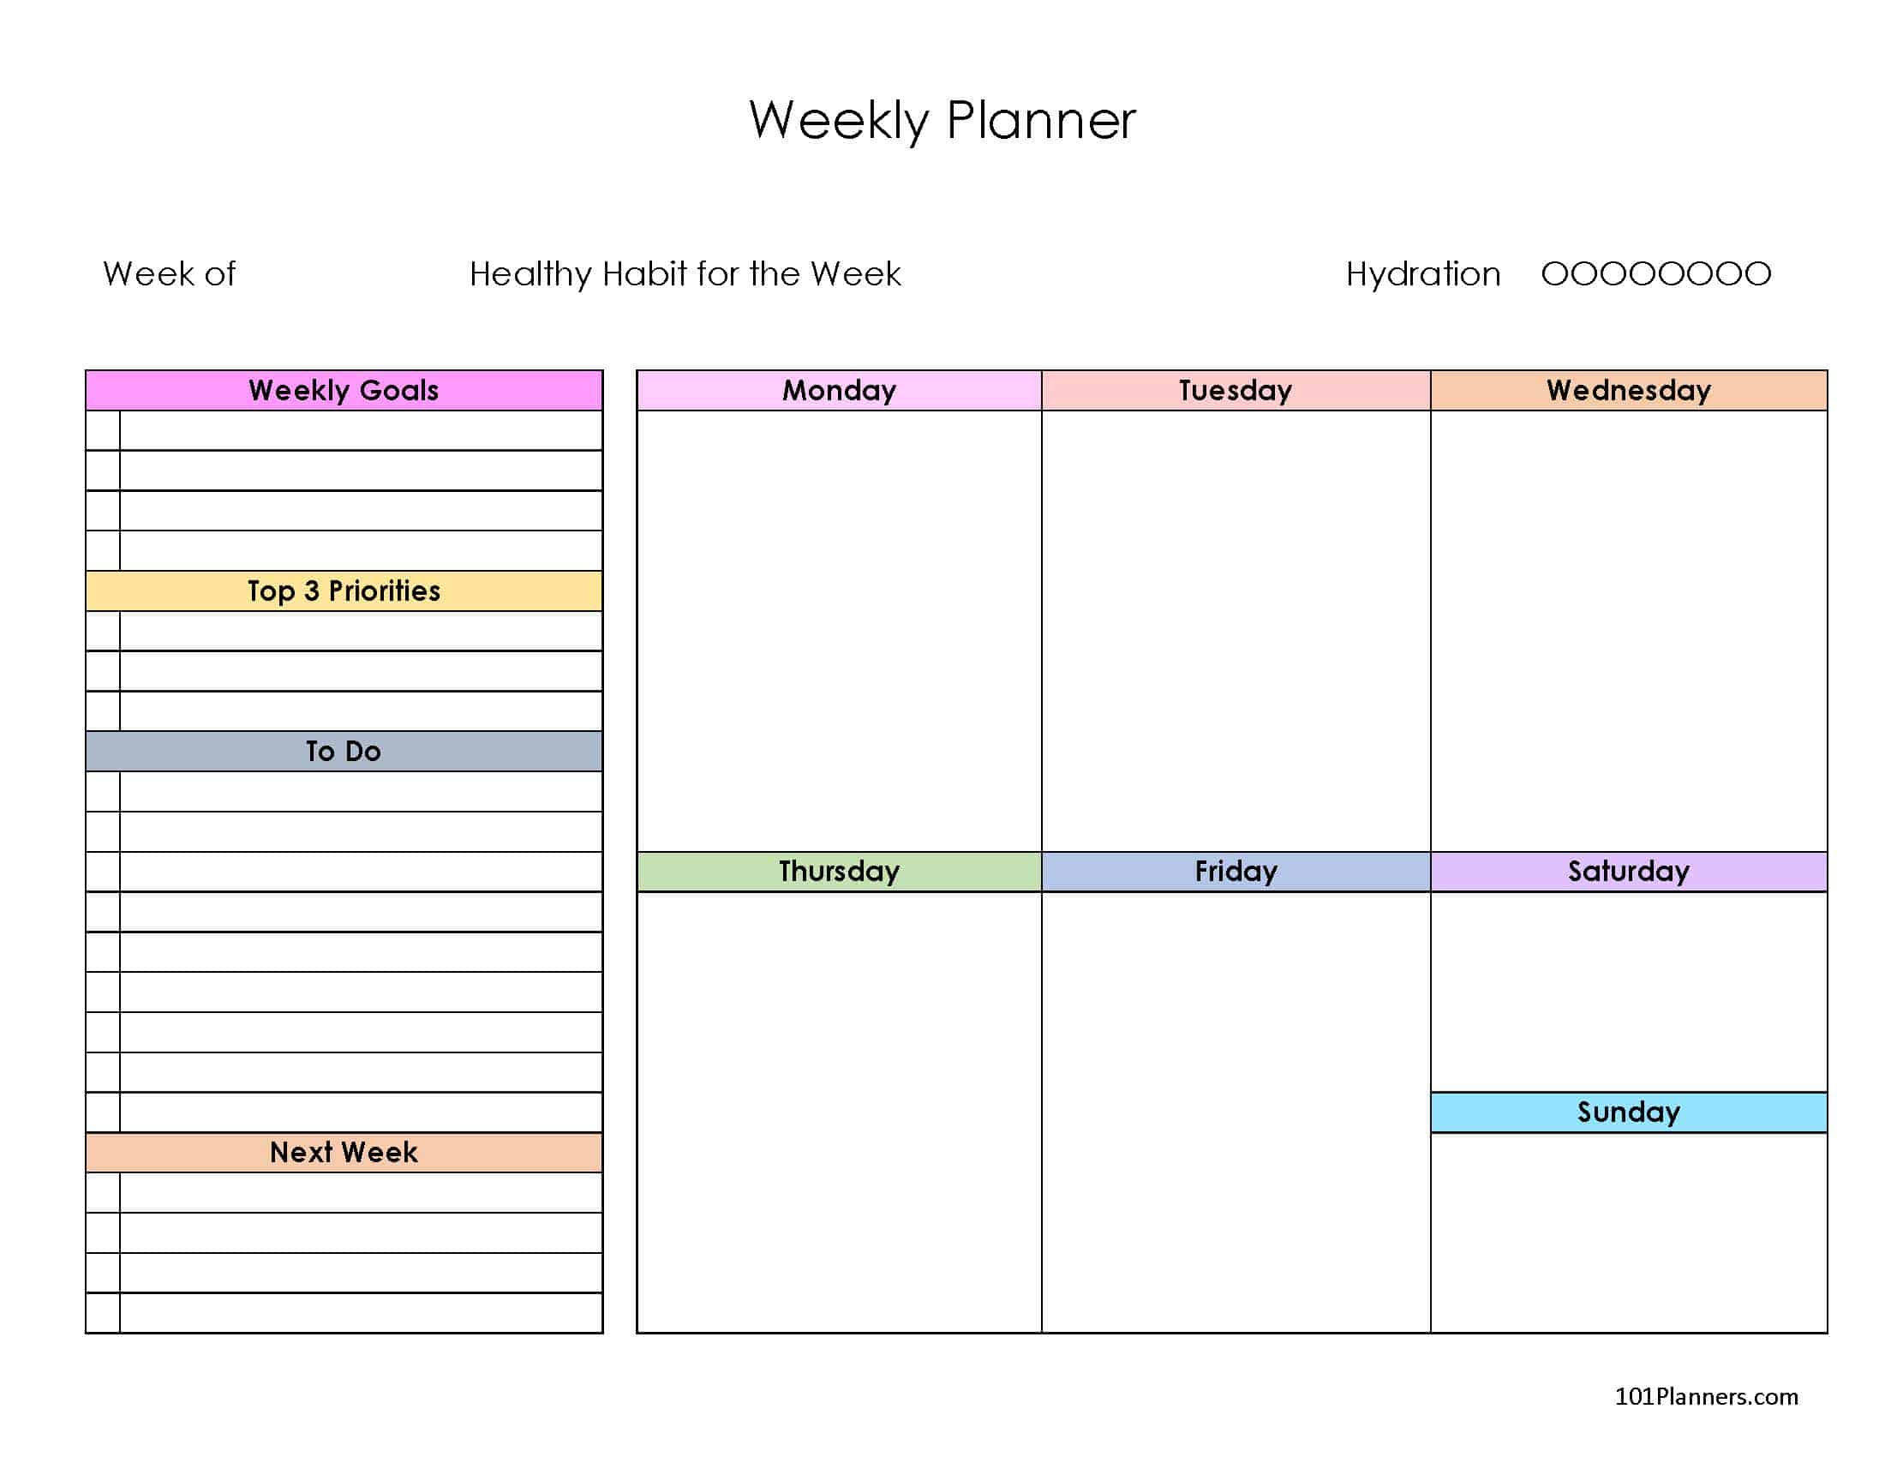
Ordinary Days
Weekly routines
Weekends
Vacations
Notes:
~ 10 minutes, with next page
One father said this after the death of his son: “I walked into a store. The ordinariness of what I saw repelled me: people putting onions into baskets, squeezing melons, hoisting gallons of milk, clerks ringing up sales. ‘How are you today?’ ‘Have a good day now.’ How could everybody be going about their ordinary business when these were no longer ordinary times?”⁴⁴
Have you ever felt this way? Inspite of our grief and our desire for the world to stop spinning, life goes on. Some how we need to figure out how to carry on with the ordinariness of life. Following are some suggestions that have helped others.
What helps
Set a goal or goals for each day. In the very early days of grief, these may be focused simply on self-care: get out of bed, brush your teeth, and eat or urgent financial and legal matters. Add at least one “feel good” activity per day (i.e., exercising or walking in nature).
If you and your loved one texted or called at certain times during the day or certain days of the week, reach out to others at these times, either by text, a call or visit. If you routinely visited your loved one in a retirement home, consider visiting with friends of your loved one there. Meet up with friends, go for a ride, read during the time that you would normally make these visits.
If Friday night was your together time at the end of a busy week, get together with friends to watch a TV program or movie, or explore new areas, go bowling, play mini golf, etc. Plan to do something; don’t sit and mope.
Perhaps Saturday night was family dinner night—what do you do now if one member is missing or your “co-host” is gone? Can you still host the dinner? Maybe now you order in food rather than cooking. Can someone else host the meal? Can you start a new tradition of a potluck dinner? Think about board games or activities to do together—perhaps what you did before or new things.
⁴⁴ Nicholas Wolterstorff, Lament for a Son. (Grand Rapids: Wm B. Eerdmans, 1987), 52.

Slide 21
Ordinary Days
Weekly routines
Weekends
Vacations
Notes:
~ 10 minutes, with previous page
If you went to a cottage in the summer, what do you do now? Can you still go? Do you need to invite someone(s) to join you? If you need to give up this activity, what other special things can you do during that time? Consider staycations––exploring local attractions each day alone or with friends. If you were snowbirds, perhaps you can find a friend or friends to join you or plan for local adventures, activities that you can do during the winter that are nearer home—perhaps a new hobby, etc. Whatever the activity, plan to continue it, change it, or find new activities.
And the list goes on.

Slide 22

Sleepless nights
Notes:
~ 3 minutes
What helps
There are many causes of insomnia, but here are some non-medical ways to promote better sleep.
During the day, exercise and eating well contribute to how your body reacts at nighttime.
Bedtime snacks, caffeine and alcohol negatively impact sleep.
Establish a calming evening routine.
Things that help the mind and body to unwind include:
A soothing bath, gentle yoga, breathing exercises and breath prayers, relaxing music, dim lights, soothing scents and lotions such as lavender, and a cooler room temperature are helpful.
Sleep experts advise turning off e-devices one to two hours before bedtime since the blue light interferes with sleep.
Alternative distractions are reading a book, devotional, the Bible, or puzzle books.
Establish a nighttime routine. Turn off the lights at the same time each night; wake up the same time each day.
A recent CTV article noted cuddling a teddy bear or other stuffed animal helps some adults sleep better. Weighted blankets, microwave heat packs, hot water bottles, heating pads or electric blankets in colder seasons can be soothing and comforting.
Warm milk or herbal teas can be relaxing, soothing.
Visualization is a way to relax your mind when the lights are off or if you wake in the night—imagine walking through peaceful woods or along a sandy beach and listen to the soothing sound of leaves blowing in the wind or waves lapping along the shore.
Instead of worrying or counting sheep, begin counting your blessings or pray (i.e. The Lord’s Prayer) or reciting favorite Psalms (i.e., The Twenty-Third Psalm).

Slide 23


Notes:
~ 3 minutes
What stands out for you from tonight’s presentation?
What questions does tonight’s session raise for you?
Encourage participants to refer to these notes as special days and holidays approach.

Slide 24
Journal assignment
Select one event that is coming up soon.
If it is an event that you have celebrated in the past, reflect on how you observed it and write how you will will observe it this year.
If it is the anniversary of your loved one’s death, write out a plan for what you will do that day.
Think of a way you can honor your loved one’s legacy on this occasion.
If you are struggling with insomnia, write what changes you need to make and begin to act on them.
Notes:
~ 3 minutes

Slide 25
Next week
What are the challenges of grief? (part two)
Circumstances, places, people
Notes:
~ 2 minutes
Pray.
Jesus, thank you that your grace will be always sufficient to our needs; your comfort sufficient for our sorrows, and your presence sufficient for our losses. Go with us now and grant us strength and comfort for the coming week. Amen.

Slide 26
Notes:
This page is intentionally blank.

