Slide 1

Welcome to Grief Care
Week #6
What are the challenges of grief?
Regret, guilt, hurt, anger
Notes:
Pre-meeting
Have this slide on screen before participants arrive.
Play background music until meeting starts.
Begin meeting
Welcome participants.
Because tonight’s topic is lengthy, we will be skipping the ketchup section.
Pray
Jesus, we ask that you meet with us now as we look at the regrets, guilt, hurt or anger that surrounds our loved one’s death. Gently shine your light into the darkness and mend our broken hearts. Amen.

Slide 2
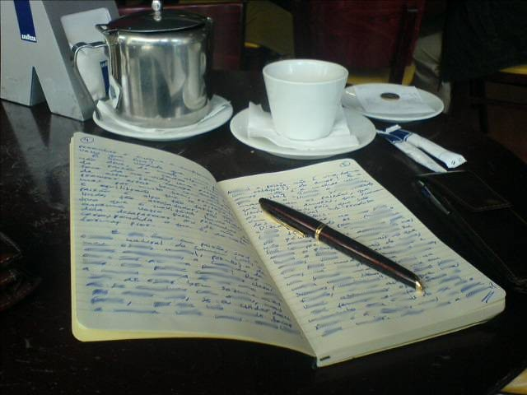
Review of last week’s journal assignment
Which circumstance or place has been most troublesome?
What can you do to help yourself better deal with that?
How have your relationships with people changed?
How are you feeling about these changes, and what can you do about them?
Notes:
~ 10 minutes
Invite participants to respond and offer encouragement for them to work at completing the weekly journal assignments.

Slide 3
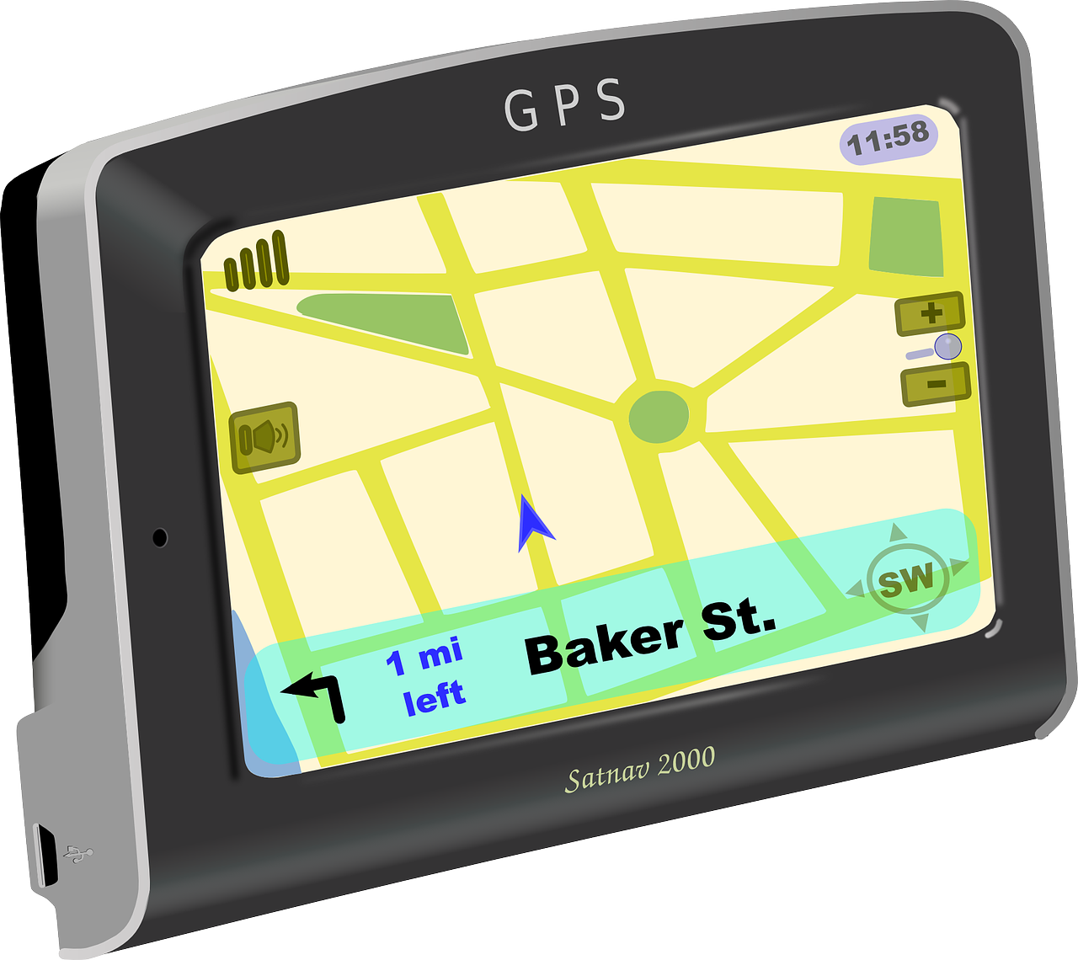
Where we are headed . . .
Regret and guilt,
Hurt and anger, and
Our response to these emotions
Notes:
~ 7 minutes
Ask participants if they have felt any of these emotions in their grief journey.
Here is some good news––all these emotions are normal!
There is nothing wrong with you––[or your faith]––if you feel regret, guilt, hurt, or anger.
However, these feelings can harm us and cause us to get stuck in our grief if we allow them to eat at us rather than to teach us and motivate us to change, or if we act out in unhealthy, harmful ways.
We will begin by looking at regret and guilt.
But let’s first take a quick five-minute break.

Slide 4

Take 5
Notes:
~ 5 minutes

Slide 5
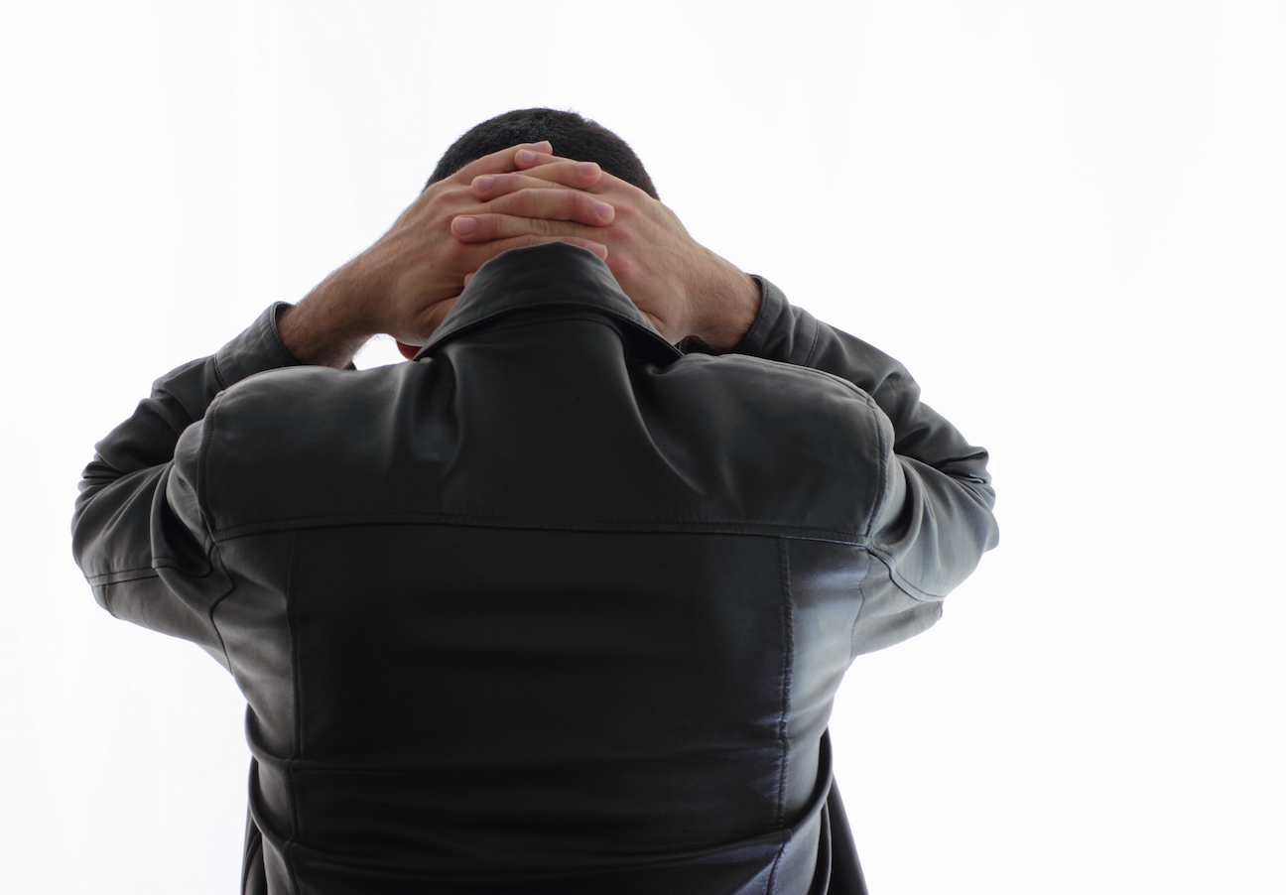
The feeling of not having said or done something.
Regret
The could haves, should haves, and would haves.
Notes:
~ 5 minutes
Regret
Regret is the feeling of having not said or done something you wish desperately now that you had.
What makes regret difficult is that there are no do-overs. We can’t rewind the tape.
Our regrets might sound like this:
I could have made the doctor’s appointment for them, or reminded them of it, or
I should have insisted that they go to the hospital sooner, or
I would have been with them if I’d known they were going to die that night.
And the list goes on.
However, even if we had done all the could haves, should haves, and would haves––that does not guarantee death would not have happened.
Sometimes our regret may lead to feelings of guilt.

Slide 6
The feeling of having said or done something wrong.
Guilt
Notes:
~ 5 minutes
Guilt
Guilt is the feeling of having said or done something wrong.
Survivor guilt – feeling that it should have been us that died. You may ask, Why them and not me?
Relief guilt – feeling relieved that our loved one died because of the pain and suffering they were experiencing yet sad that they are no longer here.
Joy guilt – feeling glad because they are now in a better place though we miss them terribly.
Imposed guilt – when someone else tells you that you are guilty—If you had gotten here earlier, we could have saved your loved one, or your baby.
Ordinary guilt – over something we said/didn’t say, or something we did/didn’t do.
Ask participants if they have experienced feelings of guilt related to their loved one’s death—and if so, how they would describe it.
How guilt affects us
Physically – It releases cortisol, the same stress hormone that increases blood pressure; it also can contribute to sickness/illness, lower our immune system and disrupt our sleep.
Emotionally – It causes depression and deprives us of joy.
Socially – It causes us to isolate, to withdraw from others and our usual activities.
Spiritually – It weighs us down, burdens us, prevents us from feeling God’s love/acceptance/forgiveness, and thwarts intimacy with God, causing us to stagnate in our spiritual journey.
Feelings of guilt and regret are normal and are indicators that we care about others and want to be a good person. But these emotions are meant “to be worked through not lived in day after day, forever.”⁵¹
So, what do we do with feelings of guilt?
⁵¹ Alan Wolfelt, The Guilt of Grief. (Fort Collins: Companion Press, 2022), 2.

Slide 7

Notes:
~ 10 minutes
What helps
First, it is important to distinguish between false guilt and true guilt.
False guilt is blaming ourselves for something over which we had no control, for which we are not responsible. Examples: I should have hugged or talked a little longer so that they would not have been at the intersection when the drunk driver ran the red light. If I’d gotten them to the doctor sooner, they wouldn’t have died.
True guilt is another matter. True guilt results from an action for which we are responsible. A drunk driver is truly guilty when they cause a vehicular accident or death.
Are you experiencing guilt over the death of your loved one? If so, is your guilt a false guilt (blaming yourself for something you had no control over, for which you are not responsible), or is it true guilt (you were responsible for your loved one’s death)? Allow participants to consider and respond to these questions.
What helps with false guilt
You cannot live in the “what if” world; you must live in the “what is world” and deal with the reality of what now is.
You need to realize that hindsight is 20-20 and accept that in the moment you did the best you could under the circumstances. You were not acting out a script; you were living real life.
Accept that you are human, and humans fail—that is the nature of being human.
Perhaps someone else is directly responsible for your loved one’s death. You cannot blame yourself for medical malpractice or a drunk driver.
Confront false guilt with truth, not feelings.
What helps with true guilt
If your guilt is real, then you need to take steps toward forgiveness so that you can move forward in your grief journey. We will circle back to this shortly.
If you continue to struggle with guilt, whether true or false guilt, it is wise to seek professional help—perhaps a minister or counsellor.

Slide 8

Hurt
A feeling of unhappiness or sadness caused by someone else’s words or actions.
Anger
An explosive emotion characterized by antagonism toward someone you feel has deliberately done you wrong.
Notes:
~ 4 minutes
You may have felt hurt or anger over your loved one’s death.
Perhaps you are disappointed with them or others –
over things said or done,
over things not said or not done.
Regret is a feeling of unhappiness or sadness caused by our own words or actions.
Hurt is a feeling of unhappiness or sadness caused by someone else’s words or actions.
Anger is an explosive emotion that we express toward someone we feel has done us wrong.
Remember, these are normal emotions, but they can get out of control or be harmful––to ourselves or others. Also, sustained or volatile anger stresses the body, can cause illness, hurts relationships, hurts ourselves and others physically and emotionally, and may have serious consequences.
To move forward, to find healing, we need to find a way to let go of hurt and anger.

Slide 9
Hurt
A feeling of unhappiness or sadness caused by someone else’s words or actions.
Anger
An explosive emotion characterized by antagonism toward someone you feel has deliberately done you wrong.
Notes:
~ 5 minutes
What helps
Take the high road
Most people just can’t understand or won’t ever understand what you are experiencing and feeling so they speak or act out of ignorance.
They may say and do insensitive things because they are uncomfortable with silence, and they desperately want to fix your pain and make it go away.
They may not think before they act or speak. Let’s face it, we don’t always know what to say or do either.
Some people who say you should be over it by now, feel bad that you are so sad and want you to feel better––and soon––for your sake but also because they miss the old you.
More often than not, these people mean well and have no intention to hurt; they may be totally unaware that they have said or done something hurtful.
By looking at these situations from the other person’s perspective, we lessen the intensity of our hurt and anger. This is easier when we recall something we said or did to someone else that now seems stupid or hurtful.
When you have truly been wronged or genuinely hurt
You may need to confront the other person.
If so, do it when you are calm and have processed your feelings.
Writing a letter to the person may help you sort out your thoughts and stay focused in the moment when confronting them.
It may be wise to have someone else with you.
Consider what is the right way, when, where, and how to broach the subject.
Always seek advice from someone else—a trusted friend, family member, or counsellor, minister or other spiritual advisor.
Holding on to anger/hurt prevent us from moving through our grief valley, causing us to get stuck.

Slide 10
Hurt
A feeling of unhappiness or sadness caused by someone else’s words or actions.
Anger
An explosive emotion characterized by antagonism toward someone you feel has deliberately done you wrong.
Notes:
~ 5 minutes
Controlled anger, suppressed anger, and uncontrolled anger
Controlled anger expresses how we feel in appropriate ways. This is evident when
We do not react in the heat of the moment but rather stay calm and take time to think before we speak or act.
We address the actions or words that hurt or anger us rather than attacking the person or their character.
We articulate our feelings without raising our voice or gesturing wildly.
Suppressed anger means that we are internalizing our anger and not allowing ourselves to express how we feel. If we suppress anger,
We may be defensive when someone says we are angry.
We may experience chronic headaches or muscle tension, overuse sarcasm or hold grudges.
This is by no means an exhaustive list, nor do these behaviors indicate that we are suppressing anger. These simply are some alerts that we may be suppressing anger. If not dealt with, suppressed anger can erupt as uncontrolled anger.
Uncontrolled anger expresses how we feel in inappropriate ways. It may be demonstrated by
verbal or physical abuse, or
violence.

Slide 11
Hurt
A feeling of unhappiness or sadness caused by someone else’s words or actions.
Anger
An explosive emotion characterized by antagonism toward someone you feel has deliberately done you wrong.
Notes:
~ 5 minutes
What helps
Alan Wolfelt suggests five steps we can use to control anger. (This is a great tool for children and grandchildren, too.)
Stop what you are doing.
Breathe deeply.
Close your eyes, feel your anger in your body, and notice your thoughts.
After a couple minutes, open your eyes; turn your attention from your anger to your surroundings; observe the sights, sounds, textures, and smells around you; keep breathing deeply.
Now that you are calmer, ask yourself: Why was I feeling angry? Is there anything I can learn from this encounter with anger?⁵²
Other suggestions that may help:
Talk to a friend, counsellor, minister.
Write about your feelings in your journal.
Write a letter to the subject of your anger, but don’t send it.
Exercise or walk in nature.
Engage in an activity that you enjoy. You might like to take a relaxing bath, have a facial, manicure/pedicure, wear a favorite piece of clothing. Others might enjoy listening to soothing music, drinking a special tea, go fishing, golfing, biking, hiking, or sitting a river, pond, or lake, or bird watching. Other calming activities might include painting, drawing, or coloring.
Ask if there are any questions/comments on the material discussed thus far?
⁵² Alan Wolfelt, The Anger of Grief. (Fort Collins: Companion Press, 2022), 34-35.

Slide 12

Notes:
~ 5 minutes
Before we proceed to the final segment of tonight’s session, let’s take another quick break to top up our coffee/tea and move a bit.
Play Madagascar video: “I like to move it, move it.”
https://www.youtube.com/watch?v=hdcTmpvDO0I

Slide 13

The following material is from a variety of sources, including:
“Greater Good Magazine,” Berkeley Education website,
Insight for Living website,
Randy Kamen—psychologist, educator and author,
David Sherbino, a leading Canadian thanatologist,
Richard Foster, a theologian and author, and
David Benner, a Canadian depth psychologist, author, teacher.
Notes:
~ 1 minute
The following information is from a variety of sources, including:
“Greater Good Magazine” cited on the Berkeley Education website
Insight for Living website
Randy Kamen—psychologist, educator and author
David Sherbino, a leading Canadian expert in death, dying and grief
Richard Foster, a theologian and author
David Benner, a Canadian depth psychologist, author and teacher.⁵³
⁵³ Depth psychology is the study of how the unconscious aspects of human experience influence psychological conditions and treatment.

Slide 14
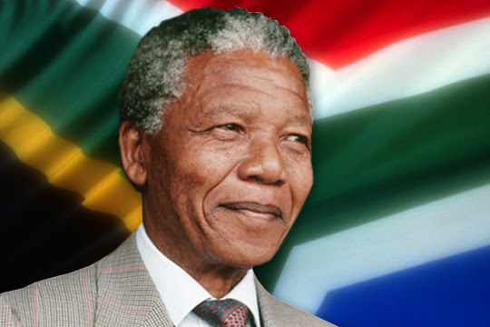
How do we respond to
regret and guilt,
hurt and anger?
Notes:
~ 3 minutes
Show left side of slide only
Regrets . . . guilt . . . hurt . . . anger––who of us hasn’t dealt with these emotions at some point in our grief journey––as well as in life in general!
Show right side of slide
Nelson Mandela, who was imprisoned in South Africa for 27 years, said this at the time of his release:
As I walked out the door toward the gate that would lead to my freedom, I knew if I didn’t leave my bitterness and hatred behind, I’d still be in prison.⁵⁴
Until his death 23 years later, Mandela chose to live in peace and hope. What a formidable testament to the power of forgiveness—a man who continued to live with the physical, mental, and emotional scars of imprisonment for the rest of his life.
Desmond Tutu, Archbishop of South Africa, said this in reference to the truth and reconciliation efforts following apartheid: Without forgiveness, there is no future.⁵⁵
⁵⁴ Nelson Mandela, Long Walk to Freedom. (New York: Little Brown and Company, 1994).
⁵⁵ Desmond Mpilo Tutu, No Future without Forgiveness. (New York: Doubleday, 1999).

Slide 15

Notes:
~ 5 minutes
Forgiveness
Mandela and Tutu knew that the key to moving forward was forgiveness.
You might think that forgiveness is just something the Bible tells us to do. You may be familiar with The Lord’s Prayer and the verses that say if we forgive others, God will also forgive us. However, forgiveness is not only a biblical principle. It is an established counselling principle that recognizes forgiveness is necessary for healing.
But what does it mean to forgive?
Invite participants time to respond to this question.

Slide 16
What forgiveness is not . . .
never feeling the hurt or pain of the wrong-doing or injustice again.
forgetting what happened, smoothing things over, or pretending the offence doesn’t matter.
excusing the person or letting them off the hook of accountability.
Notes:
~ 2 minutes
What forgiveness is not
Read slide.

Slide 17
What forgiveness is not . . .
Though forgiveness can help repair a damaged relationship, it is not an obligation to reconcile with the person who has harmed you or your loved one.
It is not thinking that things will be the same as the way they were before; we know they never can be or will be the same.
Notes:
~ 3 minutes
What forgiveness is not, cont’d
Ask if there are any questions/comments before going to next slide.

Slide 18
What forgiveness is . . .
It is a conscious, deliberate decision
to release feelings of resentment or vengeance
toward someone you feel has harmed you or your loved one.
It is an action, not a feeling.⁵⁴
Notes:
~ 2 minutes
What forgiveness is
Read slide.⁵⁶
To forgive may not give us warm, fuzzy feelings about the other person but it lets go of our deeply held negative feelings about them.
In this way, forgiveness empowers us to recognize the pain we suffered without letting the pain define us––thus enabling us to heal and move forward.
⁵⁶ John W. James and Russell Friedman, The Grief Recovery Handbook. (New York: Harper Collins Publishers, 2009), 139.

Slide 19
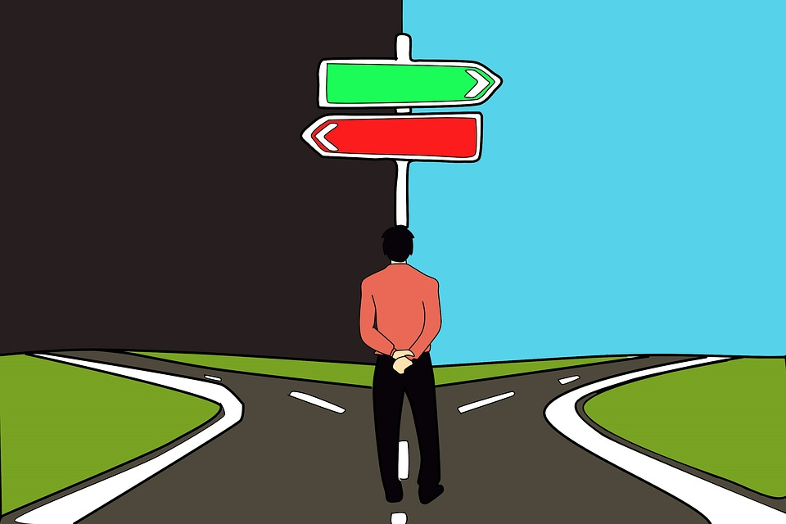
What are the benefits of forgiving? What are the effects of not forgiving?
Notes:
~ 3 minutes
Allow time for participants to answer this question.
Some positives
Physical – releases stress, decreases pain, reduces anxiety, lowers blood pressure and heart rate, improves sleep quality, reduces fatigue.
Mental – clears our mind of unhealthy thoughts, gives peace of mind, and increases concentration and focus.
Emotional – yields freedom from corrosive anger, improves our mood.
Relational – we are much more pleasant to be around––none of us find it pleasant being around angry people—whether they are family, friends or strangers..
Spiritual – doesn’t interfere with how we view our relationship with God.
Some negatives
Physical – feel stressed, experience a plethora of aches and pains, risk the side effects of increased blood pressure and heart rate, have difficulty sleeping, and may be more tired.
Mentally – our mind continually rehashes our regret, guilt, hurt, and anger, like the proverbial hamster on a wheel—constantly running but getting nowhere.
Emotionally – negative emotions keep us from fully enjoying happy moments. Or we may experience mood swings—one moment we feel good, the next we are mad at the world.
Relationally – people don’t like to be around us when we are feeling angry—and we may find we don’t like being around ourselves either.
Spiritually – we may feel alienated from God—afraid to go to him with a request or need because we are angry with him or with someone else.

Slide 20
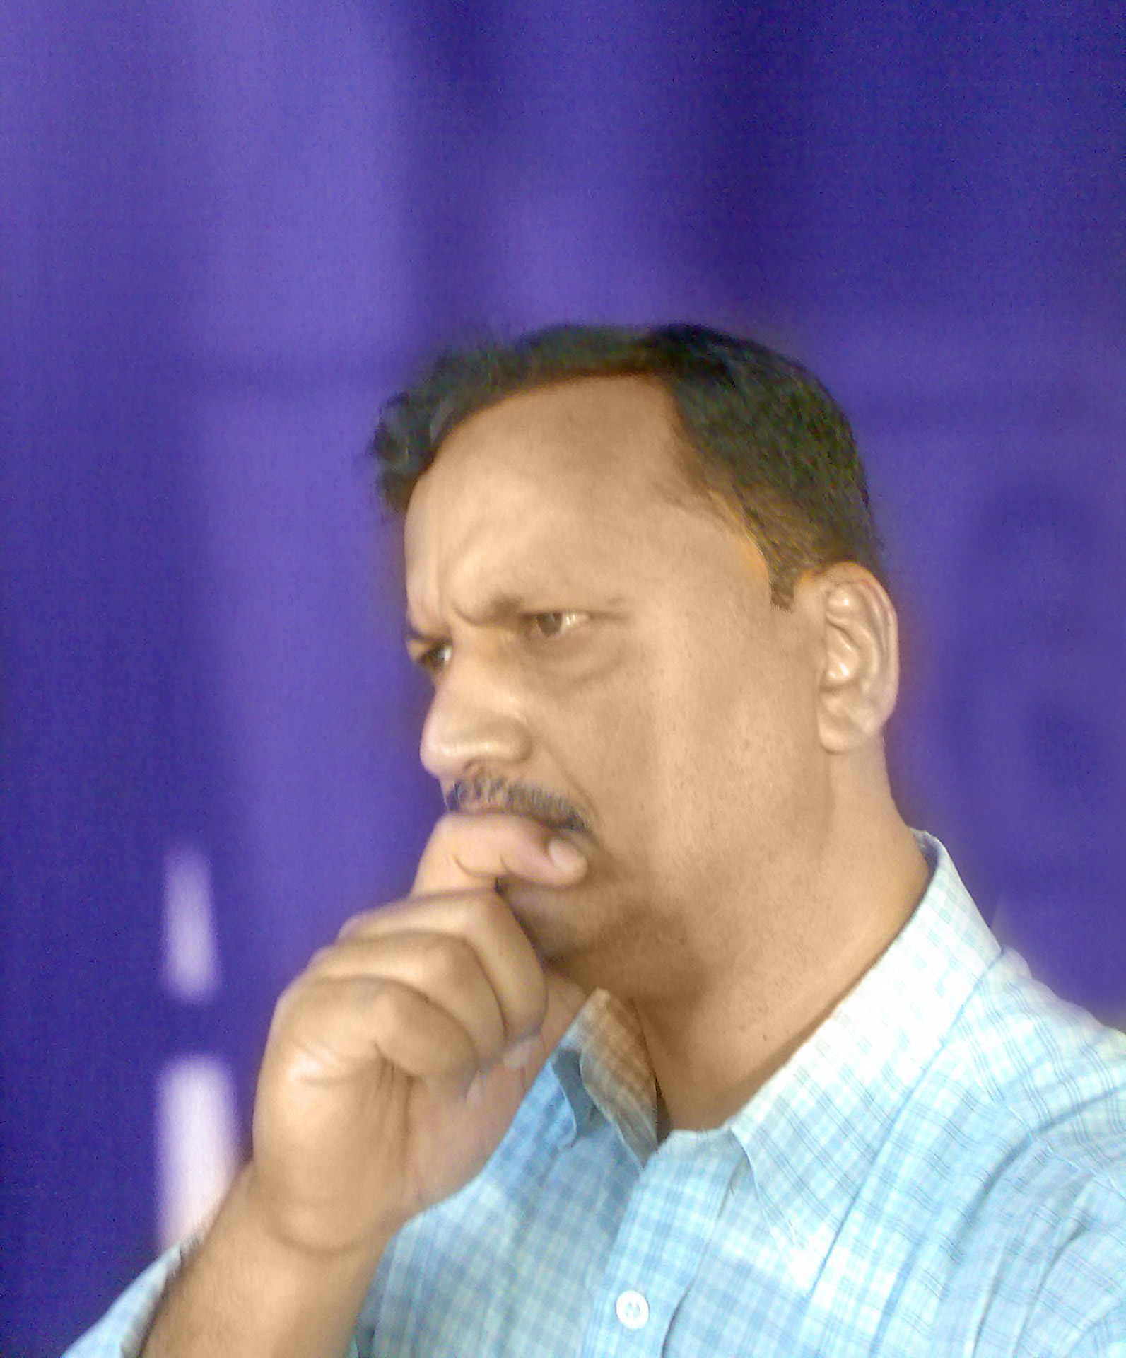
How to forgive . . .
Acknowledge your regret, guilt, anger or hurt and what it is doing to you physically, mentally, emotionally, relationally, spiritually.
Acknowledge the need to forgive.
Make a conscious decision to forgive.
Notes:
~ 2 minutes
How to forgive
Forgiveness is rarely done at the snap of a finger.
When we make a conscious decision to forgive, we must work at it––it is a process. And God offers to help in that process––to help us forgive ourselves and others––just as he offers forgiveness to us.

Slide 21

Recognize that forgiveness is a process––it takes repeated effort and time.
When the emotions of regret, guilt, hurt and anger resurface and you struggle with unforgiveness, remind yourself that you have chosen to forgive.
Notes:
~ 2 minutes
Jerry Sittser, who we have mentioned before, dealt with the challenge of forgiveness after his family was killed by a drunk driver. He learned this, “Though forgiveness may not have an ending, it has a beginning.”⁵⁷
⁵⁷ Jerry Sittser, A Grace Disguised—How the Soul Grows through Loss, expanded edition. (Grand Rapids: Zondervan, 2004), 145.

Slide 22
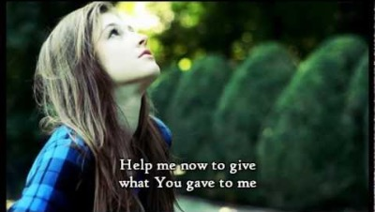
Notes:
~ 4 minutes
Play video: “Forgiveness”⁵⁸ by Matthew West.
⁵⁸ https://www.youtube.com/watch?v=h1Lu5udXEZI .

Slide 23
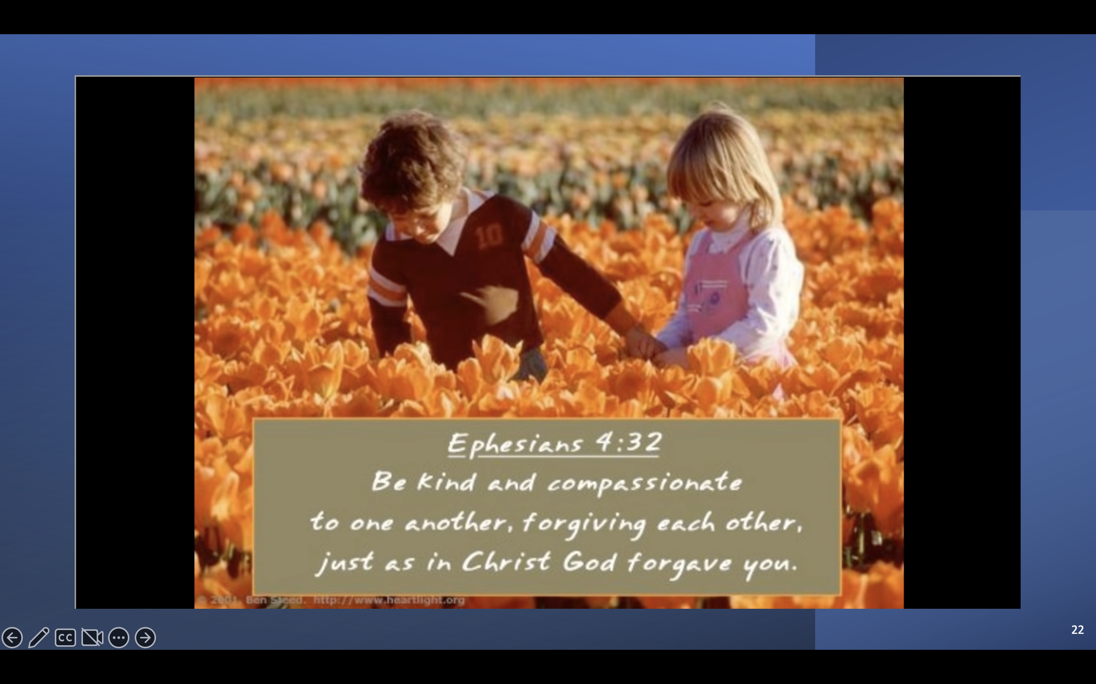

Slide 24


Notes:
~ 4 minutes
What stands out for you from tonight’s presentation?
What questions does tonight’s session raise for you?

Slide 25
Journal assignment
If you are experiencing guilt
Write how that guilt feels physically, emotionally, relationally, spiritually.
Is this false guilt or true guilt?
What do you need to do with this guilt in order to move forward and heal?
Notes:
~ 2 minutes

Slide 26
Journal assignment
If you need to forgive
Identify who you need to forgive.
Write about your feelings toward that person.
Write why you are choosing to forgive.
Write what steps you will take to forgive.
If you are unable to forgive that person, write why you can’t forgive, then write a prayer asking God to help you begin to understand the why and how of forgiveness.
Notes:
~ 2 minutes

Slide 27
Next week
What are the tasks of grieving? (part one)
Accepting, processing, and
adjusting to the death
Notes:
~ 2 minutes
Pray.
A final reminder . . . (next slide).

Slide 28
Guilt, regret, anger and hurt
are meant to be worked through
not lived in day after day, forever.³⁹
Notes:
1 minute
Read slide.⁵⁹
⁵⁹Alan Wolfelt, The Guilt of Grief. (Fort Collins: Companion Press, 2022), 2.

