Slide 1

Welcome to Grief Care
Week #7
What are the tasks of grief?
(part one)
Accepting, processing, and adjusting
Notes:
Pre-meeting
Have this slide on screen before participants arrive.
Play background music until meeting starts.

Slide 2

Notes:
~ 15 minutes
Begin meeting
Welcome participants and invite them to “ketchup” on their week.
Invite one person to share a picture and memento or special memory.
Afterwards, remind participants that each week one (or two, depending on group size) of them will be invited to share about their loved one, as they are comfortable.
Pray.

Slide 3
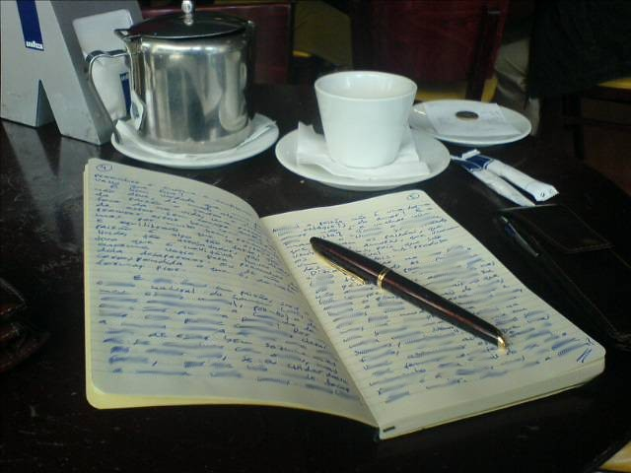
Review of last week’s journal assignment
If you are experiencing guilt
Write how your guilt feels physically, emotionally, relationally, spiritually.
Is this false guilt or true guilt?
What do you need to do with this guilt to move forward and to heal?
Notes:
~ 15 minutes, including next slide
Invite participants to share if they are comfortable.

Slide 4
Review of last week’s journal assignment
If you need to forgive someone:
Identify who you need to forgive.
Write about your feelings toward that person.
Write why you are choosing to forgive.
Write what steps you will take to forgive.
If you are unable to forgive that person, write why you can’t forgive them. Ask God to help you to begin to forgive.
Notes:
~ 15 minutes, including previous slide
Invite participants to share if they are comfortable.

Slide 5

The Tasks of Grief (aka Grief Work)
Where we’re headed ––
Notes:
~ 3 minutes
Over the years, counsellors, psychologists, and grief specialists have developed numerous theories to describe the phases or stages of grief. But many therapists, including Elizabeth Kübler-Ross⁶⁰ who wrote in the mid 1960s, focused on feelings—feelings of denial, anger, bargaining, depression, and acceptance. Moving forward, however, involves more than learning to manage our feelings. Therapists now focus on specific tasks necessary for healing.
⁶⁰ Elizabeth Kübler-Ross, On Death and Dying. (New York: Scribner, 1969).

Slide 6

The primary tasks of grief:
accepting the reality of the death,
processing the pain of our loss,
adjusting to a world without them,
continuing our bonds with them, and
finding new/renewed meaning in life.
Notes:
~ 7 minutes
These tasks are generally categorized as:
accepting the reality of the death,
processing the pain of our loss,
adjusting to a world without the person that died,
continuing our bond with them, and
finding new or renewed meaning in life.⁶¹
Worden notes that though our griefs are unique, “we all have to deal with a common set of issues or tasks.”⁶²
It is important to note that we don’t complete one task before moving to the next. These tasks are not linear; that is, they don’t follow an orderly sequence. They overlap and are intertwined.
And when we think we have finished a particular task, we may find ourselves going back and working at it again. By way of example, you may be beginning now to adjust to a world without our loved one yet have flashbacks of disbelief and shock while also beginning to re-engage in life around you. This is normal.
Life is about learning—learning to walk, talk, read, write, drive, cook, and a myriad of other tasks. We learn these skills with the help of others. And so it is with grief, we need others to help us directly or indirectly work at each task.
Hopefully today you will gain some tips and share insights you have learned for these tasks, as we look at the first three:
Accepting the reality of the death,
Processing the pain of our loss, and
Adjusting to a world without the person that died.
⁶¹ Kenneth J. Doka, Grief Is A Journey. (New York: Simon & Schuster, 2016).
⁶² J. William Worden, Grief Counselling and Grief Therapy. (London: Routledge, 2009), 65.

Slide 7

Take 5
Notes:
~ 5 minutes
But before we look at these tasks, let’s take a 5-minute break for tea/coffee.

Slide 8

Accepting the reality of the death
Task #1
Notes:
~ 7 minutes
Accepting the reality of the death
“In the beginning, grief seems unreal––a nightmare from which you hope to awaken.”⁶³ Unconsciously, you expect the person who died to walk through the door or to be on the other end of the phone when it rings.
There is a huge disconnect between our head (what we think) and our heart (what we feel). It takes time for our heart to catch up to and accept what our head knows.
It takes time for shock to wear off and to realize that our loved one isn’t coming back.
To move forward, “a crucial primary task is accepting your loss––moving past the initial sense of denial and disbelief.”⁶⁴
When we talk about accepting the loss, we are not saying we are okay with it—we are simply acknowledging that it has happened, that it’s real, and that the person who died is not coming back.
What helps
Engage in rituals; funerals and celebrations of life are stark reminders that the person has died.
Allow yourself to grieve and to ponder how your present and future are changed forever.
Talk about the person who died by name; acknowledge the ups and downs of the relationship.
Look at photographs, videos, or listen to recordings of your loved one’s voice. Many people find comfort in making memory albums and including captions or stories.
Continue to acknowledge or celebrate birthdays, anniversaries, and other occasions.
Visit places you enjoyed together.
Invite participants to share what has helped them to accept the death of their family member or friend.
⁶³
⁶⁴

Slide 9

Processing the pain of our loss
Task #2
Notes:
~ 4 minutes
Processing the pain of loss
To process our pain, we must lean into our grief.
We can’t shove it down—it will resurface.
We can’t run away from it—it will catch up with us.
We can’t numb it; alcohol and drugs may mask it for a few hours, but they don’t solve the problem or kill the pain—they just cause more problems and more pain in addition to what we are already experiencing.
We can’t make the pain go away with over-activity—it will be waiting for us when we run out of steam.
We can’t shop till we drop with hopes of distracting ourselves—as we were reminded earlier, the credit card will come due.
Nor can we sleep it off—when we wake, it will be waiting for us. (That is not to say we shouldn’t get extra rest in grief; a well-rested body is much more able to deal with grief.)
We talked in week two about the journey of grief being through the valley of the shadow of death.
We can’t dig under it, go around it, fly over it, or sprint through it.
We must walk through it to move forward.
In leaning into our grief, we allow ourselves to feel the pain and in feeling, we are forced to acknowledge our loss. A popular phrase says that we must feel it to heal it.
As in all of life, pain and joy co-exist. It takes both rain and sunshine to produce a rainbow.⁶⁵
⁶⁵ Denise Levertov, “Talking to Grief” in Poems 1972-1982. (New Directions, 2001).

Slide 10

What to do with “stuff”?
Notes:
~ 10 minutes
One of the activities that helps us accept the reality of the person’s death and process the pain of our loss is to deal with their belongings.
Invite participants to share how they are dealing with their loved one’s things.
What have they done, what do they still need to do? How have they felt doing this?
What helps
Though going through the deceased person’s things can be painful, it is an opportunity to recall memories––a special moment, a funny story, or even a painful incident that needs to be dealt with.
Don’t allow others to dictate to you when you must go through your loved one’s belongings; you will know when you are ready to do it.
Don’t allow others to dictate what you do with your loved one’s things.
Don’t try to do it all at once––pace yourself.
Consider if you want to do it alone or if there are some things you would like help with.
Whether you tackle the task alone or with the help of others, start with
a pile of what to keep,
a pile to decide about later,
a pile to give away (i.e., to other family members, friends, charitable groups),
a pile to recycle, and
a pile to trash.
At first, you may keep a lot, but as time goes by you will be able to discard more. Some people do an annual purging when a special date is nearing, such as an anniversary of the death, a birthday, or a holiday.
Following are some general suggestions:
Clothing, books, magazines, artwork, toys, and games can be sorted this way.
Vehicles – Continue to use or sell, donate to a charitable organization, transfer to a friend or family member.
Sports equipment/tools – Keep what you can use, offer the rest to family, friends, neighbours, charitable groups (i.e. Teen Challenge; Salvation Army, etc.).
Papers – Keep legal documents (mortgages, wills, birth, death and marriage certificates etc.); tax returns and financial records for seven years. You may wish to put poetry, letters, cards, etc. in a keepsake box.
For items being kept, label the containers with a general list of contents.

Slide 11

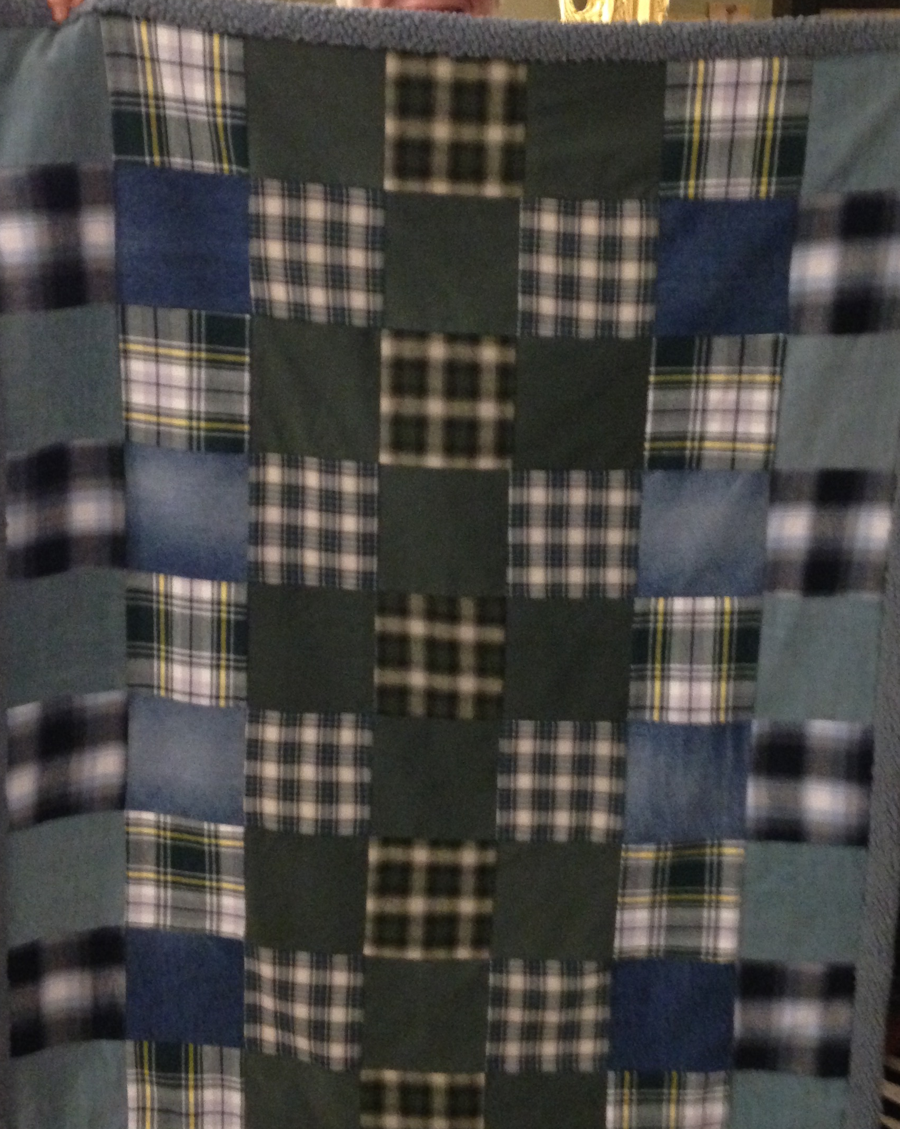
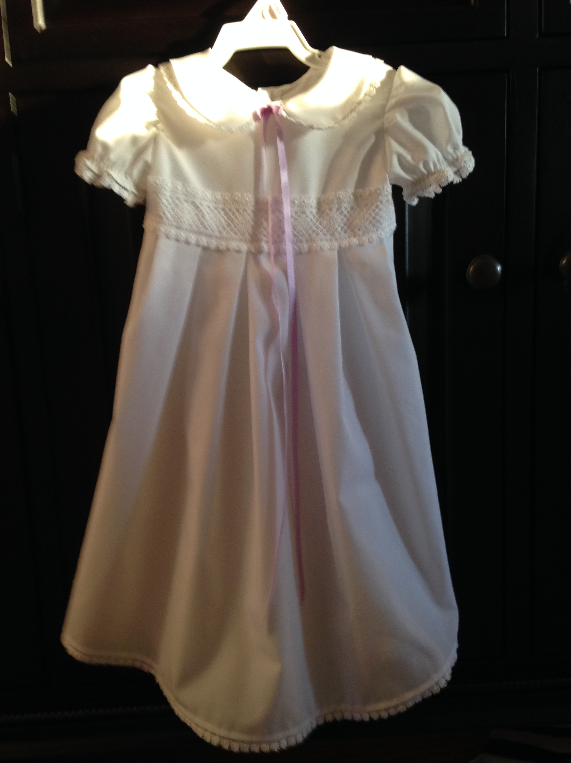
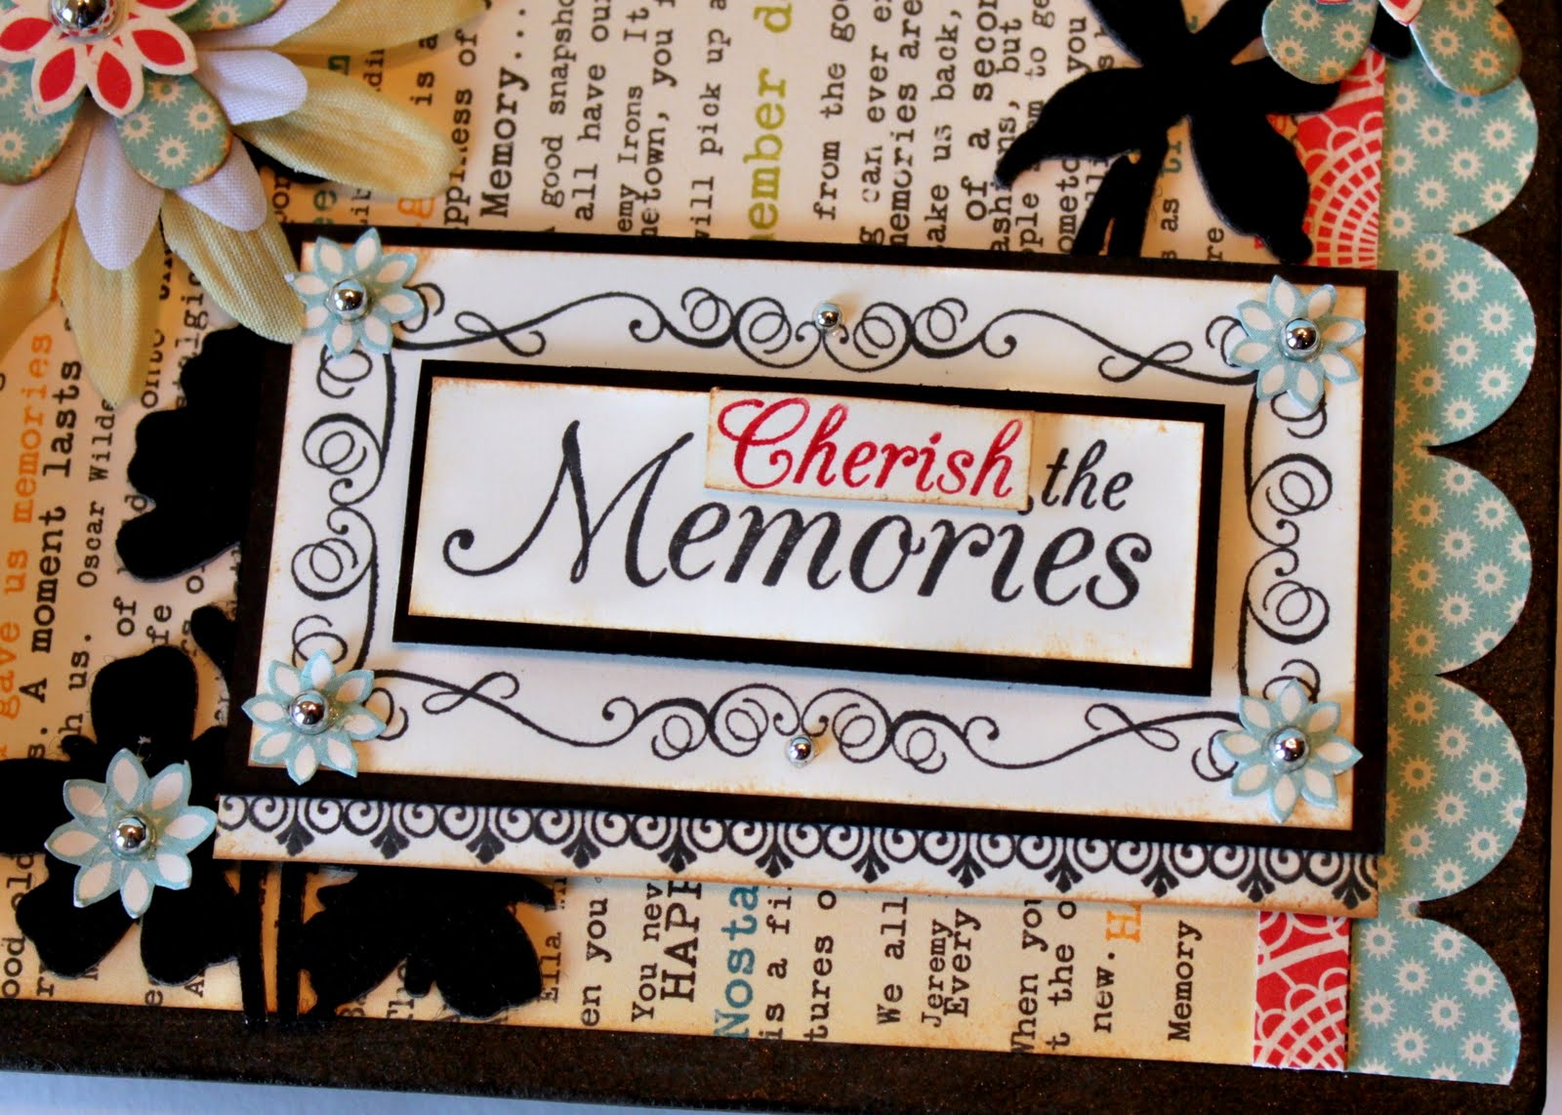
Notes:
~ 3 minutes
Clothing can be repurposed as memory quilts, pillows, Christmas tree ornaments, christening gowns, teddy bears, doll clothes, etc. You may find comfort in wearing some pieces, as may other family members or friends. Jewelry can be restyled or treasured as heirlooms, gifted, or shared.
If family members will be tackling this task together, it is wise to set the ground rules before starting. Some helpful tips:
Make a list of contents or categories.
Allow each person to choose in rotation what they want (you may have to draw straws to see who goes first).
Keep going around until nothing is left that anyone wants.
Then decide what to keep, what to give away to friends/family, charitable groups, what to sell, recycle, or trash.
At this point, family members may offer to swap with another person if they didn’t get something of particular interest.

Slide 12
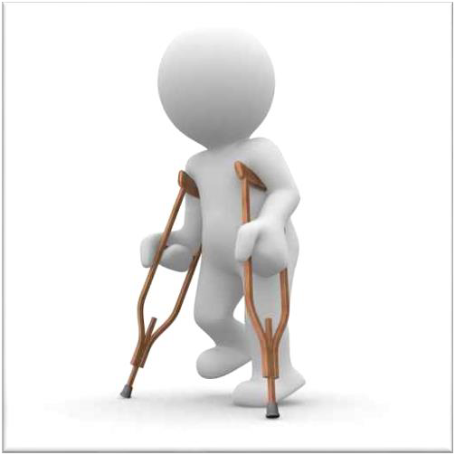
Adjusting to a world without them
Task #3
Notes:
~ 5 minutes
Adjusting to the world without the person who died
Some losses profoundly change the activities or patterns of our lives and bring with them a myriad of secondary losses. Widows and widowers “take on new roles, learn new skills, how to cook, maintain a car, or balance a cheque book. Your ways of life, your choices, even your relationships change after a loss.”⁶⁶ You wonder with whom you can share your deepest thoughts, your day-to-day lives, your concerns, who you can lean on, who will find you if you have an accident in the home, who will help you if you’re sick or just having a lousy day.
You may lose the network of friends of your child/grandchild, your spouse, your parent, your sibling, your in-laws. You need to figure out how to navigate this changed landscape.
What helps
Resist becoming helpless, bitter, or withdrawn.
Identify your needs and assess what you can do, what new skills you need to acquire, and find people who can help with the tasks you cannot do.
Ask for referrals from friends. Seek the advice of experts before making major decisions (i.e., financial, real estate, legal). Be intentional in seeking God’s wisdom and counsel.
Be careful with making too many changes too fast, which may result in increased stress or regrets later. Pace change; sometimes make a decision, then sit with it for a while before implementing it (i.e., if selling a house, you may come to the decision to do so, but you may need to process that as another loss, what you will miss, what you won’t miss, what a new location will mean––the pluses and the minuses).
If older and living alone, consider implementing safeguards (i.e., alerts, wellness calls, remove hazards such as throw rugs, keep stairs clear, install grab bars in bathrooms, etc.) Be diligent in self-care.
⁶⁶

Slide 13

Notes:
~ 5 minutes
Who am I?
For many of us, our identity is wrapped up in what we do. Over the span of our lifetime, we are issued a variety of identity documents—from birth certificates, driver’s licenses, social insurance and health cards, marriage certificates, perhaps divorce papers, passports or landed immigrant cards, etc.—and at the end, death certificates.
Adjusting to a world without the person who died is particularly difficult for caregivers of children, grandchildren, and adults. You may wonder what your role is now. Widows and widowers struggle too with who they are after their spouse dies.
Unfortunately, the stereotypical image of widows and widowers is that they live in the past, are perpetually sad, seldom have fun, are overly emotional, totally helpless, and are uncomfortable to be around. They are seen most often for who they were and who they lost, and that is normal in the immediate period after the death, but it is problematic when if it becomes an ongoing image or mindset.
Only you can change how you and others see you. Discovering who you are now and what you want to be and do in this new phase of your life requires courage and hard work. Just as the passing of one year to the next causes us to stop and reflect on past accomplishments and failures and to set new goals for the year ahead, so too does death. It is an opportunity to re-examine where you have been and what you want to be and do moving forward. It is for you to decide if you will be happy or sour, content or bitter, a weed or a flower.

Slide 14
Notes:
~ 5 minutes
What helps
Work at accepting the death and process the pain of your loss.
Reflect on life experiences and lessons learned (good and bad).
Examine your beliefs and values.
Consider the question that little kids have been asked for decades, What do you want to be when you grow up? Ask yourself, What do I want to be in this new phase of my life?
Dare to dream.
Seek counsel from others and from God.
Identify steps to achieving your new goals.
Be flexible, go easy on yourself, and resist self-pity.
Gather strength and courage from others.

Slide 15
Enriching who you are
It is not forgetting, but rather bringing your past into the future.
It is finding meaning and purpose and hope to go on.
It is a refocus.
Notes:
~ 3 minutes
Enriching who you are
Enriching who you are does not mean you deny who you were or that you leave the memories of your spouse or partner behind. It is an enrichment of who you were and who you can become. It is a refocus.
And, just as it took time to grow in your relationship with your loved one, it will take time to grow into your future.
Ask participants if they have questions or comments before moving on.

Slide 16
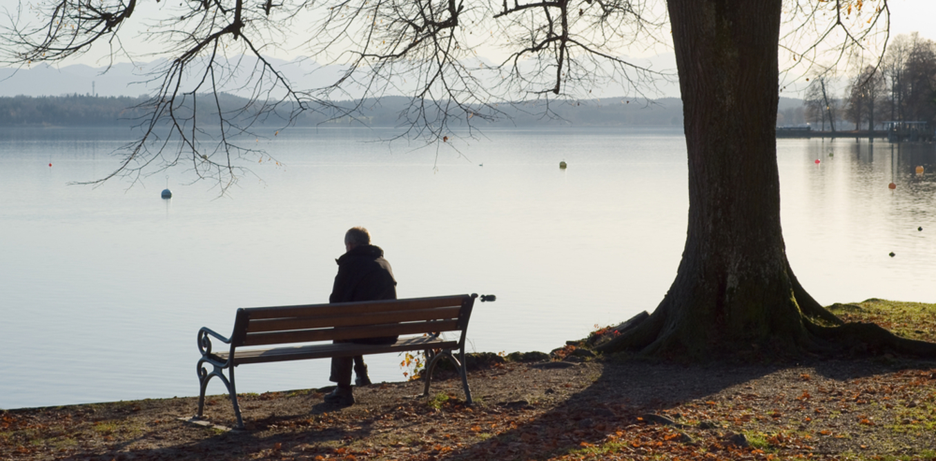
Being alone vs being lonely
Notes:
~ 7 minutes
SHOW PICTURE only
For some, the greatest adjustment is being alone or being lonely which occur when the person who died was your primary attachment, the person with whom you were closest. While this is particularly true for widows and widowers, it also applies to non-marital relationships in which each person was the primary physical, emotional, mental support for the other. The surviving person is left with profound feelings of being alone or lonely. Some express it as abandonment.
SHOW caption
Though similar terms, being alone and lonely are dissimilar in meaning. What do you think is the difference? Give participants time to respond to this question.
Being “alone” is a physical state; you are physically by yourself—no one else is around.
Being “lonely” is an emotional state; you feel disconnected from others – even when they’re right next to you. You can be lonely in a room full of people.
Being alone at times can be a good thing. We all need some solitude to reflect, to rest, to recharge––to be still, to process thoughts, feelings and matters of the soul.
Let’s talk briefly about being lonely or the feeling of loneliness.
“Loneliness hurts. It may feel like a twinge, a yearning, or an emptiness. It might be more pronounced at certain times than others, or it may be a constant dull ache.”⁶⁷
We were made for relationship—with others, with God—as the song goes, we all need somebody to lean on. For some of us, however, we need to learn to lean on others—inviting or allowing another person to come alongside.
An irony of the twenty-first century is that with the increased ability to connect through technology, we have experienced increased loneliness.
During the pandemic, Britain added a Minister for Loneliness to its federal government. Japan made a similar appointment in 2018. Many countries, including Canada, are striving to address the physical, mental, economic and social challenges that accompany loneliness.
⁶⁷ Alan Wolfelt, If You’re Lonely—Finding Your Way. (Fort Collins: Companion Press, 2020), 1.

Slide 17
Being alone vs being lonely
Notes:
~ 5 minutes
Why are so many people lonely?
Few of us live in multi-generational homes, where someone is usually home. Technology has replaced face-to-face get-togethers. (This is a serious issue with gaming and social media across all generations.) In the workplace and classrooms, computer screens are the norm. COVID compounded the issue even further. The western attitude of individualism—self-reliance, independence, and stoicism—is admired. Wolfelt says that if you keep your emotions to yourself and believe it’s wrong to rely on others, loneliness is a natural by-product. We may physically be alone, but that does not mean we need to be lonely.
Invite participants to share their experiences with being alone or lonely.

Slide 18
Being alone vs being lonely
Notes:
~ 5 minutes
What helps
Cuddle a pet, walk or ride through a park or forest.
Be creative—paint, sew, journal.
Play music, sing or “direct” an imaginary choir or orchestra, dance.
Pursue new or dormant interests. Join a life group/special interest group such as a book club or hobby group.
Reach out to others; don’t wait for others to reach out to you. Call or visit a friend. Invite someone to your home or to meet for coffee or a meal or to shop together or cook together. Invite someone to a movie or watch a TV series together. Accept invitations from others.
Find new purpose and meaning in life (more on this in an upcoming session).
Work at liking yourself—that may mean you need to work at self-awareness, self-esteem, self-advocacy, and self-care [that’s quite a list!]. Take care of yourself—physically, emotionally, mentally, socially and spiritually—do things for yourself that you enjoy and that help you.
Be generous. Practice random acts of kindness. Make time for others, care about them, their needs, their interests. Find others with common interests, life challenges/needs-–so you can encourage each other and problem-solve together.
To have a friend, we must be a friend.
Be willing to be vulnerable; not every effort on our part will be received or received well, but we need to keep trying until we are able to make satisfying connections.
Invite God into your loneliness. When I feel lonely, I begin to praise God by actively singing, dancing or even “directing” a choir. (Research indicates that active participation with the music is has more benefits than passive listening.⁶⁸) I sense God’s presence when I praise (Ps. 22:3) and no longer feel as lonely. This has become a way of life, and it has been a wonderful anecdote for loneliness.
Loneliness won’t go away on its own—we must actively work at it. When it hits, acknowledge it and then rather than sitting and wallowing in it, get up and do something to help dissipate it.
⁶⁸ Aimee Patterson, Suffering Well and Suffering With, Reclaiming Marks of Christian Identity. (Eugene: Cascade Books, 2023), 92-93.

Slide 19


Notes:
~ 3 minutes
What stands out for you from this presentation?
What questions does this session raise for you?
It is important that you “approach these tasks in your own unique way and work through them in your own time,”⁶⁹ but work at them you must in order to move forward.
⁶⁹ J. William Worden, Grief Counselling and Grief Therapy. (London: Routledge, 2009), 65.

Slide 20
Journal assignment
Identify a task that you need to work at now.
List the steps needed to complete this task.
3. What did you do this week to work at the task?
Notes:
~ 2 minutes

Slide 21
Next week
The Tasks of Grieving (part two)
Continuing bonds
Notes:
~ 2 minutes
Next week
Continuing bonds with our loved one.
Pray.

Slide 22
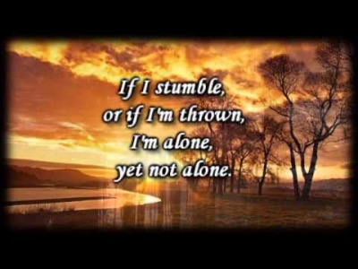
Notes:
~ 5 minutes
This song, I’m Alone Yet Not Alone, is sung by Joni Earackson Tada. Joni suffered a broken neck in a diving accident when just a teenager that left her paralyzed from the neck down.
In her memoirs, Joni talks about the fears she experiences when alone—what happens if she chokes, and no one sees or hears? What happens if she is unable to call for help, even to the next room? What if something happens to her husband, and she is unable to call for help? In this song, she shares what she reminds herself of when fears re-surface.
For facilitators
Another song that could be used would be Fernando Ortega’s Jesus, King of Angels,
https://www.youtube.com/watch?v=6wOhVh2bct8 (see next slide)

Slide 23

Notes:
Fernando Ortega’s Jesus, King of Angels https://www.youtube.com/watch?v=6wOhVh2bct8

Slide 24
Notes:
This page is intentionally blank.

