Slide 1

Welcome to Grief Care
Week #9
What happens when we die?
Is there life after death?
Notes:
Pre-meeting
Have this slide on screen before participants arrive.
Play background music until meeting starts.

Slide 2

Notes:
~ 15 minutes
Begin meeting
Welcome participants and invite them to “ketchup” on their week.
Invite one person to share a picture, memento, or special memory.
Pray.

Slide 3

Review of last week’s journal assignment
1. What memories do I need to shed in order to move toward healing?
2. How can I continue the bonds with my loved one in a healthy manner?
3. How can I honor their life, provide a lasting legacy?
Notes:
~ 15 minutes
Last week, we looked at continuing our bonds with the person who died.
Invite participants to share what they wrote.

Slide 4

Take 5
Notes:
~ 5 minutes
Before we delve into today’s topic, let’s take a 5-minute break.

Slide 5

What happens when we die?
Is there life after death?
Notes:
~ 5 minutes, including the next page
Where we’re headed
Today, we will look at what happens when we die and if there is life after death.
In grief, we become keenly aware of song lyrics that reference death and an afterlife.
Popular songs include [bracketed info is for facilitators and does not need to be read]:
This House is Not Haunted by The Men That Will Not Be Blamed For Nothing’s [denies an afterlife].
What’s It All About, Alfie? sung by Barbra Streisand [asks what are the meaning and purpose of life].
Knockin’ On Heaven’s Door by Bob Dylan [references the final moments of life].
Everyone Wants To Go to Heaven by Kenny Chesney [about the universal desire for a perfect afterlife but expresses the fear of dying and leaving the life we know].
Tears In Heaven by Eric Clapton [written after the tragic death of his 4-year-old son; it asks if they will recognize each other in heaven and expresses the father’s question of how he can go on living until then].
If Heaven Wasn’t So Far Away by Justin Moore [expresses the wish to visit loved ones in heaven and to introduce to them those born after their deaths].
Dancing in the Sky by Dani and Lizzy [expresses the wish to know that a departed loved one is enjoying a pain-free, happy afterlife].
Heaven by Beyoncé [reflects that a well-lived life helps bring closure to mourners].
Heaven Is Closed by Willie Nelson [expresses his feeling that the door to heaven is shut for him].
When I Get Where I Am Going by Brad Paisley and sung with Dolly Parton. When I first heard it, it brought a flood a tears. My oldest grandson and my husband shared a very close bond. Zachary was ten when his poppa died, and from time-to-time he would tell me how much he missed his poppa. After Zachary died, we found this song on his playlist. Verse three is about one of the things the lyricist imagines doing when they get to heaven: “I’m gonna walk with my grandaddy, And he’ll match me step for step, And I’ll tell him how I’ve missed him, Every minute since he left, And then I'll hug his neck.” Now with a smile, I often picture them walking together in heaven.

Slide 6
What happens when we die?
Is there life after death?
Notes:
~ 5 minutes, including the previous page
Many Christian hymns and choruses reference heaven, reflecting on the Bible’s teachings about heaven and expressing believers’ assurance of going there when they die. Some of these hymns include:
Blessed Assurance written by Fanny Crosby,
Rock of Ages by Augustus Toplady,
Be Still, My Soul by Kathrina von Schlegel,
Nearer, My God, to Thee by Sarah Fuller Flower Adams,
I’ll Fly Away by Albert Brumley,
The Holy City sung by Mahalia Jackson,
Swing Low, Sweet Chariot an African-American spiritual,
O That Will Be Glory by Charles Gabriel,
I Can Only Imagine by Bart Millard of the Christian rock band MercyMe, and
Jesus Reigns, So Shall I by Nathan Partain.
Ask participants what popular songs or hymns come to their mind.

Slide 7
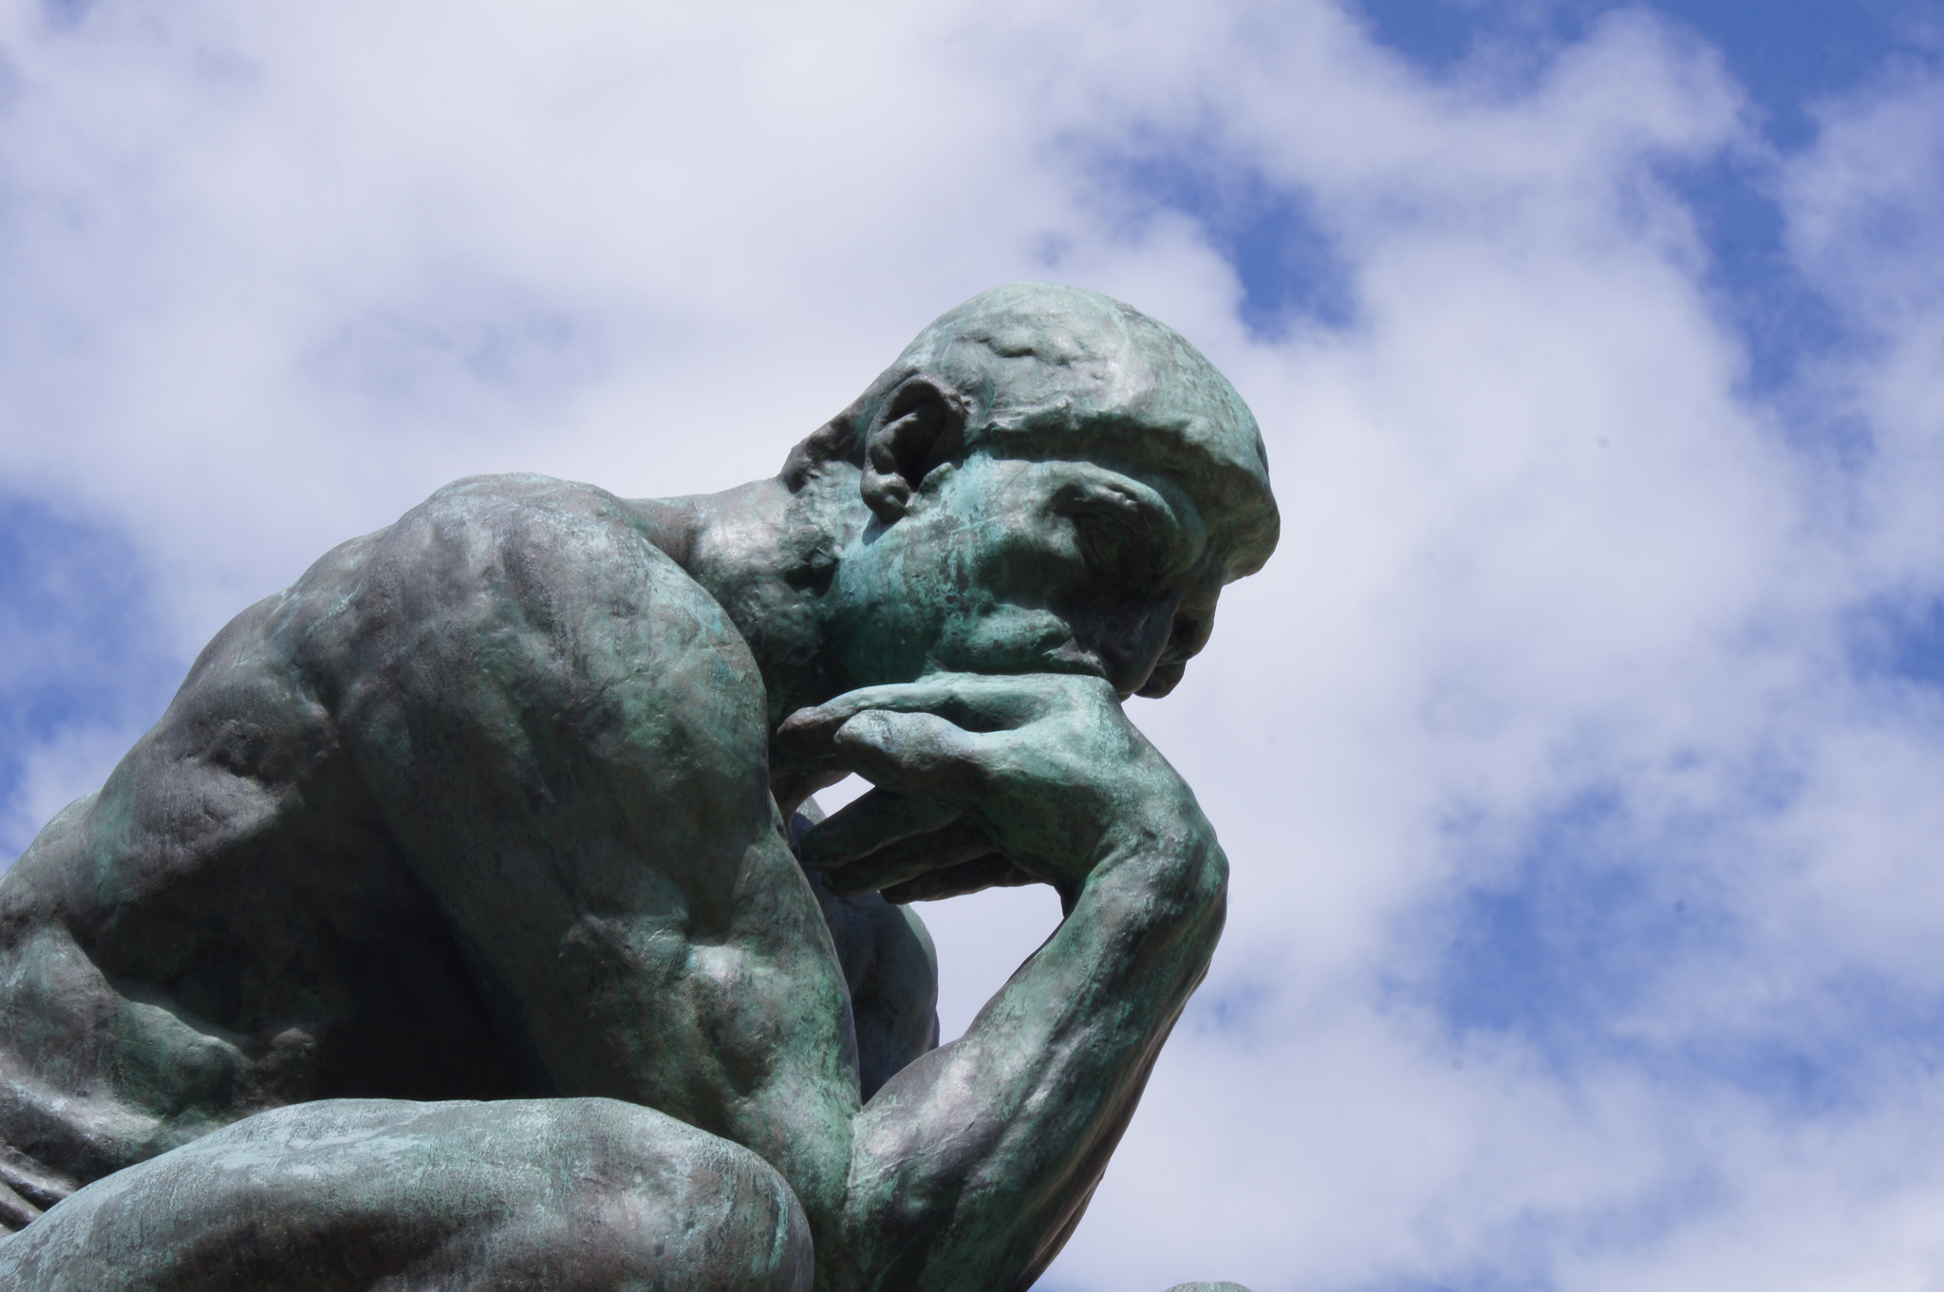
What do you think?
Is there life after death?
What makes you think there is or is not?
What influences your thoughts about life after death?
Have your thoughts changed since the death of your loved one?
If they have changed, how so and why?
Notes:
~ 7 minutes
Is there life after death?
Show one point at a time and give participants time to respond to each question.
When we are confronted by death, our thoughts often turn to age-old questions. We may wonder if there is life after death, why we believe there is or is not, or what influences our belief? For some who don’t believe in life after death, they may suddenly want to believe—hoping desperately that they will see their loved one(s) again.
After the death of his ten children, Job pondered whether there is life after death. He asked simply: “If someone dies, will they live again?” (Job 14:14).
Ancient philosophers Socrates and Plato pondered these questions, as did poets Homer and Virgil.
The questions continue into modern times.

Slide 8

Angus Reid Survey, 2024
30% do not believe there is life after death.
60% of Canadians believe life continues in some way after we die.
13% aren’t sure.
NB - The variance is due to margins of error.
⁵⁸Angus Reid Institute. “Is There Life after Death?” March 27, 2024. https://angusreid. org/do-canadians-believe-life-after-death-afterlife-reincarnation/, accessed April 2024.
Notes:
~ 3 minutes
Read slide.⁷⁹
⁷⁹Angus Reid Institute. “Is There Life after Death?” March 27, 2024. https://angusreid. org/do-canadians-believe-life-after-death-afterlife-reincarnation/, accessed April 2024.

Slide 9

Primary views of life after death . . .
Materialism
Theism
Reincarnation
Notes:
~ 1 minute
Views about life after death
There are three primary views of life after death . . .
materialism,
theism, and
reincarnation.

Slide 10
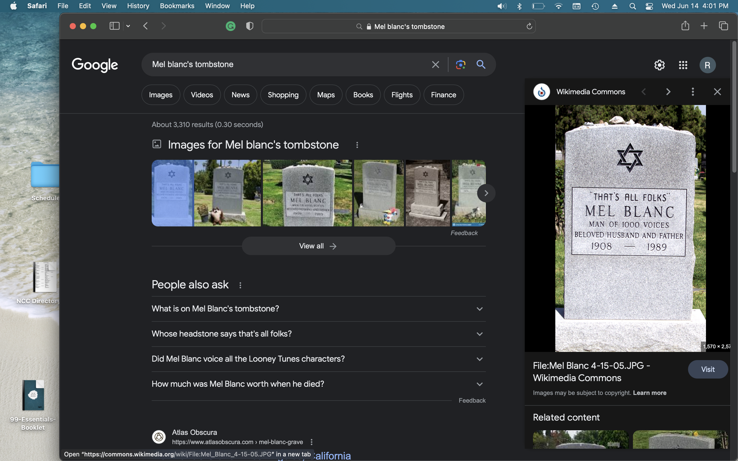
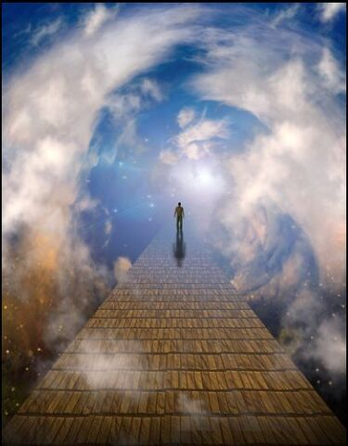

Materialism
This life is as good as it gets.
There is no life after death—only oblivion. At death, the body and the spirit/soul die.
Theism
At death, the body dies but the spirit/soul live on.
Some believe that the body and soul may be reunited.
Reincarnation
At death, the body dies, but the spirit/soul live on.
The soul continues to return in some form until it is perfected and reaches Nirvana.
Notes:
~ 5 minutes
Materialists [FYI - materialists do not believe God exists]
Materialists believe that this life is as good as it gets—that at death both the body and soul die. In other words, there is no life after death—just total oblivion.⁸⁰
Theists [FYI - theists believe in one god (monotheism) or more than one god (polytheism)]
Theists believe that at death the body dies but the soul lives on. Some believe that the body will be resurrected and reunited with the soul, while others believe only the soul lives on.
Reincarnationists [FYI - some believe in a god or divine being; others do not]
Reincarnationists believe that at death the body dies but the soul returns in some form—perhaps as a dog, bug, or another person—and when that body dies, the soul comes back again in another form. This cycle of life, death, life, death continues until the person has achieved perfection, at which point they reach Nirvana, or complete perfection.
⁸⁰ Mel Blanc was the voice over for many films, including the classic children’s cartoon, Looney Tunes, which debuted in the 1950s. These shows famously end with the featured cartoon character saying, That’s all, folks.

Slide 11

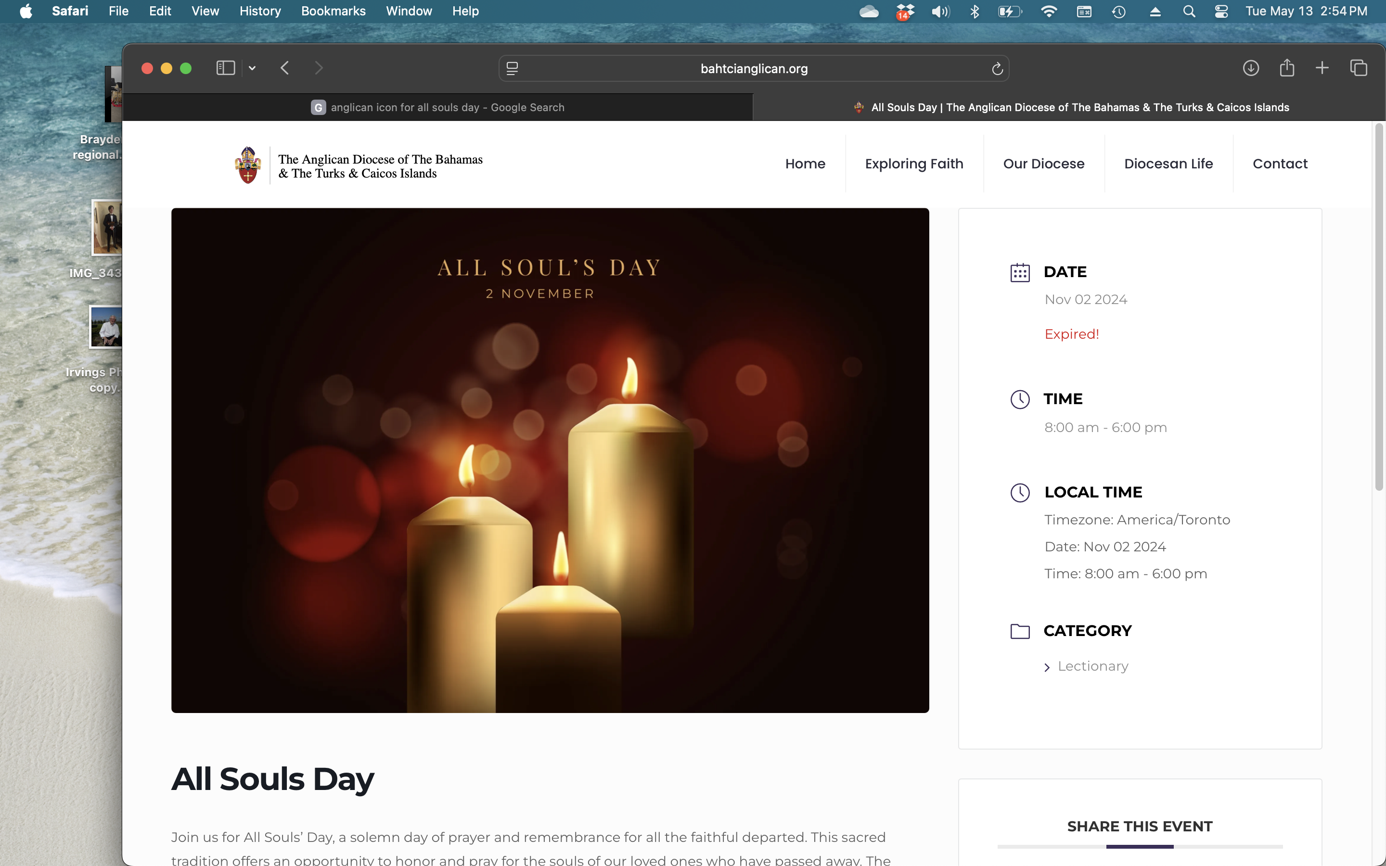
Traditional Celebrations/Observances of the Dead
All Saint’s Day (Catholics and Anglicans) – November 1
  Remember and honor all saints, canonized and uncanonized, in heaven.
All Soul’s Day (Catholics and Anglicans) – November 2
  Remember and pray for the dead and their passage to heaven.
Notes:
~ 5 minutes, including next page
Celebrations and Observance of the Dead
North Americans observe Halloween or “Hallowe’en” on October 31; its roots are in ancient Celtic traditions and Christian beliefs, that honored saints (holy persons).
Catholic and Anglican observe All Saints’ Day on November 1 and All Souls’ Day on November 2. The former honors canonized [recognized by the Church] and uncanonized [not recognized by the Church] saints in heaven. The latter is a day of prayer for all the faithful departed, particularly those in purgatory.
Ask if any of the participants observe All Saints’ Day or All Souls’ Day.

Slide 12

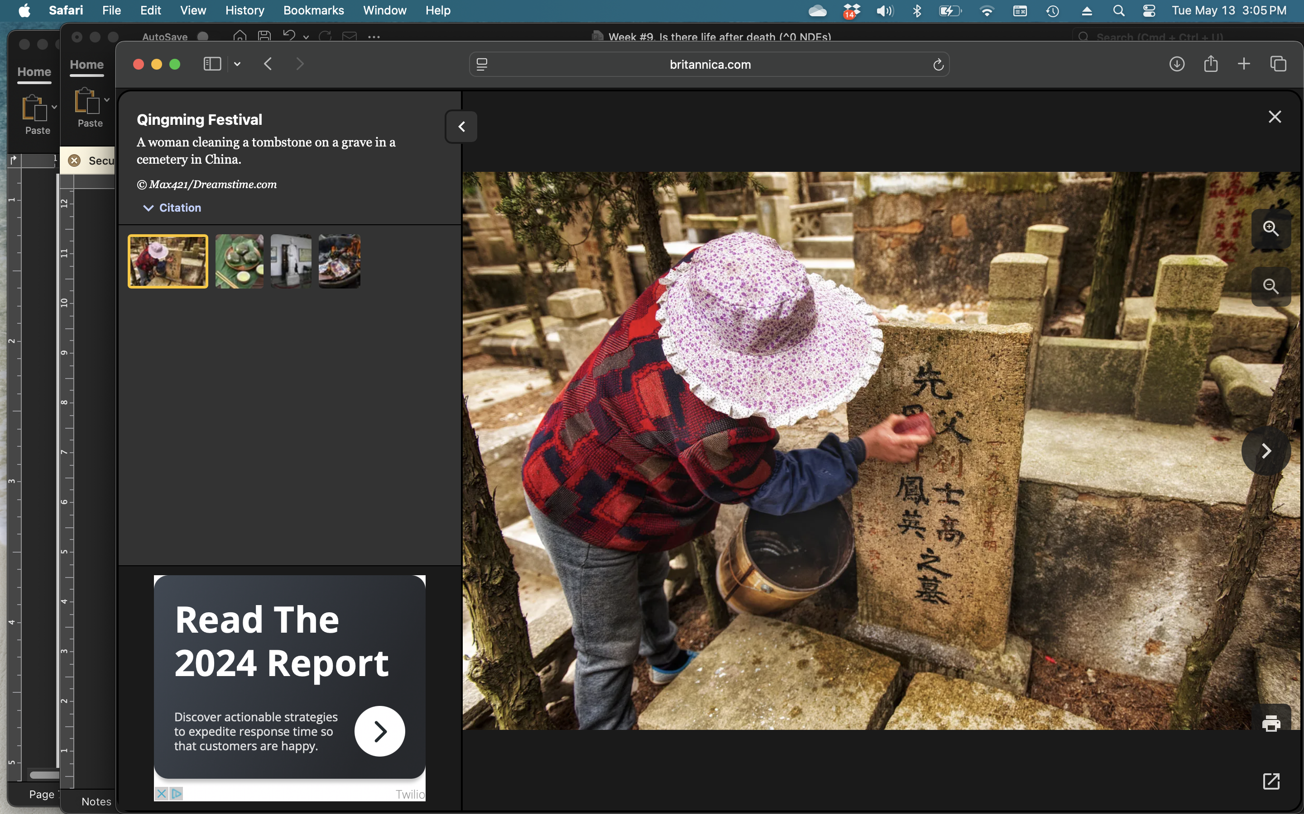
Traditional Celebrations/Observances of the Dead
Day of the Dead (Mexico, Philippines)
  Dates back thousands of years before arrival of Spanish settlers (Aztecs and indigenous peoples).
  Now is a blend of Catholic tradition and Mexican mysticism.
  Adherents believe that the dead come back to visit on that day.
  The living decorate their homes, have parades, street fairs, etc.
Qingming Festival/Tomb Sweeping
During this festival, Chinese and other Asian families clean the graves and may offer the deceased food, flowers, and paper money.
Notes:
~ 5 minutes, including previous page
Celebrations and Observance of the Dead, cont’d
Mexicans celebrate the Day of the Dead. Believing that the dead come back to visit on that day, they celebrate by decorating their homes, parading in the streets, and organizing street fairs.
During the Qingming Festival, Chinese clean gravesites and may offer the deceased food, flowers, and paper money.
In Jewish tradition, the deceased are remembered on the anniversary of their death (Yahrzeit) by special recitations. A mourner’s Kaddish is a prayer recited by at various times throughout the year.
Muslims commemorate the anniversary of a loved one’s death by charitable gifts, visiting the gravesite, and offering special prayers.
Animists regularly take food, placentas, and other items to burial sites to appease ancestors, whose spirits they believe continue to hover in the area.
Ask if any of the participants have been part of these observances.

Slide 13

  Death
  Death is the permanent cessation of heart, lung, and brain activity.
  It is irreversible.
Notes:
~ 5 minutes
Death
Death occurs when there is irreversible cessation of circulatory (heart), respiratory (lung), and brain function. Though cardiopulmonary resuscitation (CPR) can sometimes be successful in restarting heart and lung functions, there is no way to resuscitate the brain after the brainstem (which regulates basic life-sustaining functions like breathing, heart rate, and blood pressure) dies.
You likely have read accounts or watched movies about people claiming they died, went to heaven, and then were brought back after death. Their stories have generated millions and millions of dollars, bringing wealth to the writers, publishers, and the movie industry.

Slide 14

NDEs . . .
  Near-death experiences
Notes:
~ 5 minutes
Near Death Experience
Ask if any participants have had an NDE and allow time for responses.
I had an NDE at age 19 when I experienced anaphylactic shock from an allergic reaction to penicillin and knew I was dying. For years, I told no one except my mother because I had never heard of such a thing happening.

Slide 15
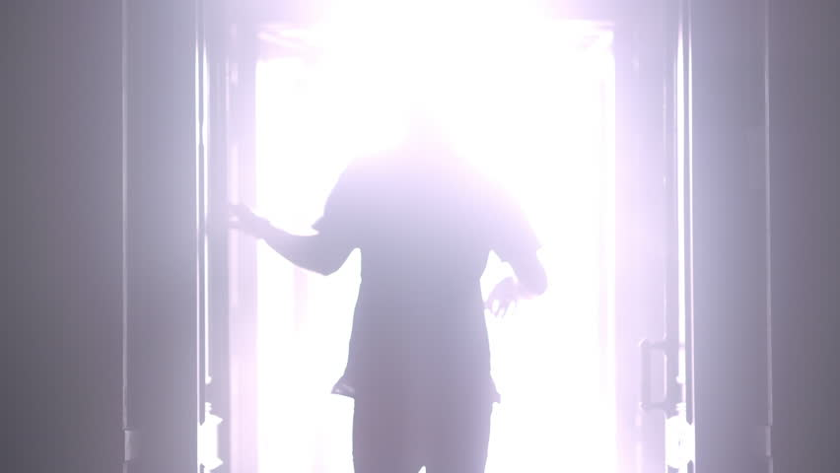
Common near-death experiences may include . . .
Being pain free.
Seeing bright light or other visual phenomena.
Feeling of floating out of one’s body.
Seeing living and dead persons or other spiritual beings.
Experiences vary from culture to culture, from religion to religion,
and among the non-religious.
Notes:
~ 2 minutes
NDE experience
Descriptions of near-death experiences may include being pain-free, seeing a bright light or other visual phenomena, a sensation of floating out of one’s body, and seeing living and dead persons and/or spiritual beings. These accounts, however, vary from culture to culture, from religion to religion, and among the religious and non-religious.

Slide 16

Similar experiences can occur in non-death events, such as . . .
The use of psychedelic and hallucinogenic drugs (legal and illegal).
During seizures.
In electroshock therapy.
In deep meditative states, such as practiced by Buddhist monks.
Notes:
~ 5 minutes
Similar experiences
Similar experiences can occur also with the use of psychedelic and hallucinogenic drugs (legal and illegal), in seizures, in electroshock therapy, and in deep meditative states, such as practiced by Buddhist monks.
CTV News published an article in 2023 that reported on a University of Michigan clinical study conducted on four comatose patients. Each person suffered a cardiac arrest while their brain activity was being monitored by an electroencephalogram (EEG).
At the time of cardiac arrest, two of the patients “showed a surge of gamma wave activity.” ⁸¹ CTV science and technology specialist Dan Riskin told CTV’s Your Morning that this is “suggestive that there’s something going on that would be an experience that a person has as they pass away.”
The article cited a similar study published in 2022. In that study, an 87-year-old man patient died of a heart attack and “showed unexpected activity in the memory retrieval area of the brain. The team behind that study said the rhythmic brain activity they detected could support the ‘life flashing before your eyes’ theory . . . They detected activity in the area between the temporal, parietal and occipital lobes in the back of the brain, a so-called ‘hot zone’ associated with dreaming, visual hallucinations in epilepsy, and altered states of consciousness.” The article goes on to say that further studies “could help determine whether bursts in gamma activity are evidence of hidden consciousness near death.” The article goes on to say that further studies “could help determine whether bursts in gamma activity are evidence of hidden consciousness near death.”
⁸¹ Michael Lee. “Brain Activity before Death: Study Pinpoints a ‘Hot Zone’ Surge.” CTV News, published May 15, 2023. https://www.ctvnews.ca/sci-tech/article/brain-activity-before-death-study-pinpoints-a-hot-zone-surge/#:-:text=In%20the%20latest%20study% 2C%20the, and%20altered%20states%20of%20consciousness.

Slide 17

An NDE can be positive or negative . . .
Positive ones get a lot of press.
Negative ones? - Perhaps these are under-reported because of shame, social stigma, and social pressures to conform to happy NDEs.
Notes:
~ 2 minutes
Read slide.

Slide 18

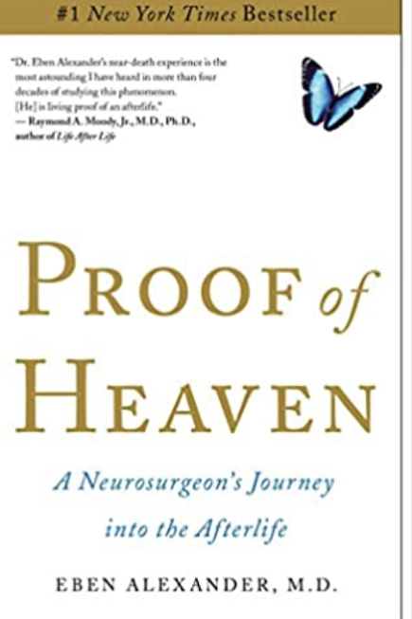
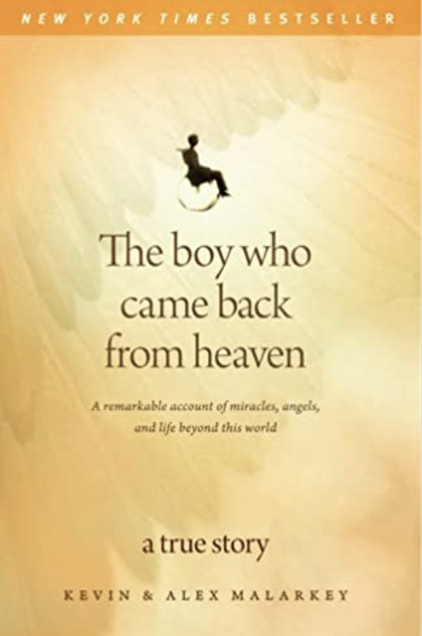
Famous accounts . . .
Colton Burpo
young child with appendicitis
Heaven Is for Real.
Dr. Eben Alexander neurosurgeon with a form of encephalitis
Proof of Heaven.
Alex Malarkey
later retracted his story, saying it was a fairy tale that got expanded on and sold well.
Notes:
~ 3 minutes
Three famous accounts of positive NDEs are:
1. Heaven Is for Real, written by Todd Burpo, is about his four-year-old son Colton, who had appendicitis and purportedly visited heaven. Colton has since stated that he did not die, that his was a near-death experience.⁸²
2. Proof of Heaven is a first-hand account by Dr. Eben Alexander, a neurosurgeon who contracted encephalitis and supposedly died. His story has been discredited by physicians who knew him and cared for him.⁸³
3. The Boy Who Came Back from Heaven was written by father and son duo, Kevin and Alex Malarkey. Alex later retracted his story, saying it was a fairy tale that was expanded on by the publisher.⁸⁴
There are many, many near-death accounts; some have been disproved, and others are still held to be true. Benjamin Radford, who researches paranormal accounts, believes such books sell well because they support a standard set of Western Christian beliefs about heaven.⁸⁵
⁸² Todd Burpo with Lynn Vincent, Heaven Is for Real. (Nashville: Thomas Nelson, 2010).
⁸³ Eben Alexander, Proof of Heaven. (New York: Simon & Schuster, 2012). https://en. wikipedia.org/wiki/Eben_Alexander_(author).
⁸⁴ Kevin and Alex Malarkey. The Boy Who Came Back from Heaven. (Carol Stream: Tyndale House, 2010). https://en.wikipedia.org/wiki/The_Boy_Who_Came_Back_from_
Heaven.
⁸⁵ “Why People Believed Boy’s ‘Visit to Heaven’ Story” news.discovery.com.
Archived from the original on May 11, 2016. Retrieved January 30, 2015.

Slide 19
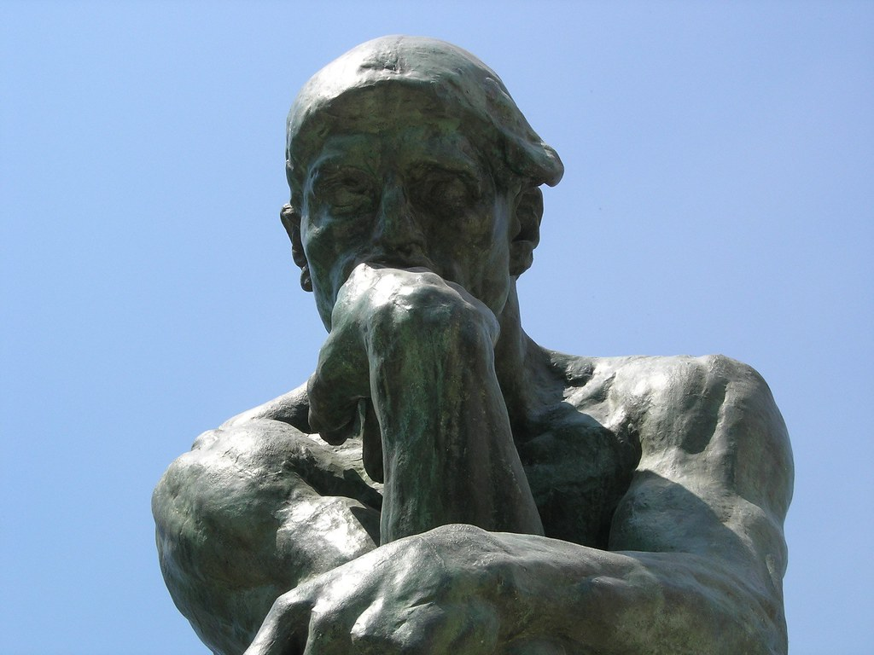
My thoughts . . .
Notes:
~ 2 minutes
My perspective on NDEs
NDEs are subjective experiences; each person interprets their NDE through the lens of their personal beliefs or pre-existing knowledge.
I do not doubt the experiences of NDEs; after all, dreams, apparitions, and visions seem real, too.
I do question, however, the interpretation and the conclusions drawn from these experiences.
These are stories of near-death experiences. According to the definition of death, the subjects nearly died—they did not die.
My conclusion is that rather than telling us what heaven is like, NDEs tell us what the dying process may be like since each person was brought back, not from death, but rather from the brink of death.
A common thread in the accounts
The common thread in NDEs (even across cultures and belief systems, in good and bad NDEs) is that the soul doesn’t die––the person continues to live outside their physical earthly body.

Slide 20
If then the soul doesn’t die,
where does it go?
Notes:
~ 5 minutes
Ask participants what they think.
If the soul doesn’t die, what happens to it?
Atheists – This is not a relevant question for them as they believe when they die, both the body and soul are dead and gone forever.
Animists – They believe the soul lives only as long as someone remembers that person.
Buddhists/Hindus – They believe that after death, the soul seeks out a new body to live in; it is a never-ending cycle of life, death, life, death, life, death, life, etc.
Sikhs – the soul reunites with the universe from whence it came.
First Nations peoples – Their traditional system believes that departed souls go to be with the ancestors or the universe.
Generally, followers of Christianity, Judaism, and Islam believe that when the body dies the soul goes either to heaven or hell until the soul and body are reunited at the resurrection. (I say generally, because some do not believe in hell.) These beliefs are based on their sacred Scriptures (The Bible, The Tanakh, and The Qu’ran).
American poet Henry Wadsworth Longfellow captured the Christian view in his poem, A Psalm of Life, written in 1838 not long after the death of his first wife.

Slide 21
Henry Wadsworth Longfellow:
Life is real! Life is earnest!
And the grave is not the goal;
Dust thou art, to dust returnest,
Was not spoken of the soul.
A Psalm of Life
Notes:
~ 3 minutes
Discuss Longfellow’s poem, A Psalm of Life, before moving to text below.
Graveside committal services often conclude with the minister or funeral officiant saying, “Dust to dust, ashes to ashes.” This comes from the biblical account of creation and the fall. Genesis says that God made Adam from “the dust of the ground and breathed into his nostrils the breath of life, and the man became a living soul (2:7). After Adam and Eve were expelled from the Garden of Eden, God said to them, ”By the sweat of your brow you will eat your food until you return to the ground, since from it you were taken; for dust you are and to dust you will return” (Gen. 3:19).

Slide 22
One of the men being crucified with Jesus, said to Jesus:
“Remember me when you begin ruling as king!”
Jesus replied,
“I promise you, today you will be with me in paradise.”
Luke 23:42-43, ERV
Notes:
~ 2 minutes
Christian view of life after death
In contrast to Judaism and Islam whose followers believe people go to heaven based on their own righteousness––that is, how good they have lived––Christianity teaches that one gains entrance to heaven not through their own righteousness (let’s face it, as much as we strive to be good, we all fail) but through the righteousness of Christ, which is received by asking Christ’s forgiveness.
Jesus said that “I am the way and the truth and the life. No one comes to the Father except through me” (John 14:6).

Slide 23
“God so loved the world, that He gave His only Son, so that everyone who believes in Him shall not perish but have eternal life.”
John 3:16 NASB
Notes:
~ 1 minute
A familiar verse is John 3:16 - “God so loved the world, that He gave His only Son, so that everyone who believes in Him shall not perish but have eternal life.”(NASB)
It is important to note that this belief is based on one’s repentance, not on the church or denomination to which they belong, nor even on how much they understand.
God has revealed Himself to us in nature (Rom. 1:20) and in our hearts (Eccl. 3:11).
God reveals himself to anyone who seeks Him (Jer. 29:13).

Slide 24
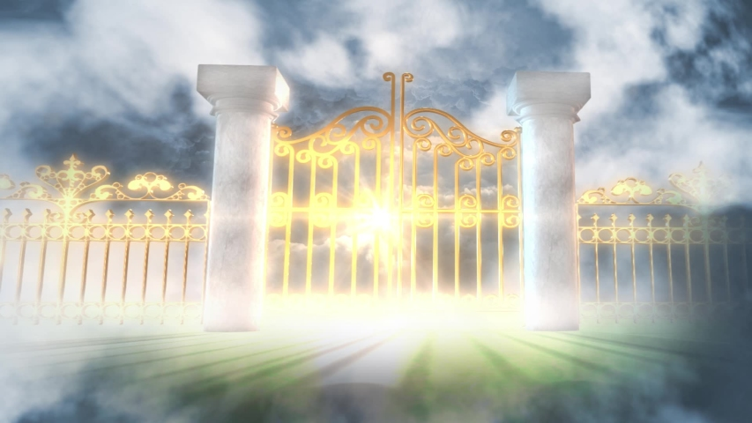
The
$64,000
Question
Notes:
~ 5 minutes, including next page
The $64,000 Question was an American game show broadcast in primetime on CBS-TV from 1955 to 1958. . . Contestants answered general knowledge questions, earning money which doubled as the questions became more difficult. The final question had a top prize of $64,000 (equivalent to $700,000 in 2022), hence the show’s title.⁸⁶
For some of us, we have no doubt that our loved ones are with Jesus because we know that they asked Him into their hearts. But what if your loved one never made a public confession of Jesus as Lord and Saviour? As a believer, you may be desperately wanting to know if you will see your loved one again. The $64,000 Question for you might be, Is my loved one in heaven? It is an agonizing and haunting question, the answer to which is worth far more than $64,000.
Randy Alcorn, author of Heaven, a comprehensive book on what the Bible tells us heaven will be like, responded to the question this way:
We need to “realize that we do not know what happens inside a person before they die. We don’t know whether the Holy Spirit of God has done a work of grace in someone’s heart and life at the last moment. They may have been aware of the hours, minutes, even just seconds leading up to their death and cried out to God for deliverance.
“Take the person who has been in a coma for a period of time and is unresponsive. Everyone might think, ‘They were in this accident. They didn’t know Christ when they left home that day, so obviously they still don’t know the Lord.’ But we don’t know what God is doing in someone’s heart and mind—bringing back to their memory aspects of the Gospel that have been shared with them, and things they’ve read and heard. In their weakness—in their most vulnerable, least independent, most dependent state—they could be turning to Christ in faith. We may be surprised and delighted to one day see them in the presence of Christ.”⁸⁷
⁸⁶ https://en.wikipedia.org/wiki/The_$64,000_Question, accessed June 29, 2023.
⁸⁷ https://www.epm.org/blog/2010/Oct/25/how-do-i-minister-unsaved-friend-whose-loved-one-d, accessed June 29, 2023.
This slide and the next need only be part of the presentation if participants are concerned if their loved one is in heaven.

Slide 25
The
$64,000
Question
Notes:
~ 5 minutes, including previous page
We are not the judge of others. It is not for us to say who will be in heaven or who will not. At the beginning of the Bible, we are told that that the Judge of all the earth will do right (Gen. 18:25). If you are agonizing over the eternal fate of your loved one’s soul, let this verse give you comfort and hope. “God is a sovereign Judge of righteousness, full of grace and mercy to all who call upon Him. It is His very justice that offers a ‘way’ for all to escape the judgment of His righteousness, and it is in that justice that we must rest. It is grace that saves us, and it is grace in which we must stand when we go through the double grief of the death of a loved one who we may believe is unsaved.
Trust God, who feels your pain and will comfort you with His great love and mercy. Trust that he is not willing that any should perish (2 Peter 3:9), and that he will do all in his power to bring redemption to all who will believe on him.
FYI - The following resource may be useful to the discussion. Alistair Begg, “The Man on the Middle Cross said I could come.” https://www.google.com/search?client= safari&rls=en&q=Alistair+Begg%2C+“The+Man+on+the+Middle+Cross+said+I+could+come.”&ie=UTF-8&oe=UTF-8, accessed May 3, 2023.
This slide and the previous need only be part of the presentation if participants are concerned if their loved one is in heaven.

Slide 26


Notes:
~ 5 minutes
What stands out for you from tonight’s presentation?
What questions does tonight’s session raise for you?

Slide 27
Journal assignment
What do you think happens to the soul/spirit after death?
How did you reach this conclusion?
How should our belief or non-belief in life after death affect our decisions about how we live now?
Notes:
~ 5 minutes

Slide 28
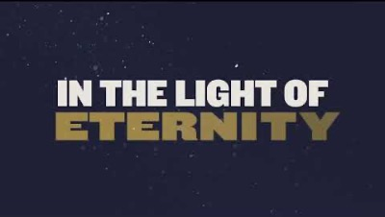
Notes:
~ 4 minutes
Play video, In the Light of Eternity.⁸⁸
⁸⁸ “Heaven Changes Everything,” sung by Bib Daddy Weave. https://www.youtube.com/watch?v=z3mpo2VEDaI .

Slide 29
Next week (our closing session)
What now?
How do I go on living?
Notes:
~ 3 minutes
Next week’s topic
What now? How do I go on living?
Pray.

Slide 30
Notes:
This page is intentionally blank.

