Slide 1

Welcome to Grief Care
Week #10
What now?
How do I go on living?
Notes:
Pre-meeting
Have this slide on screen before participants arrive.
Play background music until meeting starts.

Slide 2

Notes:
~ 15 minutes
Begin meeting
Welcome everyone to this last session.
Invite participants to share about their week.
PRAY.

Slide 3
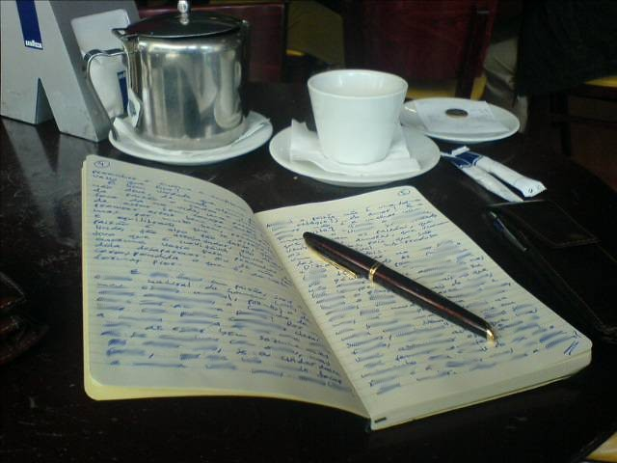
Review of last week’s journal assignment
How did you respond to the following questions:
What do you think happens to the soul/spirit after death?
How did you reach this conclusion?
How should our belief or non-belief in life after death effect our decisions about how we live now?
Notes:
~ 15 minutes
Invite participants to respond to questions.

Slide 4

Where have we been over these past weeks?
Notes:
~ 10 minutes
Give participants opportunity to respond to the following questions, then add bullet points not mentioned.
What have you learned about grief?
Feelings are intense and chaotic—like a tangled ball of emotions, like part of us has died.
Everyone grieves differently because we and each of our relationships are different.
With the loss of a loved one or friend comes a host of secondary losses.
There is no right or wrong way to grieve.
It’s a journey.
It is not a straight, orderly path, but with time and work the highs and lows become less extreme, less intense, and less frequent.
There are ambushes and triggers, but with time and work these too can diminish in intensity and become less frequent—in time they can bring more smiles than tears.
It is unpredictable, exhausting, and hurtful.
Friendships/relationships change.
Life really does go on.
What have you learned about yourself?
Grief affects us physically, emotionally, mentally, relationally, vocationally, uniquely, and spiritually.
Not to let others try to rush our grief, but rather to move forward at our own pace and in our own way.
Other topics we discussed
The “why” questions.
The challenges of grief—including regret, quilt, hurt, anger—and forgiveness.
The tasks of grief: 1) accepting the reality of our loved one’s death, 2) processing the pain of our loss, 3) adjusting to a world without them, 4) continuing our bonds with our loved ones—and what to do with “stuff.”
In this session, we will look at task 5) finding new/renewed meaning or purpose in life.

Slide 5

Take 5
Notes:
~ 5 minutes
Before we begin with today’s topic, let’s take a five-minute break.

Slide 6
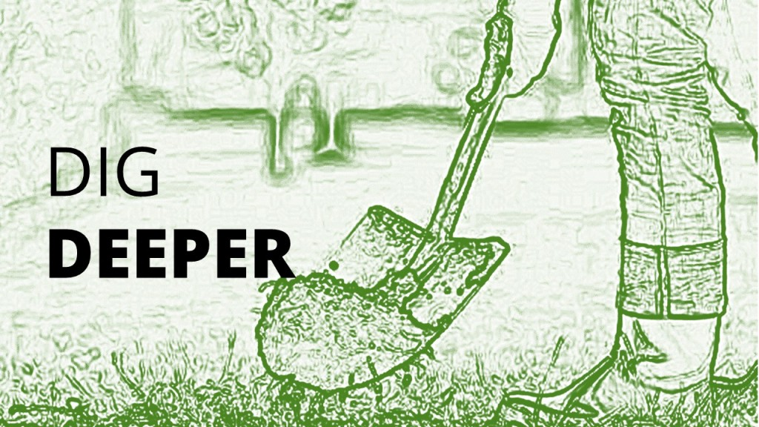
Finding new or renewed purpose in life
Task #5
Notes:
~ 5 minutes
Meaning and purpose in life
Death causes us to think about the meaning and purpose of life, why we are here. Viktor Frankl, a Jewish psychiatrist and neurologist, was imprisoned in Hitler’s concentration camps. Following liberation, he published a book about his observations of his and other prisoners’ responses to their circumstances. A classic, the English version is entitled Man’s Search for Meaning. What Frankl discovered is that life is not primarily about the pursuit of pleasure or power. Rather, “the greatest task for any person is to find meaning in his or her life,”⁸⁹ even amidst abject circumstances.
After the death of someone we dearly loved, we may feel lost in a wilderness with no signposts to guide us. We wonder what gives life meaning? What gives it purpose? Alan Wolfelt quotes Pablo Picasso, “The meaning of life is to find your gift. The purpose of life is to give it away.”⁹⁰ For Christians it is expressed in Jesus’ words: “Love the Lord your God with all your heart and with all your soul and with all your mind and with all your strength . . . [and] love your neighbor as yourself” (Mark 12:30-31).
⁸⁹ Viktor Frankl, Man’s Search for Meaning, translated by Ilse Lasch. (Boston: Beacon Press, 1959), x.
⁹⁰ Alan D. Wolfelt. One Day at a Time—365 Meditations to Help You Heal After Loss. (Fort Collins: Companion Press, 2016), reading for December 22.

Slide 7
Finding new or renewed purpose in life
Task #5
Notes:
~ 5 minutes
What helps
Finding new or renewed purpose in life requires us to dig deep and ask ourselves:
who am I?
what has life taught me that I can share with others?
what gifts/talents do I have that I can bless others with?
what interests me that I can explore?
what hobbies can I pursue?
what new skills can, or do I need to learn to not only survive but to thrive?
what legacy do I want to leave behind?
what can I do to improve who I am? – i.e., reading, studying, courses, attending classes, small groups in the community or my church
what can I do to help others? – where can I volunteer?
what can I do to help my faith community? – i.e., teach a small group, volunteer to help at events, sign up for a prayer team, greet people
Death causes us to think about the meaning of life, why we are here. Digging deeper is not easy, nor is it quick, but as we find new or renewed meaning and purpose in life, we see a way forward, a way to move beyond surviving to thriving.
This process can be facilitated through reading (i.e., Rick Warren’s The Purpose Driven Life⁹¹), asking friends and family for their insights, talking with a minister or counsellor, engaging the help of a spiritual mentor, completing a personality test to discover interests,⁹² strength finder test,⁹³ spiritual gifts inventory,⁹⁴ and seeking wisdom and direction from God through prayer and Bible reading.
Ask participants what might bring meaning/purpose to their life.
⁹¹ Rick Warren, The Purpose Driven Life. (Grand Rapids: Zondervan, 2002).
⁹² Personality test, https://www.16personalities.com/free-personality-test .
⁹³ Strength Finder test, https://personality.co/.
⁹⁴ Spiritual Gifts test, https://giftstest.com/.

Slide 8
Where do we go from here?
Notes:
~ 3 minutes
Where do we go from here?
In our journey through grief, we change.
We look at life differently now—we are more aware of its brevity.
Our priorities change.
Our belief and values may have changed.
In time, we become more understanding and empathetic towards others in grief.
Alan Wolfelt describes this as a transformation of who we are. “To the extent that you are different, you can say you have grown [through your grief]. . . [and] growth means change.”⁹⁵
⁹⁵ Alan Wolfelt, Appreciate Your Transformation.” www.centerforloss.com, nd.

Slide 9

What to leave behind
Notes:
~ 5 minutes
What to leave behind
Even in the best relationships, there may be attitudes, habits or perspectives that need to be changed.
“One of the tasks of grief is . . . Deciding how you will live with and honor your memories of and associations with” your loved one. ‘The critical question is not if but how you will remember’ them.”⁹⁶
What helps
It is important to remember that none of those that died were perfect, and some much less than others. Perhaps there are traits or characteristics that need to be shed.
For some who have had dysfunctional and/or traumatic relationships, we must remember that we need not be that person and that with the help of counsellors and God, we can become different people.
Even in wonderful relationships, there can be things said or done that leave a bitter taste. Those too need to be shed—and focus placed on the good, the positive.
Whatever the relationship––good or bad––don’t let that relationship hinder the person you are now or can become. Don’t live in your past.
Is there something that your loved one said you should not, or could not, or would not do or be? A dream or goal or vision that you let die, but now you could revive?
What baggage are you carrying? What do you need to leave behind?
Give participants opportunity to respond if they wish, or at least time to think about the question, even write them in their journals.
Some baggage you can discard on your own, but some things may need professional help to work through. Don’t be afraid to seek help.
⁹⁶ Kenneth J. Doka, Grief Is A Journey. (New York: Simon & Schuster, 2016), 72, 73.

Slide 10

What to carry forward
Notes:
~ 5 minutes
What to carry forward
Good memories.
Stories.
Traditions/interests/causes you shared.
Lessons learned, skills acquired.
What is something from your loved one that you want to carry forward?
Give participants time to think about and answer this question.
With respect to carrying forward our memories, “Sometimes this happens naturally. In other cases, we may have to work on revisiting and restoring these memories.”⁹⁷
For a time, memories of an extended illness or events surrounding the death may dominate our thinking, so we must work at recalling memories of happier times to bring perspective and balance, or to re-examine our memory to find good in it. We must work at getting off the hamster wheel so that we can move forward.
⁹⁷ Kenneth J. Doka, Grief Is A Journey. (New York: Simon & Schuster, 2016), 72.

Slide 11
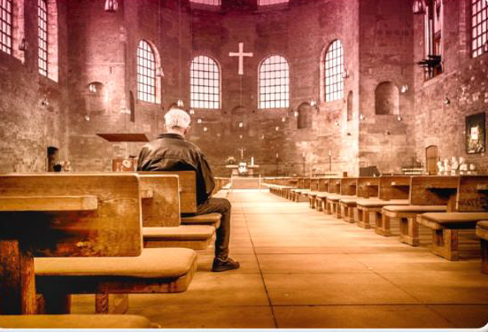
Building your faith
Notes:
~ 5 minutes
Building your faith
In week one, we looked at how grief affects us physically, emotionally, mentally, socially, relationally, behaviourally, vocationally, and uniquely. We turn our attention now to how it affects us spiritually. We talked in session three about how death challenges our assumptions about life and our belief system. Ken Doka says this: “As we cope with the reality of loss, we have to re-examine our faith. Whether it’s a reaffirmation of a closely held belief or a complete reversal of years of assumptions, grief forces us to ask, What do I believe now?”⁹⁸
Ask participants what they do to nourish their beliefs, their soul.
What helps
Talk to another person who is further along in their journey of grief who has grappled with these questions and is willing to engage without judgment.
Attend spiritual retreats.
Talk to a minister, priest, rabbi, or other spiritual leader.
Pray, meditate, and practice other spiritual disciplines.
Be part of a faith community or search for a new one.
Read devotionals, the Bible, and other books on faith.
If you are interested in exploring the Christian faith, join an Alpha group.
Your Grief Care facilitator can connect you with these resources.
⁹⁸ Kenneth J. Doka, Grief Is A Journey. New York: Simon & Schuster, 2016).

Slide 12
“It’s not what they take away
from you that counts . . .
It’s what you do
with what you have left.”
Hubert Humphrey
American politician
Notes:
~ 5 minutes
Read slide.⁹⁹
What to do with what’s left
Biographies and autobiographies often give us insight into how people survive and thrive the challenges of life.
A story that inspires me is that of Joseph. You may remember his story, either from the Bible or from Andrew Lloyd Webber’s ever-popular musical entitled Joseph and the Amazing Technicolor Coat.
Joseph’s brothers were jealous of him and sold him into slavery in Egypt.
Years passed by and eventually he earned privileged status in a wealthy Egyptian home, but then he was thrown into jail on false accusations. His was a tumultuous life.
Yet, in time he married. When the second son was born, he declared that God had made him fruitful in the land of his affliction, or as The Message reads in the land of his sorrow. I too have found this to be so in my life and seen it in the life of others—God won’t waste our pain but rather wants to take what is left of our lives and use it for good to help others.
Who inspires you? [Others that inspire me are Elisabeth Elliot and Horatio Stafford—each of whom experienced multiple deaths of loved ones.]
Last week we looked at the question, Is there life after death? and what happens to the soul after the body dies.
Life isn’t so much about our circumstances—circumstances we didn’t choose, circumstances we may not like, circumstances we cannot change.
After Jerry Sittser’s wife, mother, and daughter were killed by a drunk driver, he was left to raise their surviving three children. He too asked a myriad of whys. He too struggled with the challenges and tasks of grief. He too wondered about life after death and re-examined his beliefs. Through this he discovered that . . .
⁹⁹ Words are attributed to American politician Hubert Humphrey (1911-1978).

Slide 13
“Finally, we reach the point when
we begin to search for a new life,
one that depends less on circumstances
and more on the depth of our souls.”⁹⁷
Jerry Sittser, A Grace Disguised, 90.
Notes:
~ 3 minutes
Read slide.¹⁰⁰
Invite participants to comment on this.
What helps
Take time to discover and nurture your soul.
Pray and read Scripture.
Attend services at your place of worship.
Join small faith study groups.
Practice spiritual disciplines.
Journal.
Practice gratitude and forgiveness.
¹⁰⁰ Jerry Sittser, A Grace Disguised—How the Soul Grows through Loss, expanded edition. (Grand Rapids: Zondervan, 2004), 90.

Slide 14
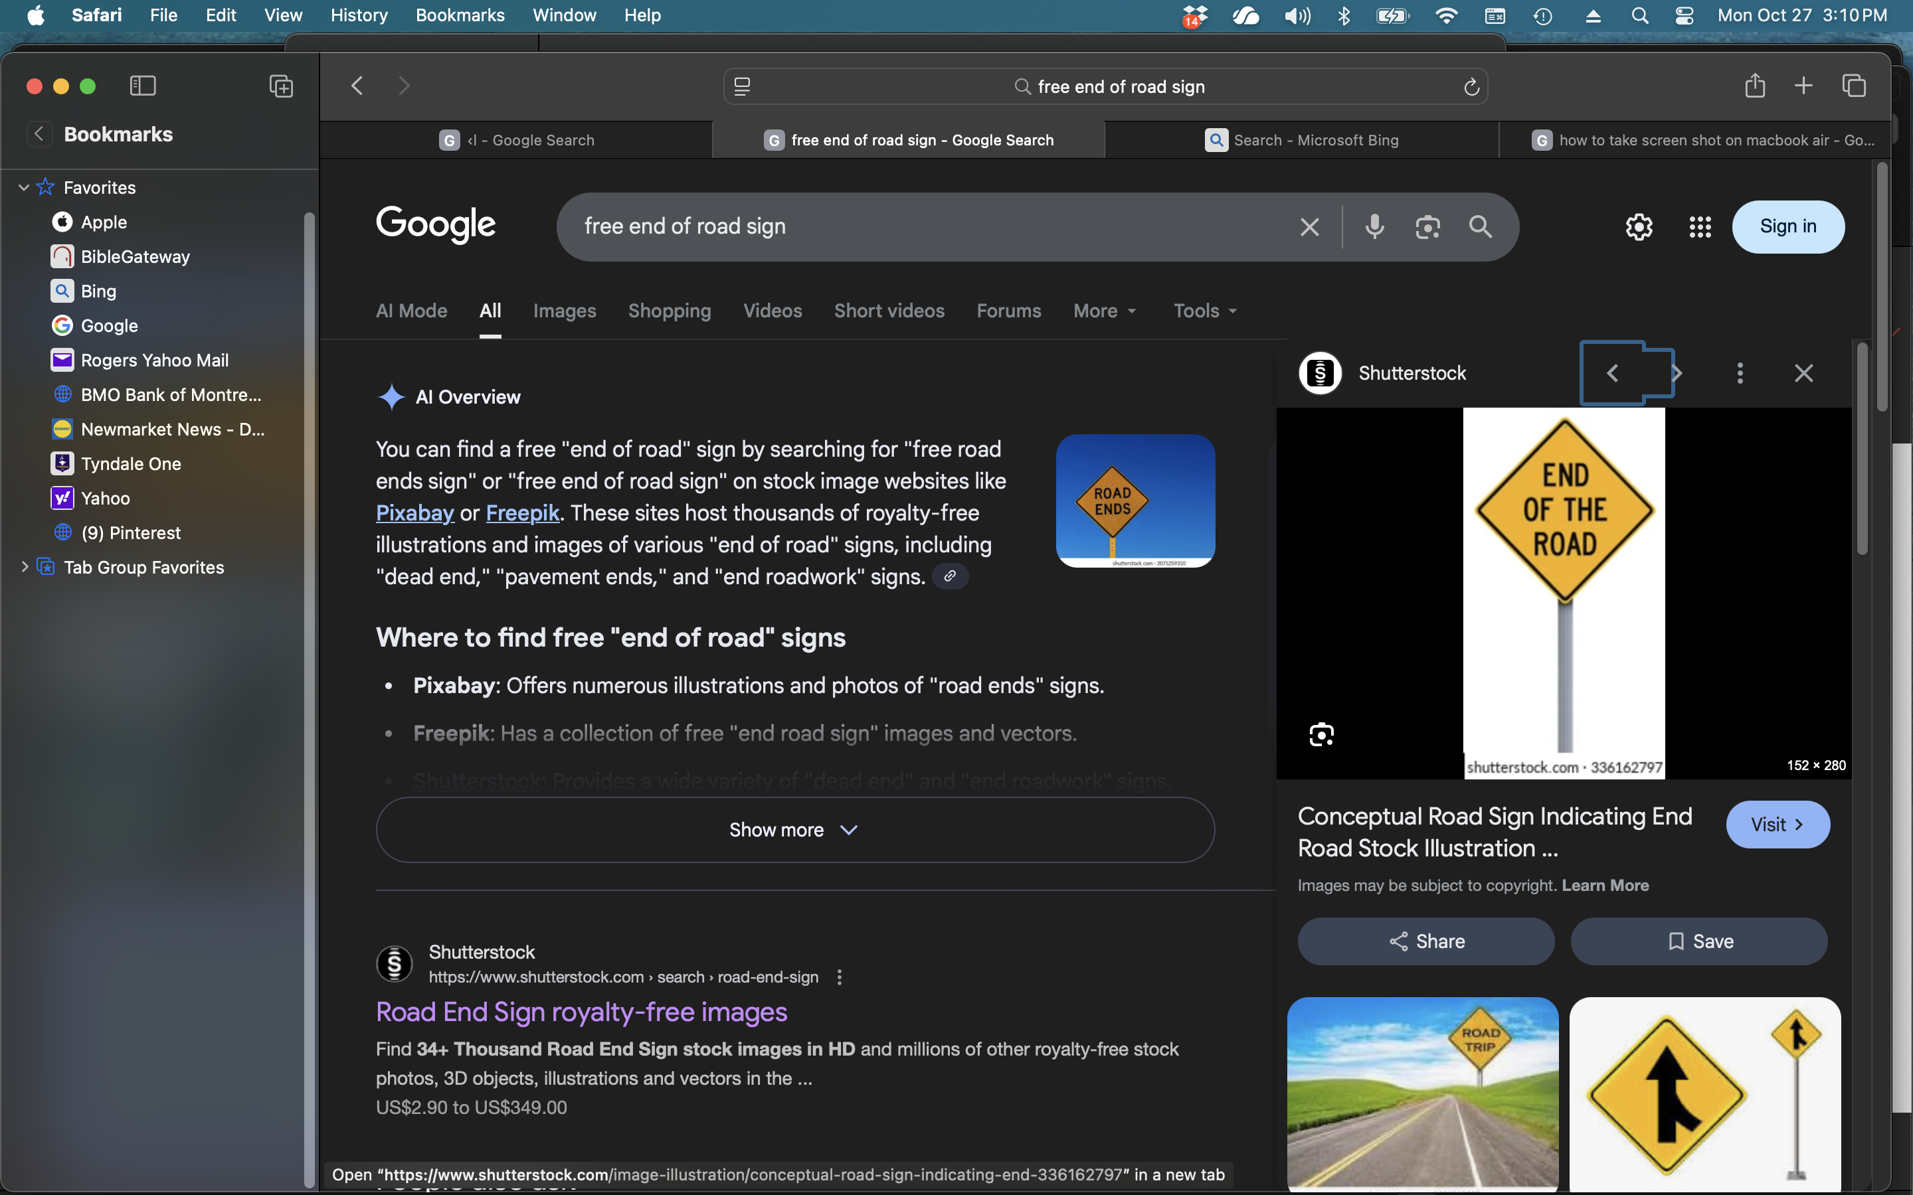
When does grieving end?
Notes:
~ 4 minutes
When does grieving end?
“Asking when mourning is finished is a little like asking, ‘How high is up?’ There is no ready answer.”¹⁰¹ Though there is no definitive timeline, there are indicators that our grieving has ended.
Note—healing from our grief does not mean we are forgetting our loved one. It simply means we have integrated their death and our loss into our new reality.
One indicator is that we can remember and speak of our loved one without the intensity of emotion we felt early in our grief. Another indicator is that we are able to reengage with life, are hopeful once again, and experience gratification and joy in life.
Healing is a slow process. It takes times to accept our loss, to process the pain and adjust to our new reality, to figure out our new relationship to the deceased, and to find new/renewed purpose and meaning in life.
Our grief will always be with us, but it will no longer dominate our thoughts and actions. One writer expresses it this way: “Moments of happiness or pleasure don’t negate other feelings. Life isn’t a swap meet where we trade one thing [grief] for another [happiness] . . . Life isn’t either/or, it’s both/and.”¹⁰²
¹⁰¹ ………….
¹⁰² ………….

Slide 15
When does grieving end?
Notes:
~ 4 minutes
When does grieving end?, cont’d
As we do the hard work of grieving, we acknowledge the past but work at building the present and future. It is figuring out how to integrate our loss and the lessons we’ve learned into our new reality. There still will be triggers—especially holidays, anniversaries, and birthdays. Healing our grief and integrating our loss means that we have more good days than bad. Our loved one’s death and our loss are not the most dominate thoughts in our day. We cherish old memories and make new ones. Our energy and motivation increase, and we find enjoyment in activity and relationships.
There won’t be a signpost to tell you when you have finished the hard work of grieving, but you will recognize it in hindsight. That was how it was with me after my husband’s death. I knew I was moving forward, but then one day around the third or fourth year or so I realized I was fully engaged in a new life—a life that honored our past but was forward looking. With respect to my grandson, at the time of this writing, I’m not there yet though I see positive signs.

Slide 16
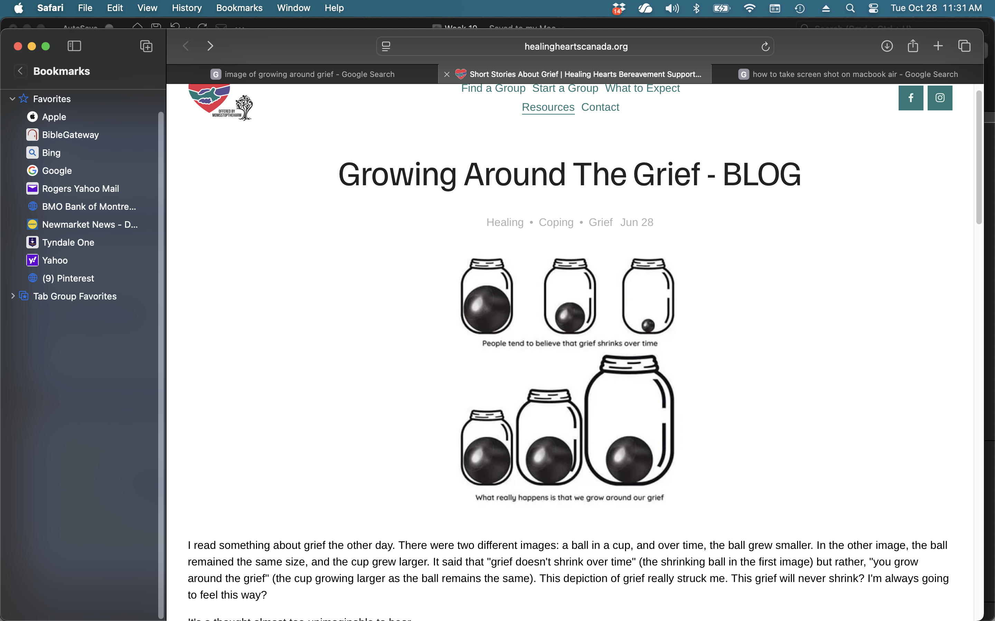
Notes:
~ 1 minute
Visual of moving forward with loss
People tend to believe that grief shrinks over time.

Slide 17
Notes:
~ 1 minute
What really happens is that we grow around our grief.

Slide 18
Notes:
~ 1 minute
We become much larger than our grief; it is no longer the dominate theme of our life—it is not our identity.

Slide 19


Notes:
~ 5 minutes
Ask if there are any questions on today’s session or any lingering questions from the previous weeks.
Invite feedback on the overall program:
What was helpful?
What was not?
What did we miss?
Suggestions for future Grief Care groups.

Slide 20
“It’s not what they take away
from you that counts . . .
It’s what you do
with what you have left.”
Hubert Humphrey
American politician
Notes:
~ 1 minute

Slide 21
On-Going Support
Notes:
~ 2 minutes
Upcoming events: [list church, community, Grief Care activities-–including next series—that may be of interest to participants].
Feel free to stay in touch with your facilitators and each other.

Slide 22

“The wilderness and desert will sing joyously,
the badlands will flower––like the crocus in spring,
bursting into blossom, a symphony of song and color.”
Notes:
~ 3 minutes
A new perspective of the valley of the shadow of death, of the wilderness of grief
Share the story of how Moses led the Israelites out of slavery in Egypt and how they wandered in the desert for forty years, before they were able to enter the Promised Land. Many years later, they were taken captive by the Babylonians for 70 years.
Isaiah (35:1) described the experience as a desert, but in looking ahead to the time when the Israelites would be in their own land, he described it this way, as paraphrased in The Message:
The wilderness and desert will sing joyously,
the badlands will flower––like the crocus in spring,
bursting into blossom, a symphony of song and color.
In your grief journey, you may feel as though you are wandering endlessly, aimlessly in the desert of grief.
Our hope and prayer for each of you is that you will take what we have learned together these past weeks and to continue to work your way through this desert place, that you will come to a place of healing, where the badlands of grief and sorrow will give way to flowers in a symphony of song and color.
Pray.
Distribute encouragement notes and/or gifts to participants.

