Slide 1
The unspoken language of race in the workplace
Presenter: Ed Gough Jr.
June 30, 2020

Slide 2
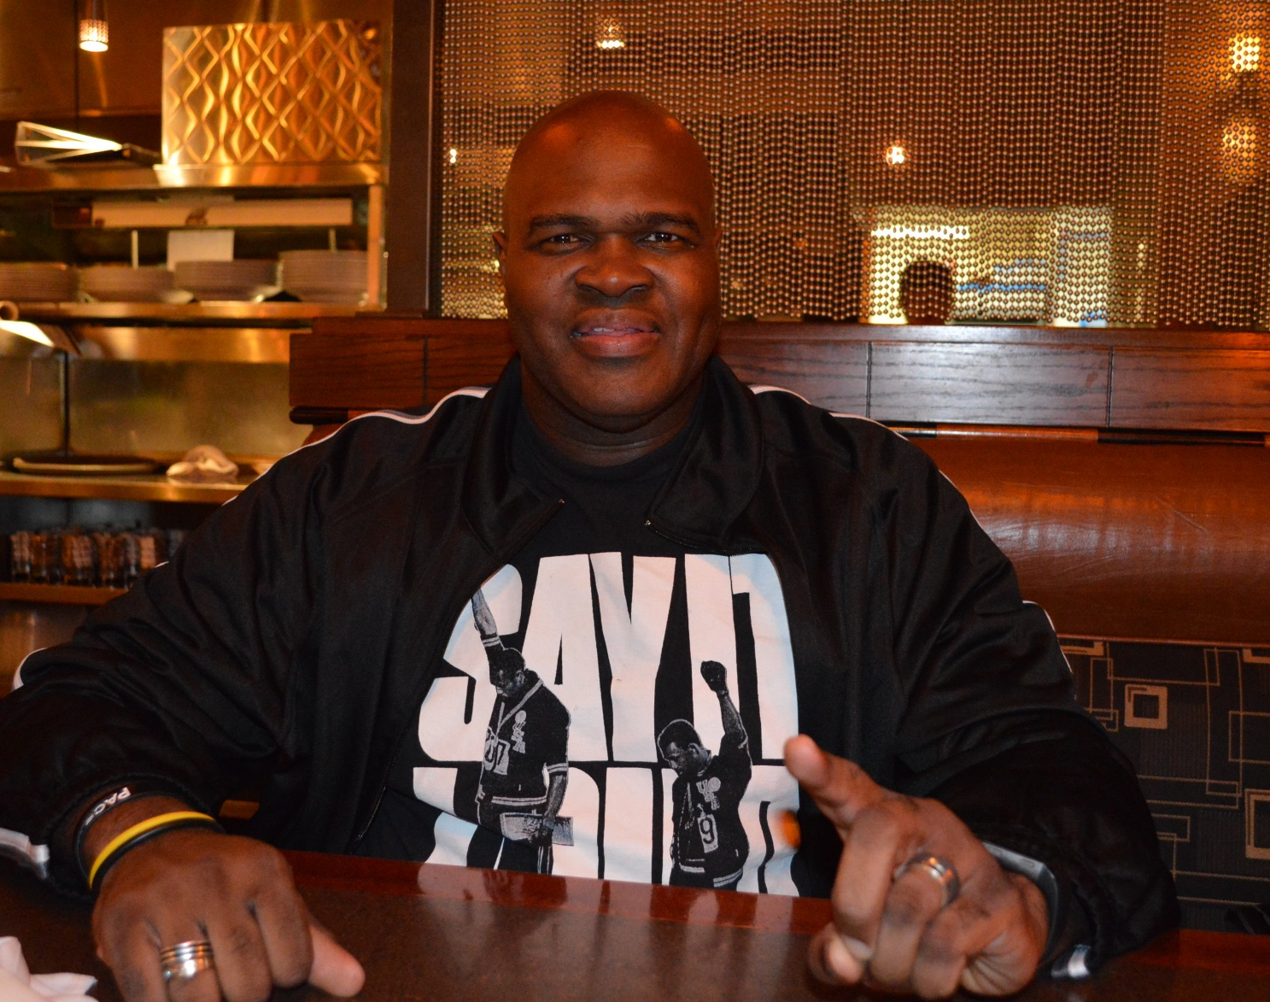
A little about me …
Ed Gough Jr. is a father and manhood advocate who works with fathers, men and organizations to help men and fathers be better for themselves, their loved ones and the world. After spending many years working with fathers and men, Ed knows that the better fathers and men are the better men they are, the better they are for their families and loved ones and the better they are for the world.
Some of the organizations that Ed has helped with fatherhood and manhood are the Ontario Association of Children’s Aid Societies and the Ontario Ministry of Children, Community and Social Services. Ed is the co-host and co-producer of the monthly live online conversations for fathers that are sponsored by Dove Men+Care and Dads Central (Canada’s national fatherhood organization). For the last eight years, Ed has been a featured contributor for the Good Men Project (one of the most viewed website in the world for men). He is also the host of The Dr. Vibe Show™ which won the 2018 Innovation Award given by the Canadian Ethnic Media Association.
Ed has worked for various companies such as Adidas, Universal Music and Young and Potential Fathers.
Ed has been featured on various media platforms including CTV News Channel.

Slide 3

Importance of addressing the topic of race in the workplace
Fit is a critical part of any organizations success. When an employee feels stressed at work this makes for an unhappy experience for multiple employees. This often leads to unnecessary stress which can result in loss of productivity even stress leave or the departure of the employee. The expense resulting from unaddressed or ill addressed occurrences can be quite costly.

Slide 4

Tenets of racism and anti-black racism practices in the workplace
Perceived racist incidents are not important and will just blow over.
Black employees are making too much out of an incident. They are whining, an angry black women, angry black man, etc.
Black employees have a job because of a special accommodation (Diversity plan) therefore they need to be micro-managed because they are not as smart as other employees.
We don't have that problem in our organization, everyone gets along.

Slide 5

What are the steps that organizations can take to ensure inclusivity?
Ask racialized employees how they are being impacted in the workplace and what solutions would resolve the issues
Hire Black people. We are diverse and most of us do not resemble the negative stereotypes about us.

Slide 6

How can organizations become anti-oppressive workplace?
Examine your own biases and behaviour to ensure that you are not oppressing people
Hold dialogue with employees.
Create meaningful polices and penalties for infractions of them.

Slide 7

How can we get the dialogue started in our teams?
Survey employees
Ask employees to take the personal bias test.
Hold meetings to discuss anti-oppressive behaviour with employees.
Circulate a newsletter on how to identifying anti-oppressive behavior and tips to better.

Slide 8
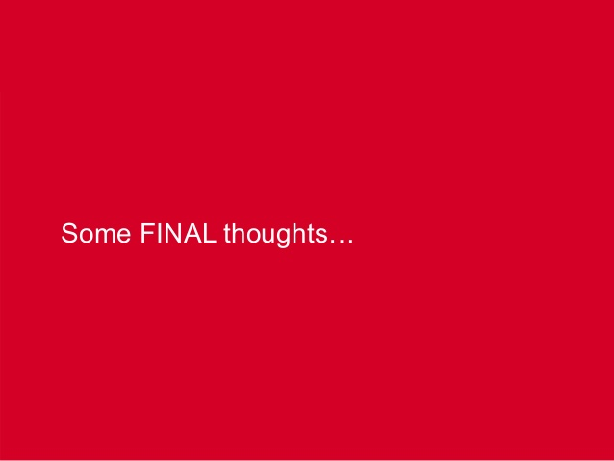
Some final thoughts …
1. Perceptions: White employees often have a freedom of being fully human in the work place...They can have good or bad days...Not always the case for black persons depending on a good or bad day they are either perceived as a beacon of righteousness or a angry/intimidating individual
2. What is it like to be in the minority in a particular industry? Cultural values that dominate workplaces can often make the minority cautious or uneasy because they feel alone. How would others feel if there were many more black people in a workplace then white people for instance? And why?
3. Advancement: the challenges of advancing in a predominantly white industry. What is the likelihood when the board, management are typically looking for someone like themselves?

Slide 9

Questions

Slide 10
Thank You …
I would like to thank you for your time and consideration. It is appreciated and not taken for granted .
My wish for all of us to #BeMoreEr (eg. kinder, healthier, politer, etc.) in the future.
Please feel free to contact me via:
Ed Gough, Jr.
edgoughjr@gmail.com

