Slide 1



CANADIANS SERVING
INTERNATIONALLY
Ministry Highlights
& Prayer Requests

Slide 2
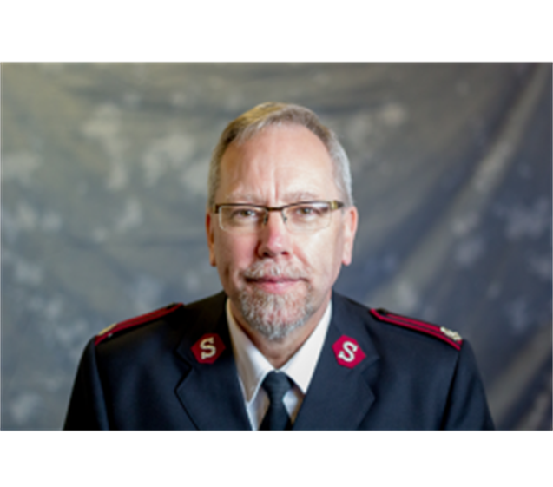
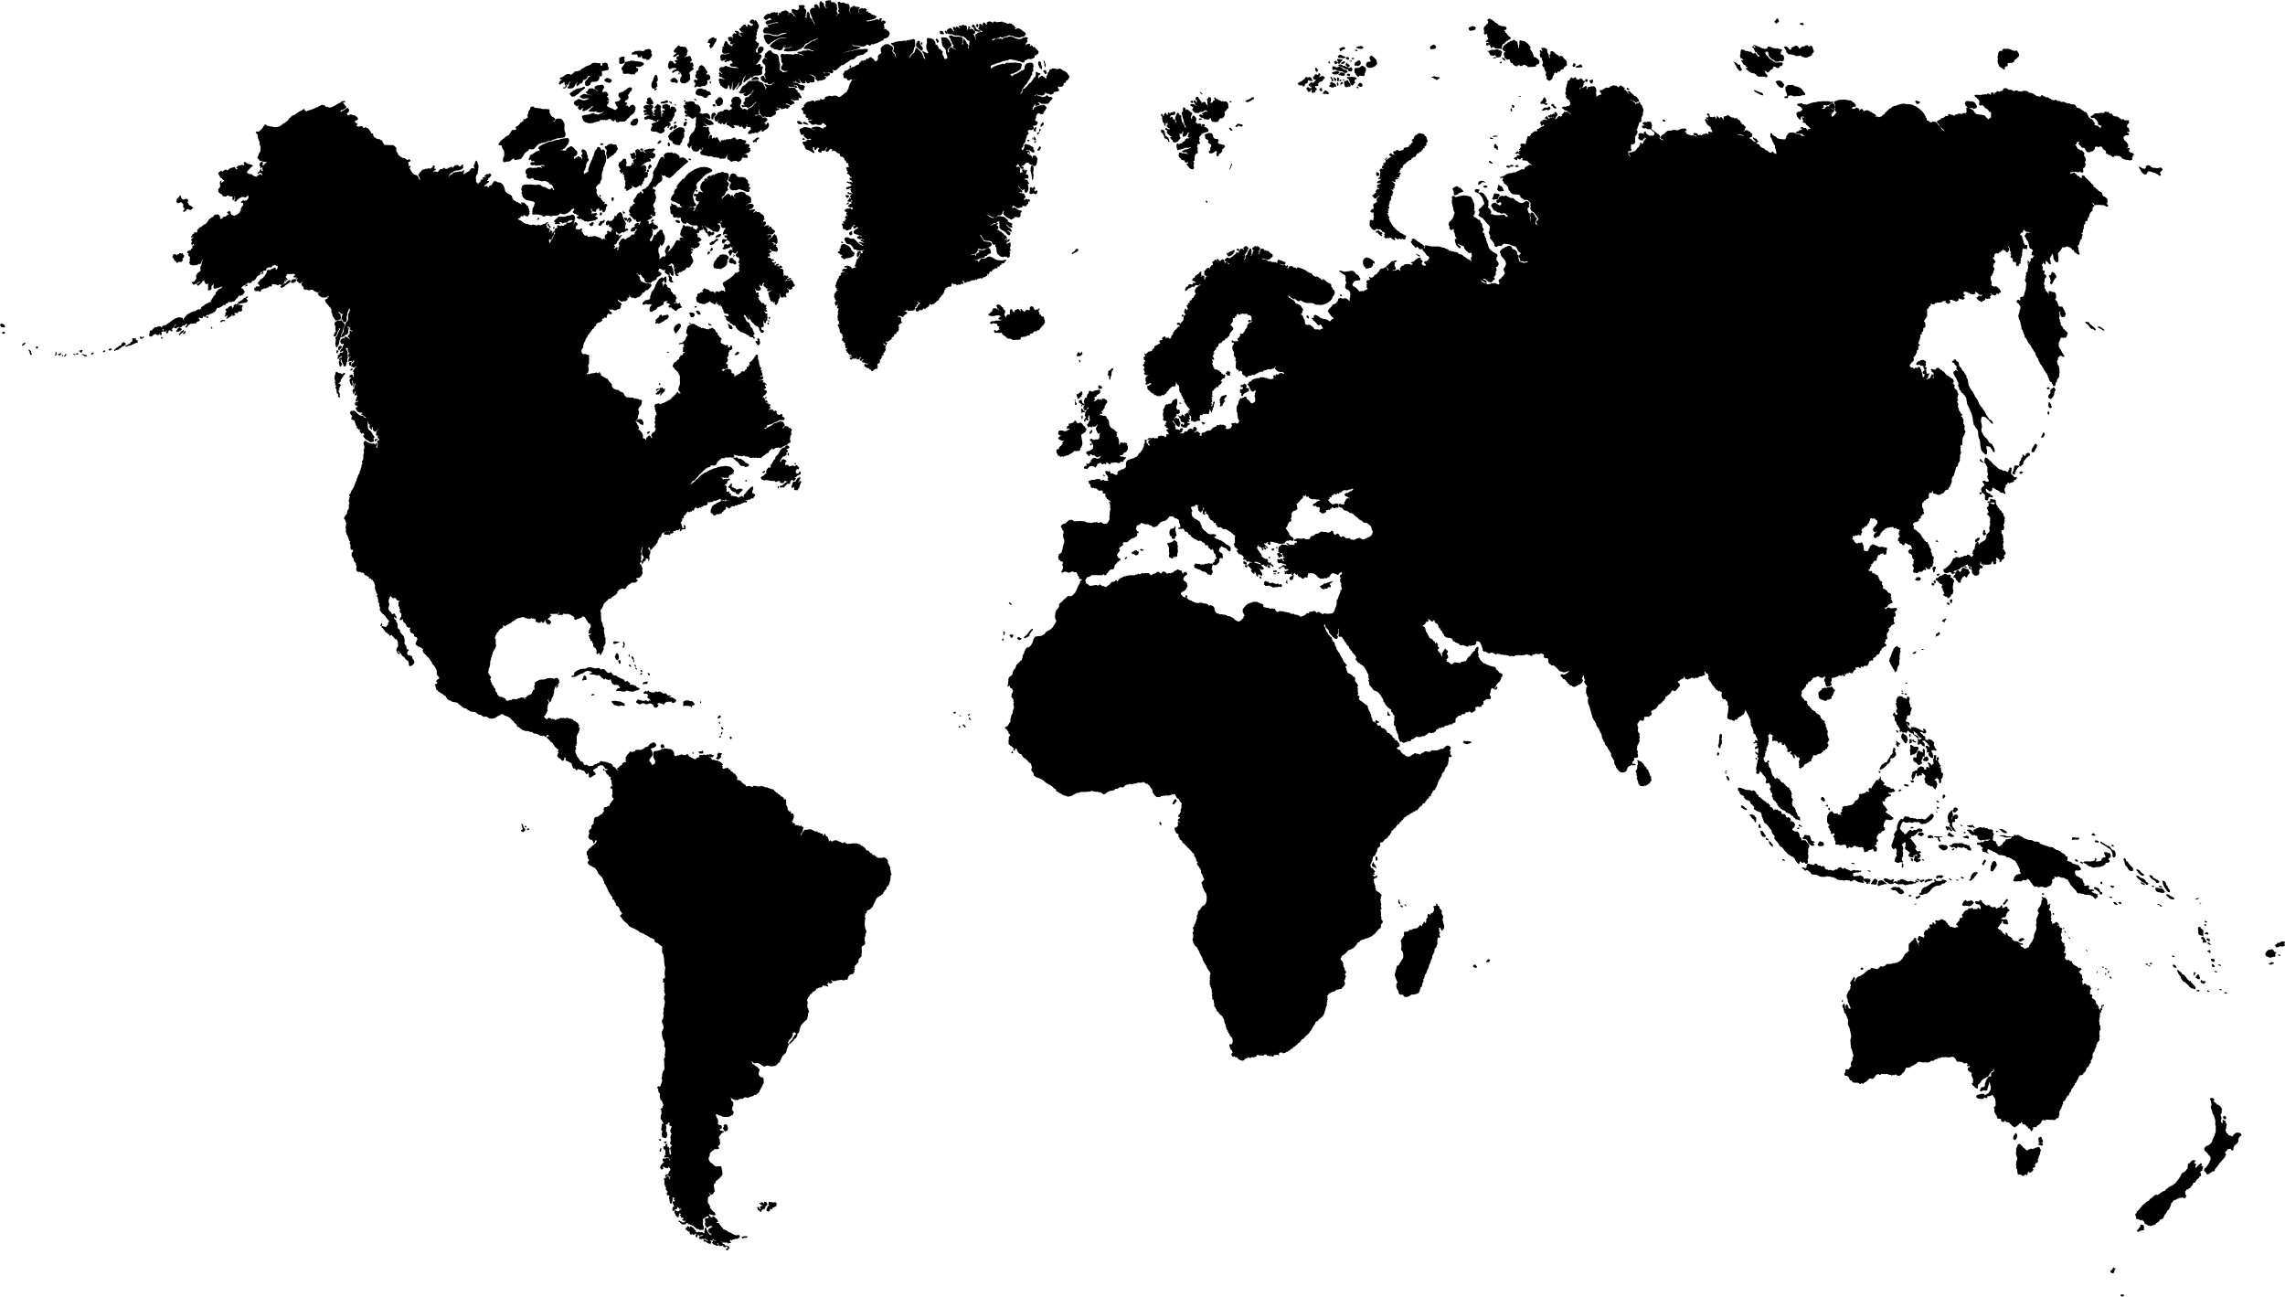

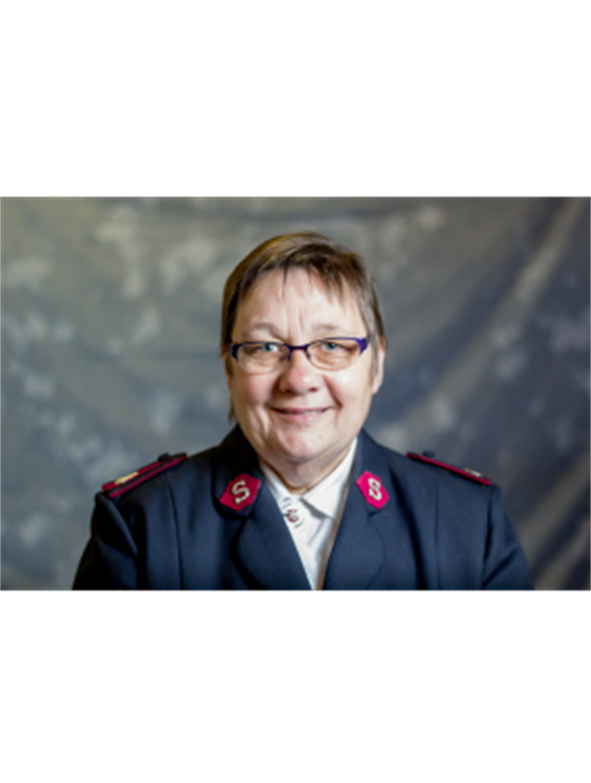



MAJORS COLIN
AND
MAUREEN BAIN
Corps Officers
Lurgan Corps, Ireland Division
United Kingdom & Ireland Territory

Slide 3


PRAYER REQUESTS
For our transition to retirement at the end of this appointment and return to Canada.
For the Lurgan Corps as we prepare for transition, and that they will have officers appointed.
For the process of mission discovery and enhancement of the community work with our partners.

Slide 4
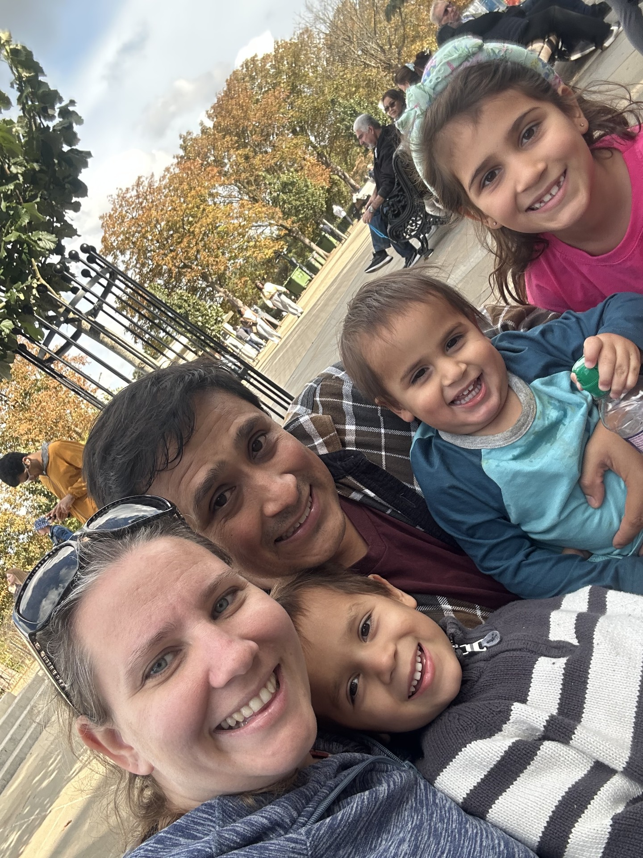
LIEUTENANT APRIL BARTHAU
LIEUTENANT MARCO HERRERA-LOPIZIC
Older People’s Residential Care Coordinator & Assistant Health Services Officer
International Health Services Coordinator
With Hadassah, Elijah and Caleb
International Headquarters

Slide 5
PRAYER REQUESTS
  For our family as we settle into a very different environment and for the children to choose good new friends.
  For Lt Marco and I as we learn more about our new appointments, that we take intentional time to hear God’s direction and have wisdom for moving our areas of responsibility forward.
  This Christmas season please pray with me that we will actively spread the good news of Immanuel and that the world would choose grace and shalom.

Slide 6
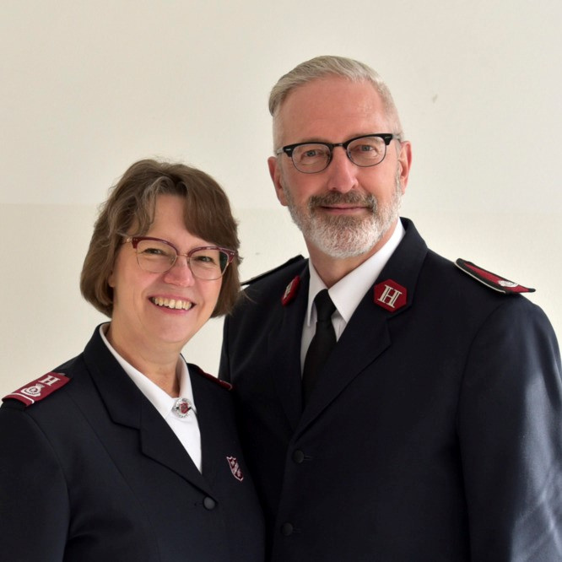
LT.COLONEL DAVID BOWLES
Corps Officer, Leipzig
LT.COLONEL MARSHA-JEAN BOWLES
Regional Leader Corps North-East
Germany, Lithuania and Poland Territory

Slide 7
PRAYER REQUESTS
  Thanks for the Lord’s grace and mercy during Luke’s illness. Prayer for our family as we continue to grieve, heal and adjust to life without Luke.
  For two of our kids, and their families, who no longer follow Jesus
  For our new ministries that will be attentive to God’s leading and direction
  For a renewed, passionate love for Jesus

Slide 8
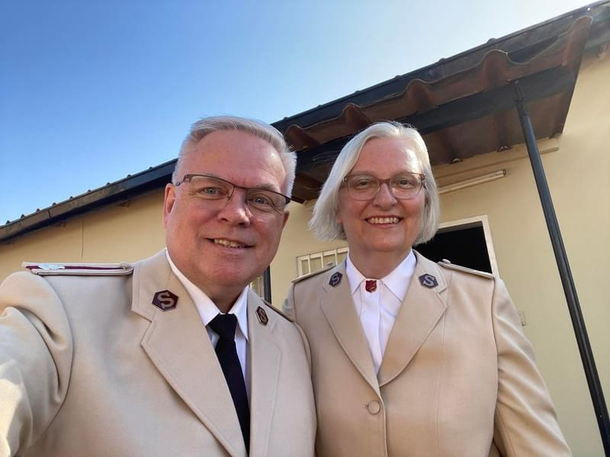
LT. COLONEL BRENDA CRITCH
Territorial Secretary for Spiritual Life Development
LT. COLONEL SHAWN CRITCH
Territorial Secretary for Business Administration
Zambia Territory

Slide 9
PRAYER REQUESTS
  For personal health and safety as travel within the territory becomes a greater expectation in 2026.
  For wisdom in ensuring operational decisions support the strategic plan of the territory.
  For the upcoming national election later this year. That unity and respect will take priority over protest and violence.
  Give thanks to God for the transformational events, the Territorial Brengle Institute and Marriage Enrichment Seminar last Fall, made possible by the financial support of the Canada and Bermuda Territory and a Canadian donor.
  Pray for the financial resources for more spiritual life development opportunities and for financial means to improve the standard of living of officers in Zambia.
  Pray God will continue to fulfill His purpose for our ministries in Zambia and that there will be “much fruit” for the Kingdom and in our personal lives.
  Pray God will bless our family in Canada and continue to meet their needs.

Slide 10
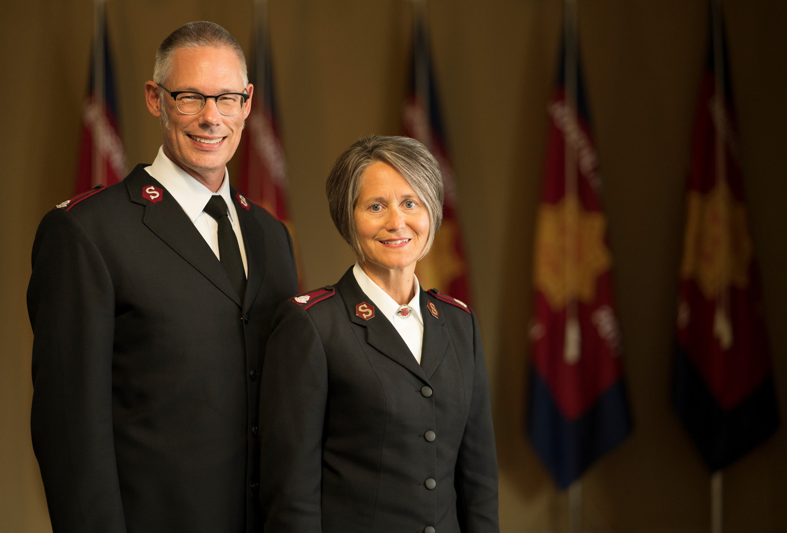
LT. COLONEL ANDREW MORGAN
Territorial Commander
LT. COLONEL DARLENE MORGAN
Territorial President of Women’s Ministries
Italy & Greece Territory

Slide 11
PRAYER REQUESTS
  Spiritual unity within the territorial leadership team. This is a true gift which we don’t take for granted.
  A dedicated THQ staff that serves with excellence.
  Health, and the ability to get out into nature.
  Discernment and boldness of officers for missional initiatives.
  A growing understanding of Governance in the territory, so that accountability in all Kingdom matters will likewise grow.
  Wisdom to prioritize the demands of having several roles.

Slide 12
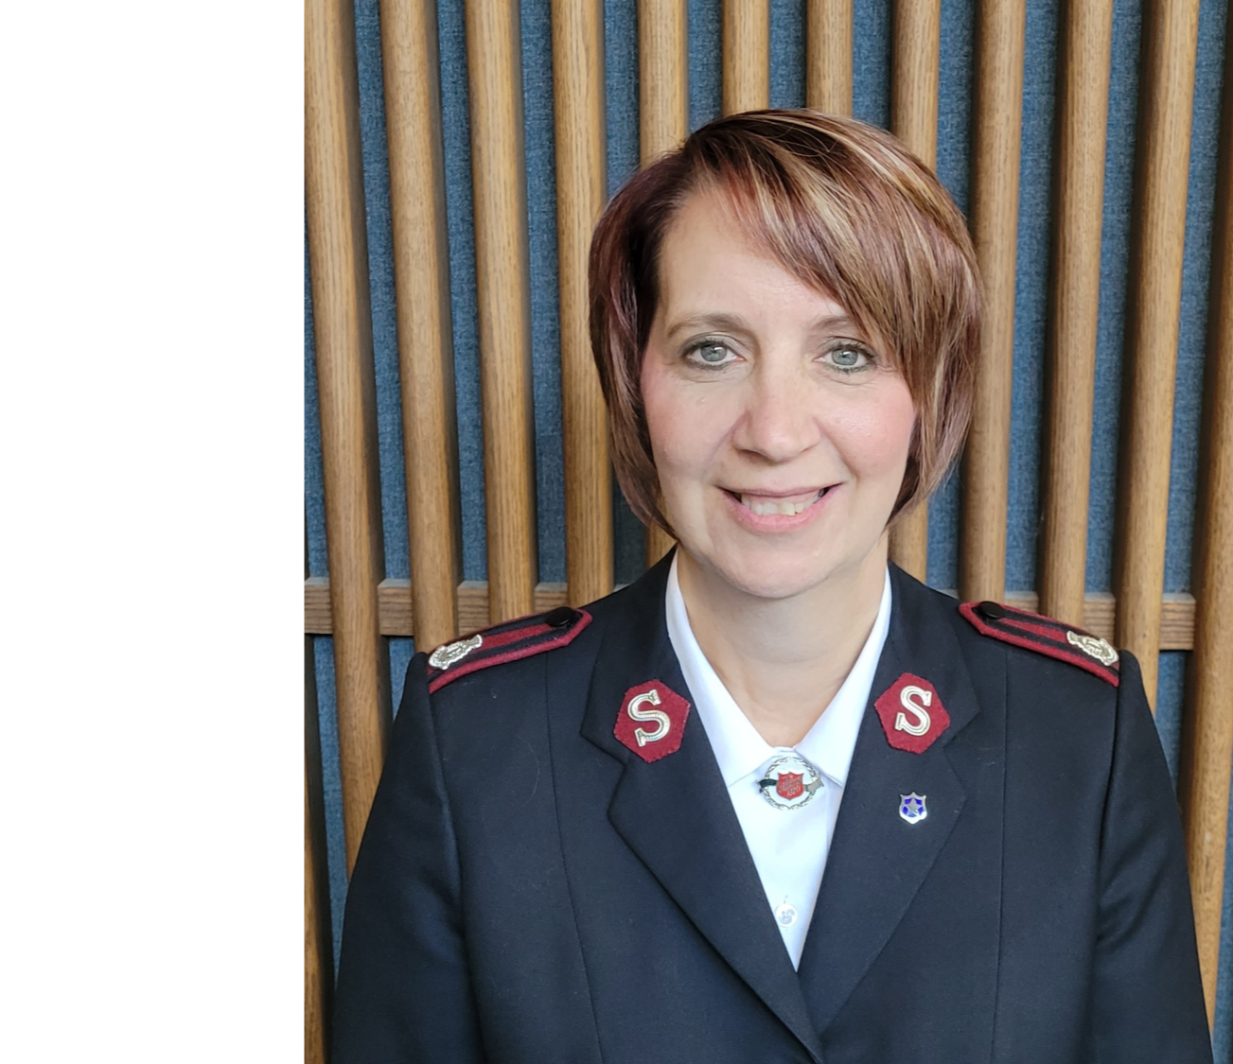
MAJOR WENDY MOULAND
Private Secretary to the Chief of the Staff
International Headquarters

Slide 13
PRAYER REQUESTS
  Spiritual Discernment: That I may be led by the Holy Spirit to clearly discern God’s perfect will for my life and ministry.
  Protection: God’s covering, safety, and strength for my family, friends, and ministry colleagues worldwide.
  Gratitude: Thanksgiving for God’s faithfulness—His constant sustaining, encouraging, and blessings beyond anything I could ask or imagine.

Slide 14
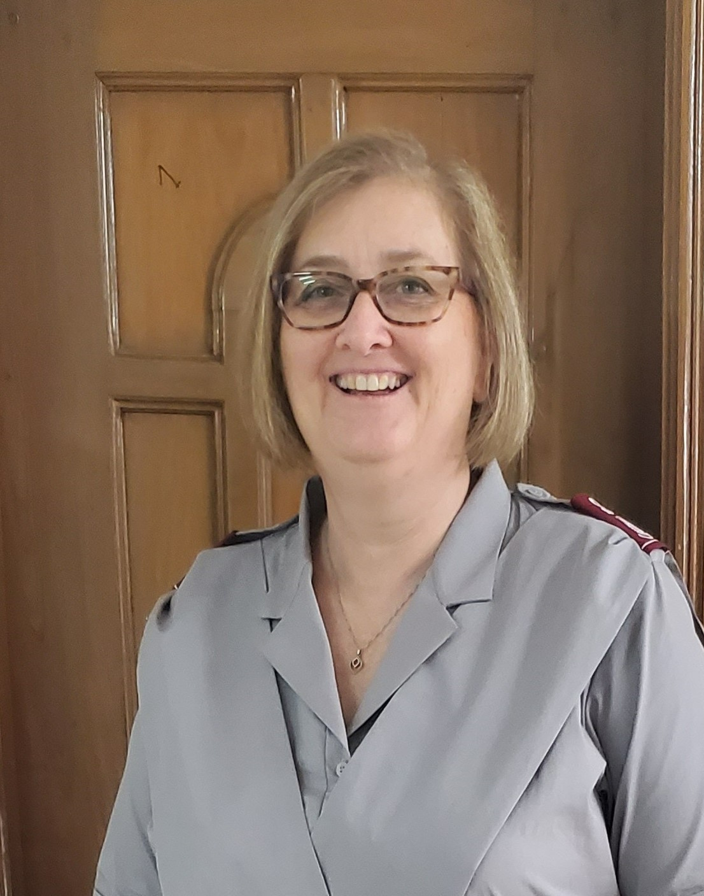
LT. COLONEL
ELIZABETH NELSON
Territorial Commander
Bangladesh Territory

Slide 15
PRAYER REQUESTS
  Our Training College - 7 cadets will be welcomed in January for the Proclaimers of Transformation session. We are thankful for the new college staff who are preparing for the session and training programme. The Training College is opening after being closed for a year. Praying that God will lead and equip them all in the months ahead.
  Personnel - We are in critical need of some qualified, capable staff to fill some positions that are vacant, and soon to be vacant, due to retirements. We struggle to find capable staff for positions that are important to the effectiveness of our work.

Slide 16
  Sally Ann - We are so grateful for our Sally Ann company and for the way that it is growing and the support it is able to give to the Army's work. It is going through some growing pains, and we need new staff to take over some key positions as some staff prepare to retire. Finding people with a heart for Sally Ann's mission and work culture is not easy, especially someone who is Christian. Please pray that the right people are found for these positions.
  Spiritual Health of our officers and soldiers - through our Spiritual Life Development seminars and Officers Retreat, there is a desire to grow more in their walk with the Lord.
  Financial Sustainability - we will be working with some partners in 2026 to develop plans for income generating programs that will help us on our financial sustainability. We are grateful for those who support us and want to help us develop our capacity to move towards financial sustainability.

Slide 17
  Political Unrest - the country will be working towards elections this year after having a caretaker government. The demonstrations and unrest has already started and we anticipate this will only grow as we get closer to election day. We are praying for peaceful and fair elections that are accepted so the country can move forward.
  Personally - The load is heavy some days. Please pray that every day that I continue to rely on the Holy Spirit's guidance and wisdom as we make decisions for the territory. There is much to do, but I always need wisdom to assess the priorities and not try to do it all. I would also ask for prayer for - health and strength and safety on the roads. Grateful for friendships and connections that speak into my life and encourage me on my walk.

Slide 18
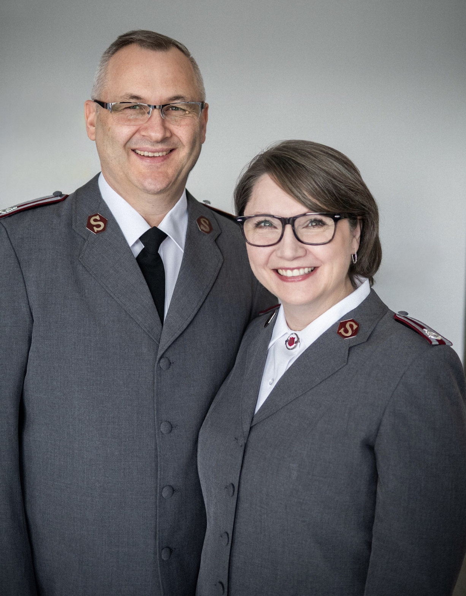
MAJOR KELLY RIDEOUT
Theological Formation Coordinator
Training College
MAJOR PAUL RIDEOUT
Training Principal
Training College
College for Officer Training – Tanzania Territory

Slide 19
PRAYER REQUESTS
  For our family
  For our ministry and the development of cadets
  For Ordination and Commissioning December 2026
  For Good health
  Peace and justice for the Tanzanian people.
  Gratitude for the Lord's guidance and provision.

Slide 20
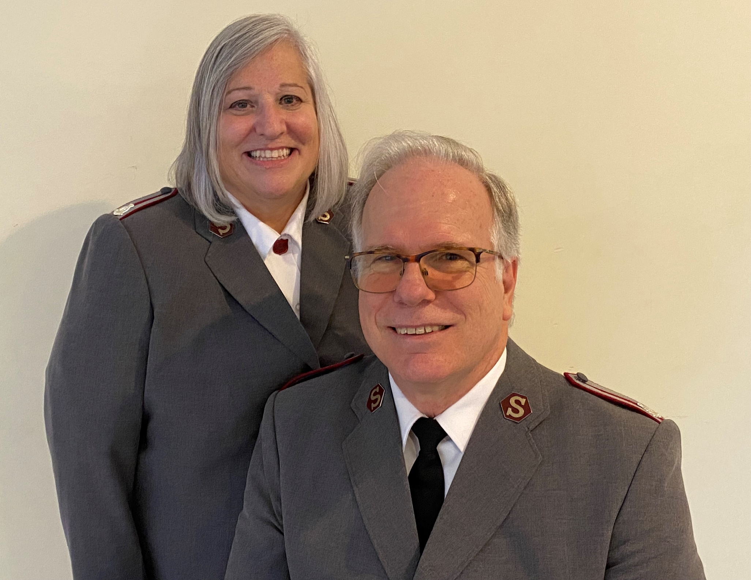
MAJORS DONNA &
ROYAL SENTER
Corps Officers
Freeport, Bahamas
Caribbean Territory

Slide 21
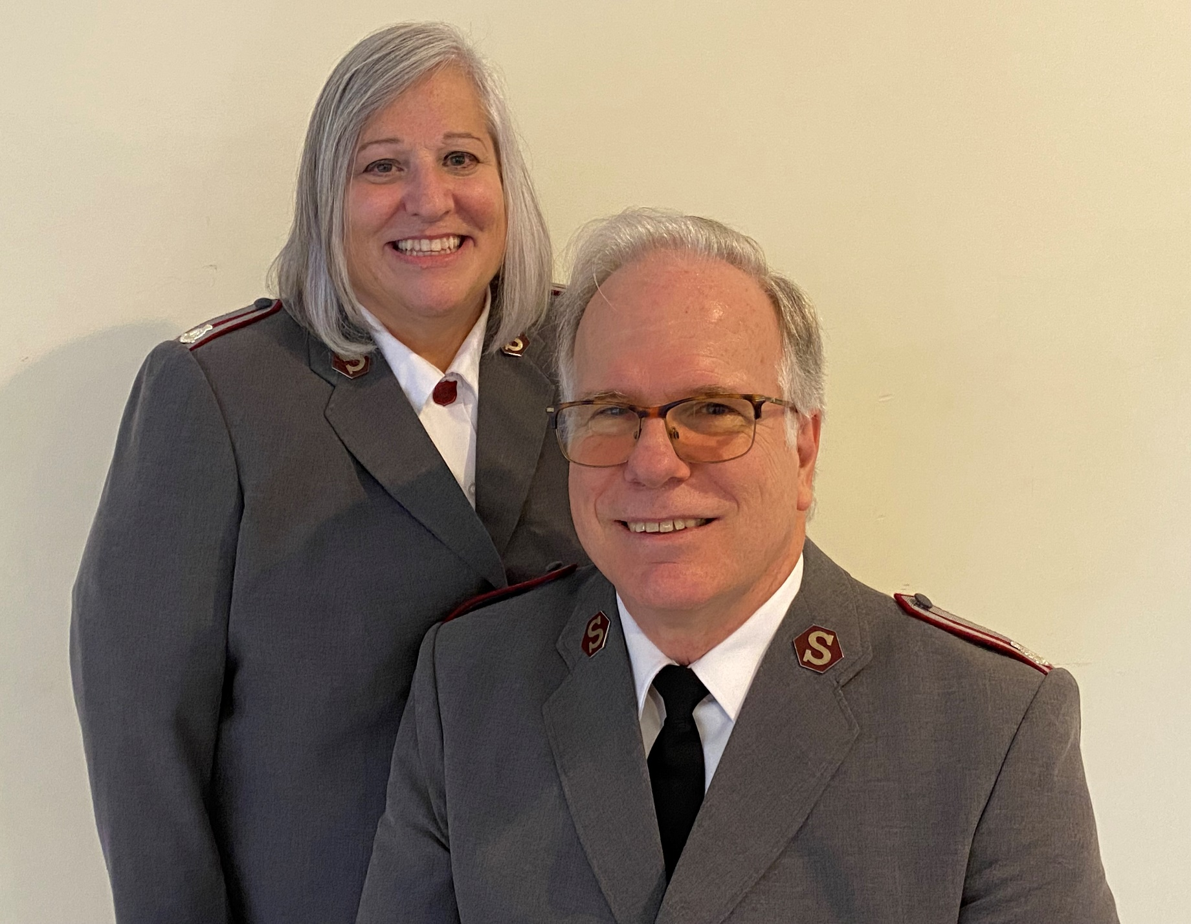
PRAYER REQUESTS
  Pray for spiritual and numerical growth in our corps - that God will lead us into new, innovative and effective ministries to accomplish both.
  Pray for the community or Freeport and Grand Bahama Island which has been struggling with economic decline and recovery from past devastating hurricanes. Young people frequently leave for other places in search of more opportunities.
  Pray for our strength and stamina as growth will require significant energy.
  Pray that we will find new personal fellowship opportunities.

Slide 22
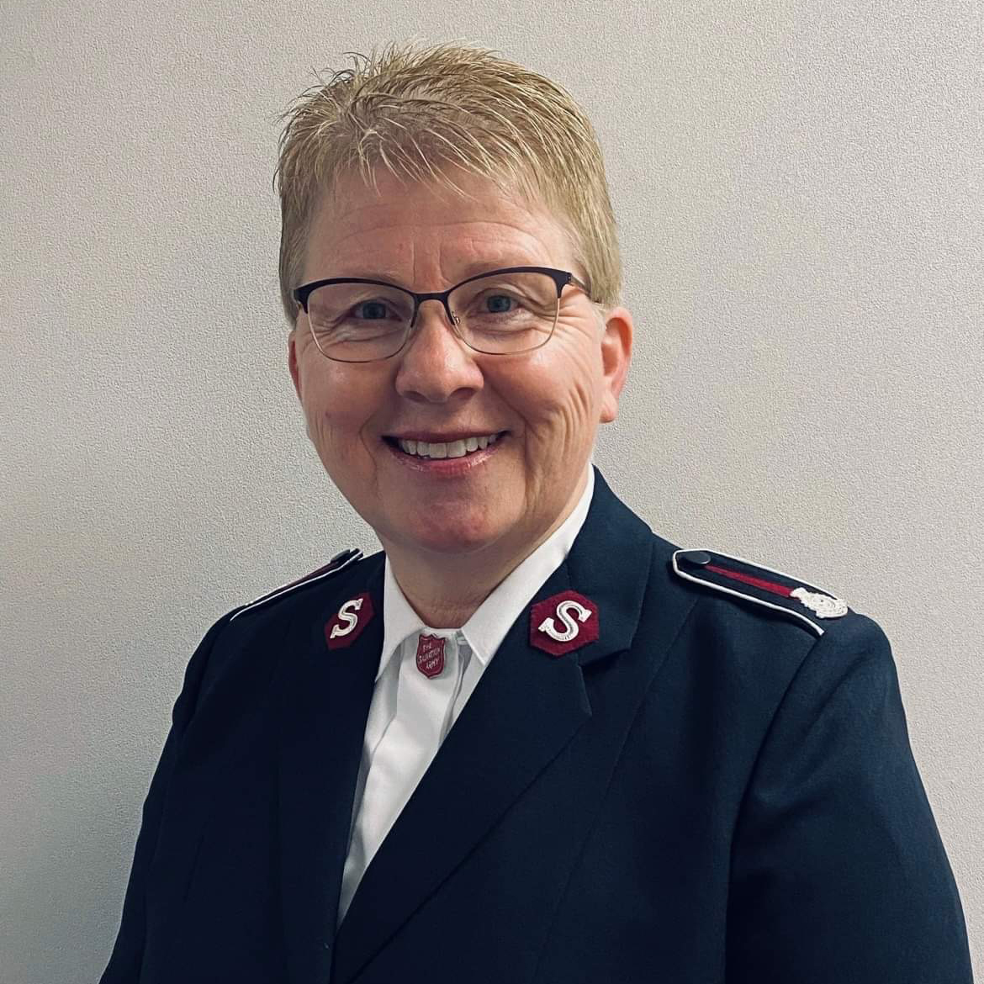
LT. COLONEL SANDRA STOKES
Territorial Commander
Denmark & Greenland Territory

Slide 23
PRAYER REQUESTS
  Health
  Continued grace and strength for transition to a new Country - culture and language.
  Wisdom, discernment and courage in decision making.

Slide 24
  Candidates Strategy: With a desire to ensure the bright future of the Army, we ask for wisdom to create a strategy that fits our culture.
  Discipleship: Pray that disciple-making communities may shape our Corps, so that faith is deepened, lives are transformed, and everyday witness reflects faithful discipleship to Jesus for the young people in our territory.
  Financial Challenges: Please pray for wisdom and provision as the territory navigates significant financial challenges. With limited territorial resources, we need God’s wisdom and courage to step out in faith. Ask God to provide creative and sustainable solutions to support ongoing ministry.
  Recruitment: Please pray for recruitment and training of new members and Officers. Pray also that soldiers and adherents will take on local leadership responsibilities in the Corps.

Slide 25
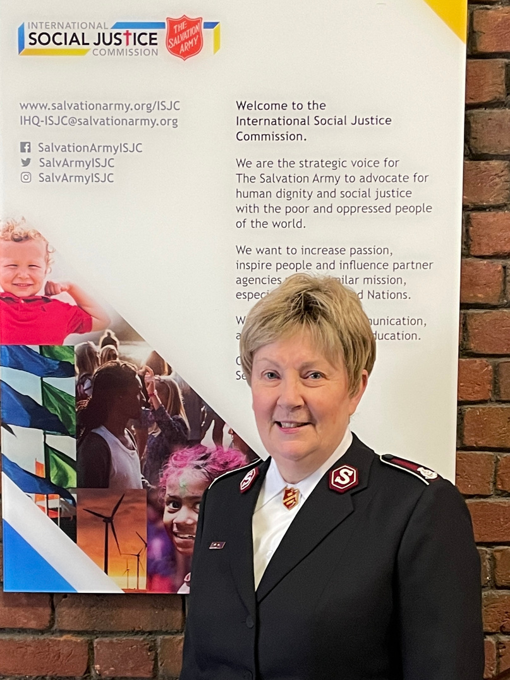
COLONEL WENDY SWAN
Director
International Social Justice Commission
International Headquarters

Slide 26
PRAYER REQUESTS
IHQ-International Social Justice Commission
  Just completed the 2025-2040 Strategic Plan which envisions the role of The Salvation Army in the public international sphere – where would we like to be, where should we be and where do we need to be?
  New personnel are moving into position for the Army’s Geneva (human right in social and economic matters) and Vienna (drugs, crime, modern slavery and Human trafficking) United Nations’ offices.

Slide 27
IMASIC (International Moral and Social Issues Council – I am the Chair)
  New International Positional Statements being released
    Gender Based Violence
    Religious Freedom
    Use of Power (a revision from 2011)
  Continued work on new statements
    Eradication of Extreme Poverty
    Displacement of Peoples
PERSONAL
  Working out daily the unthinkable and unexpected loss of Ian.
  After 30 years of international service, I am taking up a Canadian appointment effective April 1st.

Slide 28
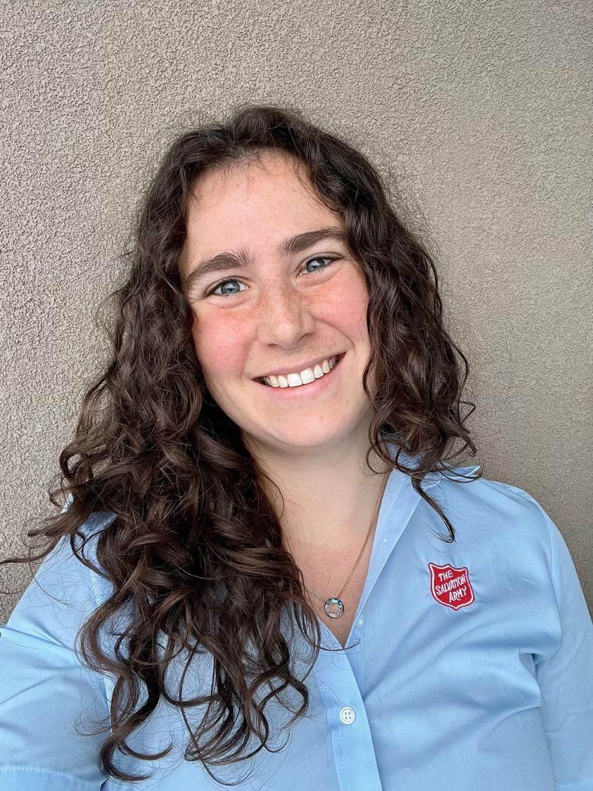
ALYSHIA VAN KANNEL
Director of Schools
(Early Education & Literacy)
Papua New Guinea and Solomon Islands Territory

Slide 29
PRAYER REQUESTS
  For unity in Christ and reconciliation in areas of increasing tribal fighting in PNG.
  For our children and young people, including for improved access to education and discipleship.
  For all our schools undergoing the national education restructure, and wisdom for me as I navigate how we can best support our officers, staff, communities, and students through it.

Slide 30
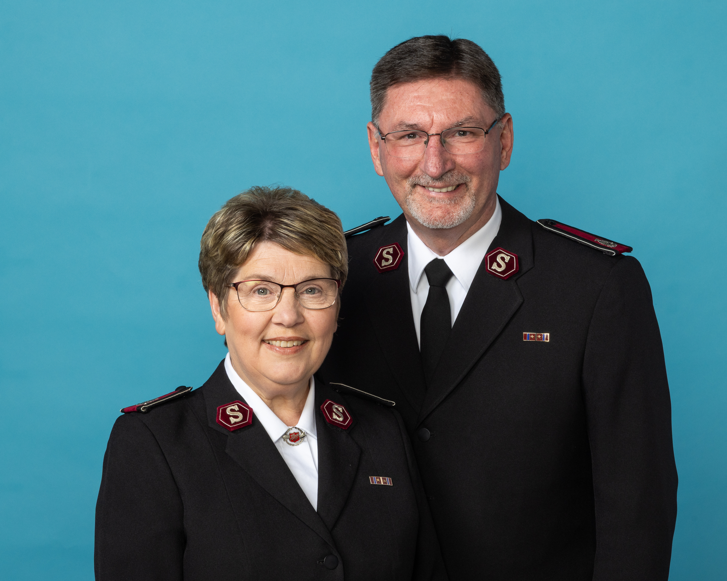
COMMISSIONERS EDDIE & GENEVERA VINCENT
International Secretaries
Americas & Caribbean Zone
International Headquarters

Slide 31
PRAYER REQUESTS
  The transition to our new appointments at IHQ and that God would provide safety and protection for the significant travels that will be part of these new responsibilities.
  We also ask people to pray that God will provide the wisdom necessary in navigating the complexities associated with supporting the needs of the Americas and Caribbean Zone.

Slide 32
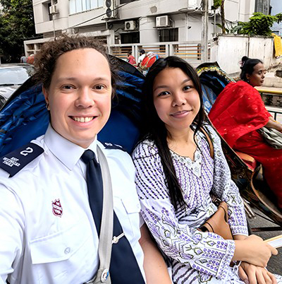
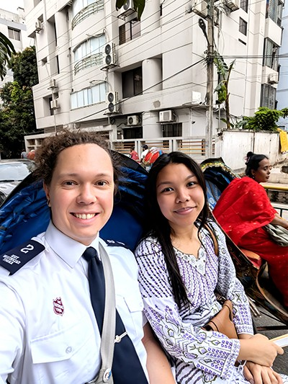
JAHRED WARKENTIN
Program Coordinator
JESSICA WARKENTIN
Development Officer
Bangladesh Territory

Slide 33
PRAYER REQUESTS
  Bangladesh elections (taking place in February 2026)
  Good health & safety
  Deepening friendships
  Ongoing language acquisition and cultural integration
  Community development strategy
  Wisdom and guidance for managing our project portfolio
  New ministries and programs
  Reignited passion for the Gospel across the Territory

Slide 34


