Slide 1
January 2020
Featured this month:
“Salvationist women have a voice our world needs to hear,” says Captain Laura Van Schaick.
Mark and Kelsie Burford knew they were meant for officership, but when?
Why Jesus’ race matters.

Slide 2
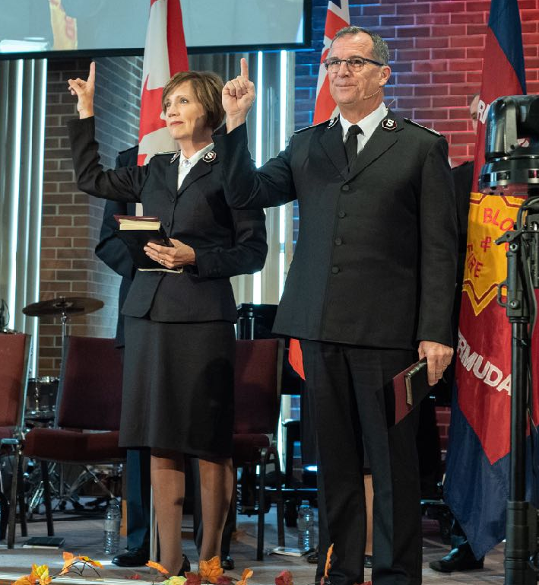
January 2020
A New Chapter Begins
Commissioners Floyd and Tracey Tidd are installed and welcomed as leaders of the Canada and Bermuda Territory.

Slide 3
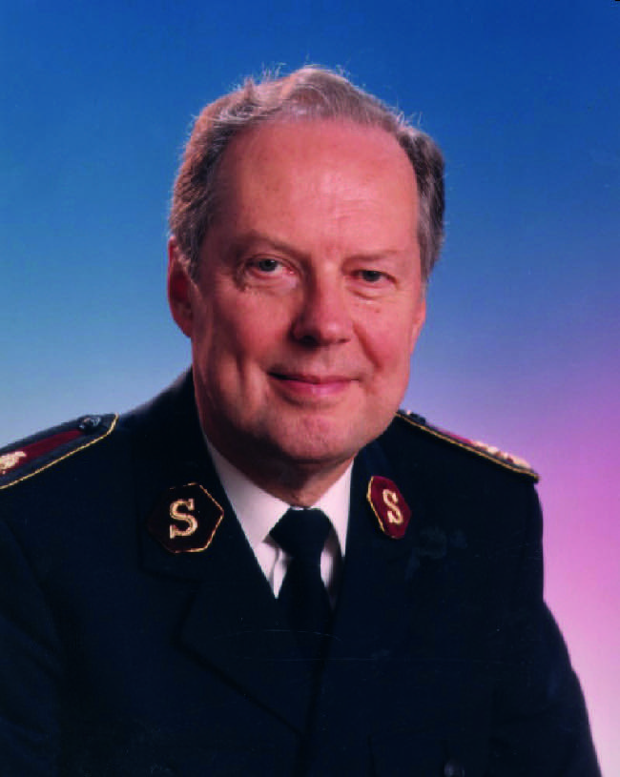
January 2020
A General’s Journey
Celebrating the life and ministry of the late General Bramwell H. Tillsley.

Slide 4
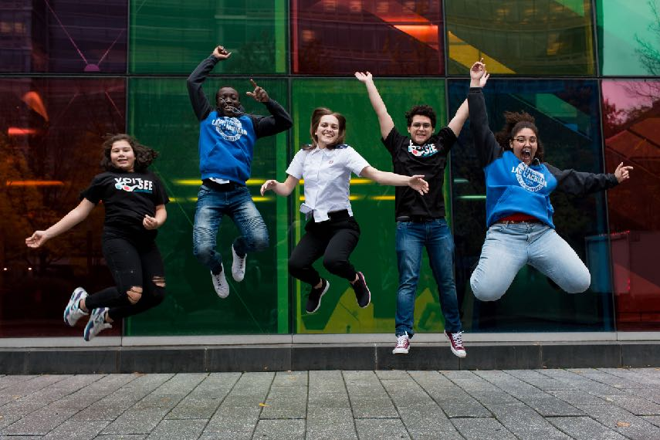
January 2020
Change Your Perspective
Territorial Youth Congress is an opportunity to see that God is doing a new thing in Canada and Bermuda.

Slide 5
January 2020
Featured this month:
After a devastating hurricane, a baseball player and The Salvation Army assist the Bahamas.
A simple question changed the course of Kevin’s life.

Slide 6
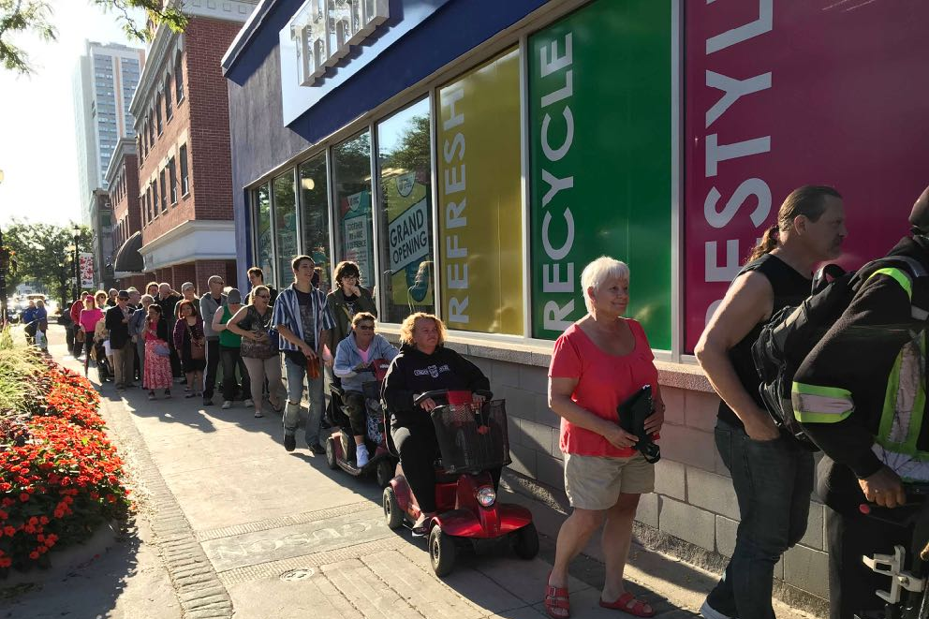
January 2020
More in Store
When a Salvation Army thrift store was threatened with closure, the community rallied to save it.

Slide 7
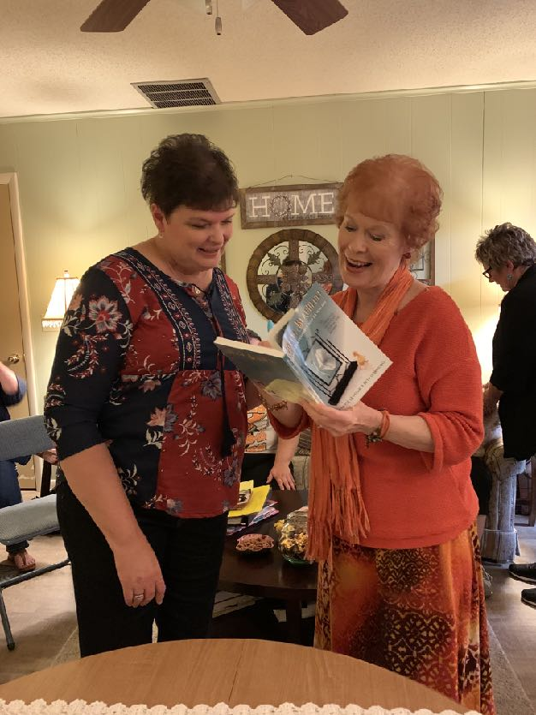
January 2020
People Like Hannah
How could Jeanette Levellie help others find answers, when her life seemed so out of control?

Slide 8
January 2020
Featured this month:
Go to the temple with Jesus.
Find out how Jesus resisted temptation.
Meet John the Baptist.
Learn about the Trinity—Father, Son and Holy Spirit.
Plus stories, puzzles, colouring, jokes and more!

Slide 9
January 2020
Pick up your copy today!

