Slide 1
UltiPro Change Agent Network
UltiPro Change Management
July 10, 2017
Notes:
ACTION items…

Slide 2
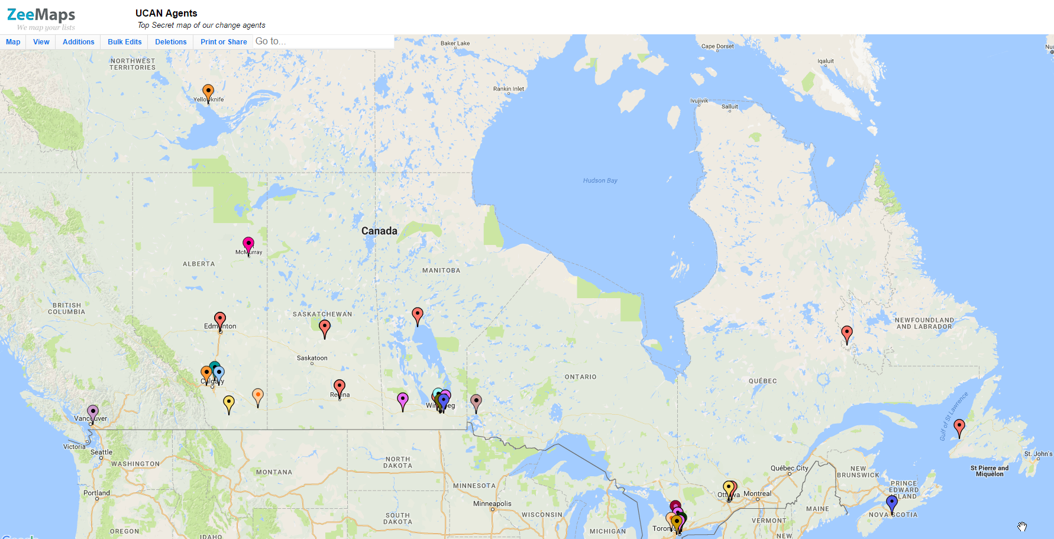
Add yourself – use link on UCAN web page (salvationist.ca/finance/ultipro/ucan)

Slide 3
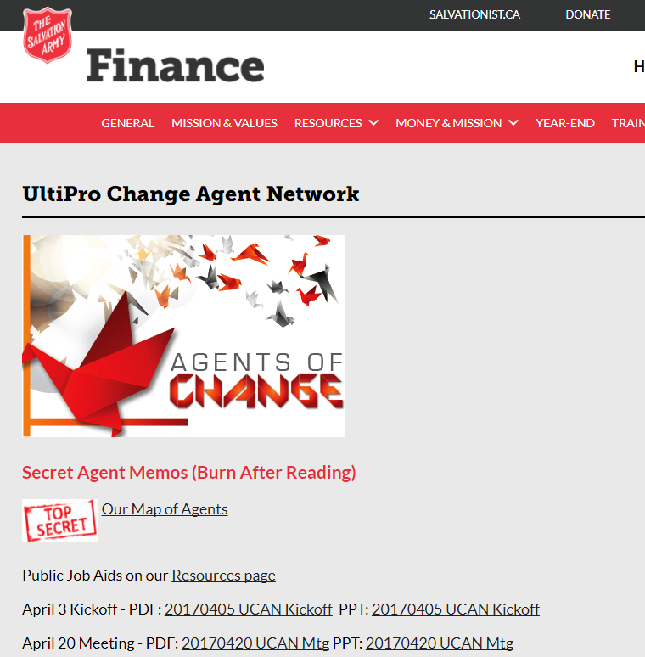
salvationist.ca/finance/ultipro/ucan

Slide 4



UltiPro Rollout
Jan | Feb | Mar | Apr | May | Jun | Jul | Aug | Sept | Oct | Nov | Dec | Jan | Feb | Mar | Apr
3
Testing
1
Unit/
Functional
Parallels
E2E
Phase 3: All remaining
divisions
Phase 1: THQ &
Jackson's Point
Data
Training
Training
Export, conversion, mapping, import
Dual maintenance
Support
*Staggered rollout
of Time/scheduling
functions through
March 2018 for select ministry Units
Time Entry Go-live
October 21 / 28*
1st Pay
Week of November 5
2
4
Phase 2: Prairies, NFLD,
all officers
Phase 4: NRO

Slide 5
Key Dates
Data collection from MUs starting next week and continuing through August
TBD MyArmy access opens for Phase 3
September 25 Training begins
October 21 or 28 Time Entry for Salary / Hourly
October 28? Employee Administrators gain access
November 6/7 Employee access
November 9 First Pay
Week Oct 21
Week Oct 28
Pay Week Nov 6
Salary paid for…
Hourly paid for…

Slide 6
Training
30%+ no-shows in Phase 2
  Training for Managers/Timekeepers/Admins is critical
  Solution: Schedule them?
  Send reminders
Train-the-Trainer
  Maritime approach
Early training
  Dual Maintenance – end of July
  Ramp up testers – early August

Slide 7
Roles
Who | What
Everyone | Navigating UltiPro Review my pay statement Change my personal information Request time off
Timekeeper | Reviewing, changing timesheets Entering time for hourly employees Entering overtime, unplanned time off Modifying shifts
Managers | Timekeeper functions Time Approvals (Hours worked, time off) Name change approvals Running reports
Administrators | Hiring, Terminating a staff member Modifying employee records including planned time off Assigning shift patterns Adding a second role (incumbency) Printing ROEs
Scheduler | TBD
Notes:
Say: We are making training available in many forms. We learned from phase 1 that many people, once they see the system, choose not to take training as they feel it is quite easy to use. Others are satisfied with a short cheat sheet showing them exactly how to do common tasks.
BUT, if anyone wants the training, it is available to them.
We are working on the logistics of how this will be offered. We recognize there are challenges with virtual training in some locations.

Slide 8
UCAN Sessions
All Wednesdays at noon…
Aug 9 - Aleks (reading your pay statement and other great literary works)
Aug 23 - Natalie/Anthony (things you might not have known about time entry)
Sept 6 - Muhammad (Workflows, notifications and the meaning of life with UltiPro)
Sept 13 - Matthew (reports are fun!) - Matthew will be reporting live from Las Vegas ;-)
Sept 20 - Cathy B (common considerations in setting up new hires; changes to benefits)
Sept 27 - Aleks (open Q&A for payroll)
Oct 4 - Muhammad (open Q&A for employee admin, etc.)
Oct 11 - TBD depending on open issues/questions
Oct 18 - Natalie/Anthony - Final prep for timekeeping
Oct 25 - Natalie/Anthony - Open Q&A on timekeeping
November 1 - Muhammad - final tips and reminders for employee admins

Slide 9
Q&A
Next time:
  Resources page

