Slide 1
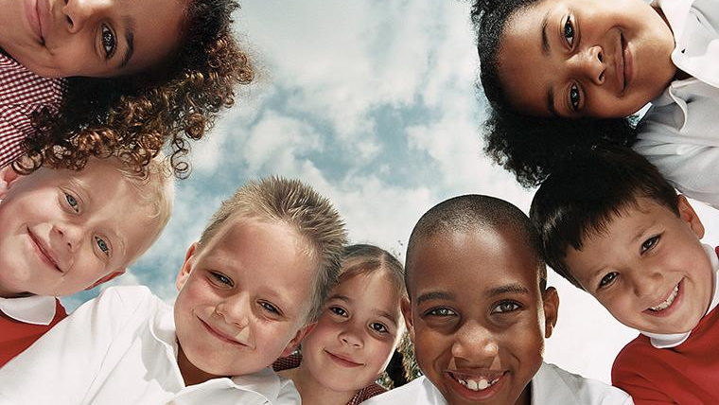
“whosoever” Creating a framework to better Understand Culture(s)
Salvation Army – Rev. Dr. Timothy Li-Hui Tang

Slide 3
Youtube: the complicated chinese family tree

Slide 4
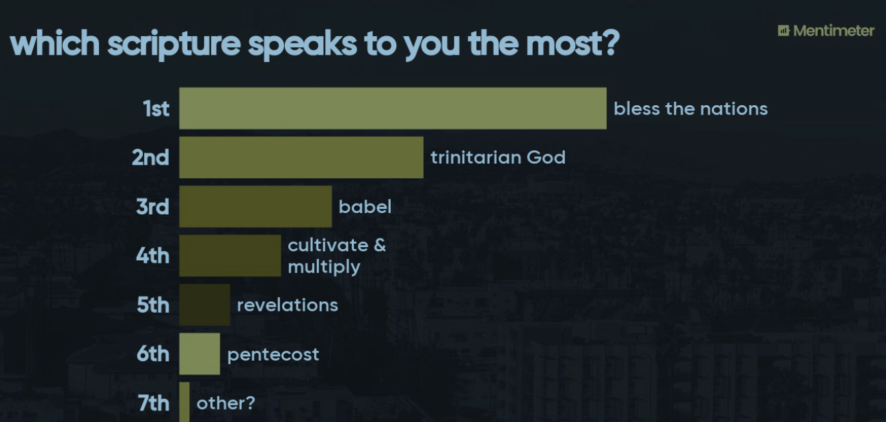

Slide 6
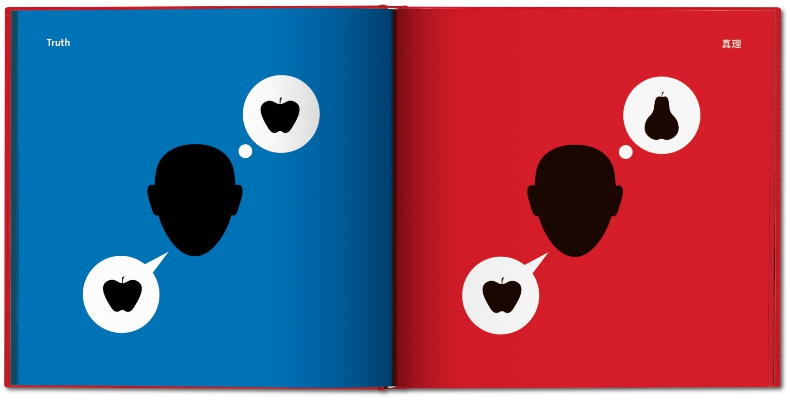

Slide 7
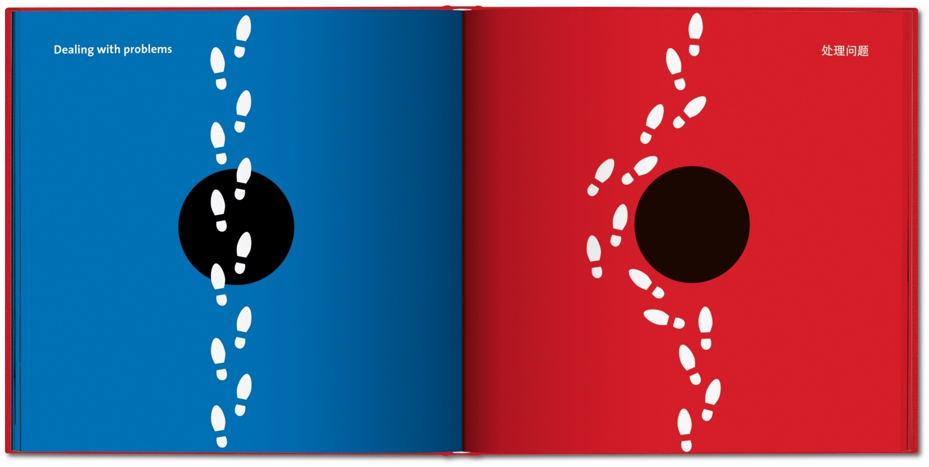

Slide 8
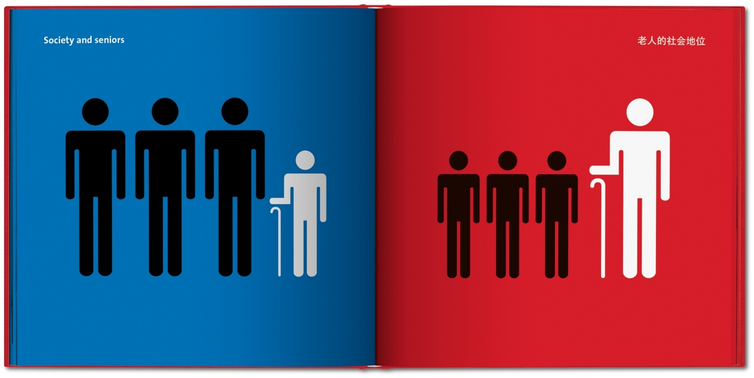

Slide 9
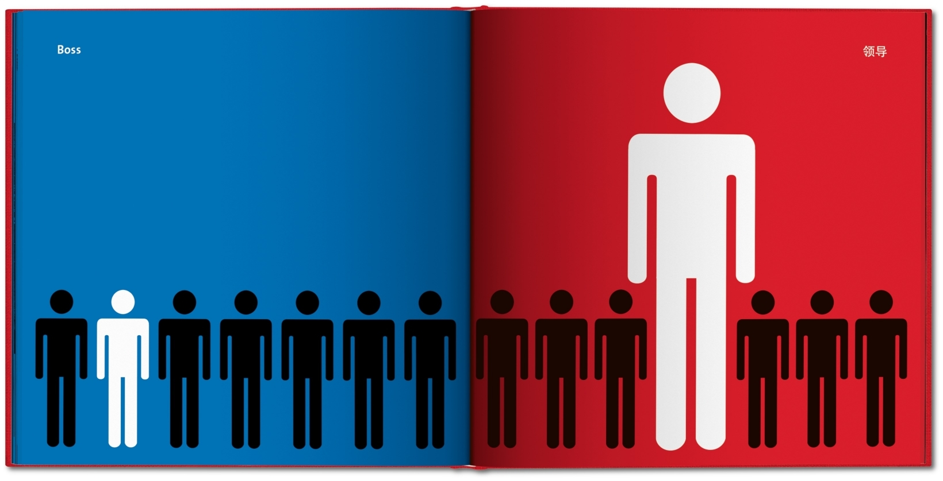

Slide 10
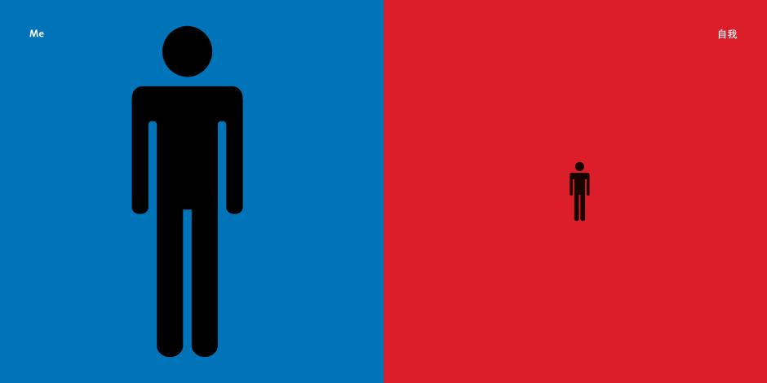

Slide 16
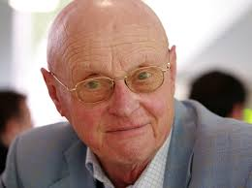
Geert Hofstede: https://bit.ly/2yXmATb

Slide 17
INTERCULTURAL DEVELOPMENT
Also referred to as: intercultural sensitivity, cultural intelligence, cross-cultural competency,
etc…
INTERCULTURAL MINDSET
attitudes
awareness
behaviour
Individual change
MONOCULTURAL MINDSET

Slide 18
INTERCULTURAL DEVELOPMENT
Stage based training
“transformation”
“inclusion”
“diversity”

Slide 19
INTERCULTURAL DEVELOPMENT
INTERCULTURAL MINDSET
Stage based training
Assessment based: Intercultural Development Inventory (IDI)
MONOCULTURAL MINDSET

Slide 20
Other books and resources
Minority Experience – Adrian Pei
From the Margins to the Centre – ed. Krause, Santos, Cousins
Strangers in the Kingdom – Das & Hamoud
The Multicultural Leader – Dan Sheffield

Slide 21
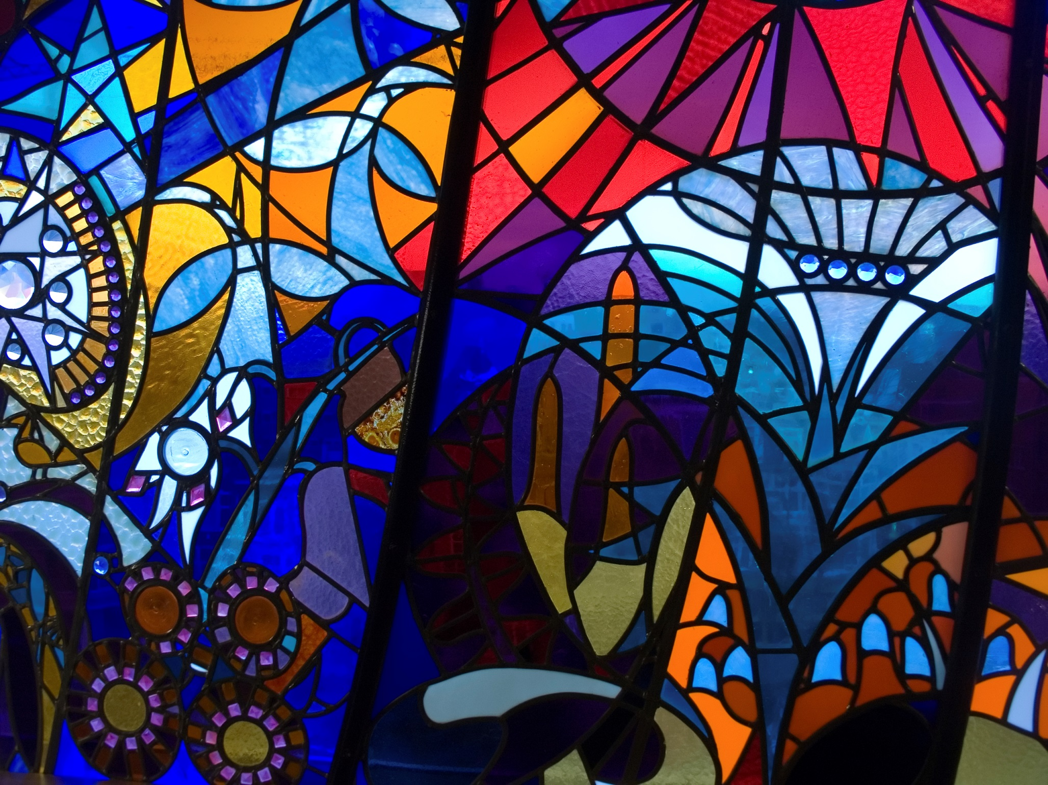
Immigrants, Refugees, and Canadian Churches
https://www.ureachtoronto.ca/finding-our-way/

