Slide 1







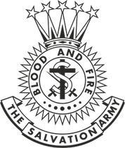

Adherent
Training
2024
The Salvation Army Canada & Bermuda Territory
www.corpsmission.ca

Slide 2

Adherent Training Course
Who is The Salvation Army?
What does The Salvation Army believe?
What is The Salvation Army’s place in the community?
How do I become a member of The Salvation Army?

Slide 3
WHO IS
The Salvation Army?
Session 1

Slide 4
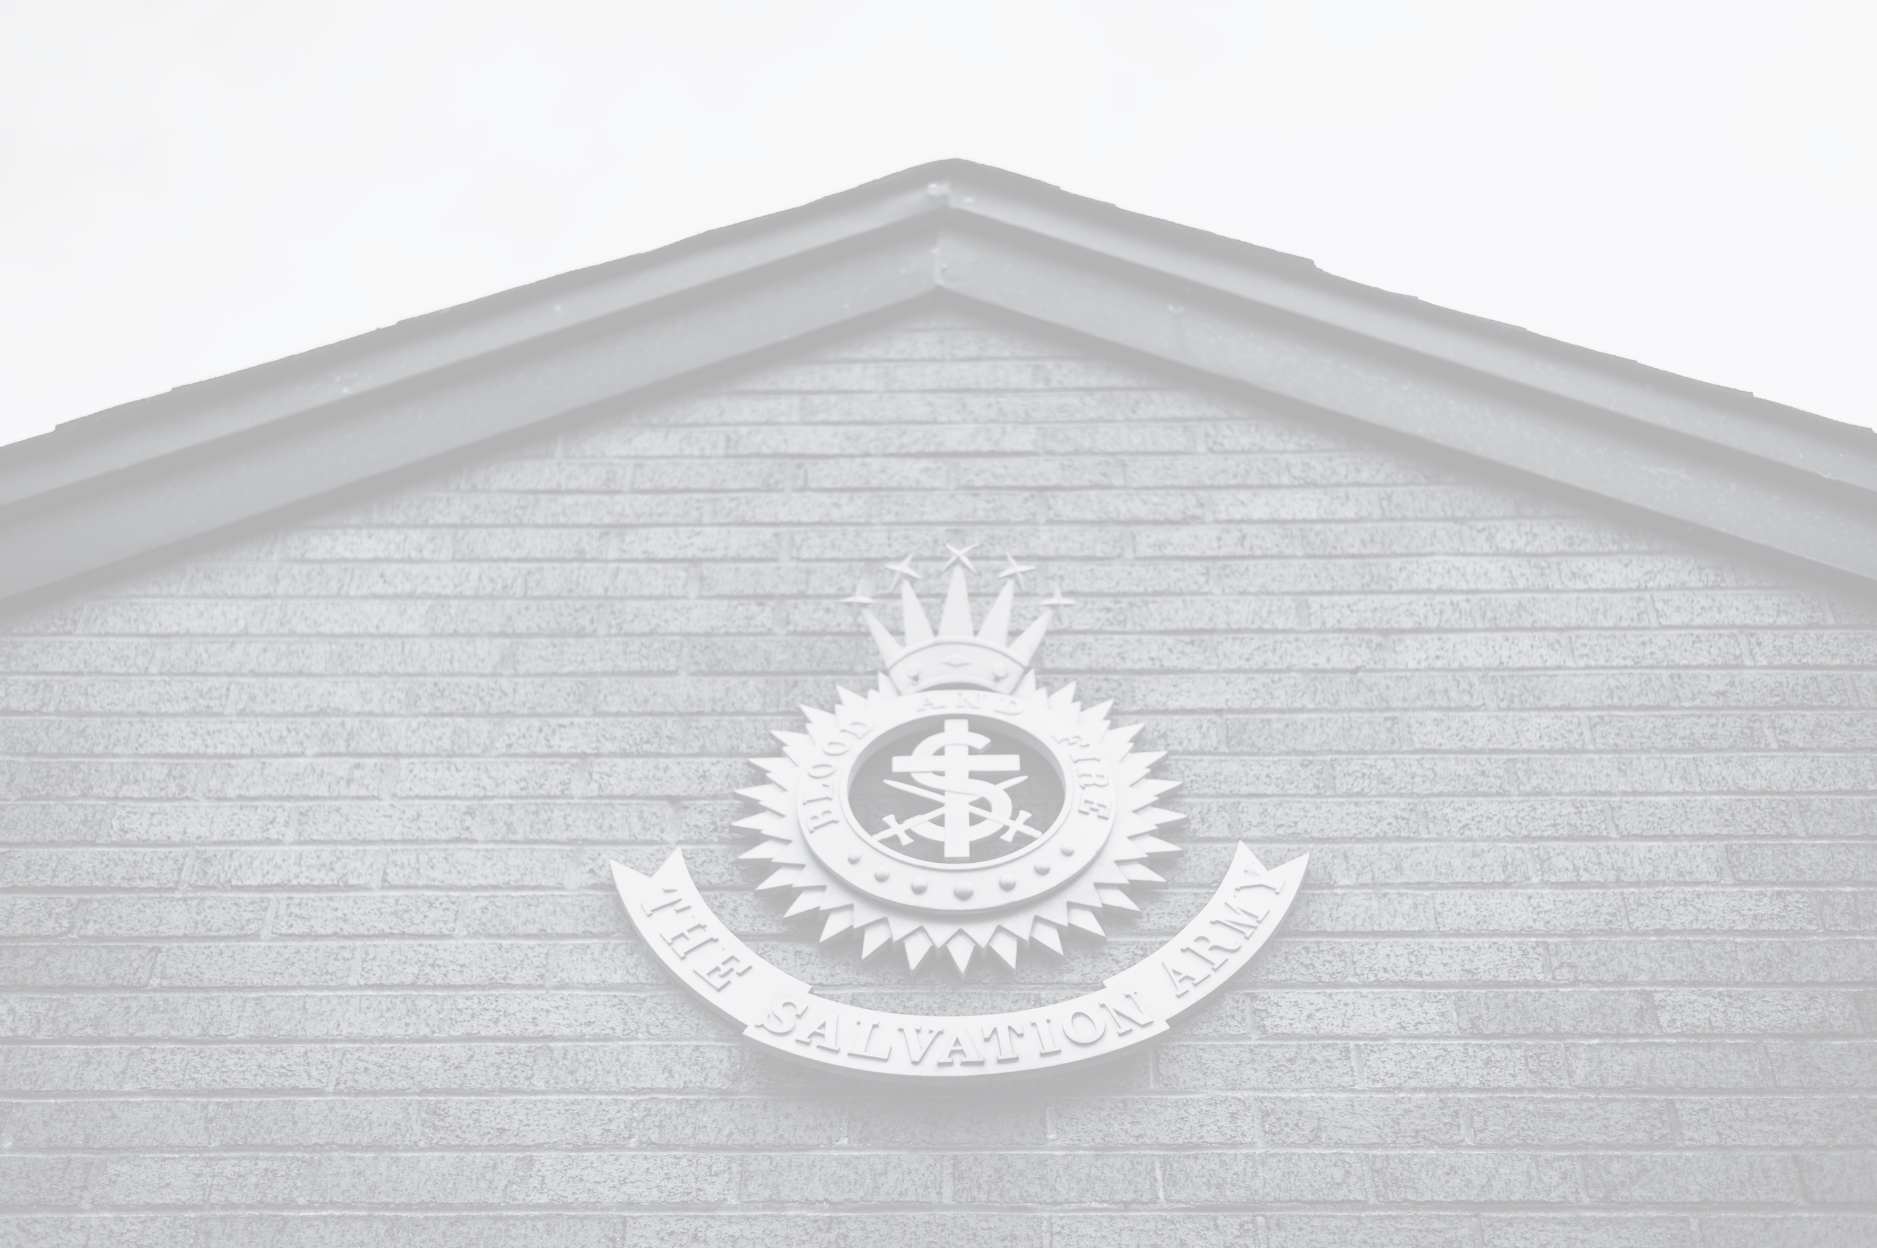



Vision And Mission
Vision
Mission
We are an innovative partner, mobilized to share hope wherever there is hardship,
building communities that are just and know the love of Jesus.
The Salvation Army exists to share the love of Jesus Christ, meet human needs and be a transforming influence in the communities of our world.

Slide 5


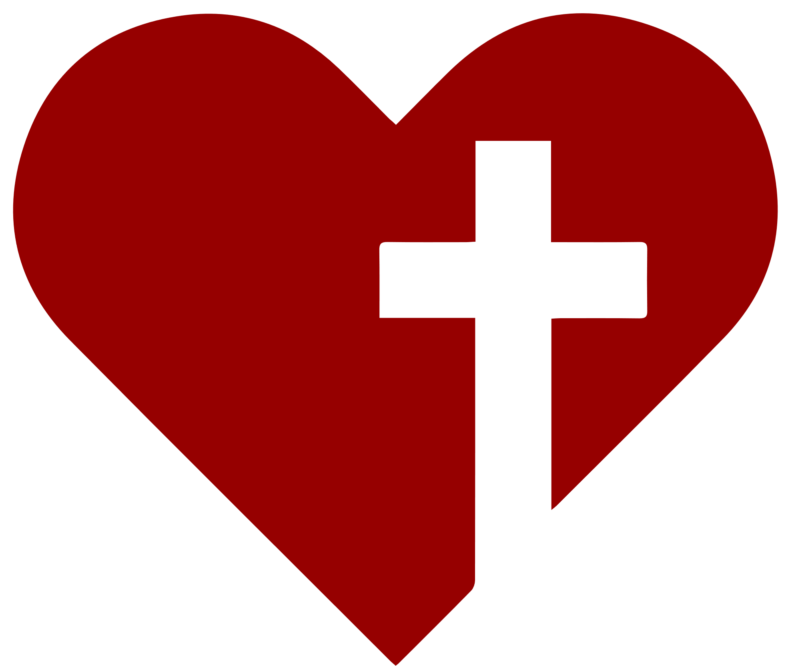



Core Values
HOPE
We give hope through the power of the gospel of Jesus Christ.
SERVICE
We reach out to support others without discrimination.
DIGNITY
We respect and value each other, recognizing everyone’s worth.
STEWARDSHIP
We responsibly manage the resources entrusted to us.

Slide 6

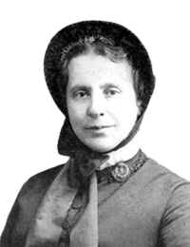
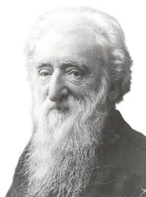
History
The Salvation Army was founded by William and Catherine Booth. William had been a minister of the Methodist Church.
1865 - The organization was originally called the Christian Revival Society and shortly after that was re-named the East London Christian Mission.
1867 - The organization grew rapidly and changed names again becoming known as the Christian Mission.
1878 - While William Booth was perusing a printer’s proof for a pamphlet which referred to the Christian Mission as a “volunteer army.” Booth swept his pen through the word “volunteer” and changed it to read “Salvation Army.”

Slide 7
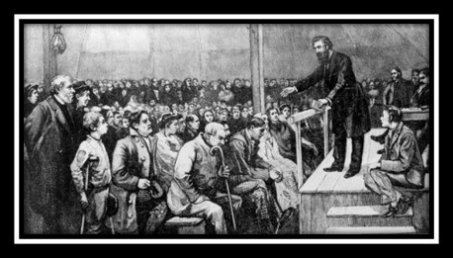
History cont’d...
1882 - The Salvation Army began its work in Canada just 15 years after Confederation, and quickly began giving hope to those in need.
1896 - The work began in Bermuda.
1909 - A Parliamentary Act solidified the Canadian status of The Salvation Army.

Slide 8
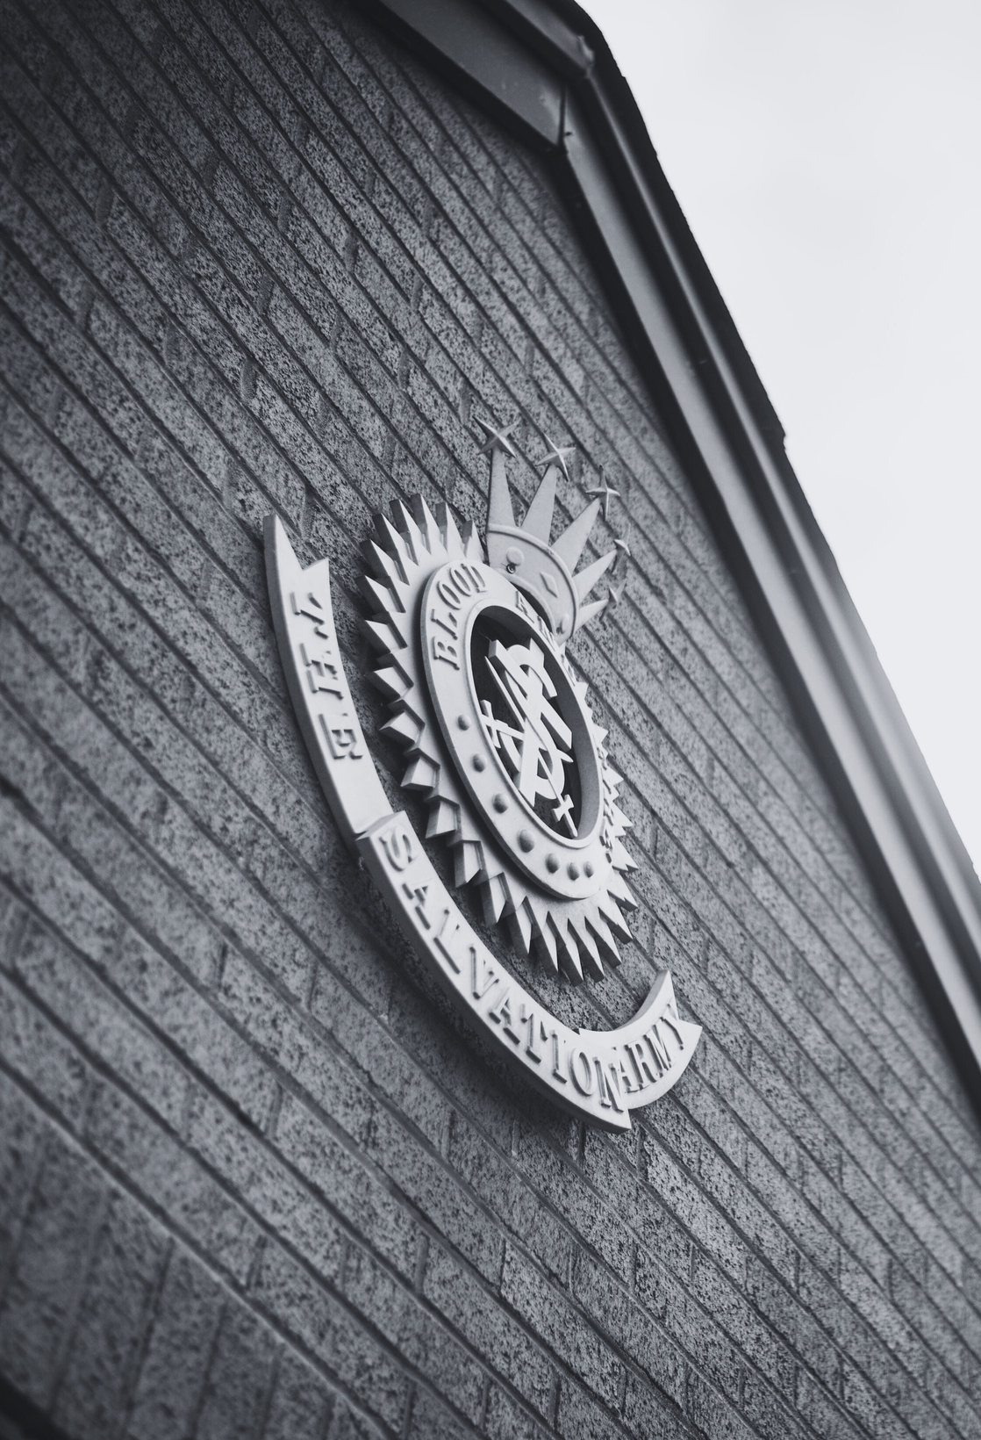
In Canada & Bermuda...
The Salvation Army has...
More than 500 active officers (clergy)
More than 14,000 soldiers
Close to 27,000 adherents
There are...
More than 250 corps (churches)
Just under 200 social service institutions
Over 70,000 volunteers
Just over 8,000 people employed by The Salvation Army in the Canada and Bermuda Territory
Close to 30 Canadian officers and lay staff also serve overseas

Slide 9
WHAT DOES
The Salvation Army
BELIEVE?
Session 2

Slide 10

Doctrines of
The Salvation Army
We believe that the Scriptures of the Old and New Testaments were given by inspiration of God, and that they only constitute the Divine rule of Christian faith and practice.

Slide 11
Doctrines of
The Salvation Army
We believe that there is only one God, who is infinitely perfect, the Creator, Preserver, and Governor of all things, and who is the only proper object of religious worship.

Slide 12
Doctrines of
The Salvation Army
We believe that there are three persons in the Godhead – the Father, the Son and the Holy Ghost, undivided in essence and co-equal in power and glory.

Slide 13
Doctrines of
The Salvation Army
We believe that in the person of Jesus Christ the Divine and human natures are united, so that He is truly and properly God and truly and properly man.

Slide 14
Doctrines of
The Salvation Army
We believe that our first parents were created in a state of innocency, but by their disobedience they lost their purity and happiness, and that in consequence of their fall all men have become sinners, totally depraved, and as such are justly exposed to the wrath of God.

Slide 15
Doctrines of
The Salvation Army
We believe that the Lord Jesus Christ has by His suffering and death made an atonement for the whole world so that whosoever will may be saved.

Slide 16
Doctrines of
The Salvation Army
We believe that repentance towards God, faith in our Lord Jesus Christ, and regeneration by the Holy Spirit, are necessary to salvation.

Slide 17
Doctrines of
The Salvation Army
We believe that we are justified by grace through faith in our Lord Jesus Christ and that he that believeth hath the witness in himself.

Slide 18
Doctrines of
The Salvation Army
We believe that continuance in a state of salvation depends upon continued obedient faith in Christ.

Slide 19
Doctrines of
The Salvation Army
We believe that it is the privilege of all believers to be wholly sanctified, and that their whole spirit and soul and body may be preserved blameless unto the coming of our Lord Jesus Christ.

Slide 20
Doctrines of
The Salvation Army
We believe in the immortality of the soul; in the resurrection of the body; in the general judgment at the end of the world; in the eternal happiness of the righteous; and in the endless punishment of the wicked.

Slide 21
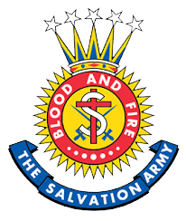

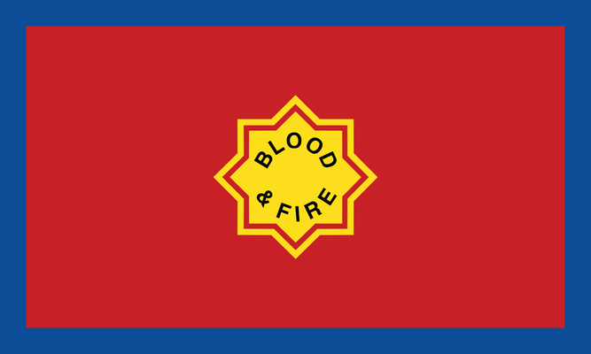
Symbols
The Shield
The Crest
The Flag
The Salvation Army shield was first used in the early 1900’s. While advertisements for shield brooches, badges and other items appeared in the War Cry as early as 1914, the earliest reference to the official use of the present shield appeared in the 1918 Fall edition of the Canadian War Cry.
Shortly after The Salvation Army’s War Congress (1878) when the name of the fledgling movement changed from “The Christian Mission” to “The Salvation Army”, Captain William H. Ebdon submitted the design for the crest that graphically illustrated the Army’s fundamental doctrines.
Around the world, The Salvation Army flag is a symbol of the Army’s war against sin and social evil. The red of the flag represents the blood of Christ, the blue border stands for purity, and the yellow star in the centre signifies the fire of the Holy Spirit. The flag is used at special occasions such as marriages, funerals, marches, open-air meetings, enrolments of soldiers, farewells, and retirements.

Slide 22
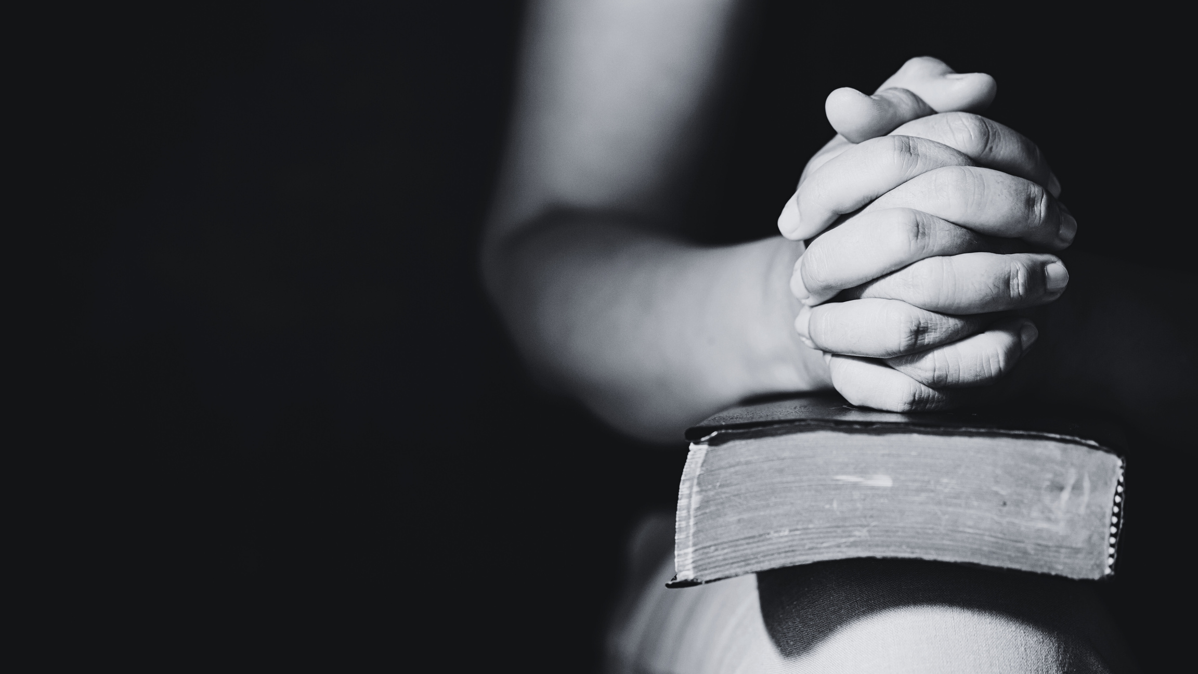
Sacraments
The Salvation Army believes that no particular outward observance is necessary to inward grace, and that God’s grace is freely and readily accessible to all people at all times in all places. Christ is the one True Sacrament. Sacramental living is at the heart of holiness and discipleship.
Baptism
The Salvation Army rejects the belief that the outward act of baptism is essential to salvation or to growth in grace. Rather the outward act of baptism simply represents an inward change of grace that has already occurred in the person.

Slide 23
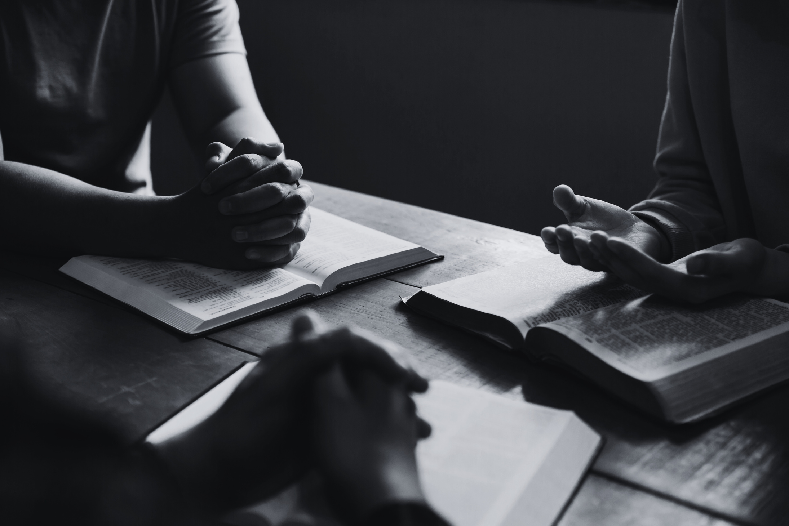
Sacraments
Communion
The Salvation Army views communion as an outward expression of an inward act of grace, however the ceremony is not essential to salvation or to growth in grace. Christ is the one True Sacrament. Sacramental living is at the heart of holiness and discipleship. Salvationists are encouraged to celebrate Christ and His real presence at all meals and in all worship services.
Mercy Seat
The mercy seat is a bench provided as a place where people can kneel to pray, seek salvation or make a special consecration to God’s will and service. The mercy seat is usually situated between the platform and main area of Army halls as a focal point to remind all of God’s reconciling and redeeming presence.

Slide 24
WHAT IS
The Salvation Army’s
PLACE IN THE COMMUNITY?
Session 3

Slide 25
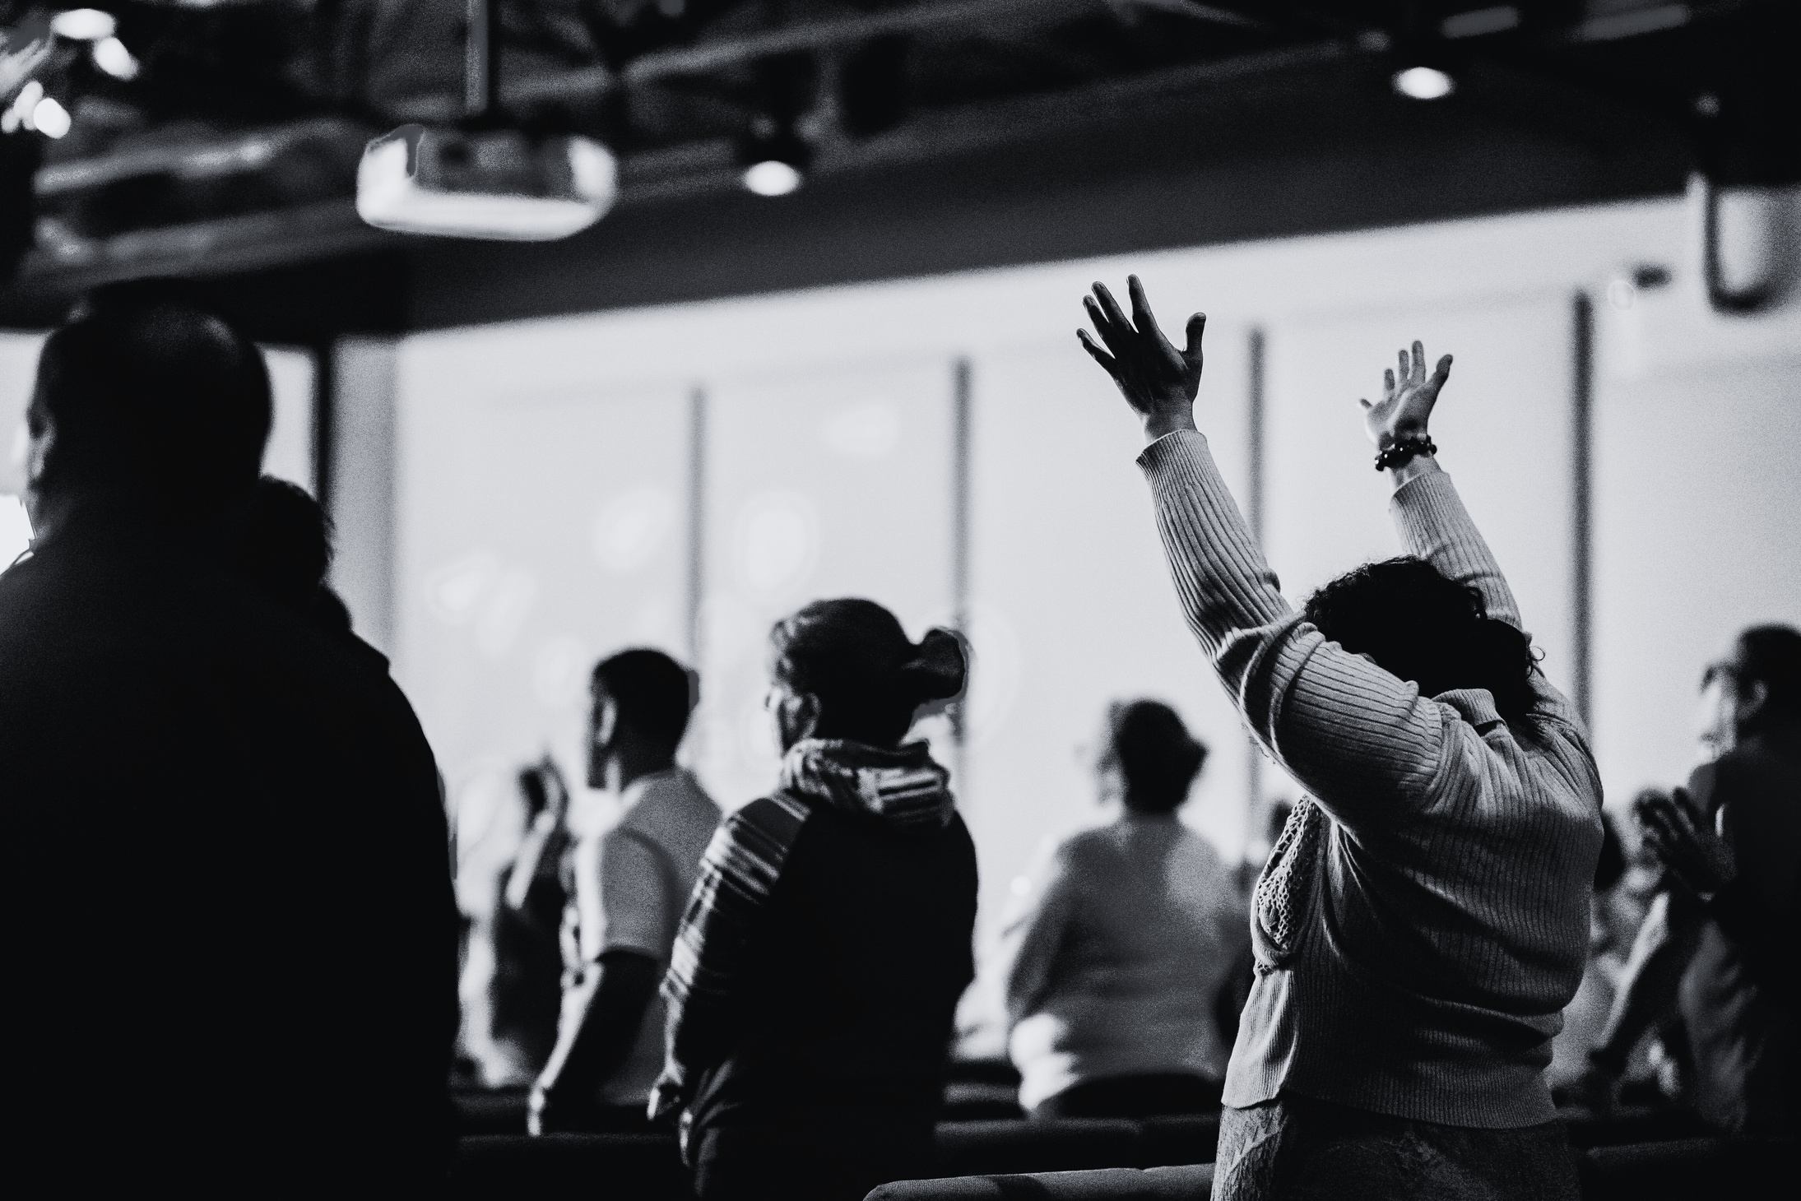
Worship
Spiritual Life
Prayer
Community Impact

Slide 26

Spiritual Development Programs
First Steps, Cradle Roll, Baby Song
Junior Soldiers, Ready To Serve
Sunday School, Kids’ Clubs
Vacation Bible School
Adult Bible Study, Cell Groups
Men’s & Women’s Groups

Slide 27
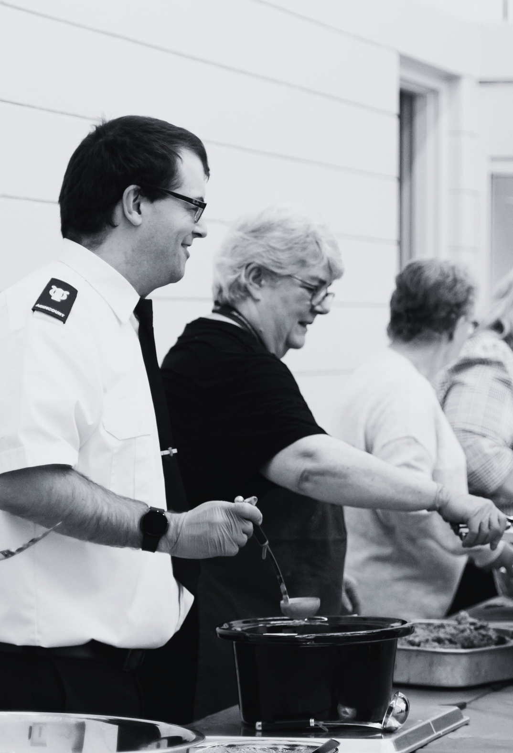
Community Impact
Addiction Services
Older Adult Care
International Development
Court and Prison Services
Disability Services
Domestic Violence Services
Emergency Disaster Services
Family Support Services
Homeless Services
Migrant Services
Thrift Stores
Youth and Children’s Services
Modern Slavery & Human Trafficking Response

Slide 28
HOW CAN I
BELONG TO
The Salvation Army?
Session 4

Slide 29




God’s Provision
Our Response
God’s Plan
Our Problem
Know that God loves you
and has a plan for your life.
Know that all have sinned and caused
a separation between himself and God.
Know that Jesus Christ is God’s ONLY
provision for our sin.
Know that we must individually
receive Jesus as Saviour
and Lord.

Slide 30




Born again
Put right with God
Adopted into God’s family
Given the assurance of a new life in Christ

Slide 31

Soldiers, Adherents, Friends
Soldiers
Adherents
Friends
Soldiers of The Salvation Army are Christians who have undertaken a specific covenant (or promise) regarding lifestyle and beliefs. They are not employed by The Salvation Army, although they may take on paid positions by applying through conventional means. Soldiers are eligible to wear the Salvation Army uniform and are part of a corps in their local area.
"Friends" refers to individuals who support The Salvation Army’s mission and activities but choose not to be soldiers or adherents. Friends may participate in Salvation Army events, volunteer their time, contribute financially, and generally align themselves with The Salvation Army’s values and goals.
Adherents are Christians who consider a local Salvation Army corps to be their church home, and want to support its vitality through their presence and involvement while not entering into a Soldier’s Covenant.

Slide 32
An adherent declares that they:
Believe in the Lord Jesus Christ and seek to follow Him.
Participate through worship, fellowship and service at a local Salvation Army corps.
Identify with the mission of The Salvation Army and would indicate so in a census.
Are 14 years of age or older and not an active member of any other religious body.

Slide 33
What does it mean to be an adherent member?
Adherent members enjoy a deep and sincere friendship within their local corps as well as a worldwide circle of Salvationist friends.
Adherent members benefit from the spiritual and practical support of their corps officer, as well as the spiritual counsel and encouragement through Salvation Army meetings and activities.
Adherent members have the sacred opportunity of contributing to the financial support of their local corps. An envelope system is available for use in all corps. Some corps provide opportunities to give online.

Slide 34
What does it mean to be an adherent member? cont’d...
Adherent members are offered a variety of opportunities to get involved in activities that further the mission of The Salvation Army.
Adherent members have the option of taking a further step of commitment by becoming a soldier member, which is strongly encouraged.

Slide 35

How do I become an adherent?
Speak to the officer in your corps about membership.
Attend membership classes.
Complete the application form.
Your application will be submitted to the Corps Pastoral Care Council.
Upon acceptance, your name will be entered on the adherent’s roll.
You will be presented with an official certificate and welcomed as an adherent member during a public ceremony.

