Slide 1

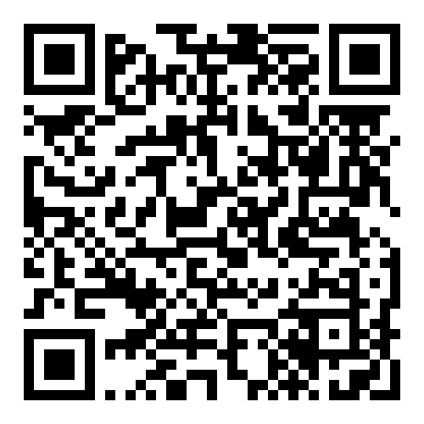

Check out the Ethics Centre’s new series!

