Slide 2
Canada and Bermuda Territory

Slide 3
INSPIRE 2023 – Venue for Conference Toronto Westin Harbour Castle Hotel

Slide 4
INSPIRE 2023 – Venue for Congress Toronto Massey Hall

Slide 5
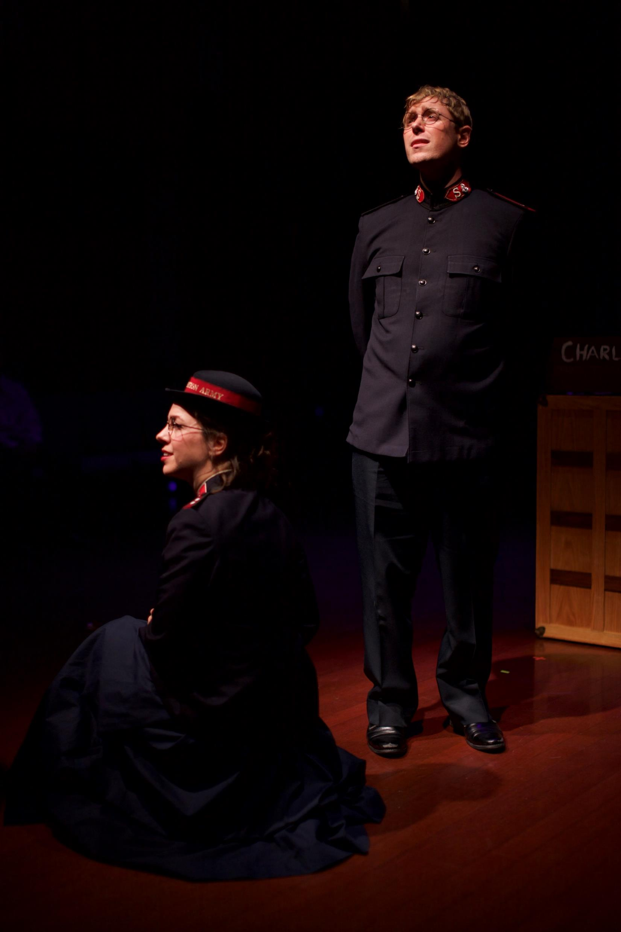
INSPIRE 2023 – Conference Highlights
Monday, June 26, 2023
INSPIRE Celebration Dinner with Territorial Leaders,
Commissioners Floyd and Tracey Tidd and Colonel Evie Diaz
Canadian Premier of

Slide 6
INSPIRE 2023 – Conference Highlights
Tuesday, June 27 to Thursday, June 29, 2023
94 Workshops – Focus on Corps Mission
Supporting Ministry Workshops
THQ Social Mission
Territorial Communications
MAGA
THQ Business
THQ Finance
International Development

Slide 7
INSPIRE 2023 – Conference Highlights
Tuesday, June 27 to Thursday, June 29, 2023
Plenary sessions with special guests:
Commissioner Floyd J. Tidd
Reggie McNeal
Jeff Lockyer
Ann Voskamp

Slide 8
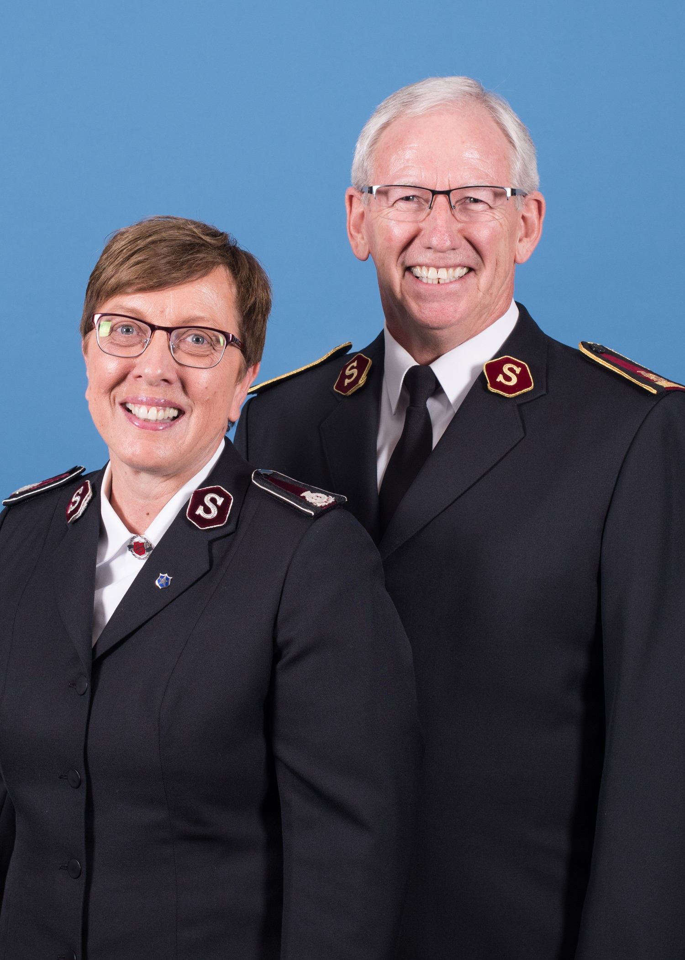
INSPIRE 2023 – Conference Highlights
Thursday, June 29, 2023
Gala and Awards Dinner with special guests,
General Brian Peddle and Commissioner Rosalie Peddle

Slide 9
INSPIRE 2023 – Congress Highlights
Friday, June 30, 2023
Officers Councils and Luncheon with our International Leaders
National Advisory Board Dinner
Inspire Celebration Service at Massey Hall
Youth Events

Slide 10
INSPIRE 2023 – Congress Highlights
Saturday, July 1, 2023
Prayer Breakfast
Commissioning and Ordination Service at Massey Hall
Silver Star Luncheon
Canada Day Celebrations and Public Events
Candidates Reception
Inspire Celebration
Youth Concert

Slide 11
INSPIRE 2023 – Conference & Congress
Delegates
As a territorial congress, all officers are required to attend both the conference and congress.
Officers with young children are invited to utilize the childcare allowances for congress childcare expenses.
All social mission executive directors are required to attend the conference and they are encouraged to stay for congress.
Accommodation will be provided for all officers and conference attendees. Transportation, and meals not covered, will be a local ministry unit expense.

Slide 12
INSPIRE 2023 – Congress Highlights
Registration
The INSPIRE registration site went “live” January 1, 2023.
Delegates can register for the conference and choose workshops and book accommodation.
Delegates are required to make their own travel arrangements. Travel arrangements will be co-ordinated by the congress committee for musical groups located outside of Ontario.

Slide 13
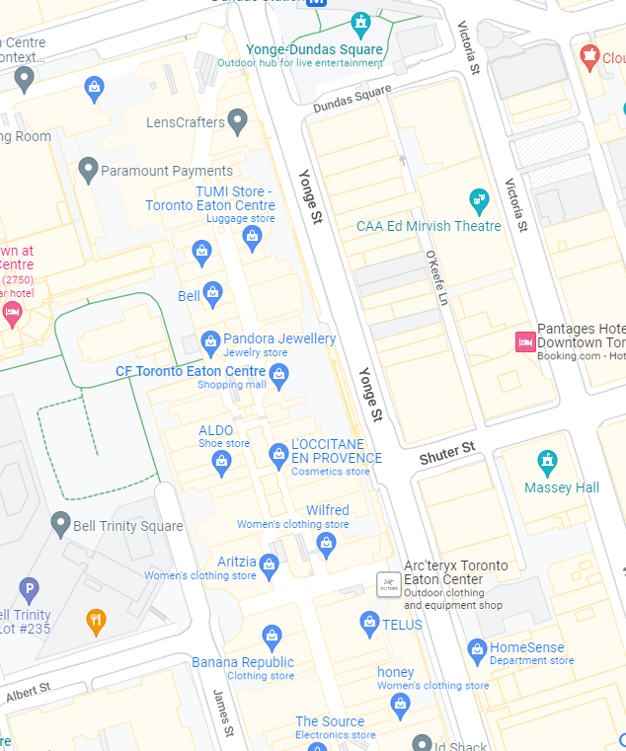
INSPIRE 2023 – Congress Highlights
Sunday, July 2, 2023
Prayer Walk
INSPIRE Holiness Meeting at Massey Hall
March in Toronto Downtown Core - Afternoon

Slide 14
Questions?
Canada and Bermuda Territory

