Slide 1
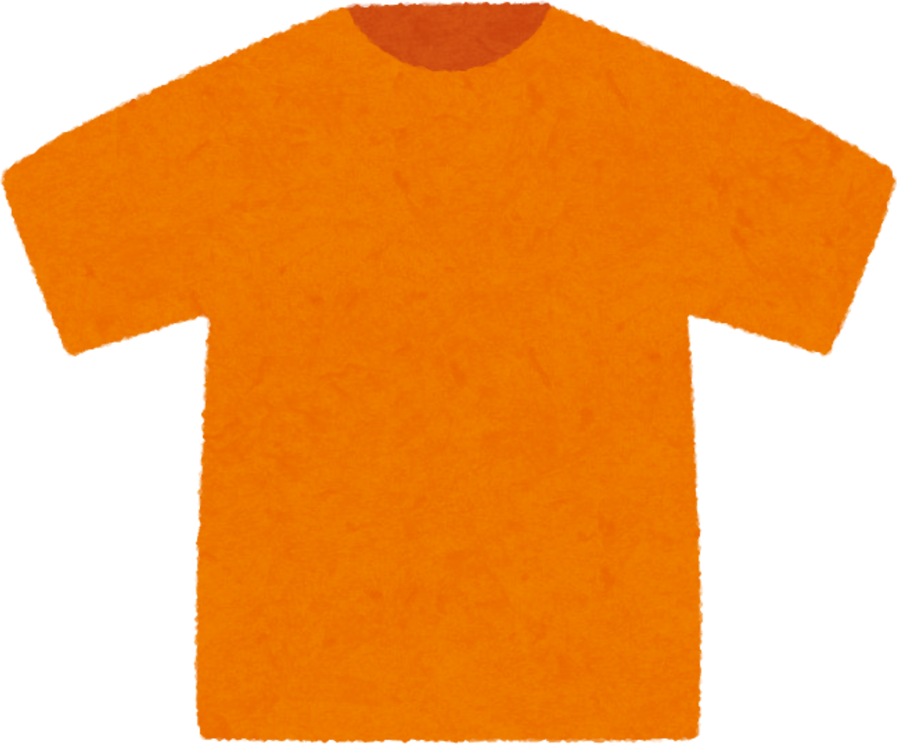
2024 Truth and Reconciliation Sunday
Why
we wear
ORANGE
SUNDAY SEPTEMBER 29
For more information please visit www.Salvationist.ca/IndigenousMinistries

