Slide 1
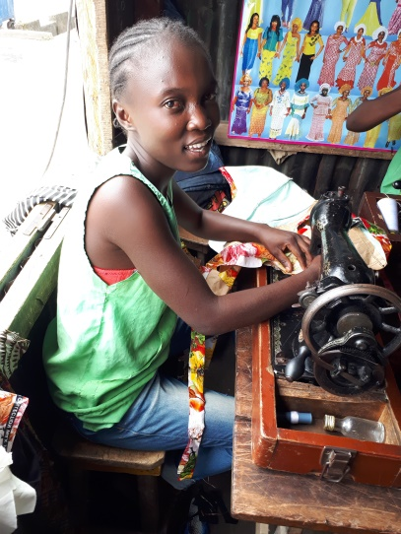
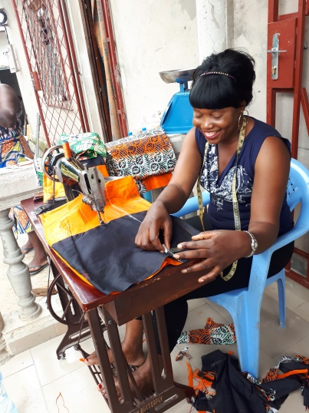
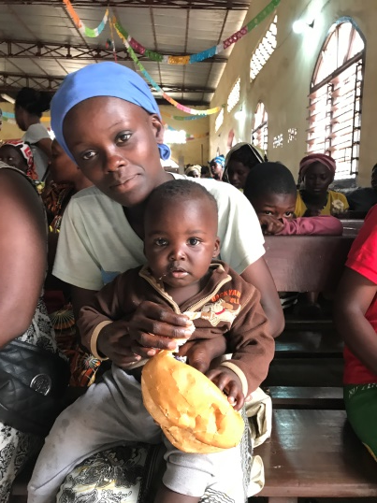
TERRITORIAL PROJECT 2018
ENRICHING THE LIVES OF WOMEN IN
CONGO-BRAZZAVILLE

Slide 2
What will your support
look like this year?

Slide 3
Project Outline
In this two year project, Women’s Ministries will support the construction and development of a vocational training centre to benefit impoverished women and young mothers in the Bacongo community of Congo-Brazzaville.

Slide 4
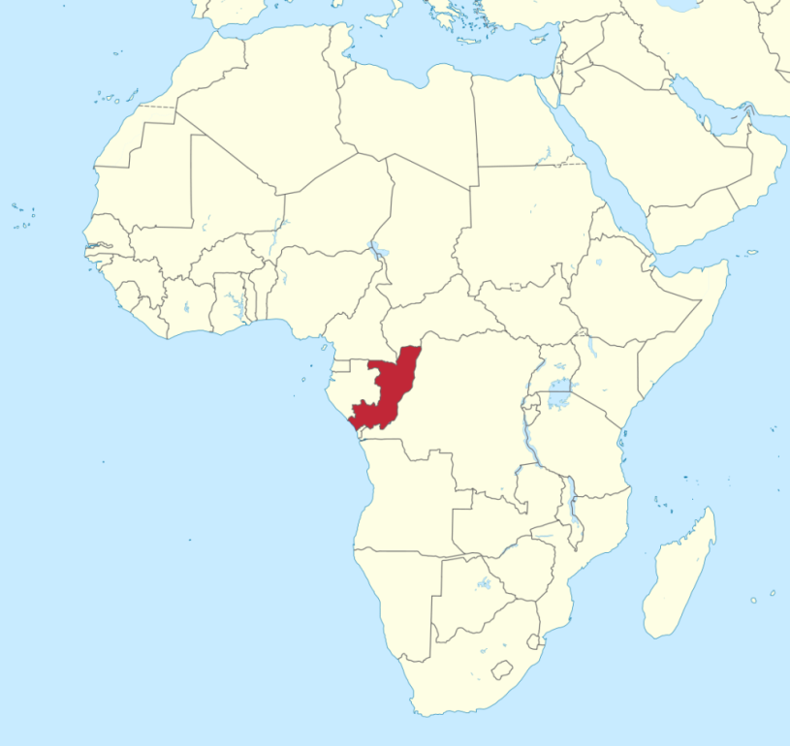
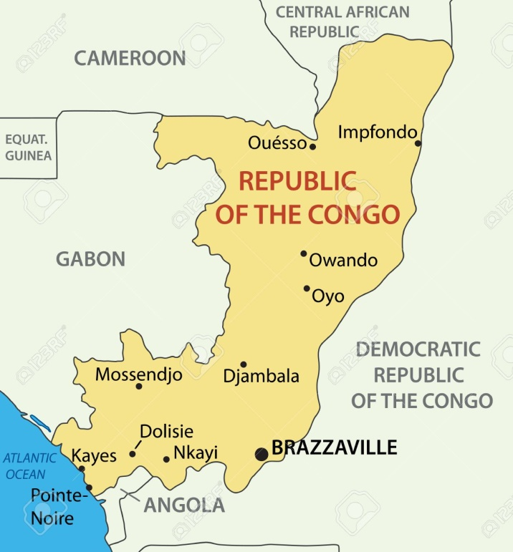
Where is Congo-Brazzaville?

Slide 5
Facts
Ranked 135 of 187 countries in 2017 Human Development Index
47% of the population lives below the national poverty line
Only 59% of all students complete primary school education

Slide 7
View from Vocational Training
Centre in Bacongo

Slide 8
For over 10 years, the educational system was affected by the civil war that broke out in 1998
The district of Bacongo, where the vocational training centre is located, was the most affected area in Brazzaville
During that time, teachers would not accept work there as they feared for their lives

Slide 9
This resulted in illiteracy, increased unemployment, and prostitution among teens and young women
Today, girls are easy prey for sexual trafficking and many become teenage mothers
Those in extreme poverty turn to prostitution and are exposed to sexually transmitted diseases, including HIV/AIDS

Slide 10
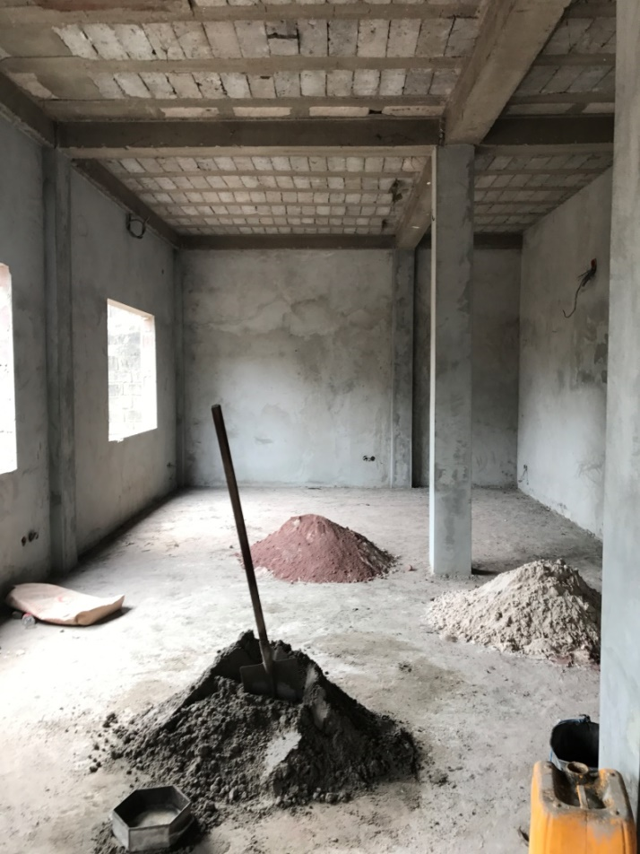
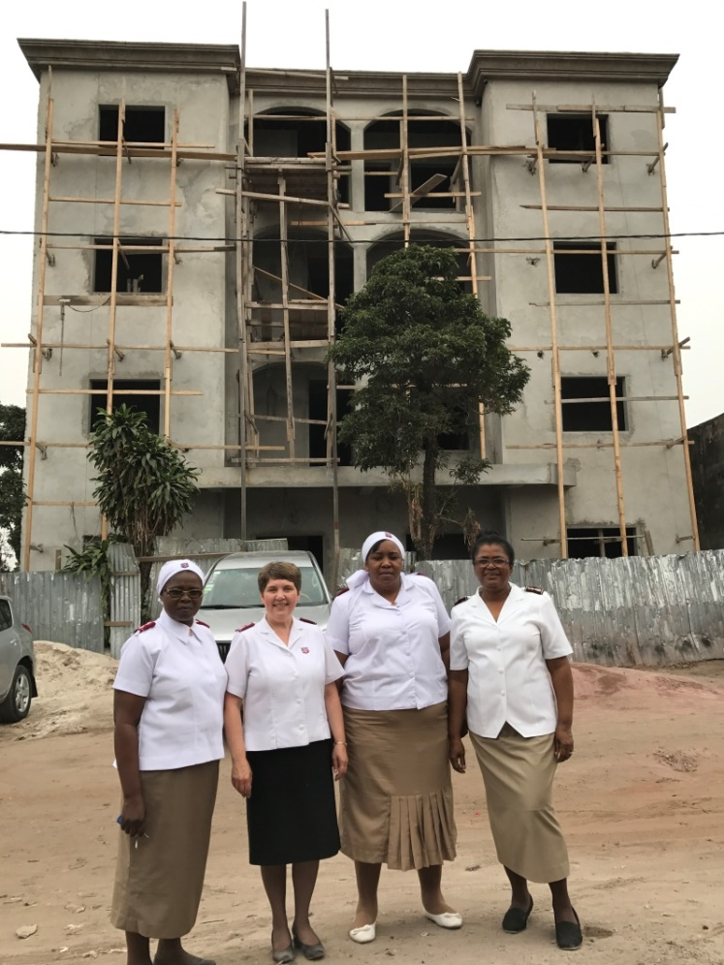
Construction of the Vocational Training Centre

Slide 11
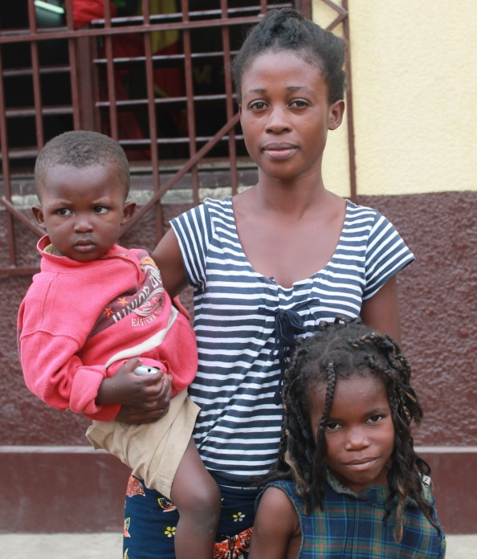
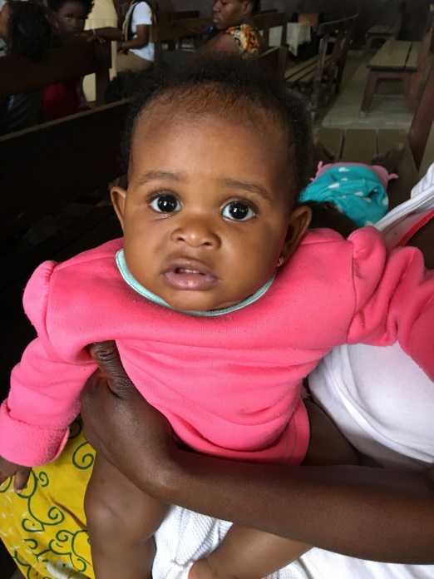
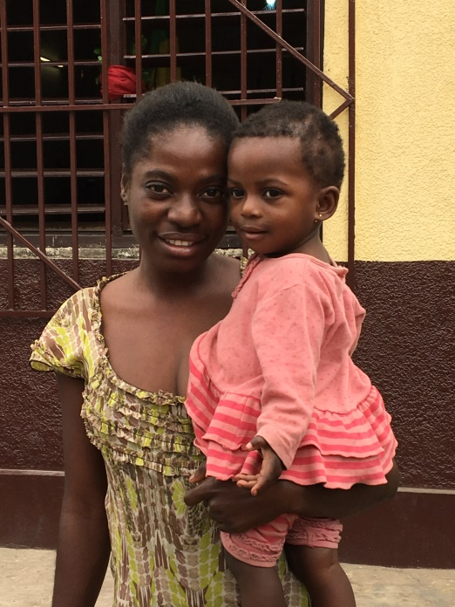
Who will be helped?
Single mothers
Impoverished young women
Women who were unable to receive a basic education

Slide 14
Vocational Training
Tailoring
20 young women
12 months
The women will make
School uniforms
TSA uniforms
Other items

Slide 15
Literacy Component
A decade of civil war made it difficult for many of the women involved in this project to attend school.
They will now have a chance to learn reading and writing skills.

Slide 16
Business Skills Training
Learning business skills will help the women set up small businesses after they finish their vocational training.

Slide 17
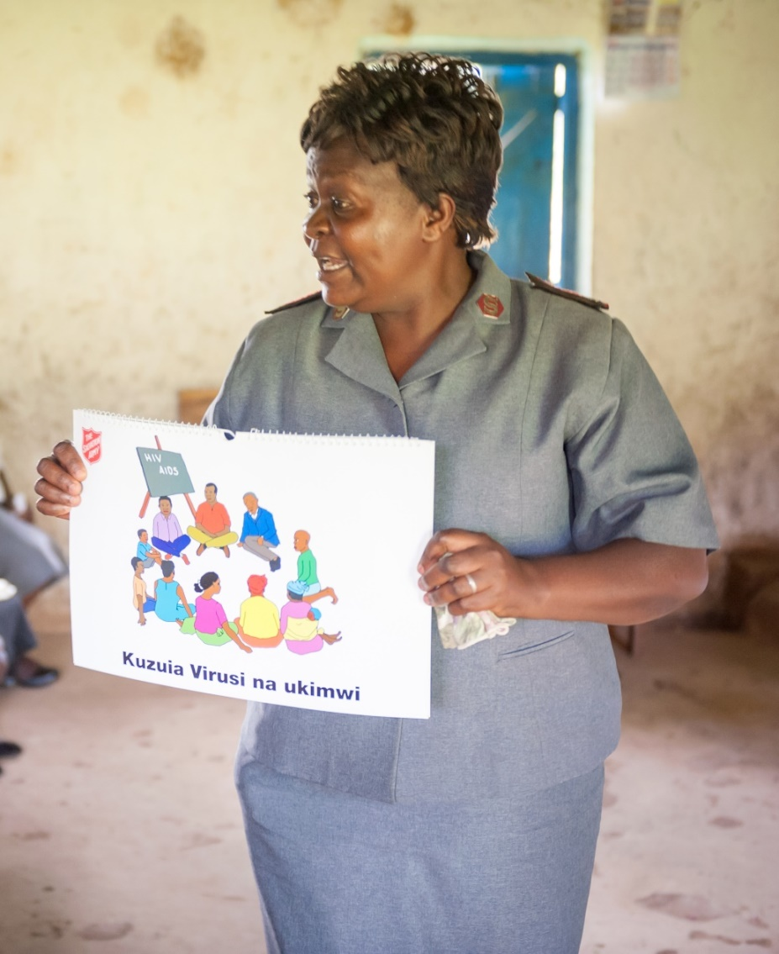
Health Component
Each woman will receive psychological, moral and spiritual support
HIV/AIDS kits will be available at the centre

Slide 18
In December, Women’s Ministries in Congo-Brazzaville held a rally to raise the funds needed to construct the centre. Despite their financial circumstances, the women contributed beyond their ability to benefit not just themselves but the entire community. Together they raised $24,000!
Fundraising

Slide 19
Your generous donations will help to provide:
Sewing and embroidery machines
Fabric
Office equipment
Furniture
Teachers

Slide 20
We are pleased to announce that we met and exceeded our fundraising goal in 2017! You helped raise $80,438.

Slide 21
This year, we hope to raise at least
$75,000
to support this project in Congo-Brazzaville.

Slide 22
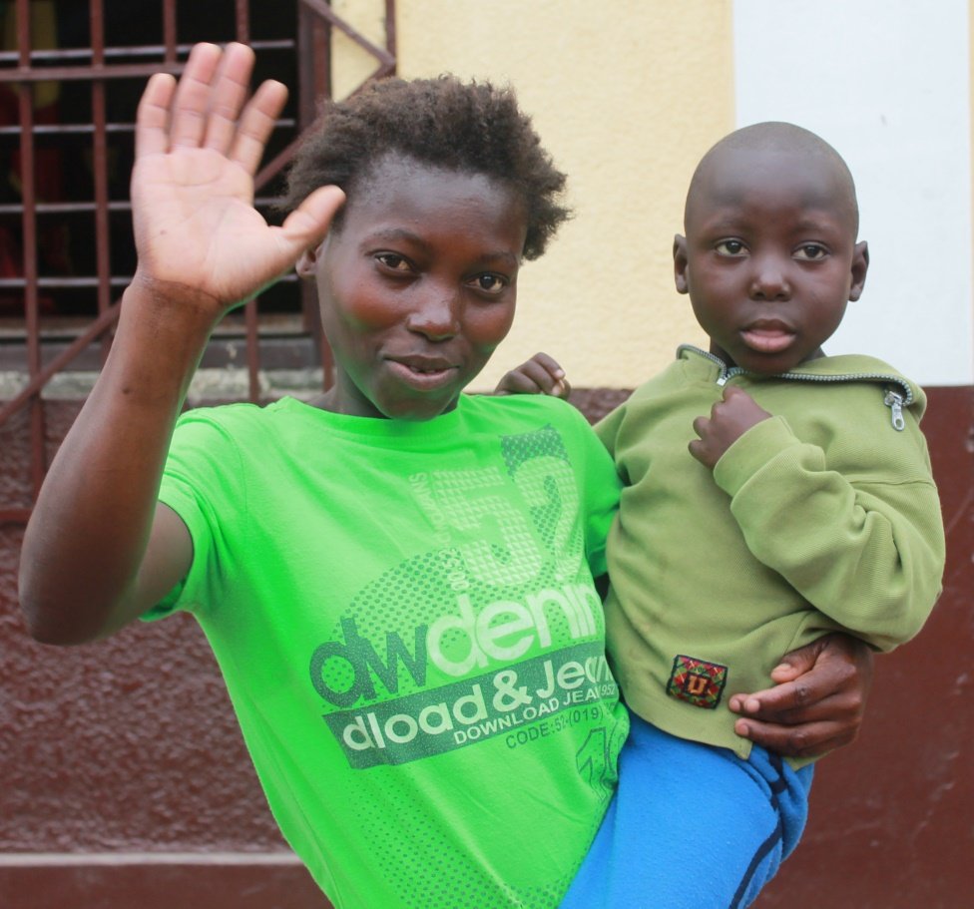
THANK YOU
FOR YOUR SUPPORT

