Slide 1
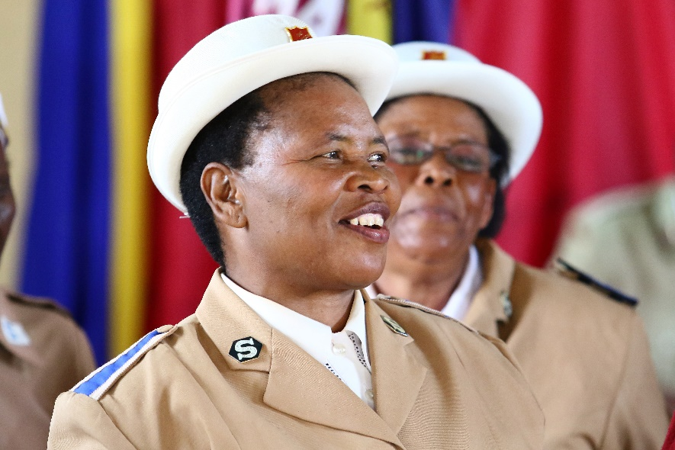
Support our
Partners in Mission campaign!
Donations accepted at your local Corps

