Slide 1


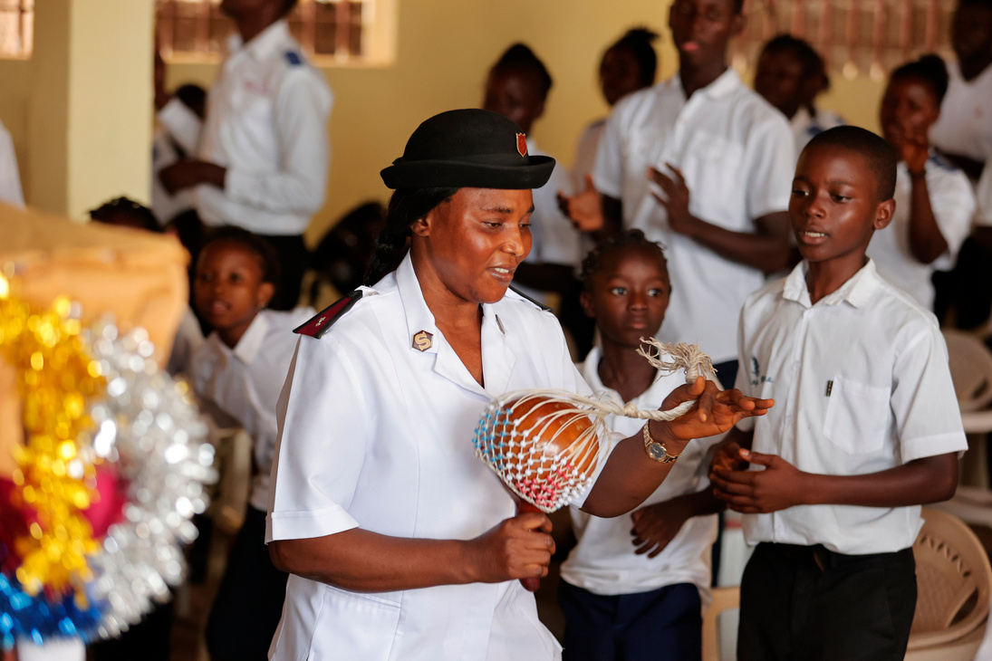
Support our Partners in Mission campaign!
Donations accepted at your local corps!

