Slide 2
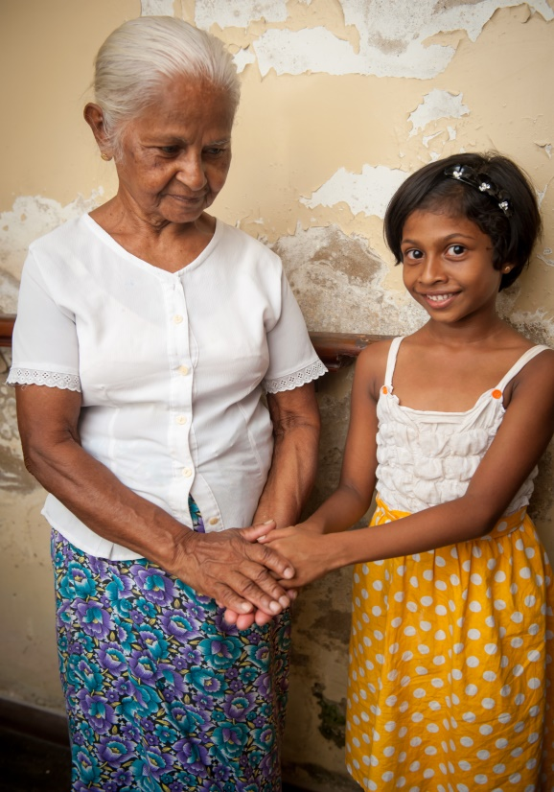
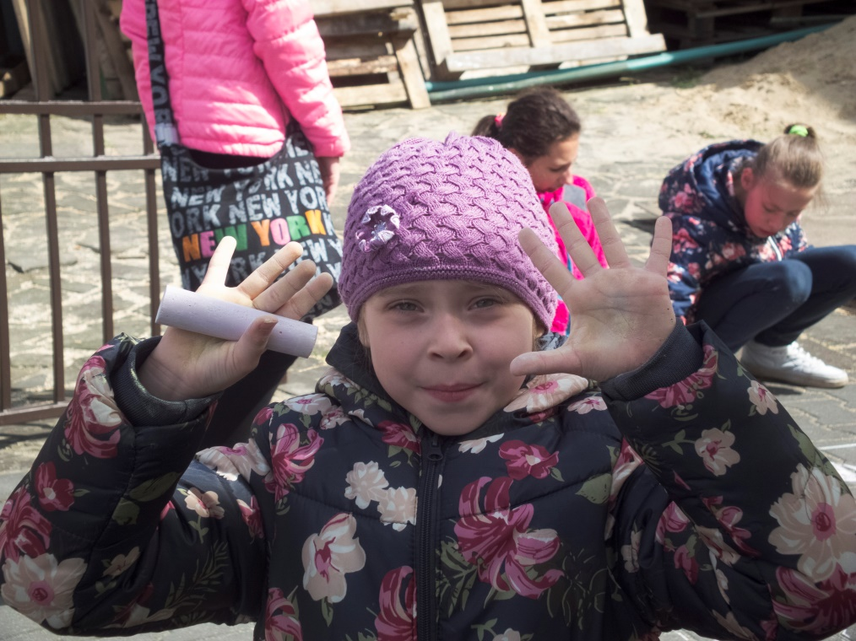
This fundraising campaign provides the necessary finances to carry out the ministry of The Salvation Army worldwide. These funds ensure that the Army continues to be a beacon of hope in countries devastated by poverty, illness and natural disasters – countries where much of the population lives on less than $2 a day.

Slide 3
How Self-Denial funding flows…
Canada and Bermuda Territory
In partnership with all other territories and commands
International
Headquarters

Slide 4
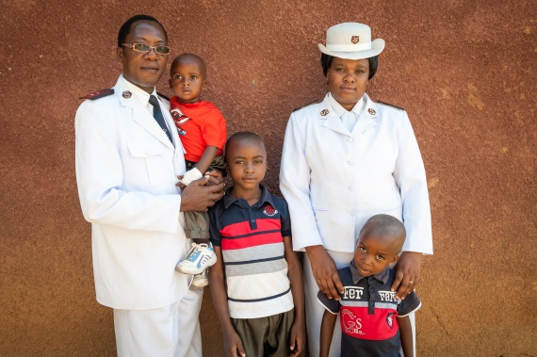
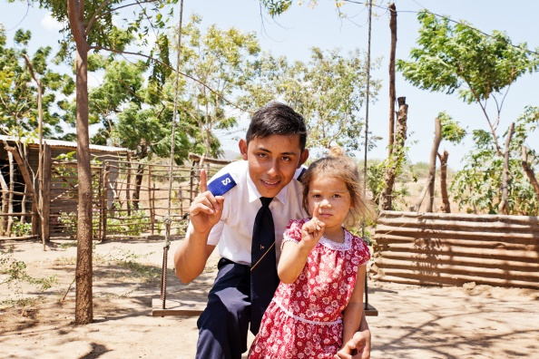
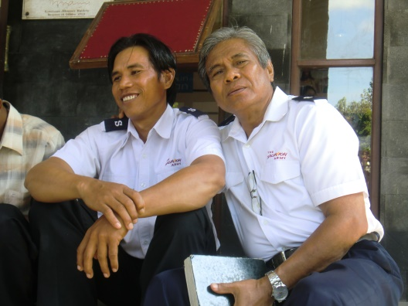
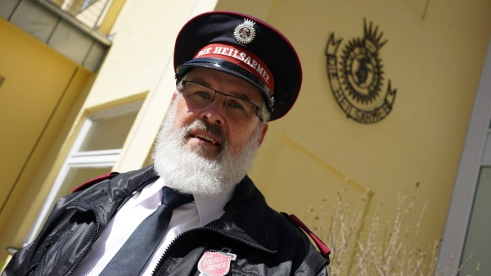
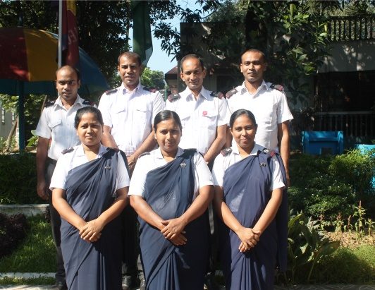
In 2016
International Self-Denial
Raised…
Africa Zone
£20,492,683!
(CDN $41,594,044)
Americas and
Caribbean Zone
Europe Zone
South Pacific and
East Asia Zone
South Asia Zone

Slide 9
Videos, photos, sermon resources and more can be found online at www.saworldmissions.ca

Slide 10
Help us reach our goal of
$2.25 Million

Slide 11
Thank you for supporting the
Partners in Mission Campaign!

