Slide 1
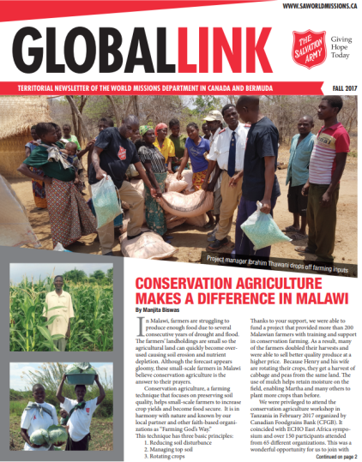
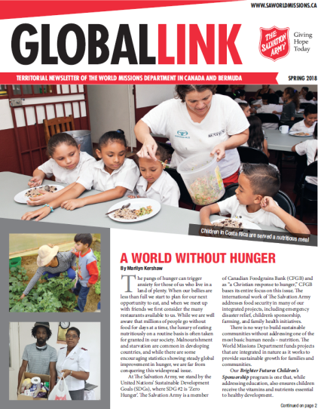
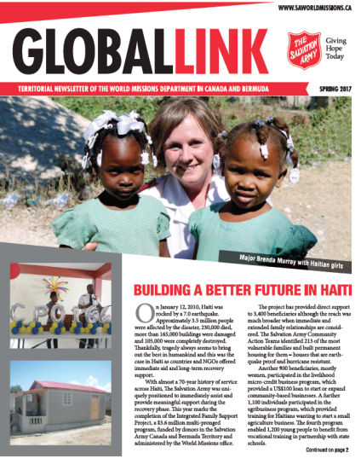
Global Link is distributed quarterly and includes stories and photos from our children’s sponsorship programs and community development projects in territories around the world.
To sign up for your FREE subscription
^{visit us at saworldmissions.ca}
See how your donations are making a difference!

