Slide 1
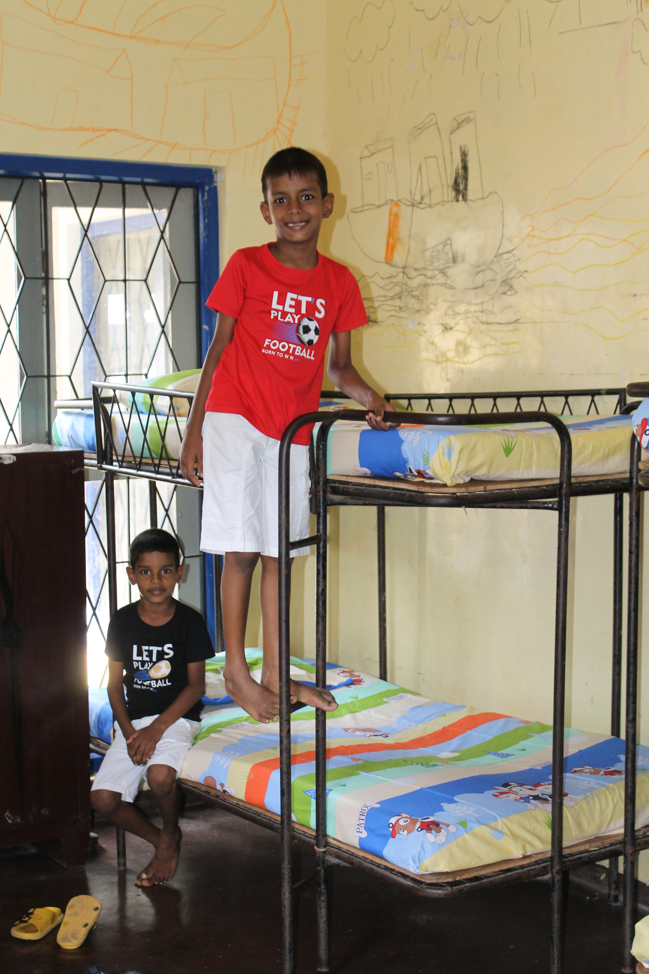
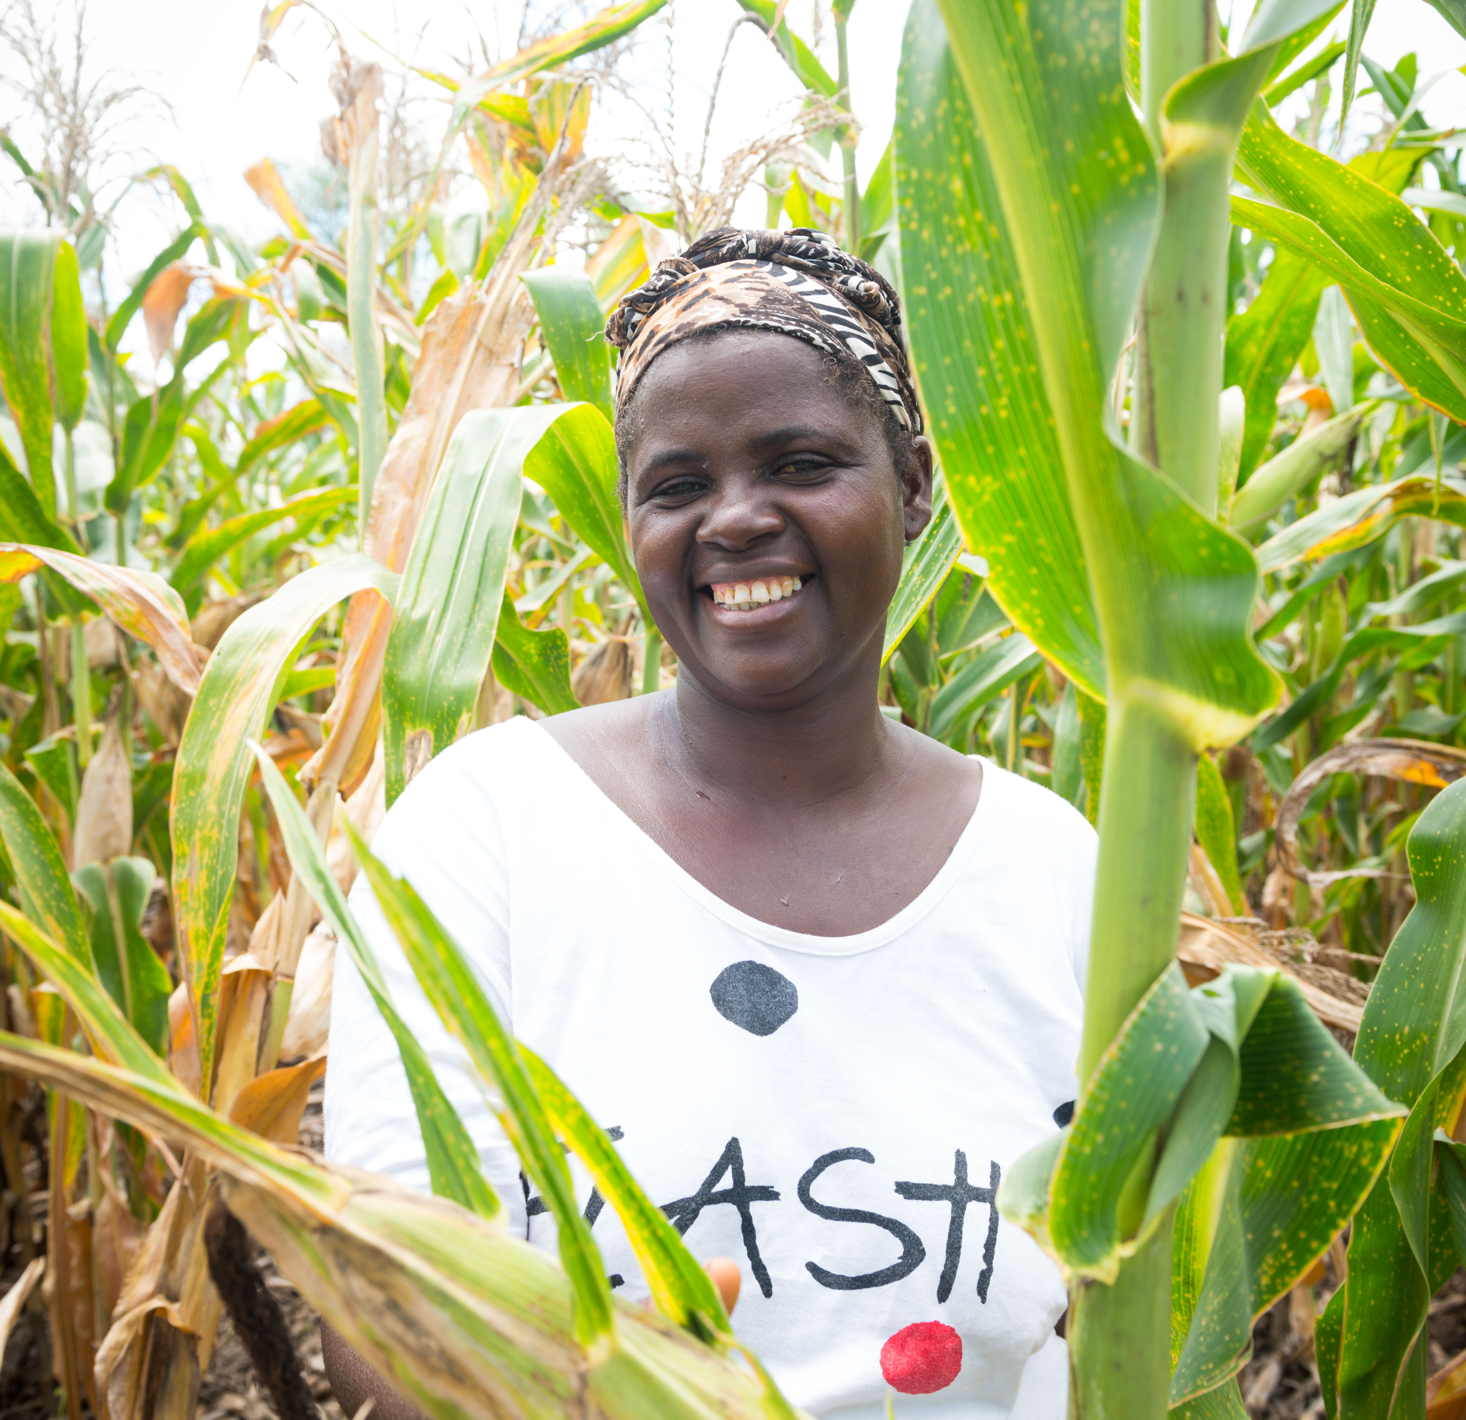
Help The Salvation Army
Fill a School in
Fill a Dorm in
Build a Farm in
RWANDA
SRI LANKA
MALAWI

Slide 2
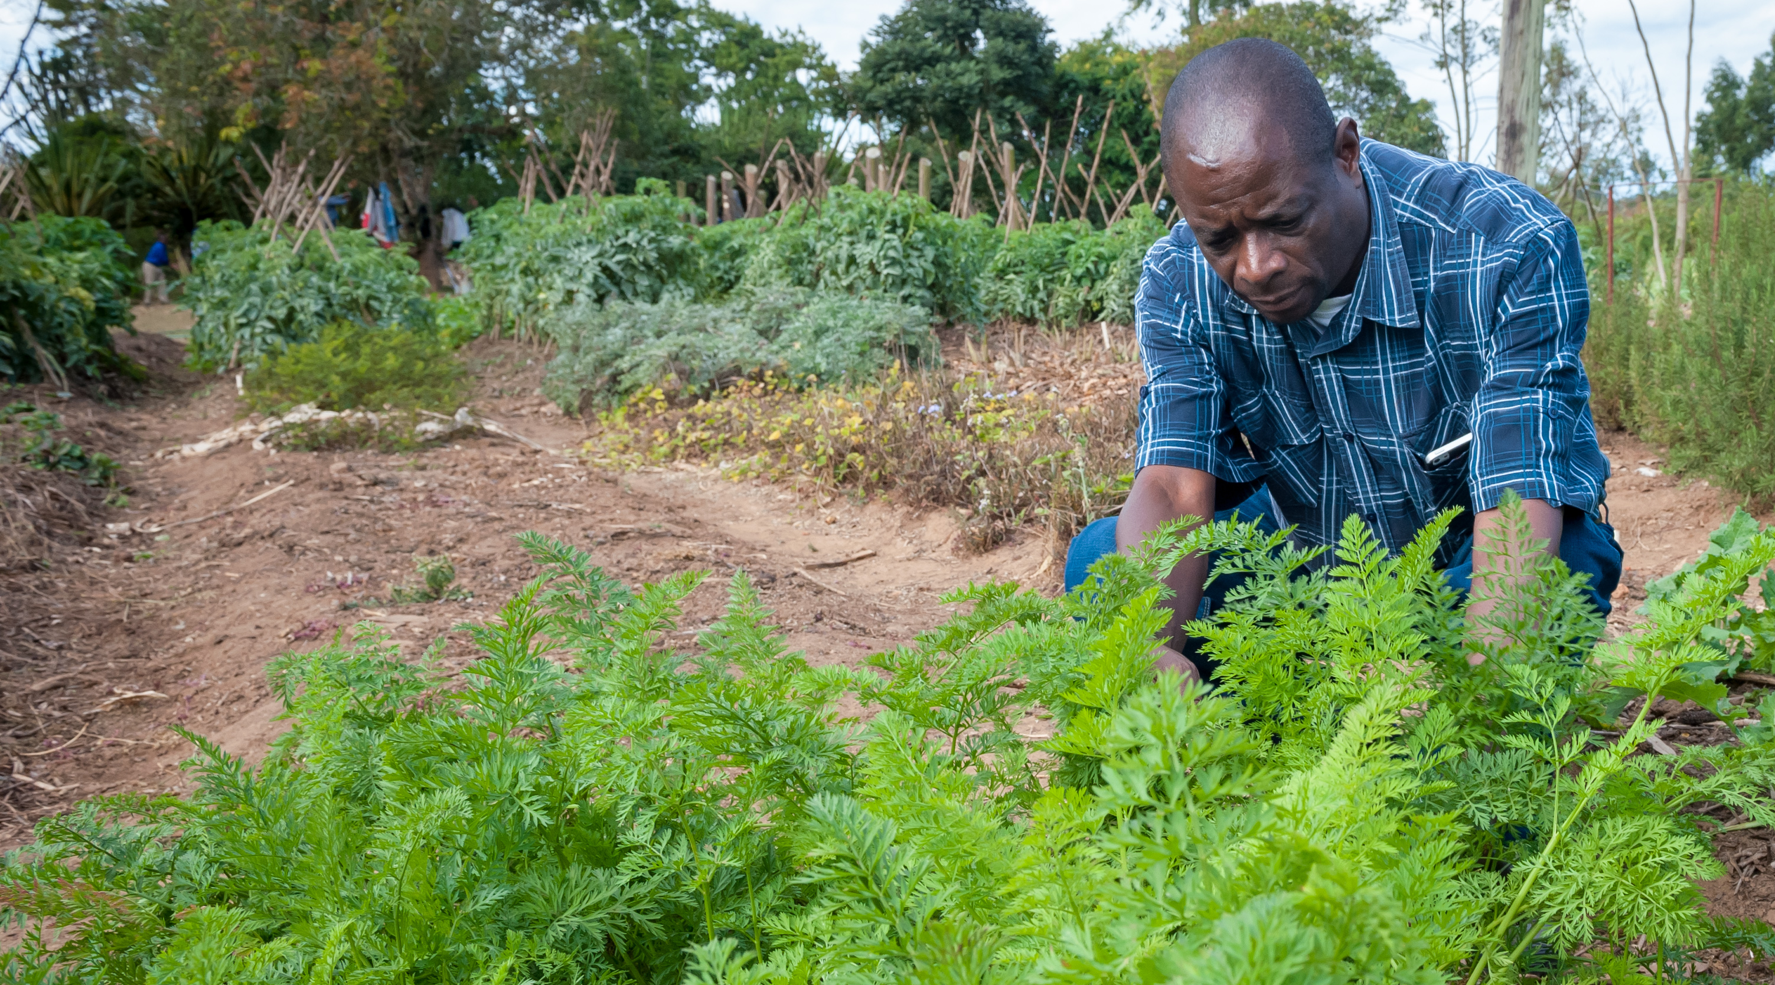
Build a Farm in
MALAWI

Slide 3
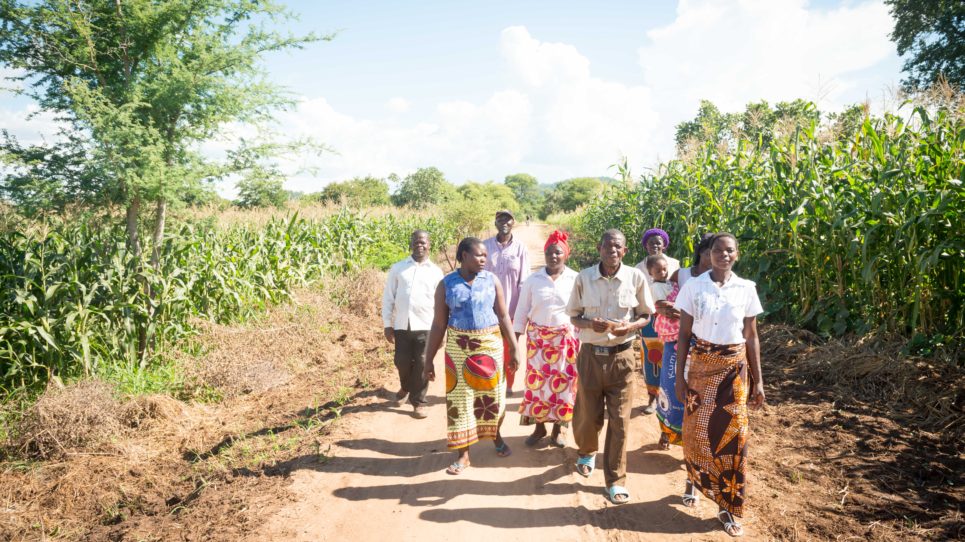
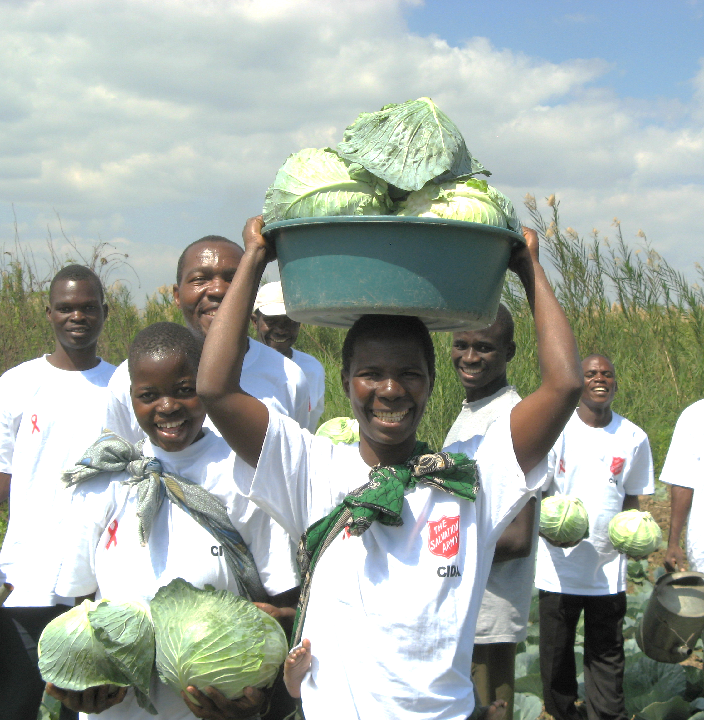
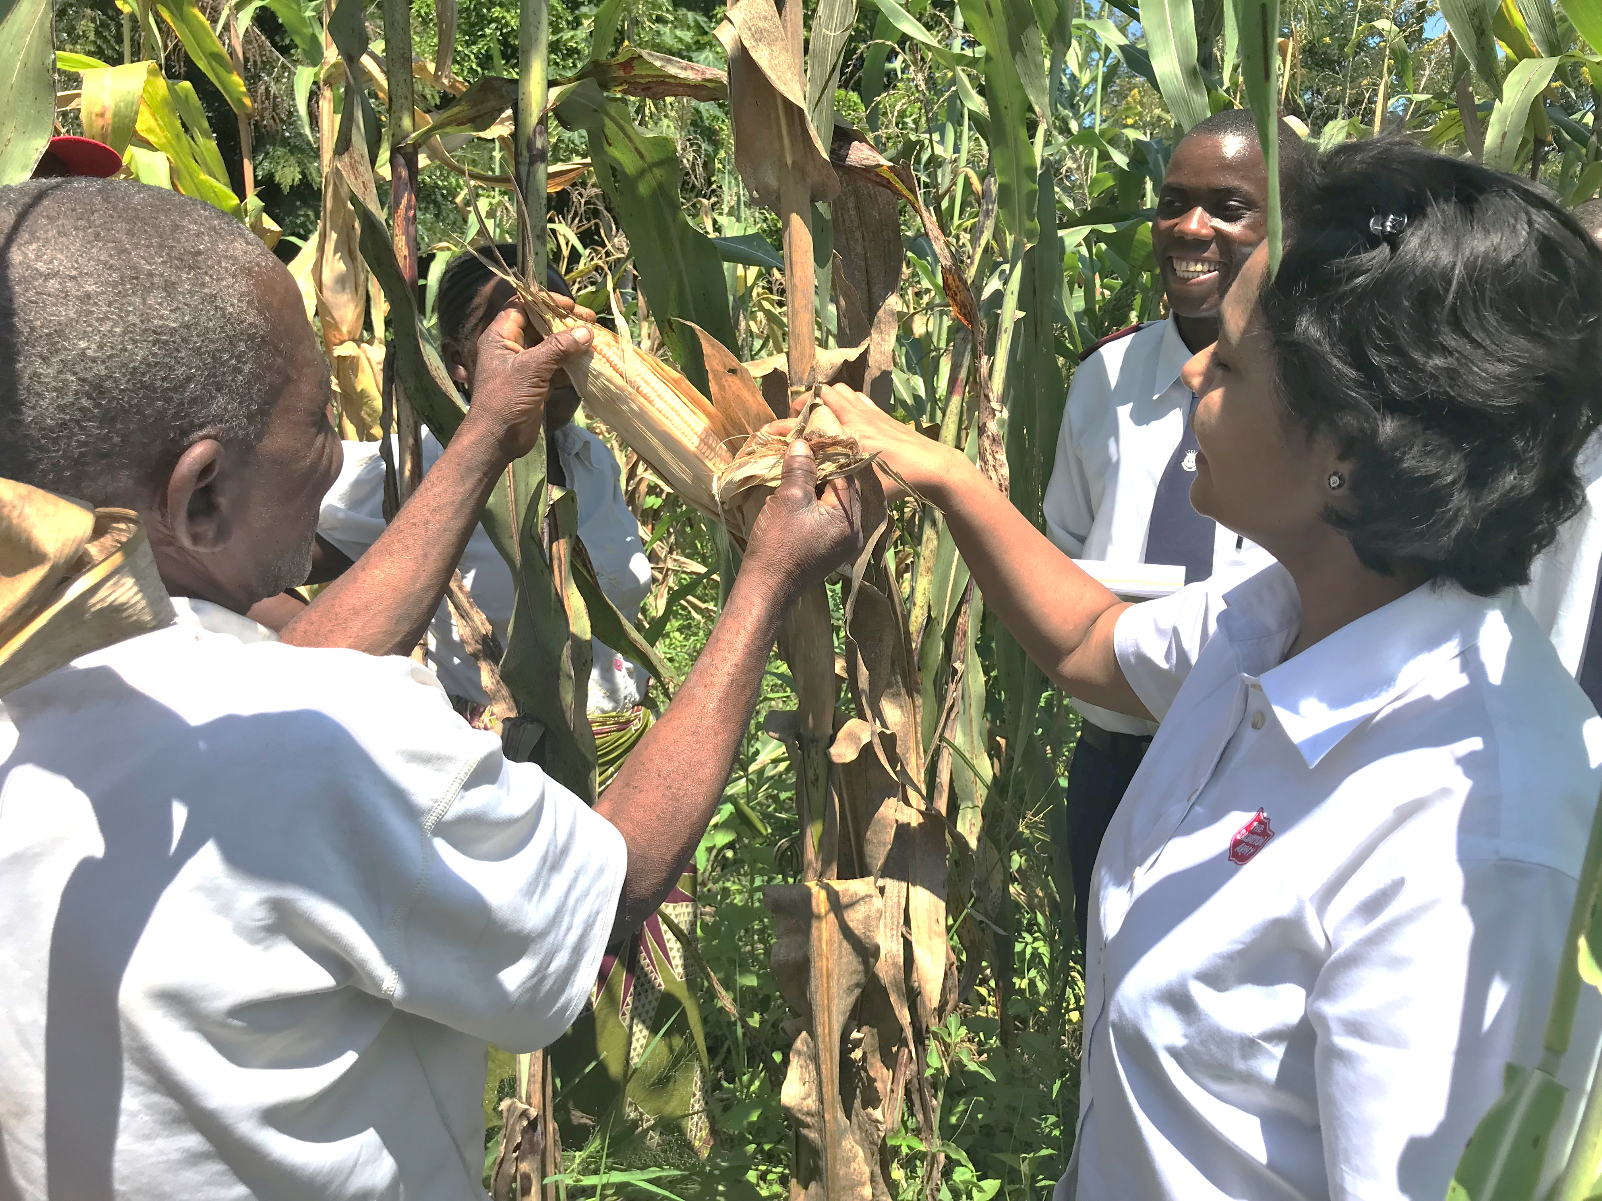
Farming In Malawi

Slide 4
Items List
Water Source
Goat
Bag of Seeds
$100
$50
$15
Tools
Farmer Training
$50
$100

Slide 5
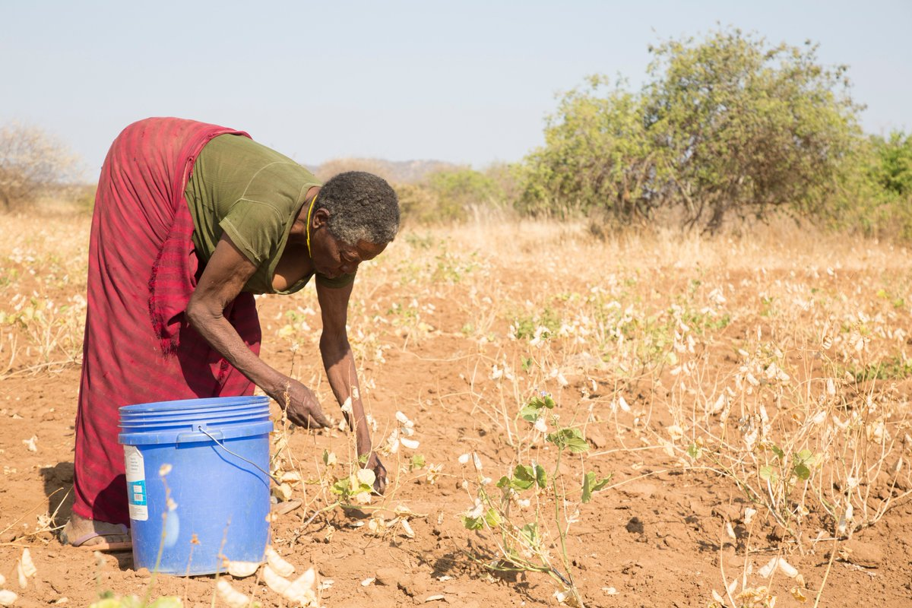

Slide 6
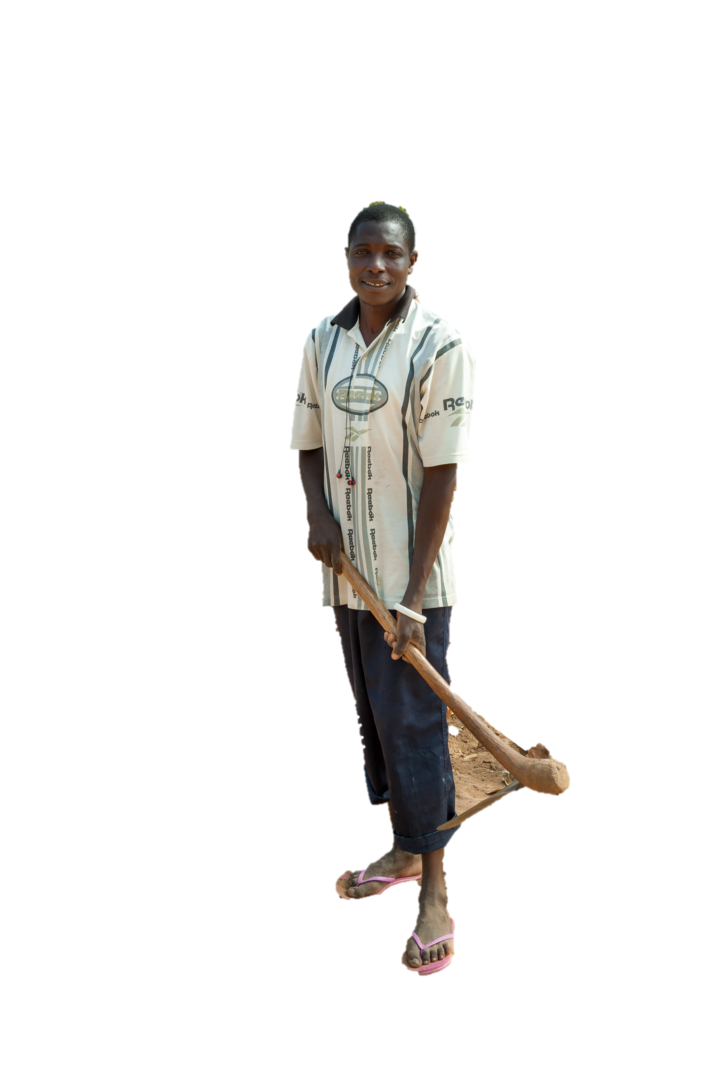
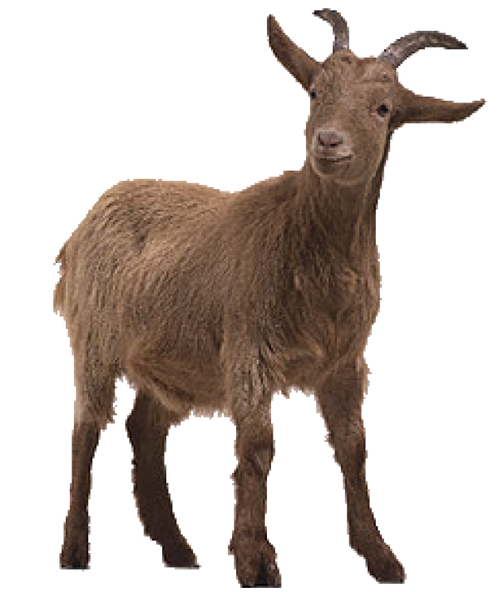
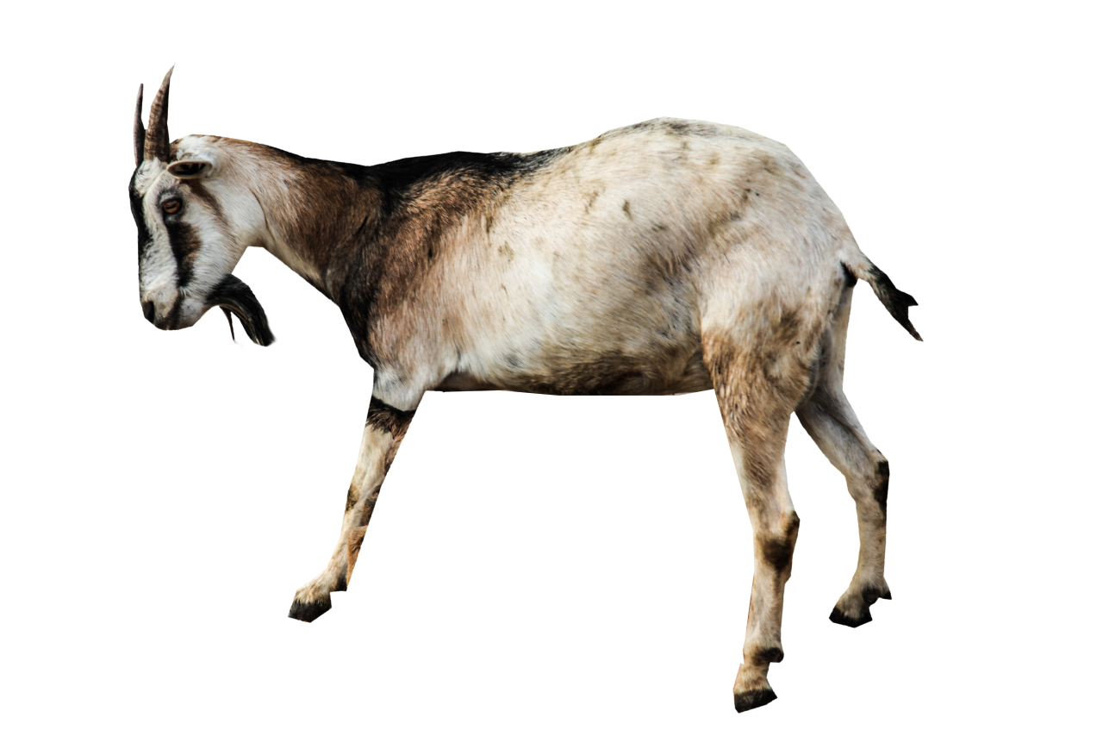
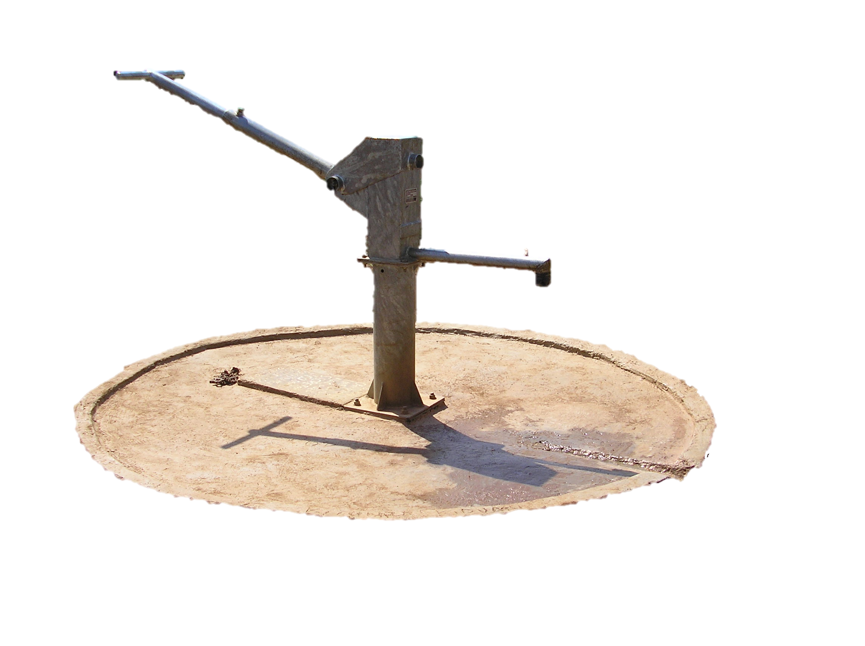
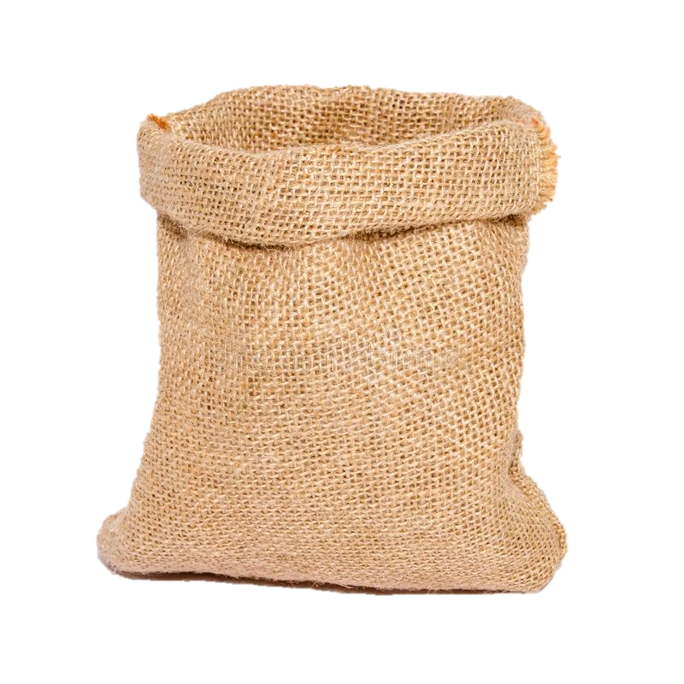
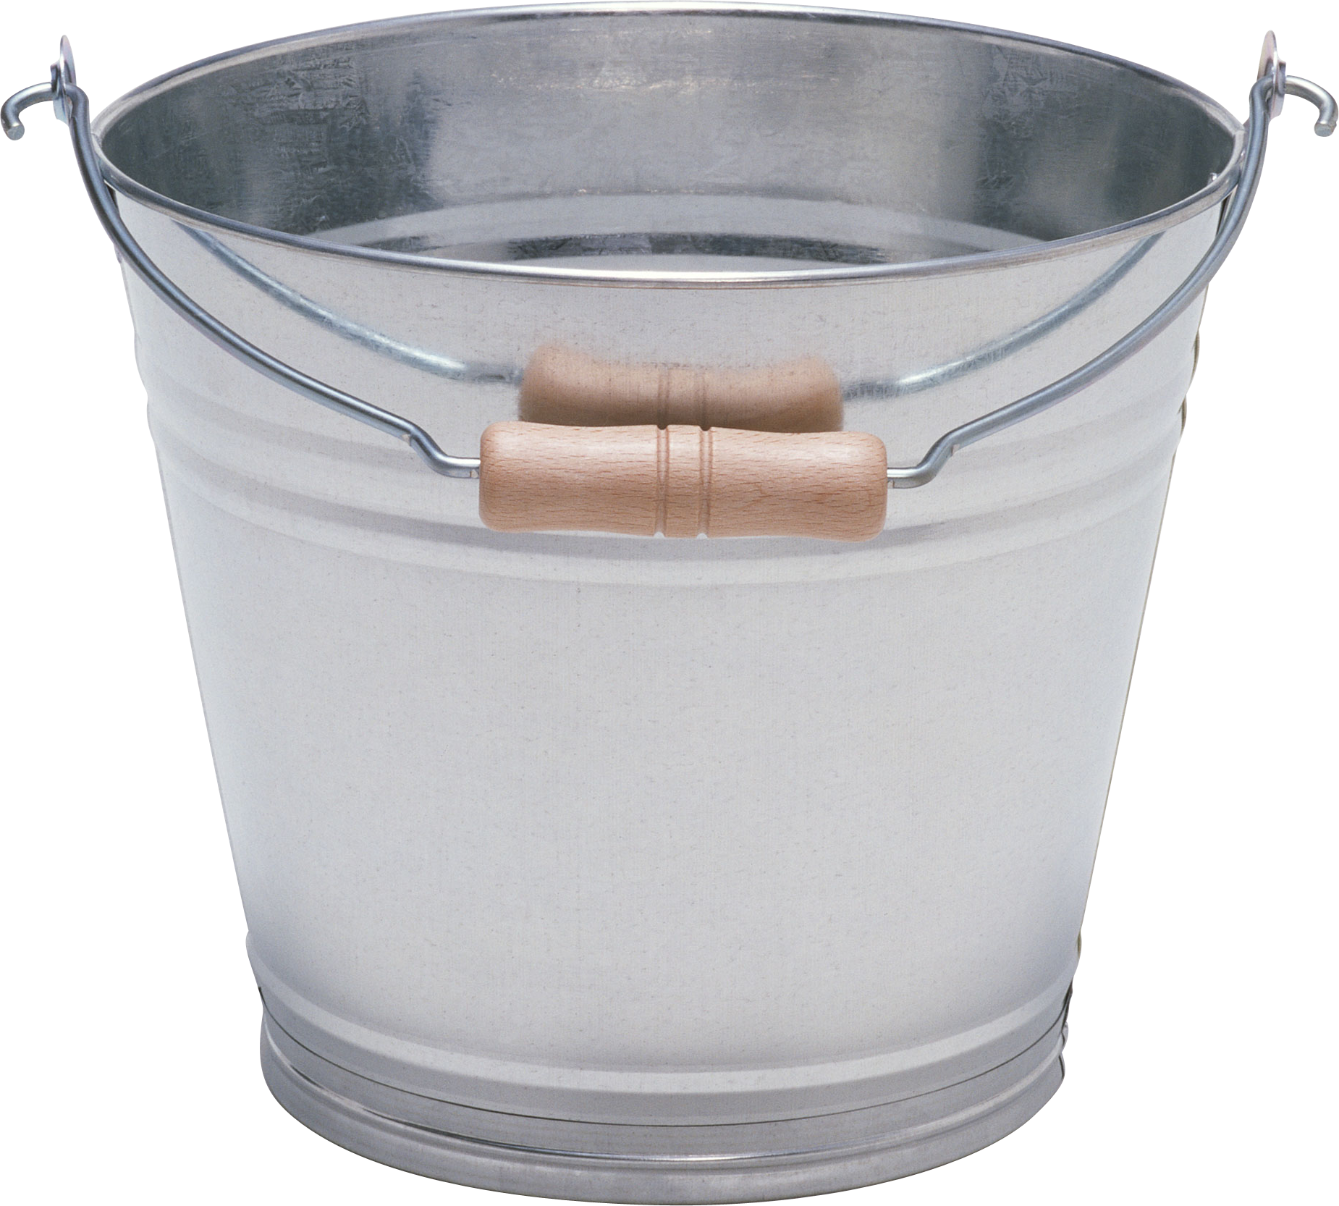

Slide 7
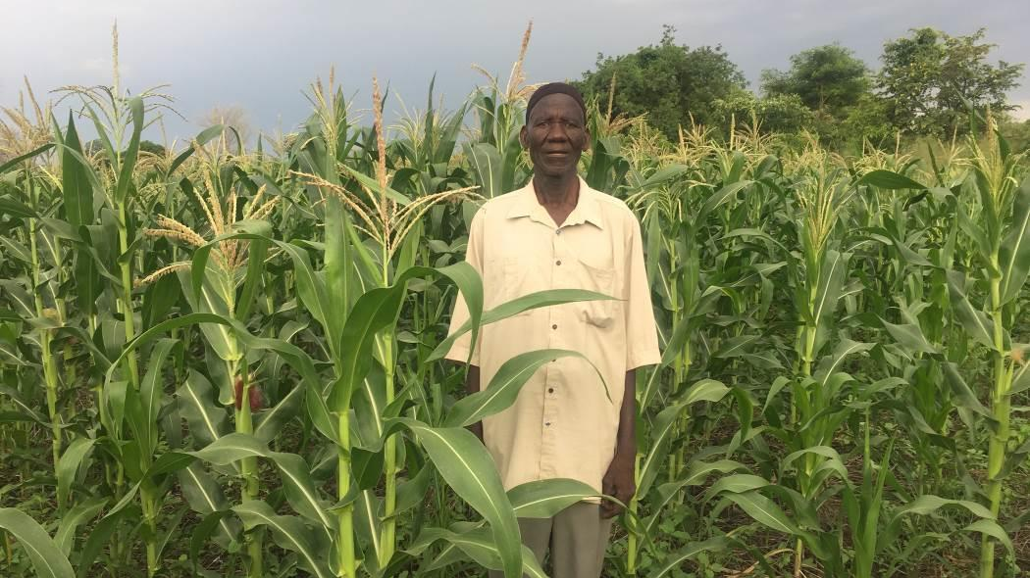
Water Source
$100

Slide 8
Goat
$50

Slide 9
Bag of Seeds
$15

Slide 10
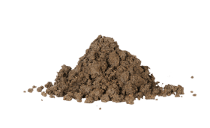
Tools
$50

Slide 11
Farmer Training
$100

Slide 12
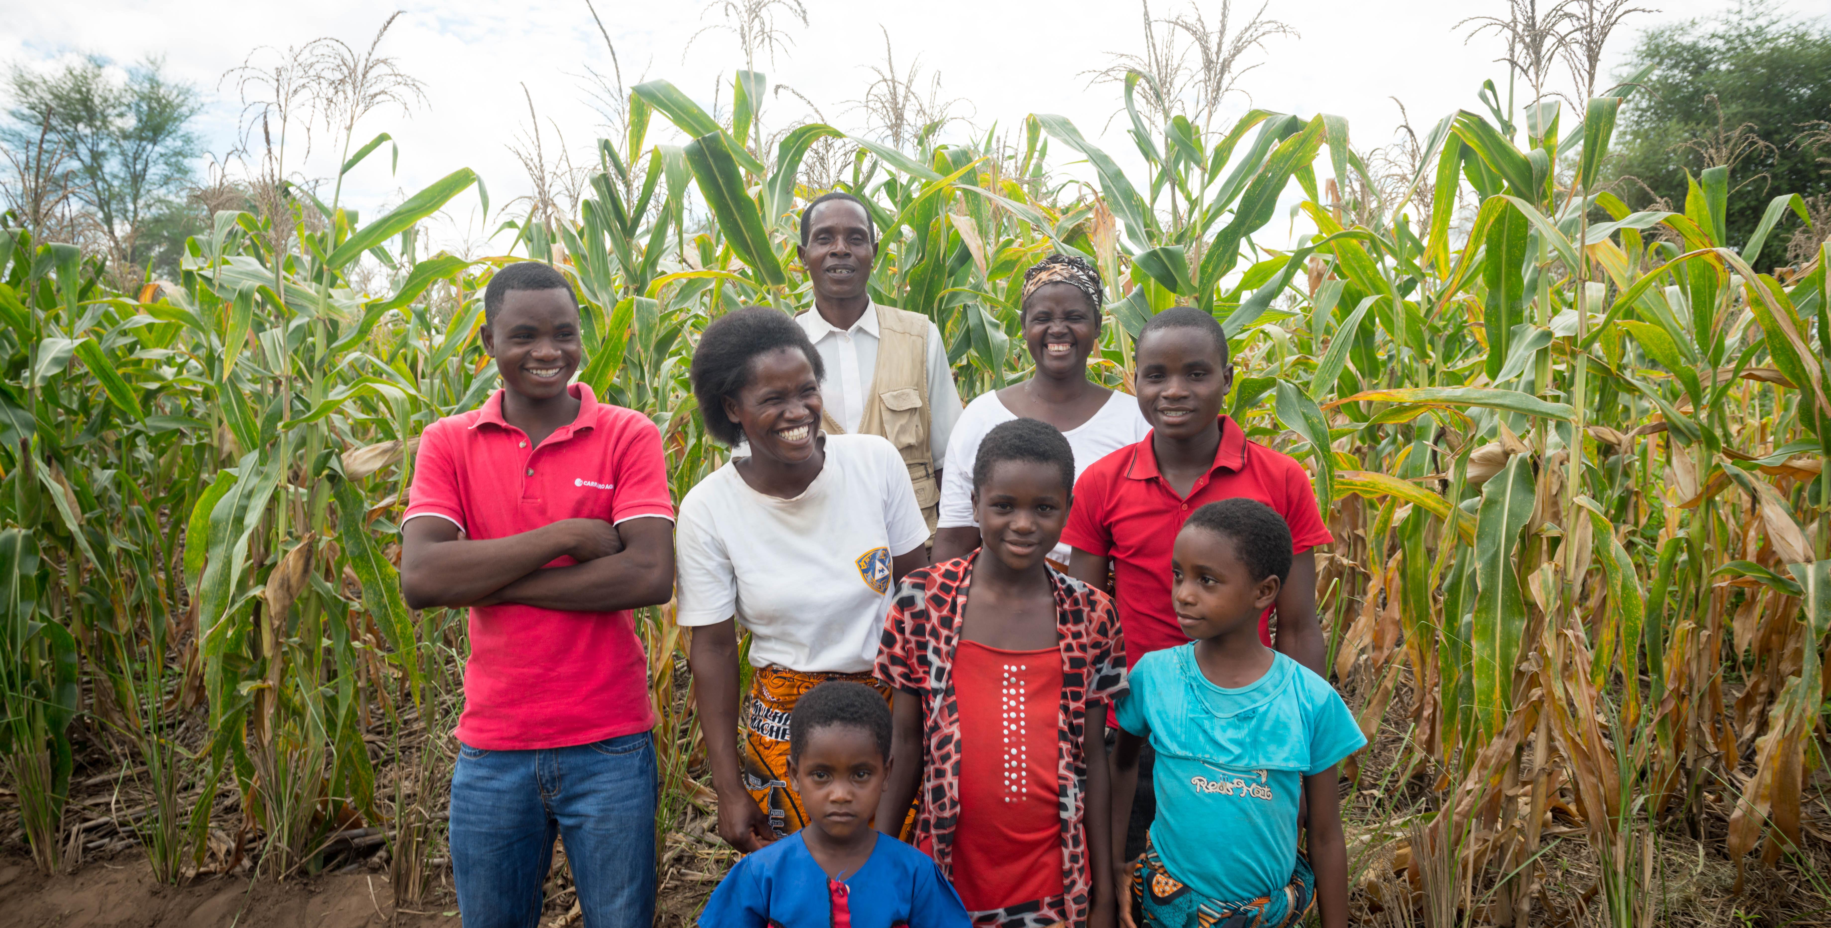
THANK YOU FOR HELPING
BUILD A FARM IN MALAWI!

