Slide 1
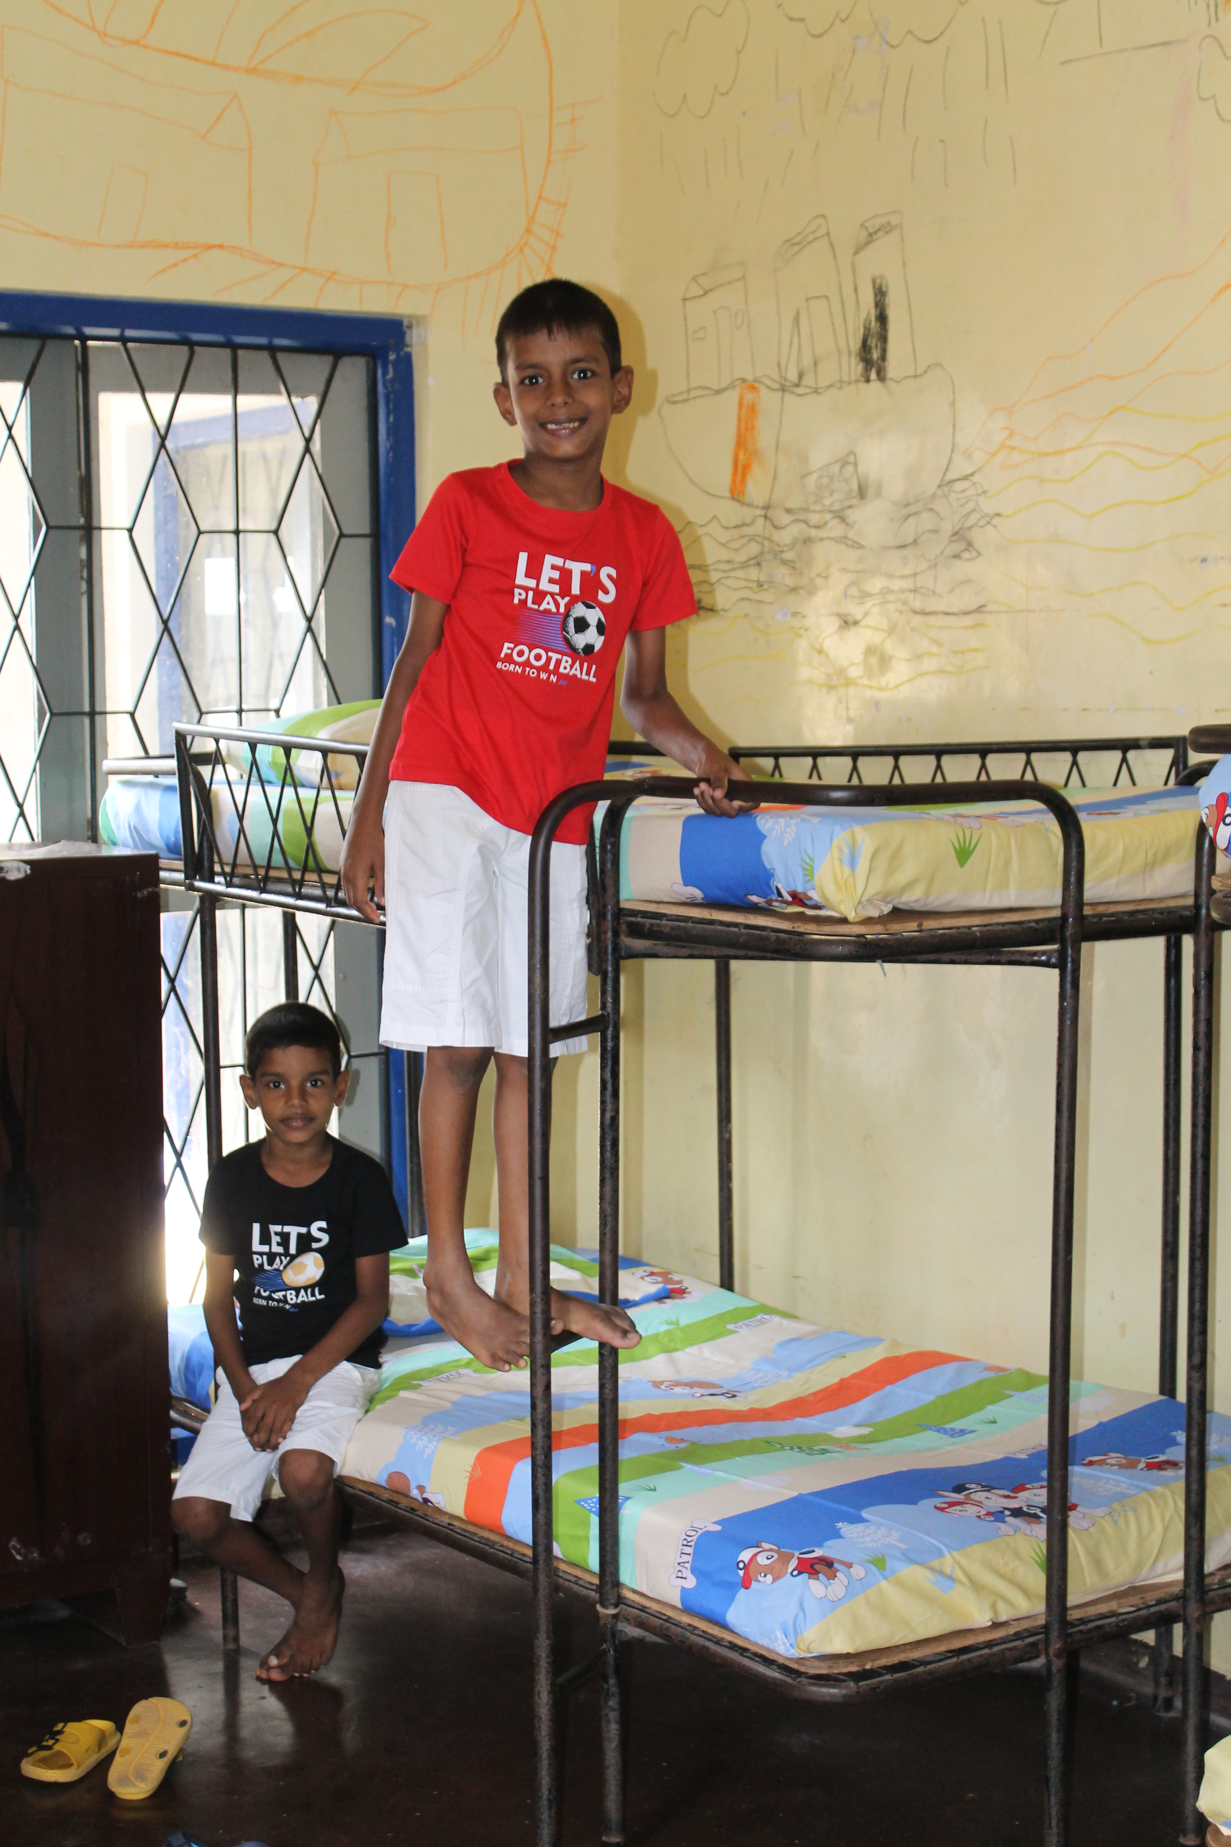
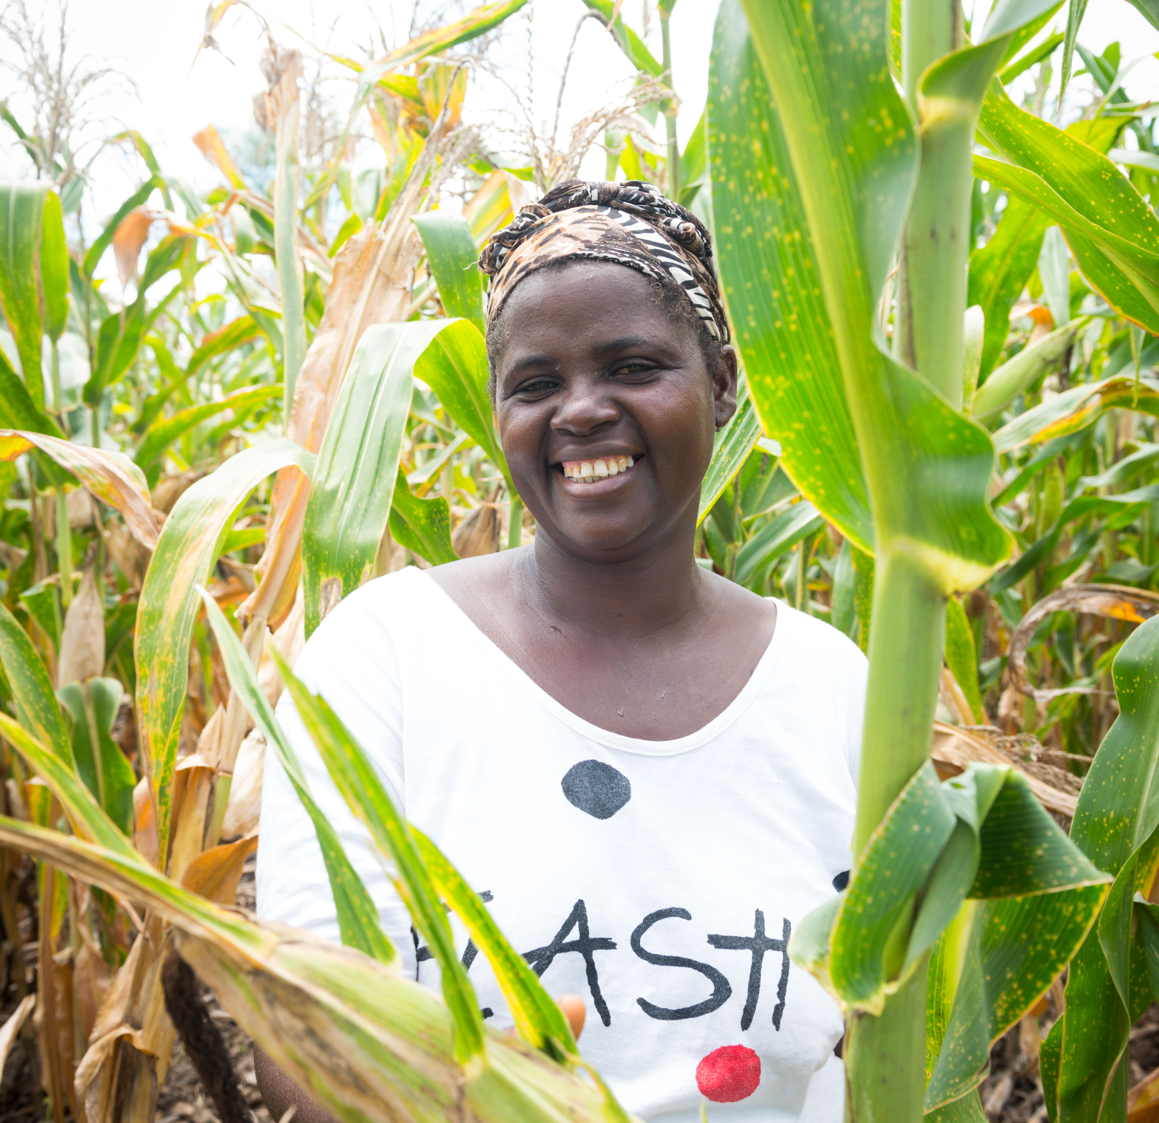
Help The Salvation Army
Fill a School in
Fill a Dorm in
Build a Farm in
RWANDA
SRI LANKA
MALAWI

Slide 2
Fill a Dorm in
SRI LANKA

Slide 3
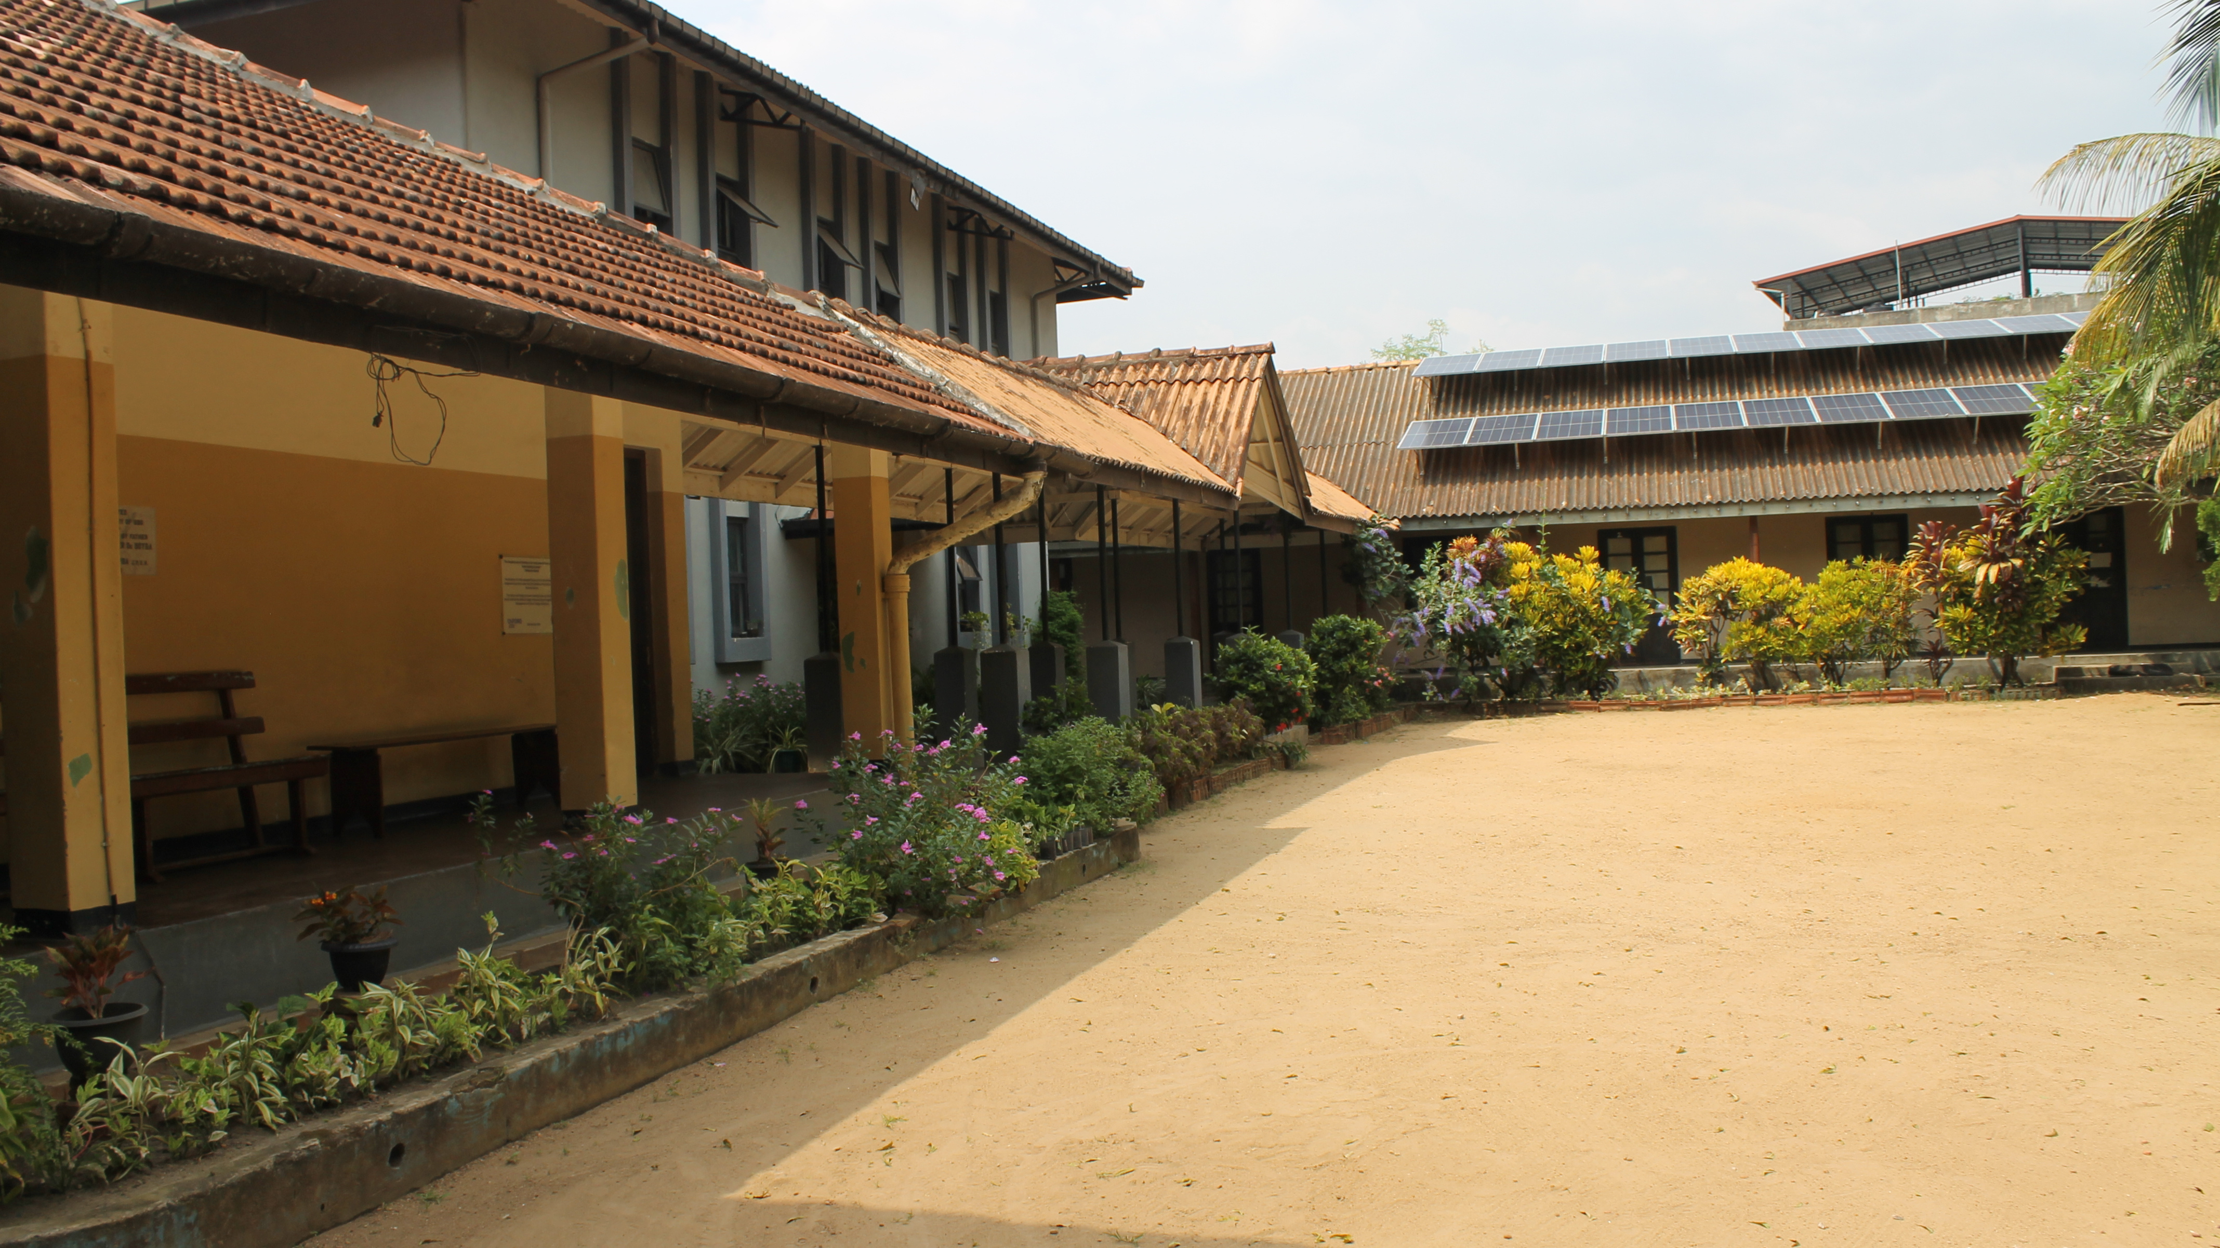
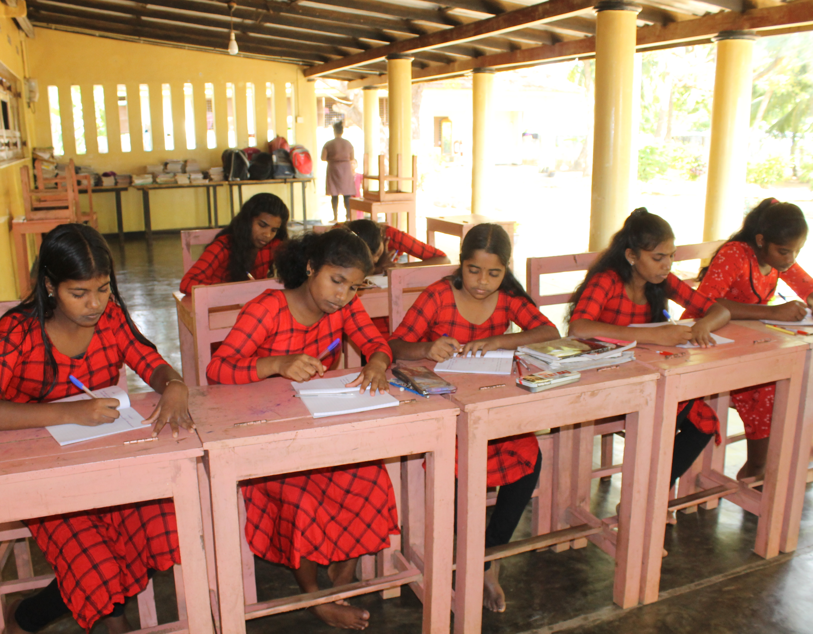
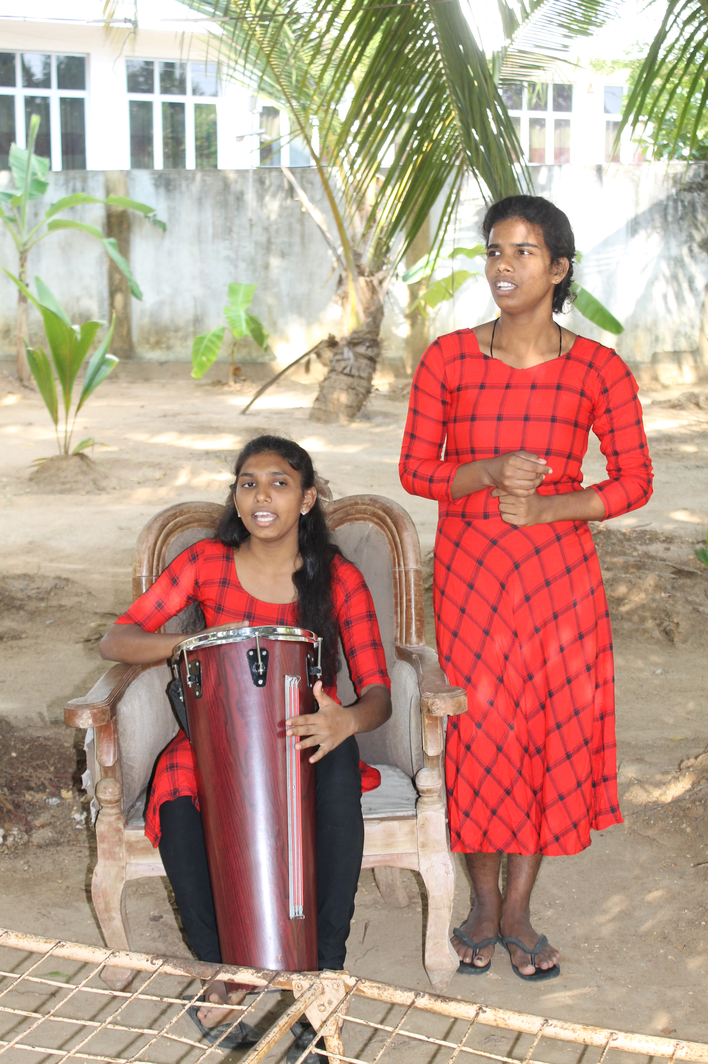
Child Development Centers in Sri Lanka

Slide 4
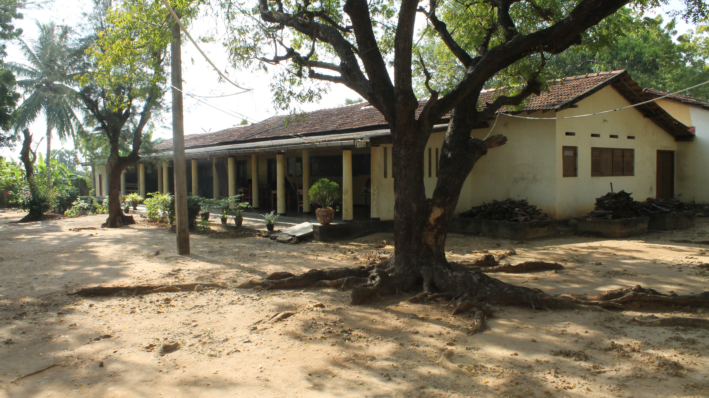
Items List
Hygiene Kit
Clothing with Storage
$20
$50
Bedding
Backpack
$25
$10

Slide 5
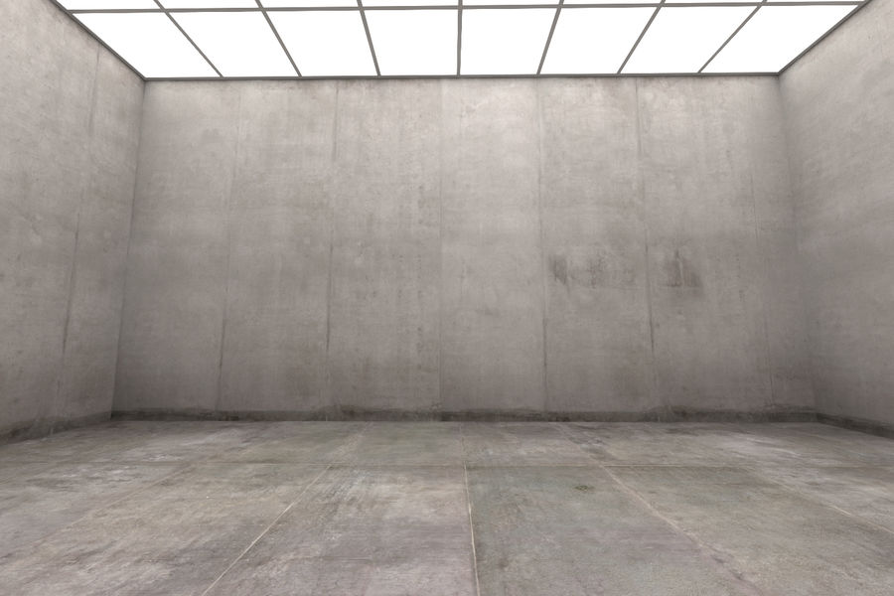

Slide 6
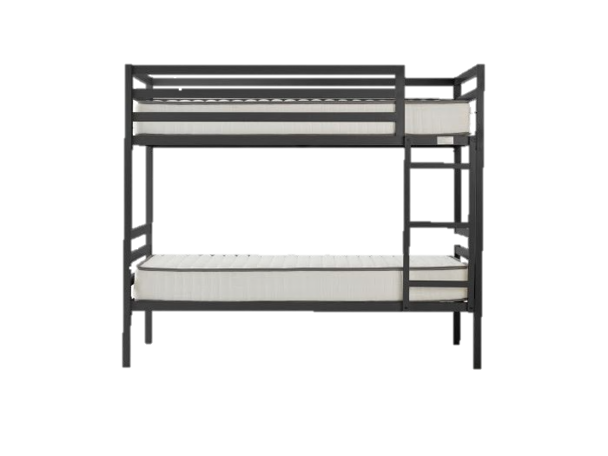
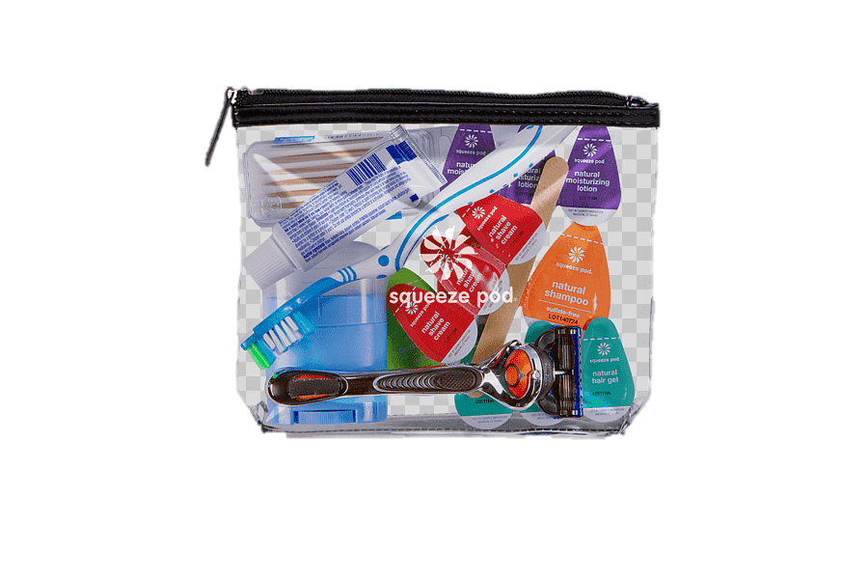
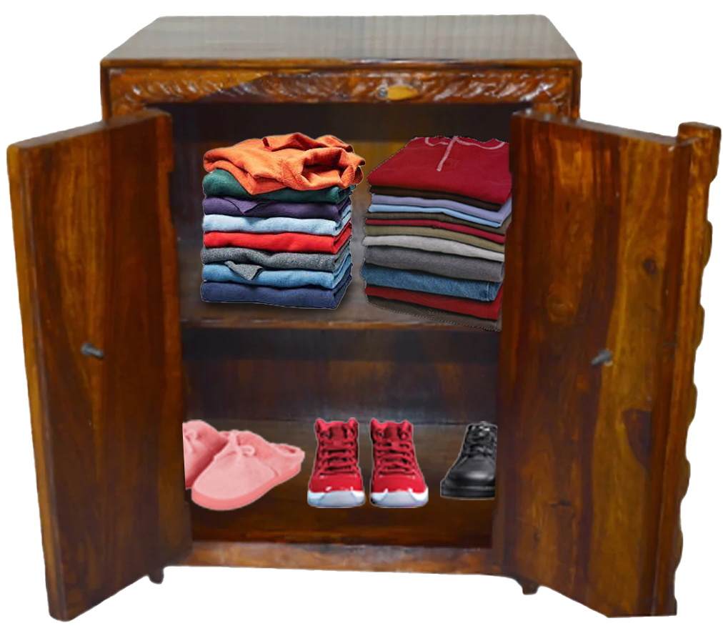
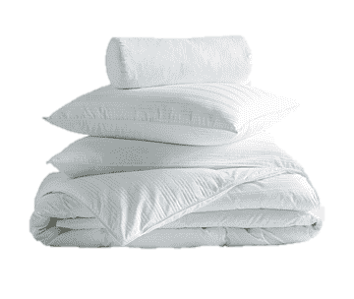
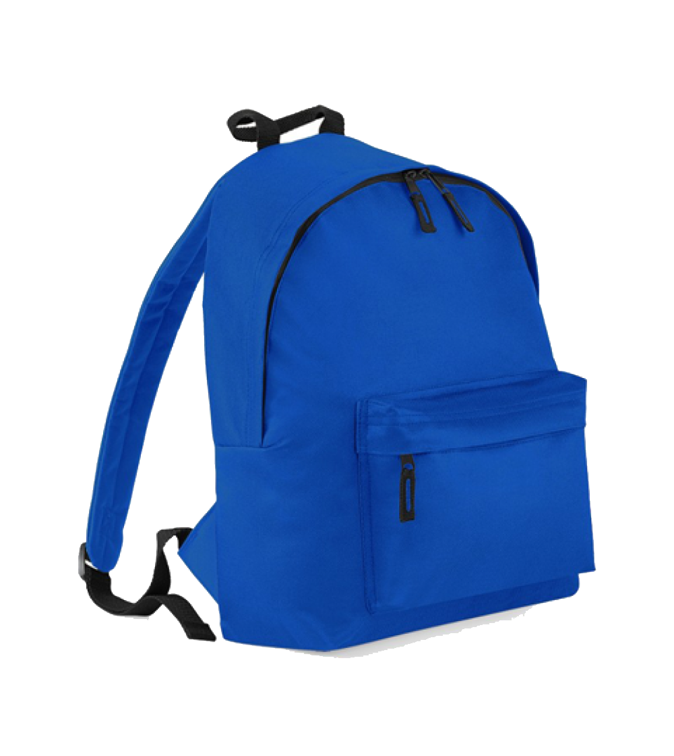

Slide 7
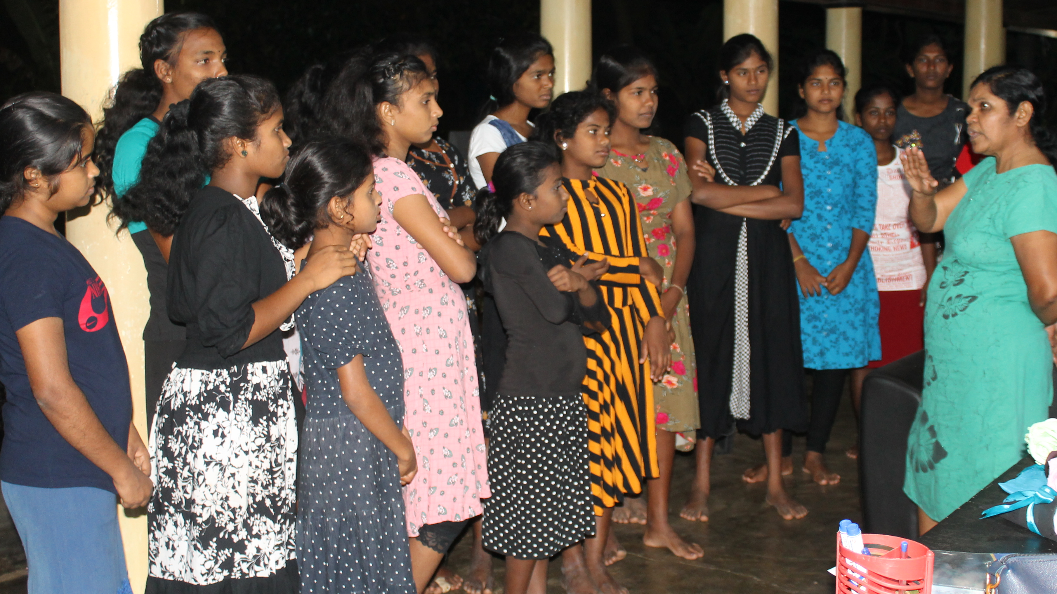
Hygiene Kit
$20

Slide 8
Clothing with Storage
$50

Slide 9
Bedding
$15

Slide 10
Backpack
$10

Slide 11
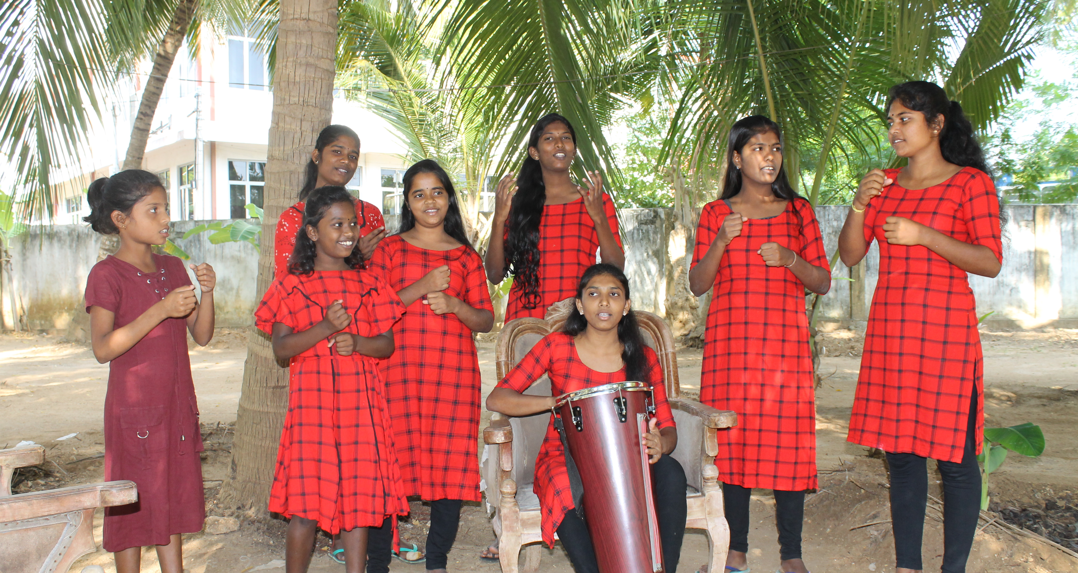
THANK YOU FOR HELPING
FILL A DORM IN SRI LANKA!

