Slide 1
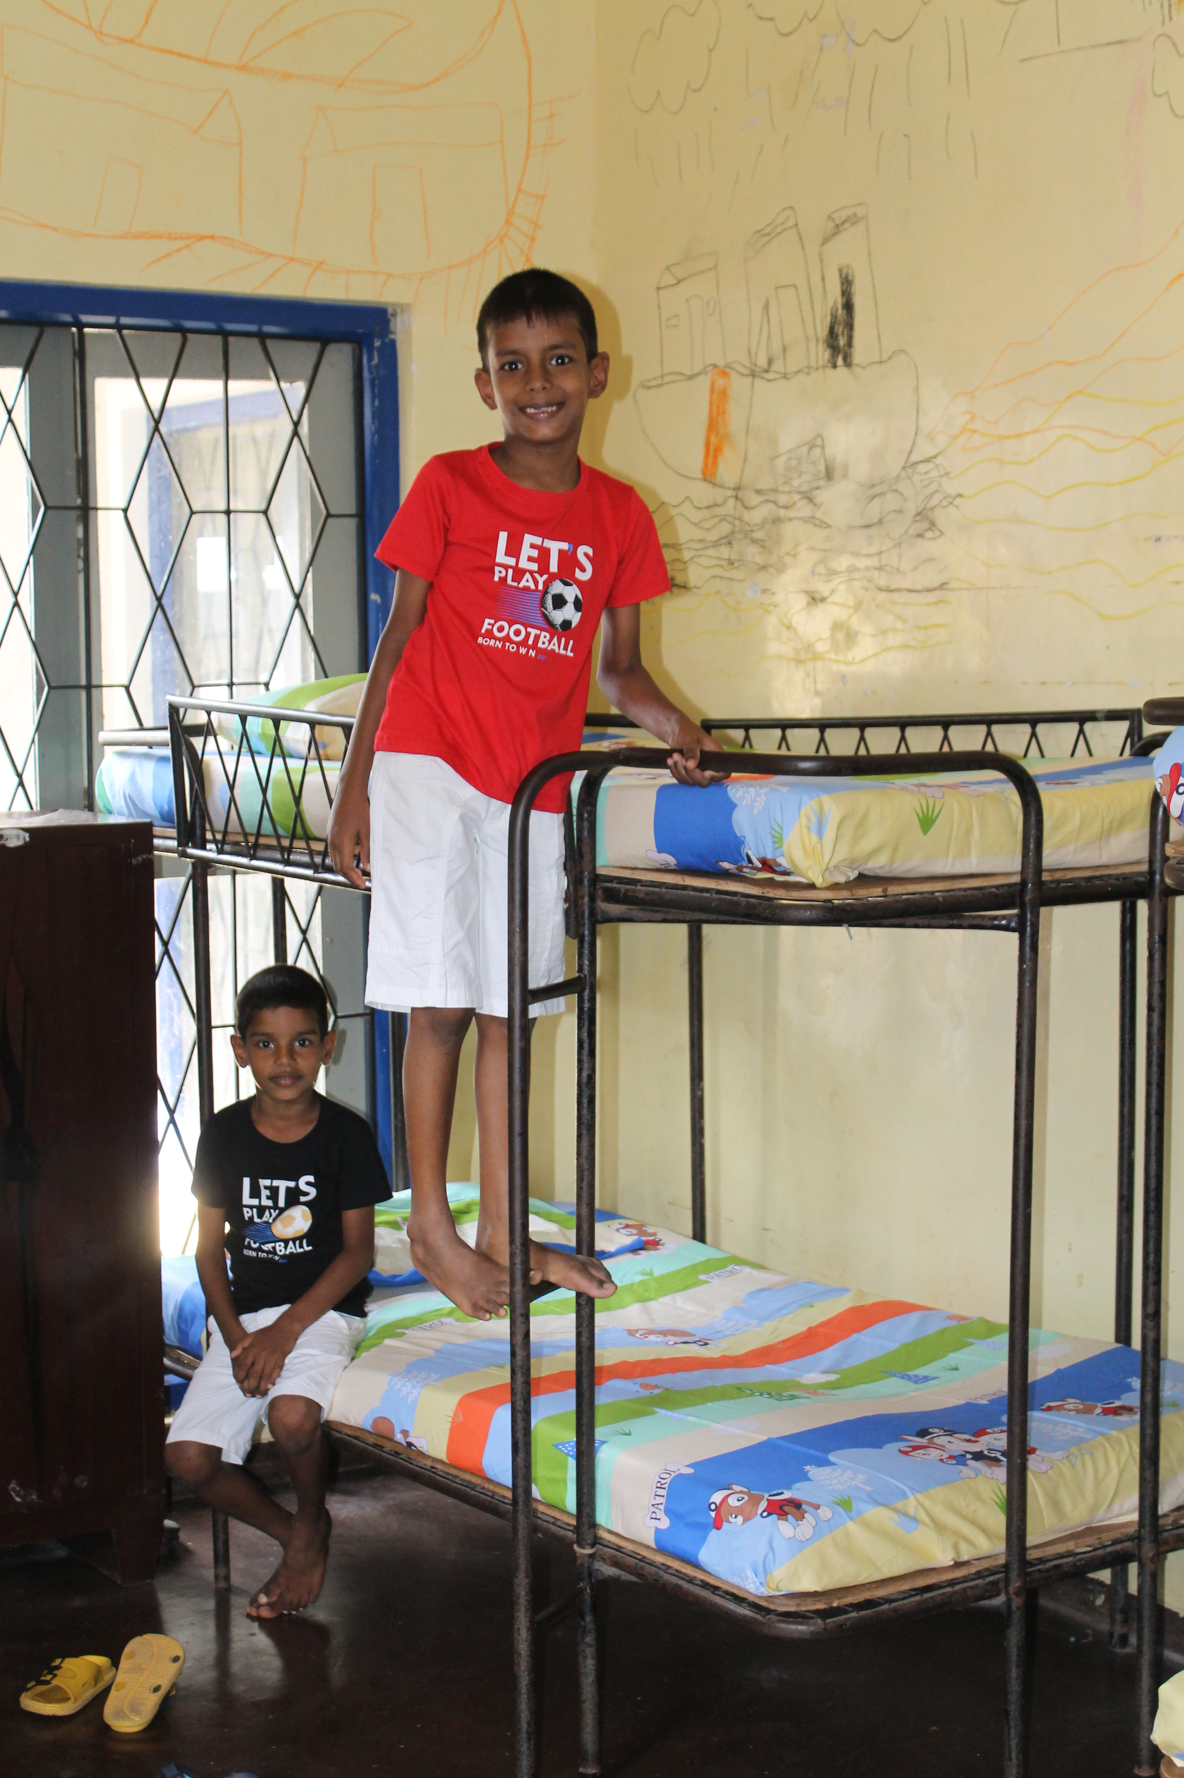
Help The Salvation Army
Fill a School in
Fill a Dorm in
Build a Farm in
RWANDA
SRI LANKA
MALAWI

Slide 2
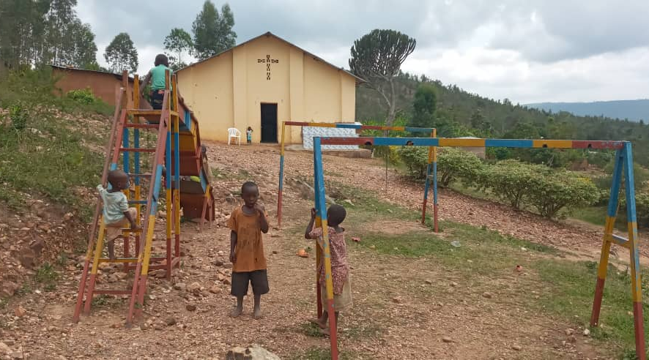
Fill a School in
RWANDA

Slide 3
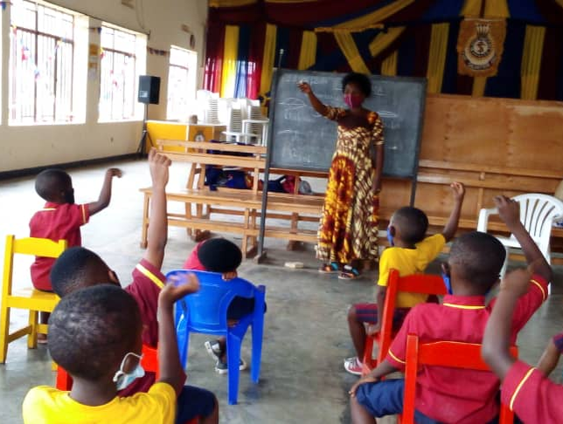
Pre-school In Rwanda

Slide 4
Items List
Books
Toys
Chair
$25
$25
$15
Sleeping Cot
Blanket & Pillow
$50
$40

Slide 5
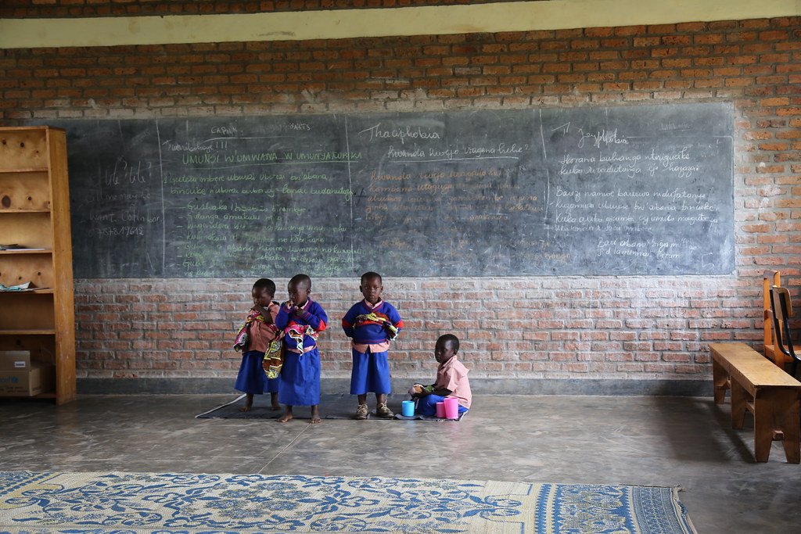
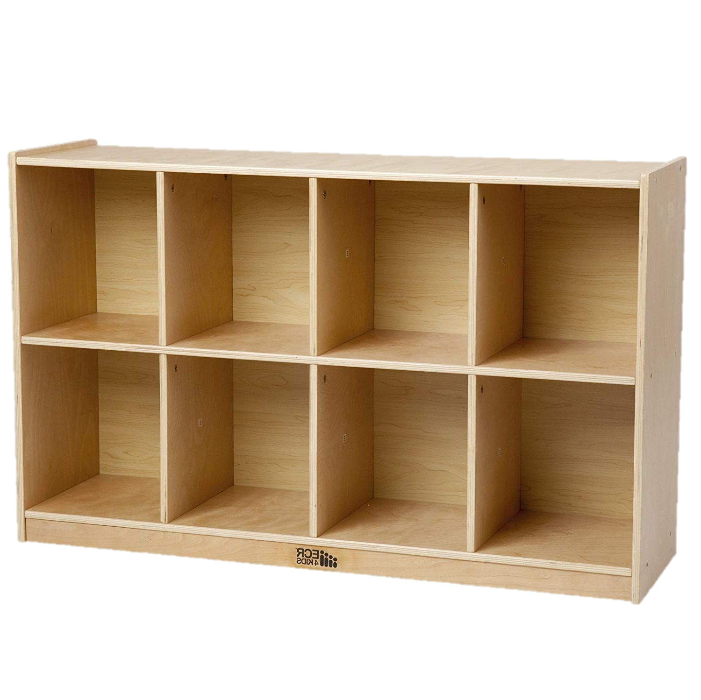

Slide 7
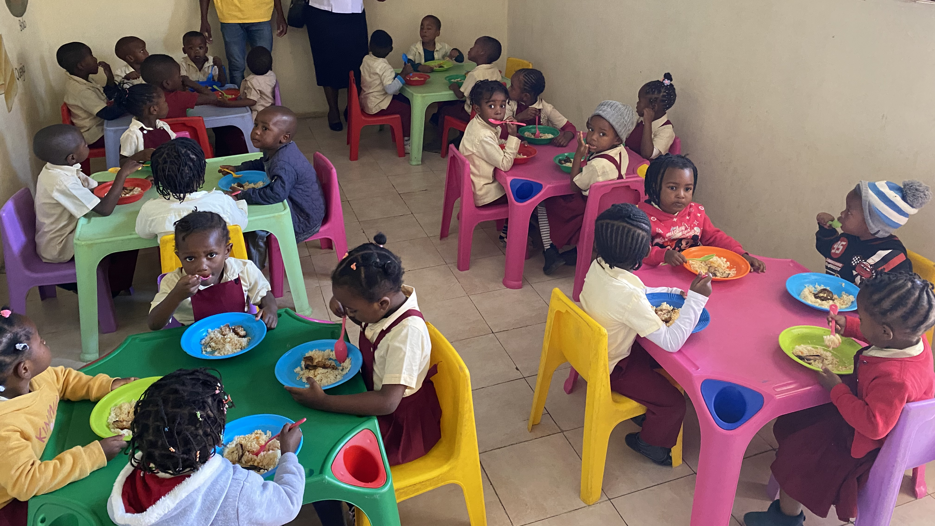
Books
$25

Slide 8
Toys
$25

Slide 9
Chair
$15

Slide 10
Sleeping Cot
$50

Slide 11
Blankets & Pillows
$40

Slide 12
THANK YOU FOR HELPING
FILL A SCHOOL IN RWANDA!

