Slide 1

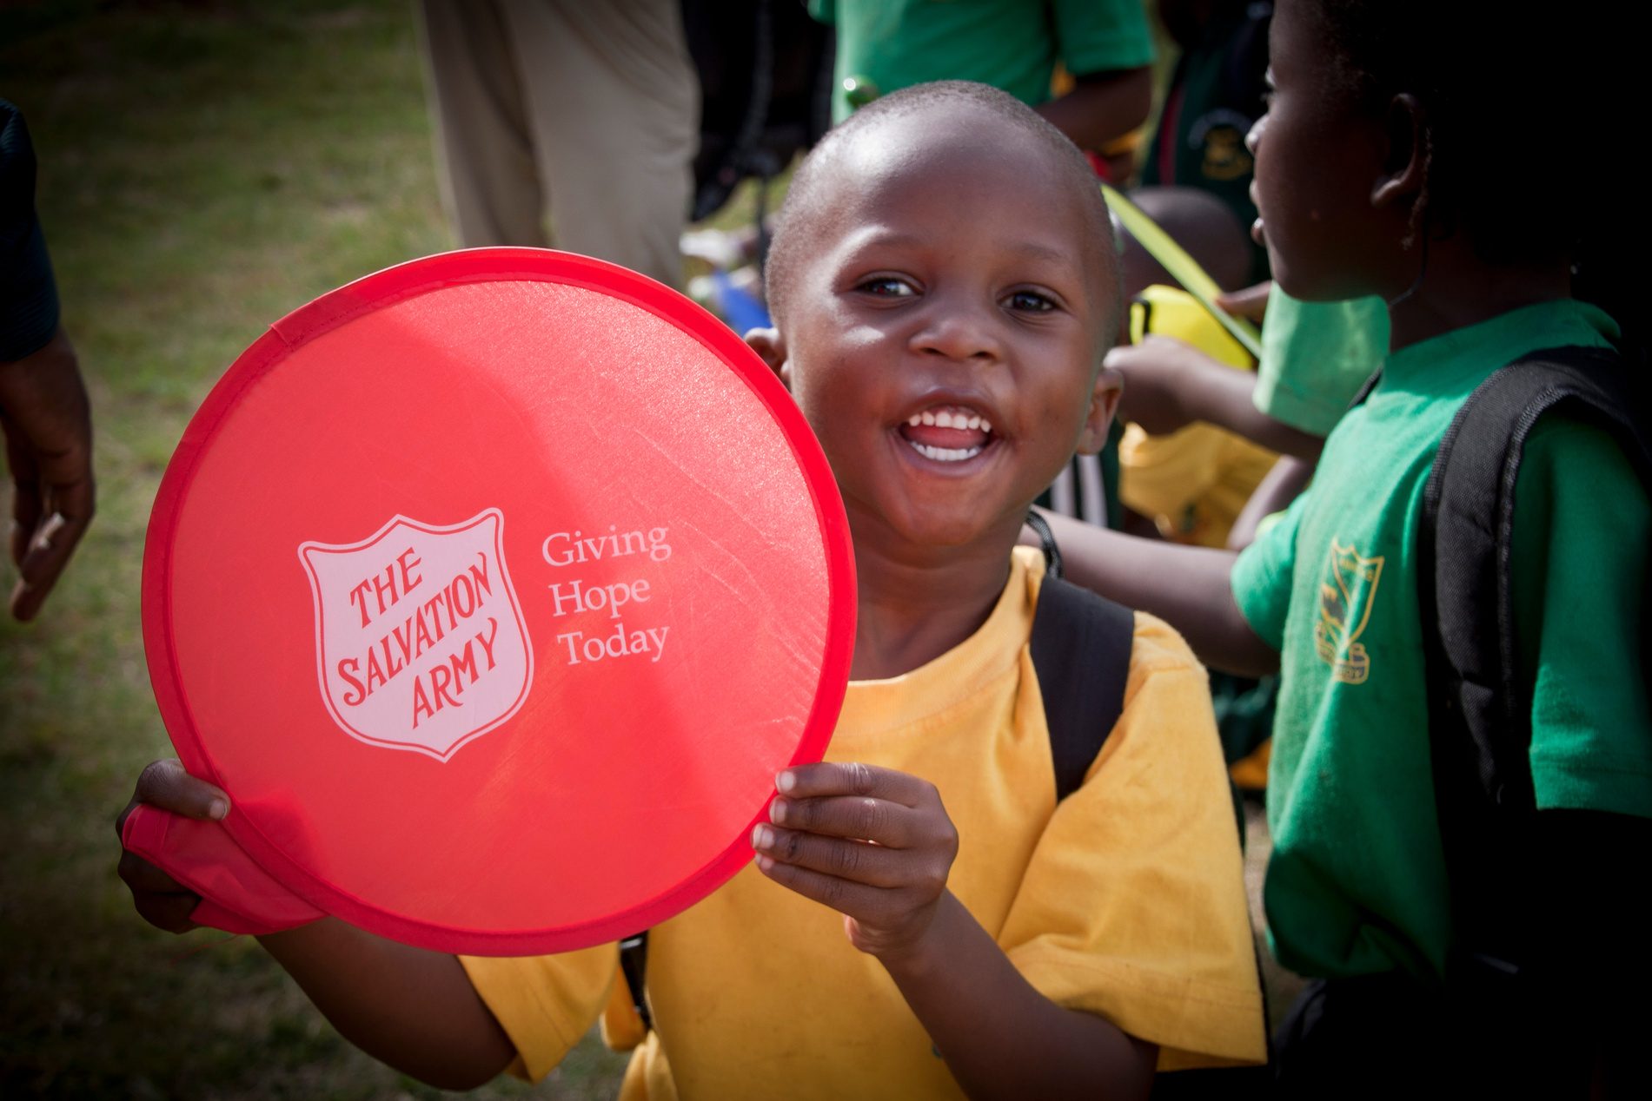






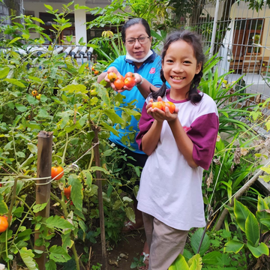

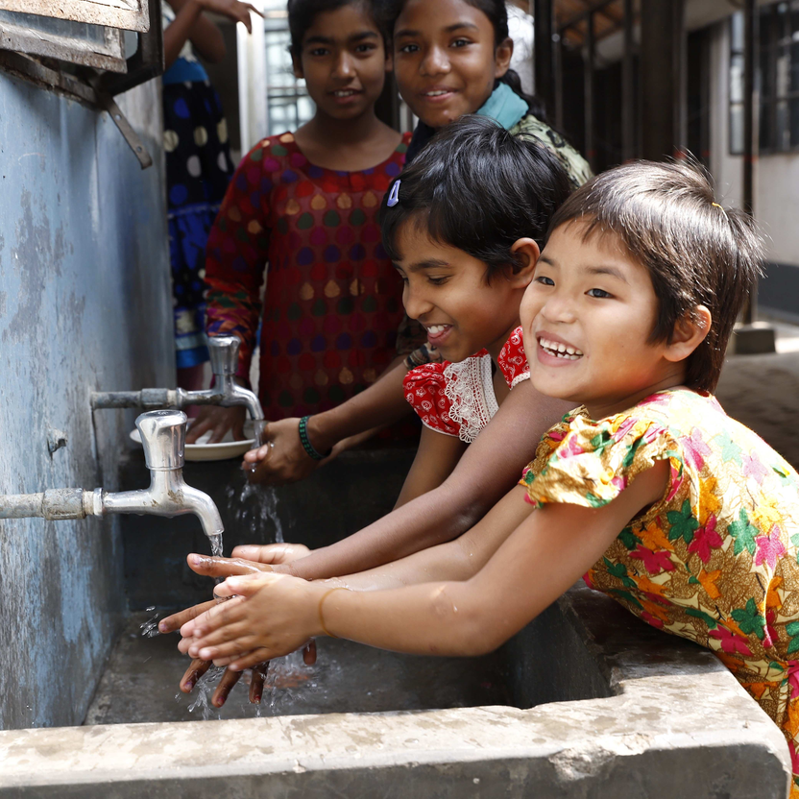
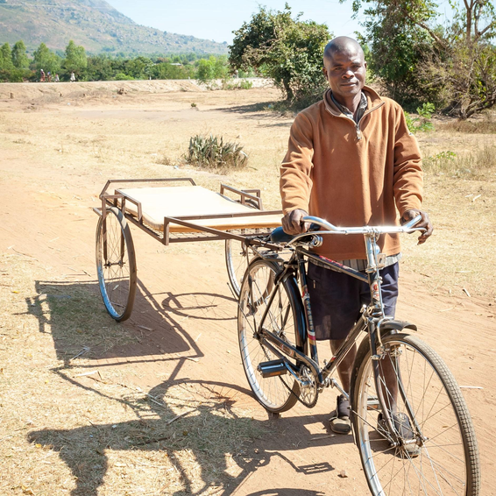
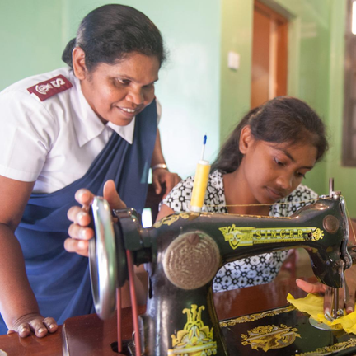



HOPE THROUGH FARMING
Gifts that make memories
HOPE THROUGH HEALTH
This Christmas, share the true spirit of the season by giving gifts that make a lasting impact.
HOPE THROUGH COMMUNITIES
HOPE THROUGH EDUCATION
or consider giving to
HOPE WHERE NEEDED MOST
SalvationArmy.ca/GOHChristmas

