Slide 1

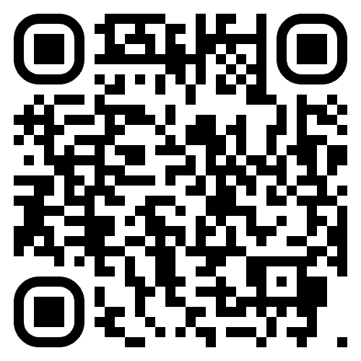

We want to hear from you!
Share your experience by scanning the
QR code or visiting salvationist.ca/valuessurvey

