Slide 1

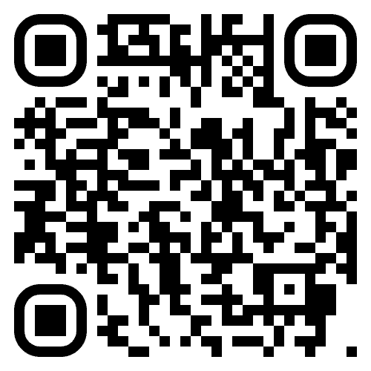

Results now available by scanning the
QR code or visiting salvationist.ca/valuessurvey

