Slide 1


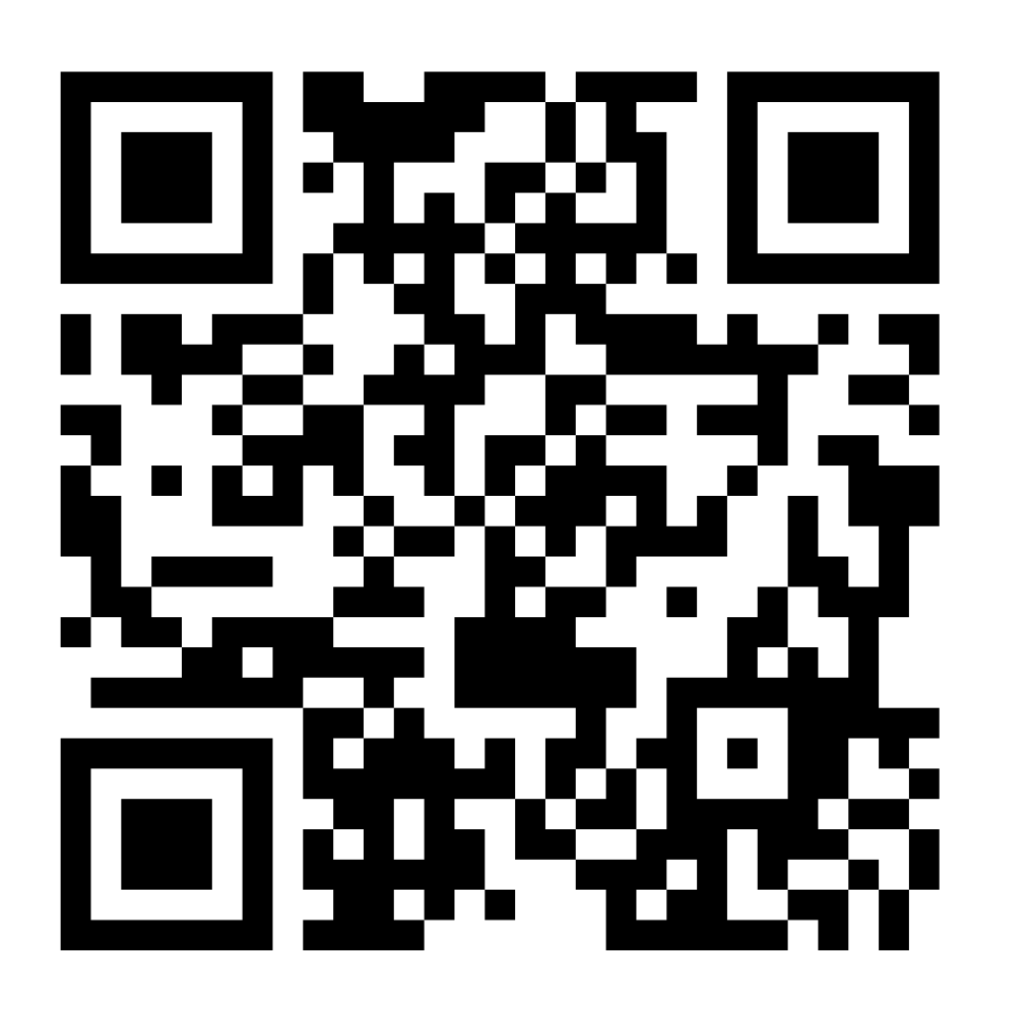
Add Ministry Unit Name
Or Change Logo to Ministry Unit Logo
Join Us in Making a Difference
This Christmas Season
The Salvation Army’s annual Christmas Kettle Campaign relies on public donations to assist millions of people living in poverty. Without the help of volunteers, we can’t raise these essential funds. By becoming a Salvation Army Christmas Kettle Volunteer, you can help vulnerable Canadians.
Join our community today
Are you an existing volunteer?
Apply to become a Kettle volunteer today!
Sign in to The Salvation Army portal to easily schedule and manage your kettle shifts.
Insert QR Code for your Ministry Unit Volunteer Application Form

