Slide 1

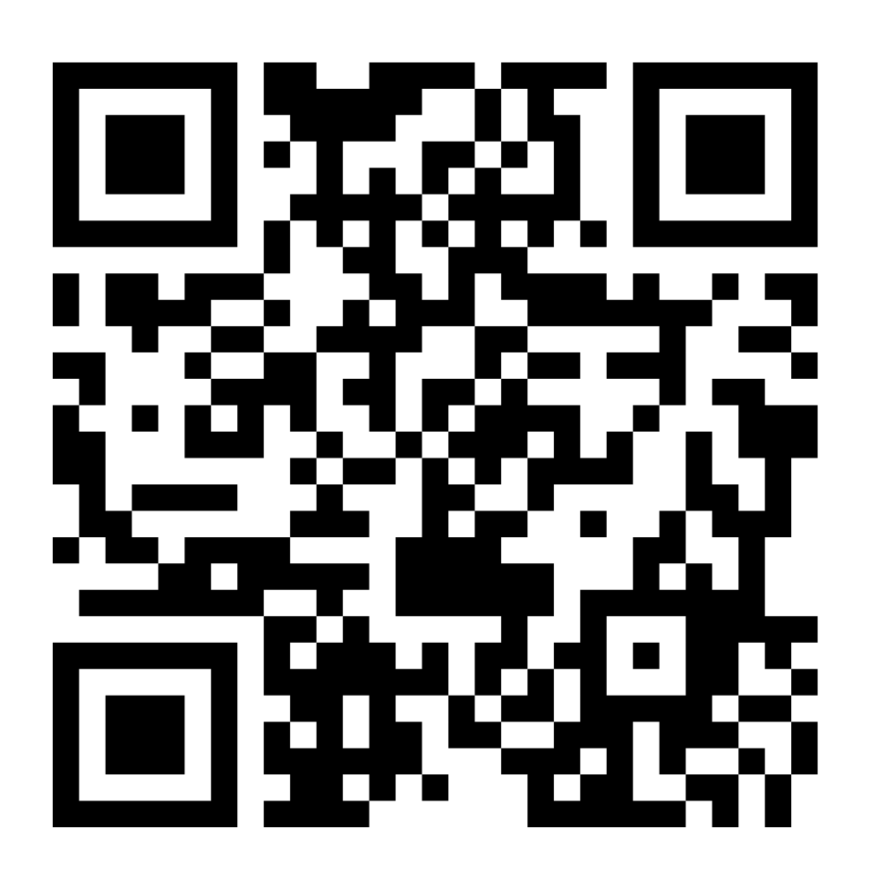
Add Ministry Unit Name
Or Change Logo to Ministry Unit Logo
Introducing The Salvation Army Portal!
Designed to make your journey with us more convenient with self-serve features where you can explore volunteer opportunities, access training materials, and sign up for shifts that suit your schedule.
New User?
Go to https://portal.salvationarmy.ca/s/login/ or scan the QR code below to sign up.
Returning User?
Simply log in using your existing sign in information.
If you have any questions or need help, don't hesitate to reach out to (Insert Ministry Unit Contact Name)
Let's make a difference together!
Join our community today
Sign in to The Salvation Army Portal
Apply to become a volunteer today!
Easily schedule and manage your volunteer shifts.
Insert QR Code for your Ministry Unit Volunteer Application Form

