Slide 1
Christian
Contributed by: Michelle Blake (BC Division)
Notes:
Adapted from the book “Let us break bread together, A Passover Haggadah for Christians By Pastor Michael Smith and Rabbi Rami Shapiro.

Slide 2
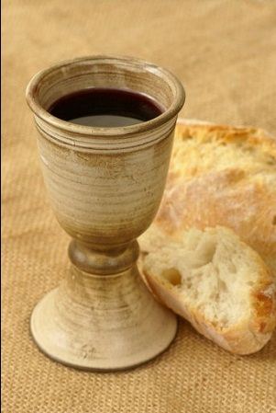
Leader’s Welcome
“How very good and pleasant it is when kindred live together in unity.”Psalm 133:1
Tonight we sit in special fellowship, honoring each other and God with a Passover meal. We do so for at least three reasons. First, Jesus celebrated Passover, and our Passover links
us to Him and to the ancient
Jewish roots of our faith.

Slide 3
Leader’s Welcome
Second, the celebration of freedom, which is at the heart of Passover, is universal, inspiring people of different faiths and even people aligned with no faith to labor for liberation.
Third, the personal challenge of Passover freeing ourselves from personal enslavements of thought, word, deed may benefit all of us.

Slide 4
Leader’s Welcome
If we are to benefit from our Passover seder, however, we must be authentic in what we are doing. We must not simply imitate the Passover of our Jewish neighbors. Instead we must engage in our own spiritual freedom. Our seder, therefore, is not an imitation but an adaptation. We draw from Judaism
but we do not pretend to be Jews.

Slide 5

Leader’s Welcome
In this way, we may learn from our deepest historical roots yet remain true to ourselves and our faith.
Our meal is called a seder, from the Hebrew term for “order.” The Book of Genesis tells us that God orders all creation. Though we affirm this is so, we must confess we often cannot
sense God’s ordering presence.

Slide 6
Leader’s Welcome
Our own habit of trying to control things for ourselves gets in the way. Paradoxically, the more we seek to control things, the more they spin out of control. The story we tell on Passover is one of human control and divine freedom.

Slide 7
Leader’s Welcome
Egypt symbolizes our enslavement to power, the kind of bondage that results from our seeking to control our own lives. Pharaoh symbolizes our addiction to power and to the need to control. The Jewish people symbolize all of us
who are enslaved in some fashion
to the ego’s need to control.

Slide 8
Leader’s Welcome
The entire Passover meal is a celebration of our rediscovery of God’s order and the freedom that comes when we refocus our attention on the only thing we can control: our decision to surrender control of our lives to God.
To that end we pray:

Slide 9
Leader’s Welcome
O Lord of all creation and of each human life, hear now our prayer. As we gather around this table, relive the story of the Exodus, and partake of the food provided, we ask that you use the occasion toward your ends. May our felt need for you be deepened, our bonds with one another be tightened, our willingness to surrender
to your rule be strengthened, and our ministry to others be extended. Amen.

Slide 10
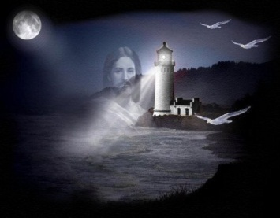
And I thank God for the lighthouse
And I thank God for the lighthouse
I owe my life to Him,
For Jesus is the lighthouse
And from the rocks of sin
He has shone the light around me,
That I may clearly see
If it wasn’t for the lighthouse
Where would this ship be.

Slide 11
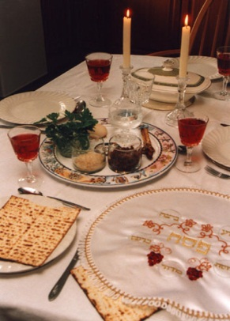
Candle Lighting
Leader: “Let your light shine before others, so that they may see your good works and give glory to your Father in heaven.” Matthew 5:16 (ESVUK)
We begin our seder with the making
of light. Yet light makes sense
only In contrast to darkness.

Slide 12
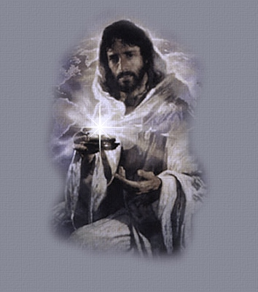
Candle Lighting
Take a moment close your eyes recall and embrace the dark times of your life: times of confusion, depression, and loss. Allow yourself to feel the “Dark Night of the Soul” not as punishment for sin but as a prelude to salvation:
“There was evening, there was morning, a first day” Genesis 1:5
Notes:
(The candles are let while the participants eyes are closed.)

Slide 13

Candle Lighting
Now open your eyes and behold the light as a gift from the One who says “light” and light comes into being.
Community: Bless you, Abba, Sovereign of all life, who honors us with the opportunity to kindle the light of freedom.

Slide 14

Candle Lighting
Question #1
Answer #1
Notes:
Q. What does it mean to be free? Is freedom simply a matter of doing what we wish whenever we wish?
A. There is a difference between independence and freedom. As a child matures he/she learns to say no to the will of others. This is the beginning of their independence. As they grow they add to this no a yes affirming their desires and will. Many of us never mature beyond this point. We call this freedom, but this is only independence. True freedom comes when we can also say no to our own desires and yes to the needs and desires of others. True freedom arises not when we do our will but when we do God's will; doing justly; acting compassionately,
and walking humbly. Micah 6:8

Slide 15
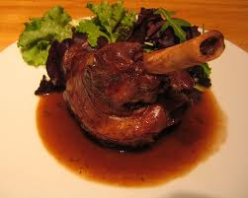
The Symbols of Passover
Leader: To help us understand the meaning of our seder as a whole, we will explore the meaning of each part.
Question #2
Answer #2
Notes:
Q. What is the meaning of the roasted shank bone?
A. The shank bone, called zeroa, reminds us of the paschal lamb offered to God by the Jews. For us Christians it calls to mind the significance of Jesus, whom we remember as God's Paschal Lamb offered on our behalf.

Slide 16
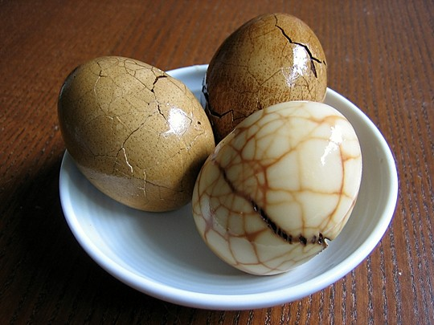
The Symbols of Passover
Question #3
Answer #3
Notes:
Q. What is the meaning of the boiled egg?
A. For many Jews and Christians the egg, baytza in Hebrew, symbolizes the circle of life and death and the turning of the seasons. Passover, like Easter, is a spring holy day. In the Jewish tradition, Passover marks the renewal of life in the natural world. Christians inevitably are reminded of the resurrection of Jesus. In Judaism he egg is also considered a sign of mourning, reminding us to honor the suffering of those trapped in slavery, both the enslaved and the enslaver's, and as Christians, to honor the Passion of our Lord whose suffering was the key to our liberation.

Slide 17
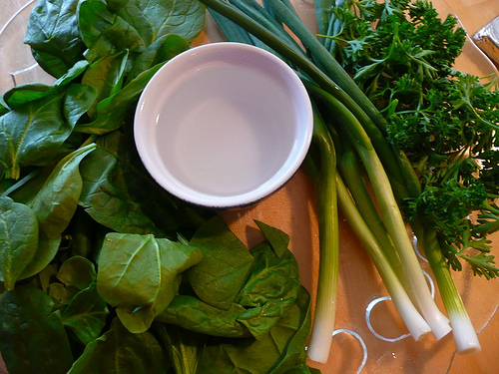
The Symbols of Passover
Question #4
Answer #4
Notes:
Q. What is the meaning of the bitter herbs?
A. The herbs are called maror, "bitter" and are eaten to remind us of the bitter taste of slavery in all its forms.

Slide 18
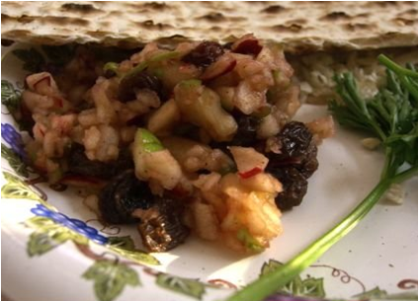
The Symbols of Passover
Question #5
Answer #5
Notes:
Q. What is the meaning of the mixture of nuts, apple and spices?
A. This is charoset and symbolizes the mortar the Hebrew slaves used to build the pyramids of Egypt. It reminds us all of the great yet ultimately futile works to which so many individuals and societies are enslaved.

Slide 19
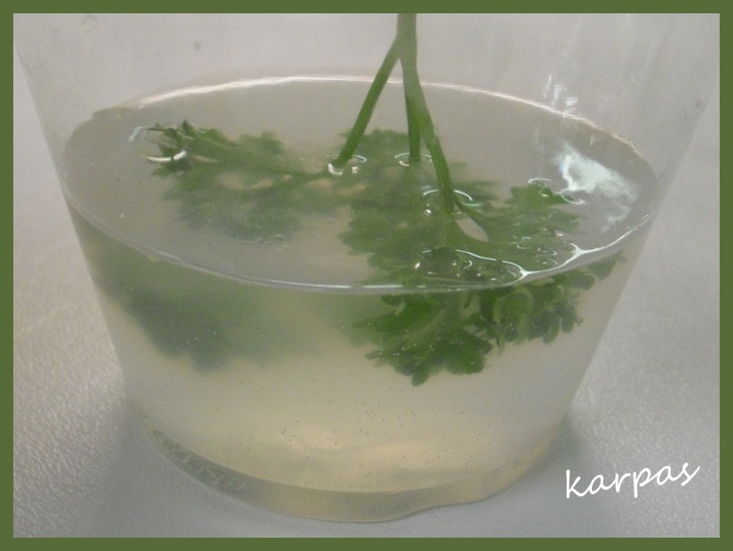
The Symbols of Passover
Question #6
Answer #6
Notes:
Q. What is the meaning of the parsley on our seder plate?
A. This is called karpas and represents hope. Later in our seder we will dip the karpas in saltwater, symbolizing the sadness of slavery, the joy of liberation, and the effort needed to move from the first to the second hope must lead to action if our desire for liberation is to become the reality of freedom.

Slide 20
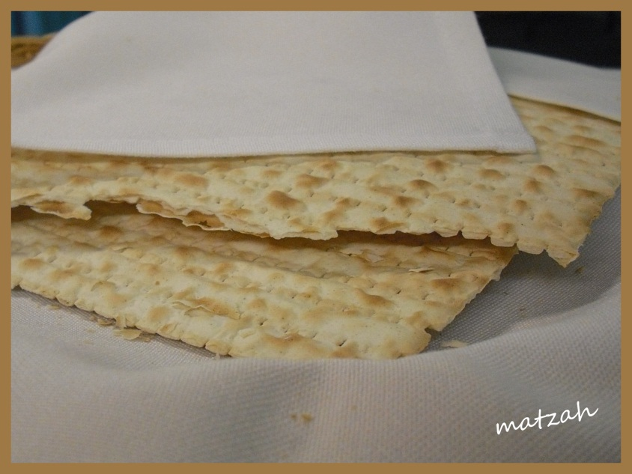
The Symbols of Passover
Question #7
Answer #7
Notes:
Q. What is the meaning of the unleavened bread?
A. Matzah has many meanings. It is called the "bread of affliction" reminding us when we eat it of the suffering of the poor. It is flat to remind us not to become puffed up but instead to remain simple and humble. It is dry to remind us that we cannot live by bread alone, that we need the water of life that is God. Matzah for Passover is prepared under strict supervision of rabbis whose job is to make sure the dough does not sour and rise. For this reason when we eat matzah we are reminded to root out the sourness in our lives and the sourness we bring to the lives of others.

Slide 21
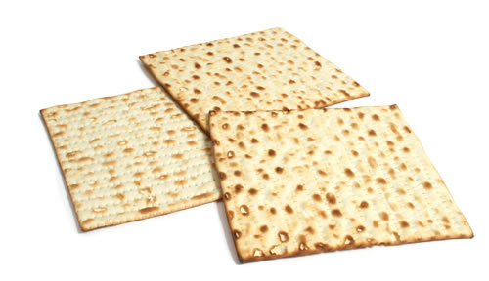
The Symbols of Passover
Question #8
Answer #8
Notes:
Q. Why are there three matzot on the table?
A. The number three is sacred in both Judaism and Christianity. In Judaism it may represent the three pillars of Judaism: God, Torah, and Israel; the three pillars of civilization: revelation, divine worship, and acts of loving kindness; and thought word and deed what Judaism refers to as the "Three Garments of the Soul" the three primary ways we engage each other and the world. For Christians, the three matzot may symbolize the completeness on God's saving work: the calling out our God's special people, the extension of God's grace to the Gentiles, and the promise of a new heaven and earth in which God's people will dwell. The number is also special to Christians as a representation of the three persons of the Trinity: God the Father, God the Son, and God the Holy Spirit.

Slide 22
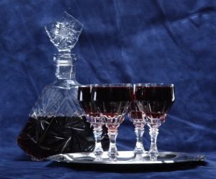
The Symbols of Passover
Question #9
Answer #9
Notes:
Q. Why is so much wine or grape juice needed?
A. It is traditional for guests to drink four cups of wine or grape juice at a seder. The number four reminds us of four aspects of liberation mentioned by God in Exodus 6:6-7: "I shall take you from under your burdens" I shall rescue you, I shall redeem you, and I shall take you unto myself.

Slide 23
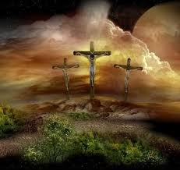
Burdens are lifted at Calvary
Burdens are lifted at Calvary, Calvary, Calvary
Burdens are lifted at Calvary
Jesus is very near.

Slide 24
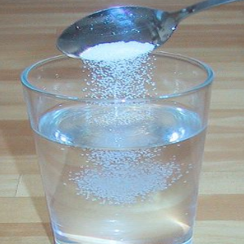
The Symbols of Passover
Question #10
Answer #10
Notes:
Q. How might we understand I shall take you from under your burdens?
A. Some burdens are so heavy as to leave us feeling crushed. We cannot push them away. Only God can snatch us safely from beneath such burdens.

Slide 25
The Symbols of Passover
Question #11
Answer #11
Notes:
Q. How might we understand "I shall rescue you"?
A. Our attachments are sometimes so strong we cannot pull ourselves loose. It is then that we must await God's rescue, allowing His power to replace our own.

Slide 26
The Symbols of Passover
Question #12
Answer #12
Notes:
Q. How might we understand "I shall redeem you"?
A. Our enslavement to wrongful habits robs us of joy and hope. We cannot redeem ourselves because it is to ourselves that we are enslaved. Only God can redeem us and free us from captivity.

Slide 27
The Symbols of Passover
Question #13
Answer #13
Notes:
Q. How might we understand "I shall take you unto myself"?
A. Our primary enslavement is to self and selfishness. True freedom comes when we surrender our small self to God and allow God to tkae us into His far greater self.

Slide 28
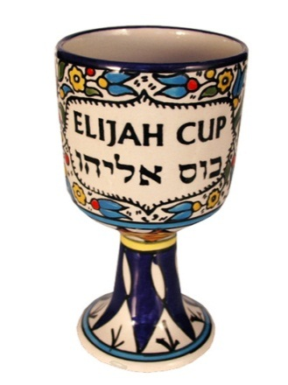
The Symbols of Passover
Question #14
Answer #14
Notes:
Q. What is the purpose of the extra empty wine cup"?
A. This is called Kos Eilyahu, the cup of the prophet Elijah. The Bible tells us that Elijah never died, but was taken directly to heaven. Jewish tradition says Elijah returns to earth regularly to help people in need. On Passover it is said he visits every seder and shares a bit of drink with the guests to remind us that God never abandons us. Elijah is also the prophet of peace who will herald the coming of the Messiah. For Jews this will be seen as the first coming of the Messiah, for Christians it will be seen as the second coming. Offering a place at our table for Elijah reminds us to offer a place in our hearts for redemption.

Slide 29
The Symbols of Passover
Question #15
Answer #15
Notes:
Q. What is the meaning of the saltwater?
The saltwater has three meanings:
- First it represents the tears of sadness that are shed in slavery.
- Second, it symbolizes the tears of joy that flow at the moment of liberation.
- Third, it reminds us of the effort and sweat that go into moving from the first to the second.

Slide 30
The Symbols of Passover
Leader: There is a great deal to remember about our Passover seder. Our hope is that the perspectives we have offered will enrich your experiences of the meal. We trust that these questions will spark further questions, which will inform our conversations as we eat. Remember, it is in the spirit of
Passover to ask questions.
There are no wrong answers.

Slide 31
The Symbols of Passover
Leader: The only mistake you can make is to pass up an opportunity to ask, explore, and share. All we ask is that your conversation be informed by the teaching of Jesus at His final seder, “I give you a new commandment, that you love one another. Just as I
have loved you, you should love
one another.”

Slide 32
The Symbols of Passover
Leader: By this everyone will know that you are my disciples, if you have love for one another.” John 13:34-35
Let us pray: “O God, teach us to trust you enough to ask the questions we have. Free us from the need to be perceived as clever or informed. Take the elements of the meal and use them to spark our curiosity, open
our minds, intrigue our hearts, and
deepen our capacity for love. Amen!

Slide 33
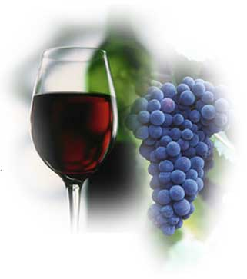
He poured in the oil and the wine
He poured in the oil and the wine
The kind that restoreth my soul
He found me bleeding and dying
On the Jericho road
And He poured in the oil and the wine.

Slide 34
Kadesh: The first cup of wine
It is customary for the guests to fill each other’s glass and not their own.
Question #16
Answer #16
Notes:
Q. Why do we fill each other's glasses and not our own?
A. The rabbis teach: what is the difference between heaven and hell? In both the souls of the departed sit at long tables lavishly prepared with
the finest foods. In both, the departed are made to eat with forks to long to allow them to feed themselves. In hell each soul struggles alone to
ease a growing hunger. In heaven each soul feeds the soul sitting across the table and in this way all souls are full. Filling each other's glasses
brings a taste of heaven to our table; it is a way of welcoming each other and affirming our desire to welcome all humanity to our table-fellowship. It is also a reminder of God's commandment to love our neighbor as ourselves. Lev19:18; Mt 19:19

Slide 35
Kadesh: The first cup of wine
Leader: The first cup binds us together in fellowship. We fill each others’ cups as we hope to fill each other’s hearts. In sharing this drink and meal we remind ourselves of our common bond as children of God.
Community: Bless you, Abba, Sovereign of all life, who births
the fruit of the vine.

Slide 36
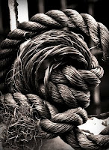
Bind us together Lord,
Bind us together Lord, bind us together
With chords that cannot be broken.
Bind us together Lord, bind us together
Lord, bind us together with love.

Slide 37
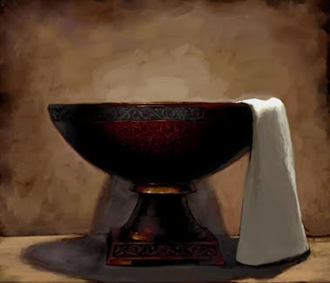
Urchatz: Washing the hands
In preparation for the meal, there is a ceremonial hand washing which is symbolic of the "clean hands" with which one comes before God.
Psalm 24:3-4
Notes:
A pitcher and basin, as well as a small towel is available at each table. A leader will guide you at each table.

Slide 38
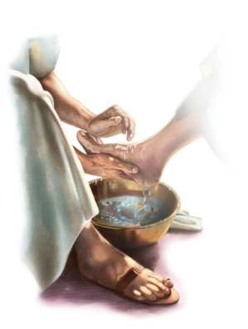
He had compassion on me
He had compassion on me
He touched my eyes that I might see
Washed my feet that I
might walk in His way
Cleansed my heart
From all sin
Gave me perfect peace within
What a wonderful Savior is He.
Notes:
A pitcher and basin, as well as a small towel is available at each table. A leader will guide you at each table.

Slide 39
Urchatz: Washing the hands
Notes:
A pitcher and basin, as well as a small towel is available at each table. A leader will guide you at each table.
(The leader washes the hands of those at their table on behalf of the community as a symbolic act of preparation for leading the community through the seder meal.)

Slide 40
Urchatz: Washing the hands
Question #17
Answer #17
Notes:
Q. Why do we wash our hands before continuing with our seder?
A. Washing the hands reminds us that we are entering a sacred space. The rabbis taught that with the destruction of the Temple in Jerusalem and the ending of sacrifice, the dinner table became the new altar, the central place of communing with God. Jesus too, made Table-Fellowship a central act of His ministry. This banquet, each table around which we sit, is a tabernacle of God. Let us cleanse our hearts
and minds even as we cleanse our hands.

Slide 41

Karpas: Blessing the green Vegetable
Dip the parsley in the saltwater,
but do not eat it.

Slide 42
Karpas: Blessing the green Vegetable
Question & Answer #18
Community: Bless you, Abba, Sovereign of all life, who births the fruit of the earth.
(The karpas is now eaten.)
Notes:
(Dip the parsley in the saltwater, but do not eat it.)
Q. Why is the parsley dipped in the saltwater?
A. Karpas, or green vegetable, symbolizes hope and renewal. The saltwater reminds us of the sweat of the brow, the hard work required if our hopes are to be realized in our lives. The first food we taste at our seder is the food of hope and work.

Slide 43
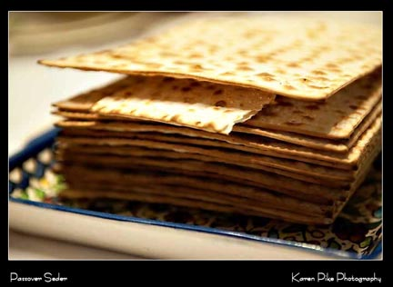
Yachatz: Breaking the middle Matzah
Notes:
One participant at each table, or leader at the head table takes the middle of the three pieces of matzah and breaks it in two.
Replace the smaller piece between the two unbroken pieces.
Wrap the larger piece in a napkin. This will serve as the afikomen, the “dessert.”
At some point during the seder the afikomen is hidden for the children to find. The afikomen is eaten at the conclusion of the meal.

Slide 44
Yachatz: Breaking the middle Matzah
Question #19
Answer #19
Notes:
Q. Why do we use three pieces of matzah at our Passover seder?
A. The number three is sacred in both Judaism and Christianity. For Jews it refers to the three pillars of Judaism: God, Torah, and Israel;
the three pillars of civilization: wisdom, worship, and love; and the three pillars of human individuality: thought word and deed. For Christians,
the number three symbolizes the Holy Trinity of Father, Son, and Holy Spirit; and the completeness on God's saving work: the calling out of
His special people, the extension of His grace to the Gentiles, and the promise of a new heaven and earth in which God's people will dwell.

Slide 45
Yachatz: Breaking the middle Matzah
Question #20
Answer #20
Notes:
Q. Why is the middle matzah broken?
A. For the Jews the broken matzah is the matzah of speech. It is broken because our words are often used to hurt rather than heal and make whole. For Christians the broken matzah is the Son, who died on the cross that we might be saved.

Slide 46
Yachatz: Breaking the middle Matzah
Question #21
Answer #21
Notes:
Q. Why do we hide this broken matzah?
A. There are two reasons. First, we hide half the matzah to remind ourselves how difficult it can be to find the right words to heal the hurts we create in our own and in other's hearts. Second, we hide it in order to remind us to seek God whenever we ourselves are feeling broken and lost. Our hope is that by sharing this meal with each other we begin to find the words of healing and to support each other's search for God.

Slide 47
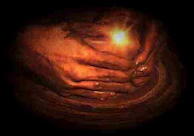
Spirit of the living God
Spirit of the living God fall afresh on me
Spirit of the living God fall afresh on me.
Break me, melt me, mold me, fill me
Spirit of the living God fall afresh on me.

Slide 48

Yachatz: Breaking the middle Matzah
Leader: Matzah is called lachma anya, the “bread of affliction.” It is the flat bread of those whose lives have been flattened by suffering and oppression. As you eat this bit of matzah, focus on your God-given kinship with all such men, women, and children. In this way you will awaken thoughts of compassion. Your words
will naturally turn toward kindness,
and your deeds toward justice.

Slide 49
Yachatz: Breaking the middle Matzah
Leader: This is the bread of suffering, reminding us of the dryness of a soul starved of hope. This is the bread of the broken, reminding us that no one is whole unless all are whole, for in the end we are one body, and when one part of the body aches the entire
body suffers.
Notes:
Uncover the matzah and lift the plate before the guests.

Slide 50
Yachatz: Breaking the middle Matzah
Community:
Let all who are hungry share this meal with us. Let all who are enslaved share this meal with us. Let all who are in need share this meal with us. Let all who are in Mitzraim share
this meal with us.

Slide 51

Yachatz: Breaking the middle Matzah
Question #22
Answer #22
Notes:
Q. Why does the word Mitzraim mean?
A. Mitzraim is the Hebrew word for Eygpt, but it means much more than that. In Hebrew mitzraim literally means "the narrow places"; Egypt is symbolic of the narrow places in which we find ourselves enslaved.

Slide 52
Yachatz: Breaking the middle Matzah
Question #23
Answer #23
Notes:
Q. Can one who is a Christian be enslaved?
A. Yes! Jesus said, "you cannot serve God and wealth" (Mt 6:24), and yet so many of us try to do so. To the extent we serve God we are free; to the extent we serve wealth we are enslaved. There is always a place of enslavement, always a narrow place from which we need to free ourselves. Sharing the bread of enslavement as part of this feast of freedom reminds us that liberation is not once and for all, but is instead an ongoing effort.

Slide 53
Yachatz: Breaking the middle Matzah
Question #24
Answer #24
Notes:
Q. How are we to invite all who are hungry to share in this meal?
A. The call to feed the hungry is a call to action. Our meal is filled with symbols, but is is not itself symbolic. We eat real food and fill real stomachs. At this point in our service, we remind ourselves of the hunger that plagues so many in the world. But it is not enough to remember; we must also act. This is why we were asked to bring canned goods with us to our seder that we might help feed those in need.
After question 24 is answered we shall place our canned goods in the donation box!

Slide 54
Yachatz: Breaking the middle Matzah
Question #25
Answer #25
Notes:
Q. Why do we mention both the hungry and the needy?
A. There is physical hunger and spiritual hunger. Even if our stomachs are filled, our hearts may be empty. This is why Jesus said people shall "not live by bread alone" (t 4:4 quoting Deut 8:3). Many of us hunger for love, companionship, community, or meaning? Just as we share our food, let us share our hearts as well, taking care to turn our talk to matters of the spirit.

Slide 55
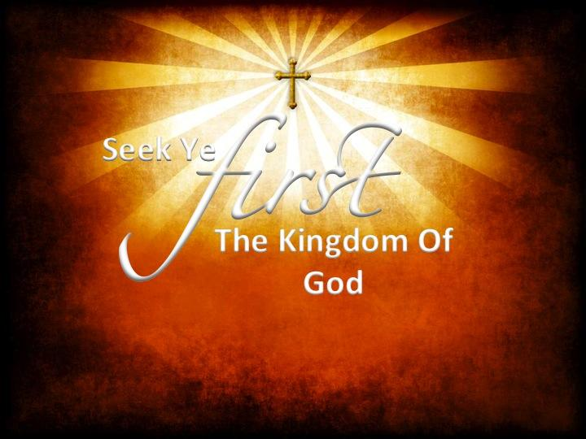
Seek Ye First
Seek Ye first the Kingdom of God
And His righteousness
And all these things
shall be added unto you
Alleluia, alleluia!
Notes:
After question 24 is answered we shall place our canned goods in the donation box!

Slide 56
Seek Ye First
Man shall not live by bread alone
But by every word
That proceeds from
The mouth of God
Alleluia, alleluia!
Notes:
After question 24 is answered we shall place our canned goods in the donation box!

Slide 57
Seek Ye First
Ask and it shall be given unto you
Seek and ye shall find
Knock and the door
Shall be opened unto you
Alleluia, alleluia!
Notes:
After question 24 is answered we shall place our canned goods in the donation box!

Slide 58
Maggid: Telling The Story
Leader: Our seder is a time for asking and answering questions. Four specific questions have been asked for centuries.
Reader: How is this night
different from other nights?
Notes:
The reader asks the four questions:

Slide 59
Maggid: Telling The Story
Community: On all other nights we eat leavened or unleavened bread, but
tonight we eat only unleavened
bread.
Reader: Why on this night do
we eat bitter herbs?

Slide 60
Maggid: Telling The Story
Community: To remind us of the bitterness of slavery.
Reader: Why on this night do we dip parsley into saltwater and matzah into the charoset. (apple & nut Mixture)

Slide 61
Maggid: Telling The Story
Community: The first reminds us of the bitter taste of slavery. The second reminds us of the sweet taste of freedom.
Reader: Why on this night do we
eat reclining on a pillow.

Slide 62
Maggid: Telling The Story
Leader: In ancient times only the free were allowed to recline at meals. We are relaxed in the company of our friends, eating without fear, and knowing that in this meal all are welcome as they are.
Notes:
Place a Pillow on the table (symbolic purpose only)

Slide 63
Maggid: Telling The Story
Leader: O God, we live in a world in which slavery is real and takes many forms. While we may not have experienced political or physical slavery, we confess we have known and know what it means to be imprisoned by poor decisions, unhealthy attachments and dependencies,
and sin itself.

Slide 64
Maggid: Telling The Story
Leader: We remember as well that in Christ you have granted us freedom if only we will accept and use the gift. Tonight help us to know afresh the good taste of freedom and to resolve to live free in you.

Slide 65
Maggid: Telling The Story
Leader: There are four kinds of questioners: the wise, the foolish, the simple, and the one who knows not what to ask. Each speaks with a different voice: the voices of wisdom, doubt, inquiry, and faith.
Notes:
The four questioners.

Slide 66
Maggid: Telling The Story
Leader: The wise one asks, “what is the meaning of Passover? This is the voice of wisdom that knows our connection with God and seeks to deepen it.
The foolish one asks, “why do you bother with all of this?” This is
the voice of doubt that separates
us from each other and from God.

Slide 67
Maggid: Telling The Story
Leader: The simple on asks, “what do these foods mean, and why do we share them?” This is the voice of inquiry that wishes to bring us closer to truth.
The child too young to ask is the voice of faith, using silence to invite the telling of our story and the good
news it contains.

Slide 68
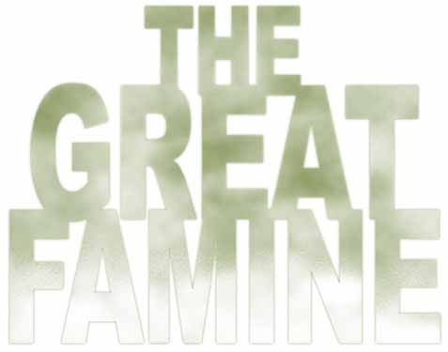
Maggid: Telling The Story
Leader: Thousands of years ago a great famine struck the Middle East. Only Egypt had food, for at the counsel of the Hebrew man Joseph, Egypt’s Pharaoh had stockpiled food in advance of the famine. He sold the food back to his people and impoverished them. The Egyptians rebelled against this
Pharaoh and established a new
Notes:
The Story of the Exodus

Slide 69
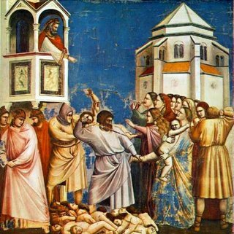
Maggid: Telling The Story
Pharaoh who enslaved the Hebrew people. The new Pharaoh feared the Hebrews might lead a revolt against him, and he ordered the midwives to kill all boy babies born to Hebrew mothers. The midwives refused!
Pharaoh then ordered his soldiers
to raid the Hebrew camps and
murder the baby boys.

Slide 70
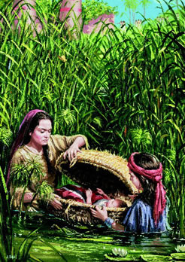
Maggid: Telling The Story
One Hebrew mother, Jochebed, hid her son in a basket she had turned into a little boat and floated him down the Nile River where he might be found and rescued. She sent the boy’s sister, Miriam, to follow the basket to see what became of her brother. Pharaoh’s daughter found the boy. She
recognized the baby as Hebrew,

Slide 71
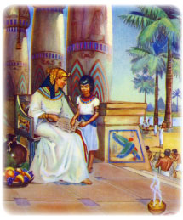
Maggid: Telling The Story
yet her love for life was greater than her fear of Pharaoh, and she raised him as her own son in the Pharaoh’s court. Miriam spoke to the princess and offered her mother as a nurse for the boy, whom the princess called Moses. So Moses was raised by two
mothers in the house of
Pharaoh:

Slide 72
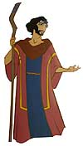
Maggid: Telling The Story
The one who gave him life and the one who saved it. Being raised as a prince in Egypt, Moses could have turned his back on the fate of the slaves, but his two mothers saw to it that he would not. Both had risked their lives to protect his life and both would teach him the value of life and the freedom to live it in service to God, compassion,
justice and truth.

Slide 73
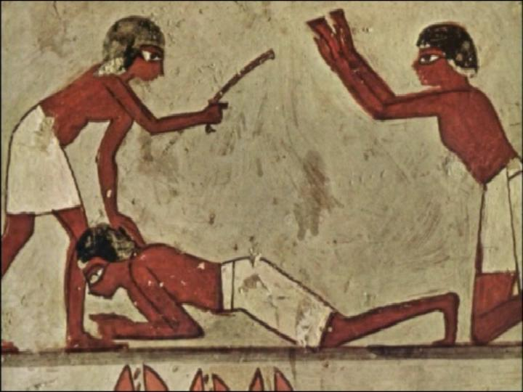
Maggid: Telling The Story
One day Moses saw a slave being beaten by a guard. Moses tried to stop the guard and accidentally killed him. Moses hoped the deed would remain a secret. When word got out that he had sided with the Hebrew slave against the Egyptian guards, he fled Egypt to save his life. He ran to Midian
where he married Zipporah,

Slide 74
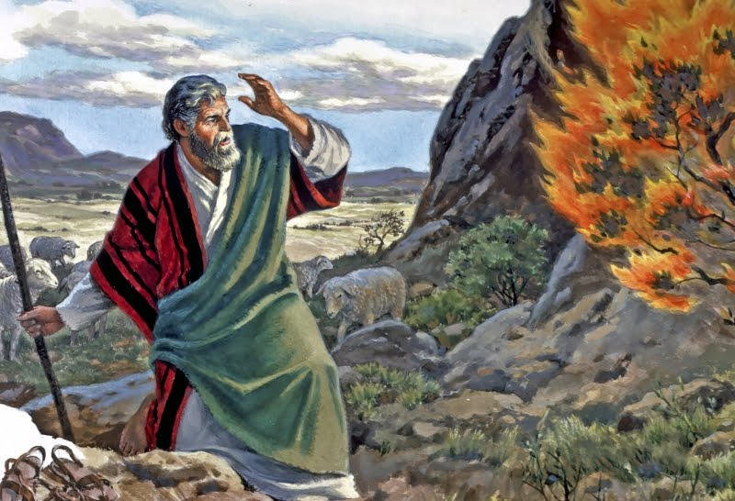
Maggid: Telling The Story
the daughter of Jethro, the priest. Moses was happy in Midian tending Jethro’s sheep and raising a family. But God had other plans for the Hebrew prince of Egypt. As Moses was shepherding his flock he saw a bush on fire. He went to investigate and found that the bush burned but was
not burned up.

Slide 75
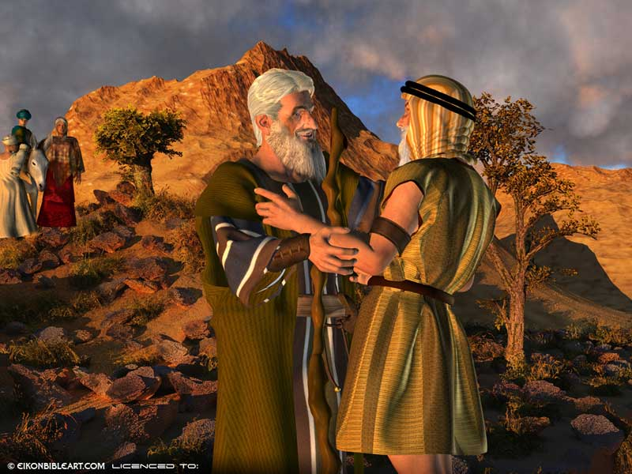
Maggid: Telling The Story
God had gotten Moses’ attention and spoke to him. He commanded Moses to return to Egypt and free the slaves. Moses hesitated! He wanted nothing more to do with Egypt and Pharaoh. But in the end he agreed to go, joining his brother, Aaron and sister
Miriam, to liberate the slaves.

Slide 76
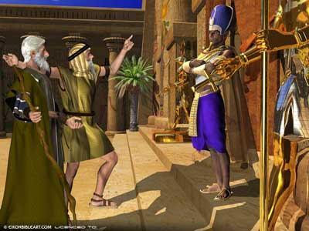
Maggid: Telling The Story
Moses tried to reason with Pharaoh but was ignored. Pharaoh saw himself as a god and doubted the power of Moses’ God. Nine times God brought terrible plagues upon Egypt to convince Pharaoh to free the slaves. But Pharaoh refused. In the end God brought upon Pharaoh and Egypt the same kind of horror Pharaoh had brought
upon the Hebrews:

Slide 77
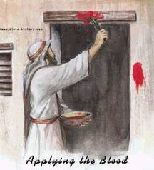
Maggid: Telling The Story
the death of the firstborn. God told Moses to warn the Hebrew people to prepare for liberation. They were to bake flat breads called matzah that could be made quickly and packed in bulk. They were to sacrifice a lamb and smear some of its blood on the doorposts of their homes to
mark them as slave quarters.

Slide 78
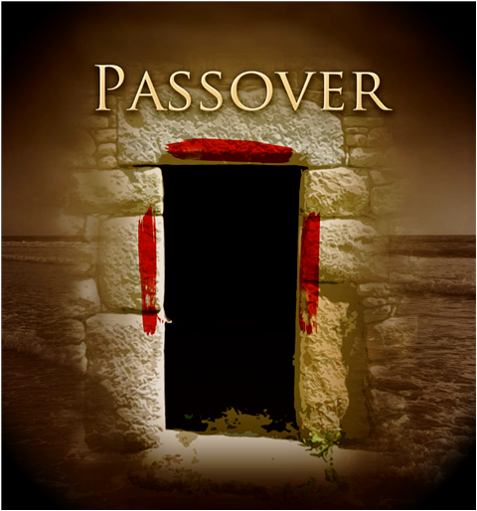
Maggid: Telling The Story
The angel of death would pass over these marked houses and spare the firstborn within them. The horror of this plague broke Pharaoh’s spirit, and he let the slaves go. But his anger against them rekindled and he ordered his army to slaughter the Hebrews
when they reached the shore of
the Red Sea.

Slide 79
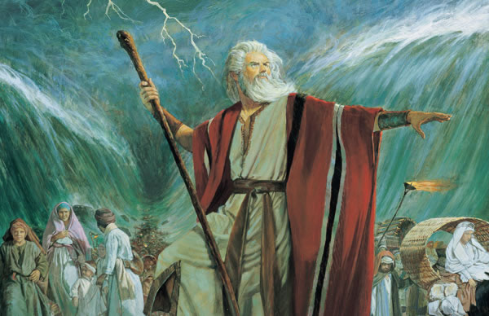
Maggid: Telling The Story
God parted the waters and the Hebrew people escaped. Pharaoh’s army raced after them, but as the last of the Hebrews reached safety, the waters closed about the Egyptians and they drowned. The ex-slaves rejoiced at the death of their oppressors, but God called to them saying,
“How dare you rejoice?”

Slide 80
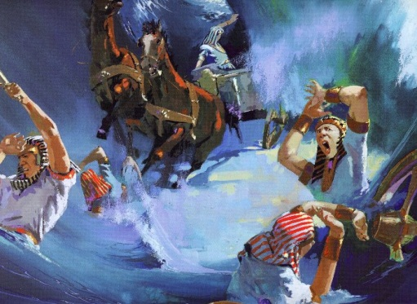
Maggid: Telling The Story
The Egyptians are also my children. There is no joy in this. The cost of freedom is high. Respect it always. In the spirit of compassion for the fallen Egyptians it is customary at every seder to spill out drops of wine for each plague they suffered. In this way
we diminish our inappropriate
joy at their suffering.

Slide 81
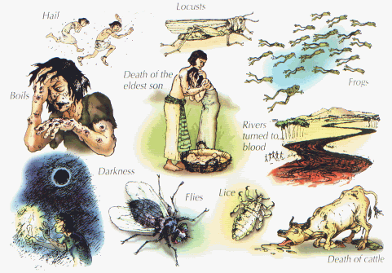
Maggid: Telling The Story
Notes:
As the Plagues are read aloud, and using the pinky of your right hand you will remove drops of wine from your cup and sprinkle them on a separate plate or napkin. 1.Blood 2.Frogs 3. Lice 4.Beasts 5.Mad Cow 6.Boils 7.Hail 8.Locusts 9.Darkness 10.Death of the firstborn

Slide 82
Dayyenu: It Is Enough
Leader: Dayyenu means “it is enough” We read this to remember all the gifts God gives and to cultivate an attitude of gratitude.
If the Jews escaped from Egypt but the sea had not opened -Dayyenu!
Notes:
Dayyenu pronounced die-ay-nu affirms that any gift from God is sufficient and that we do not ask anything from God but that which God desires us to have. The leader will say each verse and the community will respond with dayyenu, “it is enough”

Slide 83
Dayyenu: It Is Enough
If the sea had opened but they didn’t find manna in the dessert -Dayyenu!
If they found the manna but did not receive the Sabbath -Dayyenu!
If they received the Sabbath but did not receive the Torah -Dayyenu!

Slide 84
Dayyenu: It Is Enough
If they received Torah but not the
wisdom to understand her -Dayyenu!
If they received wisdom but did not receive the land of Israel -Dayyenu!
If they received Israel but didn’t build the Temple in Jerusalem -Dayyenu!
If they built the Temple but didn’t heed the call of the prophets -Dayyenu!

Slide 85
Dayyenu: It Is not Enough
Leader: While it is a good thing to say dayyenu and be satisfied with the gifts from God, it is another thing to be satisfied with ourselves. If we wish to be truly free, there is much in our world to which we must say
Lo Dayyenu “It is not enough”

Slide 86
Dayyenu: It Is Not Enough
If we love ourselves, but not our neighbors – Lo Dayyenu!
If we love our neighbors, but not our enemies – Lo Dayyenu!
If we end all war, but not starvation – Lo Dayyenu!
If we end starvation, but not illiteracy – Lo Dayyenu!

Slide 87
Dayyenu: It Is Not Enough
If we end illiteracy, but do not protect freedom of speech – Lo Dayyenu!
If we protect speech, but do not educate discerning minds – Lo Dayyenu!
If we were to educate the mind, but not the heart – Lo Dayyenu!
If we were to educate the heart, but not the soul – Lo Dayyenu!

Slide 88
Dayyenu: It Is Not Enough
If we were to educate the soul but not the spirit – Lo Dayyenu!

Slide 89
He poured in the oil and the wine
He poured in the oil and the wine
The kind that restoreth my soul
He found me bleeding and dying
On the Jericho road
And He poured in the oil and the wine.

Slide 90
Dayyenu: It Is Enough
The Second Cup of Wine
(guests fill each other’s cups)

Slide 91
Dayyenu: It Is Enough
Leader: Wine is a symbol of our joy, but it can also be the means of our enslavement. In like fashion, we can become drunk on our own power and intoxicated by the power of others, no longer seeing that only God is Lord.

Slide 92
Dayyenu: It Is Enough
It is for this reason that we preface each cup of wine with a blessing, reminding ourselves to see through the delusion of self power to the truth of God`s power. Jesus said, ``Everyone who commits sin is a slave to sin,`` John 8:34.
Our second cup of wine is in
honor of freedom.

Slide 93
Dayyenu: It Is Enough
Our second cup of wine
is in honor of freedom.

Slide 94
Dayyenu: It Is Enough
May all who drink it this night move away from sin and slavery toward freedom.
Community: Bless you, Abba, Sovereign of all life, who
births the fruit of the vine.
Notes:
Drink the second cup of wine.

Slide 95
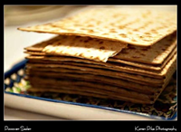
Motzi Matzah: Blessing over the Matzah
Leader: We are now about to give thanks to God for the matzah and begin the eating of our Passover meal.

Slide 96
Motzi Matzah: Blessing over the Matzah
Question #26
Answer #26
Notes:
Q. What is the significance of matzah?
A. Matzah is unleavened bread. In ancient times leaven was made from sour dough. Matzah is bread without sourness. During the week long observance of Passover, Jews abstain from all leavened products, called chumetz. Chumetz symbolizes sourness and the selfishness that causes it. We eat matzah as a reminder to examine our lives that we might stay free from sourness. The unexamined life is leavened by self-importance, self-righteousness, and self-satisfaction. We honor Passover by seeking to free ourselves from these acts of chumetz. Indeed, we Christians may find this focus a natural conclusion to the long season of Lent, with its call to discern and repent of the sins that enslave us to evil.

Slide 97
Motzi Matzah: Blessing over the Matzah
Community: Bless you, Abba, Sovereign of all life, through whom the earth gives rise to bread. Bless you, Abba, Sovereign of all life, who provides us with this opportunity to free ourselves from sourness and selfishness with the eating of this matzah.
Notes:
A small piece of matzah is eaten.

Slide 98
Maror: Bitter Herbs
Leader: It is customary to mix the bitter herbs with the charoset, the sweet apple and nut mixture. In this way we acknowledge that slavery and freedom go together. We can only know the one in relation to the other. We also remind ourselves that no matter how sweet life may be,

Slide 99
Maror: Bitter Herbs
there is still the sting of suffering , and that no matter how despairing we may feel or enslaved to habits of the body, heart, and mind, there is always the promise of liberation.

Slide 100
Maror: Bitter Herbs
Community: Bless you, Abba, Sovereign of all life, who provides us with the opportunity to taste the bitterness of slavery that we might struggle for the sweetness of freedom. May the meal we are about to share deepen our friendship with each other and with God. And may the meal be one among many as we labor to reveal the Kingdom of God on earth through the sharing of our food.
Notes:
Make & eat a small sandwich of matzah, maror, and charoset.

Slide 101
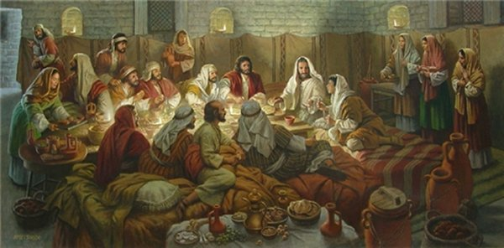
Shulchan Aruch: Dinner Is Served
Please remember this is a sacred meal, and our conversation should include discussions around the themes of Passover: enslavement and freedom.
Notes:
Matzah ball soup and lamb balls are served!

Slide 102
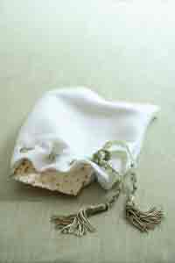
Tzafon: Finding The Hidden
Leader: Earlier in our service we hid the afikomen, the broken piece of matzah representing our sense of brokeness and imperfection. Now is the time for us to reclaim what is lost and move toward wholeness. We invite our younger children to hunt for and find the hidden matzah.

Slide 103
Tzafon: Finding The Hidden
Jesus said, “Ask, and it will be given you; search, and you will find; knock and the door will be opened for you. Matthew 7:7. While our children hunt for the afikomen, ask God for whatever it is you need. Seek out the truth, but don’t seek only find as well. Knock on your own hardened heart that it might be opened to you and to the love of and from God that is God’s freely flowing grace.
Notes:
When the afikomen is found, a monetary reward is pledged to a charity of the child’s choosing. It is appropriate to let the child announce where he/she wishes the money sent. We eat the dessert motzah.

Slide 104
He poured in the oil and the wine
He poured in the oil and the wine
The kind that restoreth my soul
He found me bleeding and dying
On the Jericho road
And He poured in the oil and the wine.

Slide 105
Tzafon: Finding The Hidden
The Third Cup Of Wine
(guests fill each other’s cup)

Slide 106
Tzafon: Finding The Hidden
Leader: We drank the first cup in honor of fellowship, and the second cup in honor of freedom. We now drink our third cup in honor of courage: the courage to wage peace as well as war, the courage to reach out with open hands rather than clenched fists,
the courage to love not only our
Friends, but our enemies as well.
Notes:
Drink the third cup of wine.

Slide 107
Tzafon: Finding The Hidden
Jesus practiced such courage and calls us to do the same.
Question #27
Answer #27
Notes:
Q. We have finished eating. Why add another glass of wine or grape juice?
A. There are two reasons. First, our Passover meal satisfied our stomach, but our souls still yearn for God. The courage to which we pledge ourselves with this third cup of wine or grape juice is the courage to satisfy not only the needs of the body but also the needs of the soul.
Second, if we fully engaged each other in the spirit of Passover, recognizing our places of enslavement, we may have slipped into another kind of enslavement: prideful and judgmental thinking. We must now free ourselves from those traps and regain the greater solidarity our table fellowship is meant to create. We drink together to reaffirm the importance of people gathering together in God's name.

Slide 108
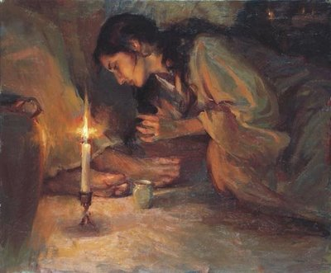
Courage to love Him
Courage to love Him
Courage to serve Him
Courage to come to
His footstool and bow
Show me the heart
that gladly will answer
I will take courage
And come to Him now.

Slide 109
Tzafon: Finding The Hidden
Community: Bless you, Abba, Sovereign of all life, who births the fruit of the vine.

Slide 110
Elijah’s Cup
Leader: This is the cup of Elijah, the prophet of redemption.
Notes:
The bread table (some communities have a cup at every table) has an empty cup set aside for Elijah, the prophet of peace and herald of the messiah. The cup is passed around as each guest pours some wine into Elijah’s cup. The cup is then set in the center of the table.
(The doors of the room are opened to the outdoors, inviting Elijah to join the seder.)

Slide 111
Elijah’s Cup
Question #28
Answer #28
Notes:
Q. Why do we fill Elijah's Cup from our own?
A. Some two thousand years ago Rabbi Naftali introduced this custom saying. "Elijah is the herald of redemption, but we are the vehicles for redemption. Only when we are willing to work for the healing of the world will the prophet come and announce that the time for healing has come.

Slide 112
Elijah’s Cup
Leader: Lo, I will send you the prophet Elijah before the great and terrible day of the Lord comes. He will turn the hearts of parents to their children and the hearts of children to their parents. Malachi 4:5-6.

Slide 113
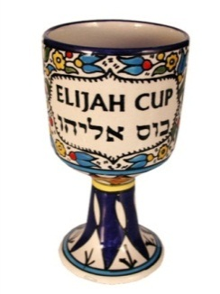
Elijah’s Cup
As we invite Elijah to our fellowship meal we invite parents to hug their children and children to hug their parents, offering each other the gift of love and forgiveness. As Jesus said, “if you forgive others their trespasses, your heavenly Father will also forgive you; but if you do not forgive others,
neither will your Father forgive
your trespasses.” Matthew 6:14.
Notes:
It is customary to sing a hymn of welcome to Elijah. Any song of healing and reconciliation would be appropriate. While the song is sung, the children are invited to come and watch the cup of Elijah and see if the prophet does not take a sip from the cup to let all of us know that he is here and the kingdom of God is at hand.

Slide 114
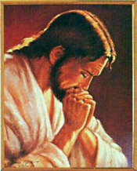
Boraych: Grace After The Meal
Leader: We praise God and give thanks for this fellowship, this meal, and this opportunity to draw closer to God.
Community: We praise the source of life and devote our lives to enhancing life.
We praise the source of justice
and devote ourselves to doing
justly.

Slide 115
Boraych: Grace After The Meal
We praise the source of kindness and devote ourselves to acting kindly.
We praise the source of forgiveness and devote ourselves to forgiving others.
We praise the source of hope and promise never to abandon hope..

Slide 116
He poured in the oil and the wine
He poured in the oil and the wine
The kind that restoreth my soul
He found me bleeding and dying
On the Jericho road
And He poured in the oil and the wine.

Slide 117
Boraych: Grace After The Meal
The Fourth Cup Of Wine
(guests fill each other’s cup)

Slide 118
Boraych: Grace After The Meal
Leader: We drink the fourth and final cup of wine in honor of peace. The Hebrew word for peace is shalom from the root shalem meaning “wholeness.” Peace is not the absence of strife but the ability to engage even an enemy without losing sight of the truth that even
one’s enemy is part of the
human family of God.
Notes:
Drink fourth cup of wine.

Slide 119
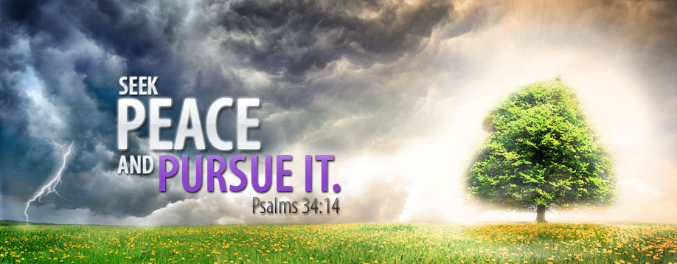
Boraych: Grace After The Meal
Question #29
Answer #29
Notes:
Q. King David wrote, "Seek peace and pursue it"(Psalm 34:14). Why did he say both seek and pursue? What is the difference between these?
A. The ancient rabbis taught that we are to seek peace when peace seems near at hand, and pursue peace when peace seems far away.

Slide 120
Boraych: Grace After The Meal
Question #30
Answer #30
Notes:
Q. How do we seek peace?
A. We seek peace when we invite those whom we struggle to sit at our table and share food and fellowship.

Slide 121
Boraych: Grace After The Meal
Question #31
Answer #31
Notes:
Q. How do we pursue peace?
A. We pursue peace when we leave the safety of our table and meet the other halfway. We pursue peace when, like Jesus, we go even further and seek out the estranged where they live.

Slide 122
Boraych: Grace After The Meal
Community: Bless you, Abba, Sovereign of all life, who births the
fruit of the vine.

Slide 123
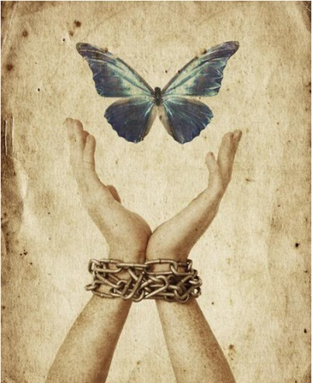
Nirtzah: Conclusion
Leader: For thousands of years the Jewish people have remembered and listened to the call of liberation. Tonight we too, are honored to hear that call.
Community: Tonight we remember the bitterness of slavery. Not only the enslavement of the Hebrews to
Pharaoh,

Slide 124

Nirtzah: Conclusion
but our own enslavement to power, greed, and pride; to labels, logos, and manufactured needs; and to sour habits of thought, word, and deed that rob us of dignity and incite us to rob others of the same.

Slide 125
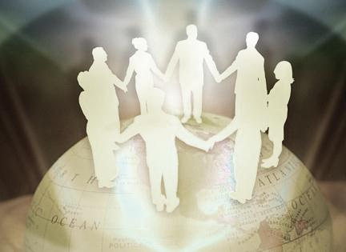
Nirtzah: Conclusion
Leader: Let us stand, join hands and hearts, and honor the call of Passover: the call to accept God’s gift of freedom. Let us rise up with courage and grasp hold of freedom that we might fashion a world more strongly committed to justice, kindness, and humility which was and is the way of the
prophets and of Jesus.

Slide 126
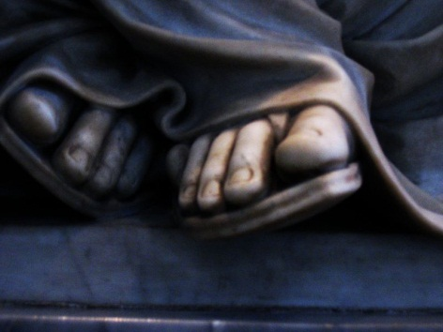
Nirtzah: Conclusion
Community: Lord, make me an instrument of your peace. Where there is hatred, let me sow peace; where there is injury, let me sow forgiveness; where there is doubt, let me sow faith; where there is despair, let me give hope; where there is darkness, let me give light, where there is sadness, let me
give joy.

Slide 127

He gives strength to me
He gives strength to me
As I worship Him
And my heart is filled with praise
Jesus breaks the bands
As I raise my hands
In glorious liberty.

Slide 128
Adapted from the book “Let us break bread together, A Passover Haggadah for Christians By Pastor Michael Smith and Rabbi Rami Shapiro.

